Slide 2
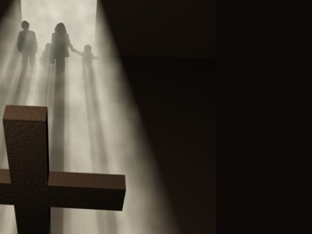
“Him!” (Colossians 1:15-20)
Mark Mason July 12, 2015

Slide 3
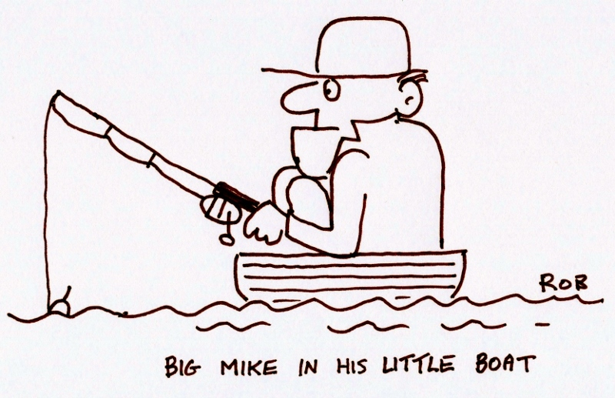

Slide 4
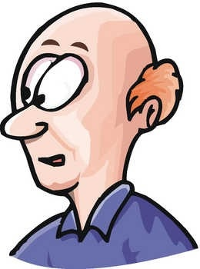
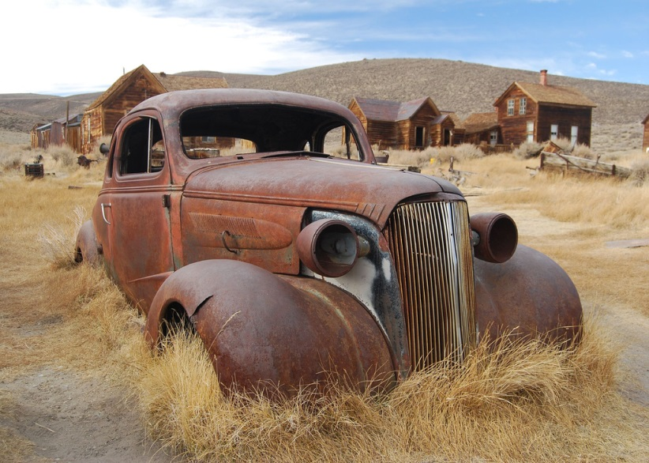
2nd Law of

Slide 5
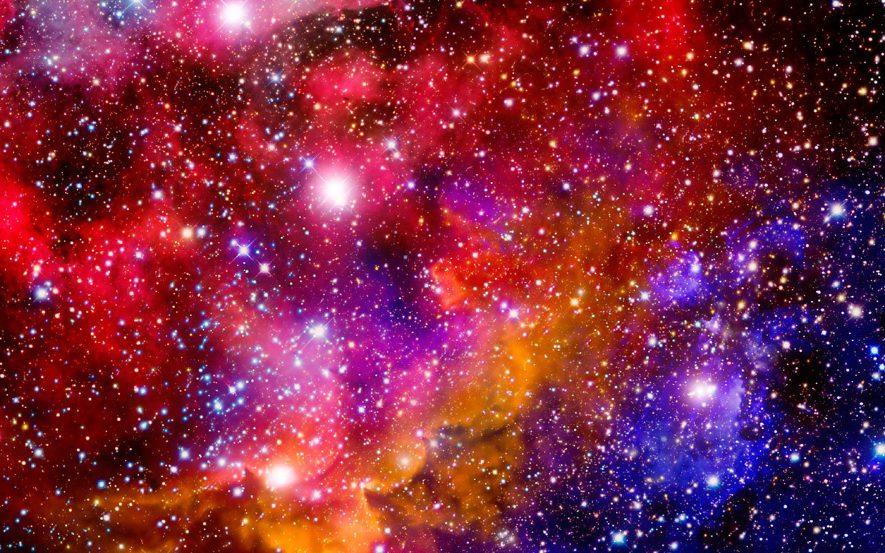

Slide 6
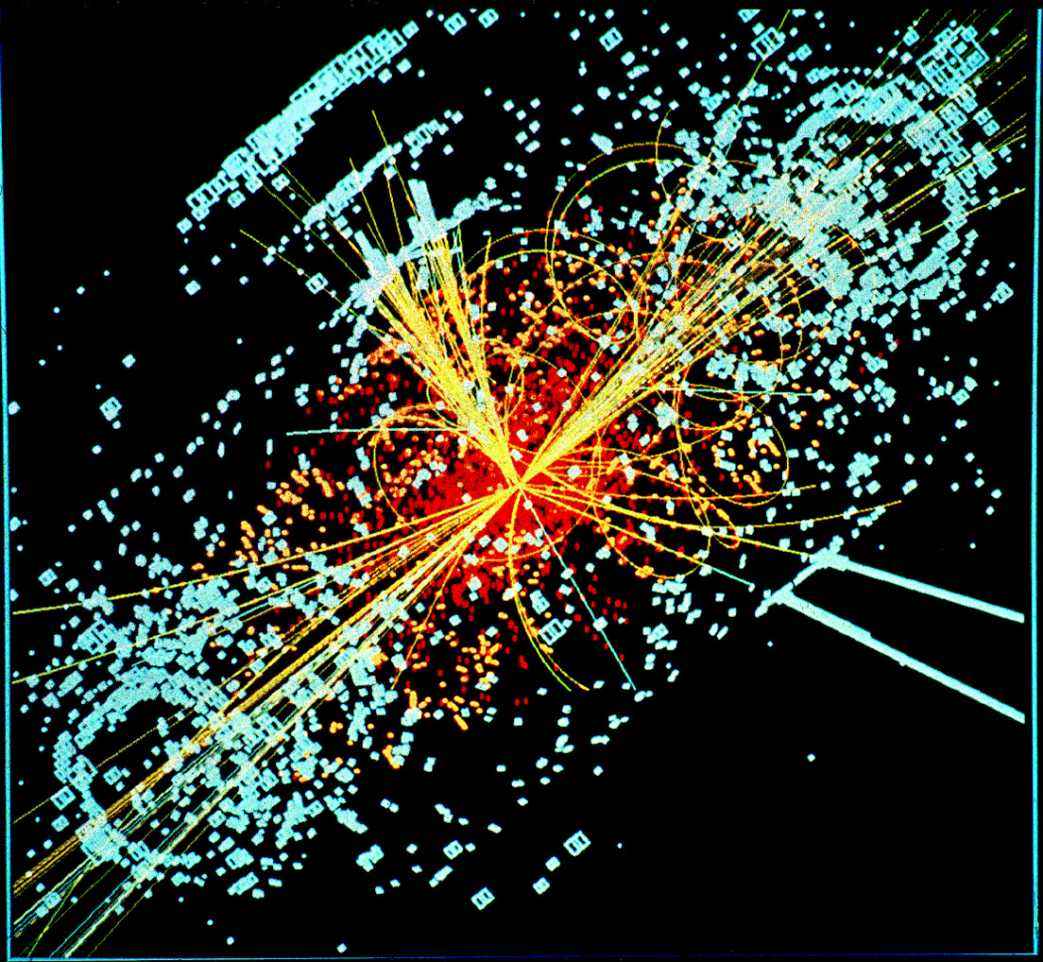

Slide 7
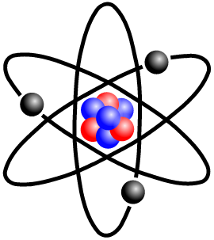
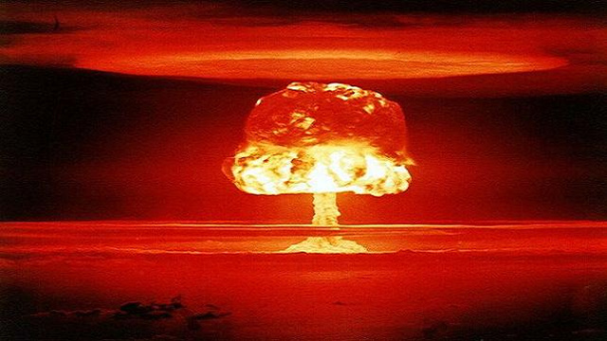

Slide 8
What Holds
EVERYTHING Together?

Slide 9
Colossians 1:15-20 (ESV)
¹⁵ He is the image of the invisible God, the firstborn of all creation.
¹⁶ For by him all things were created, in heaven and on earth, visible and invisible, whether thrones or dominions or rulers or authorities—all things were created through him and for him.
¹⁷ And he is before all things, and in him all things hold together.

Slide 10
Colossians 1:15-20 (ESV)
¹⁸ And he is the head of the body, the church. He is the beginning, the firstborn from the dead, that in everything he might be preeminent.
¹⁹ For in him all the fullness of God was pleased to dwell,
²⁰ and through him to reconcile to himself all things, whether on earth or in heaven, making peace by the blood of his cross.

Slide 11
What Holds
EVERYTHING Together?
“HIM!”

Slide 12
Colossians 1:15-20 (ESV)
¹⁵ He is the image of the invisible God, the firstborn of all creation.
¹⁶ For by him all things were created, in heaven and on earth, visible and invisible, whether thrones or dominions or rulers or authorities—all things were created through him and for him.
¹⁷ And he is before all things, and in HIM all things hold together.

Slide 13
Colossians 1:15-20 (ESV)
¹⁵ He is the image of the invisible God, the firstborn of all creation.
¹⁶ For by him all things were created, in heaven and on earth, visible and invisible, whether thrones or dominions or rulers or authorities—all things were created through him and for him.
¹⁷ And he is before all things, and in him all things hold together.

Slide 14
Colossians 1:15-20 (ESV)
¹⁸ And he is the head of the body, the church. He is the beginning, the firstborn from the dead, that in everything he might be preeminent.
¹⁹ For in him all the fullness of God was pleased to dwell,
²⁰ and through him to reconcile to himself all things, whether on earth or in heaven, making peace by the blood of his cross.

Slide 15
Colossians 1:15-20 (ESV)
¹⁵ He is the image of the invisible God, the firstborn of all creation.
¹⁶ For by him all things were created, in heaven and on earth, visible and invisible, whether thrones or dominions or rulers or authorities—all things were created through him and for him.
¹⁷ And he is before all things, and in HIM all things hold together.

Slide 16
“Long ago, at many times and in many ways, God spoke to our fathers by the prophets, but in these last days he has spoken to us by his Son, whom he appointed the heir of all things, through whom also he created the world. He is the radiance of the glory of God and the exact imprint of his nature, and he upholds the universe by the word of his power.”

Slide 17
“Long ago, at many times and in many ways, God spoke to our fathers by the prophets, but in these last days he has spoken to us by his Son, whom he appointed the heir of all things, through whom also he created the world. He is the radiance of the glory of God and the exact imprint of his nature, and HE upholds the universe by the word of his power.”

Slide 18
“Long ago, at many times and in many ways, God spoke to our fathers by the prophets, but in these last days he has spoken to us by his Son, whom he appointed the heir of all things, through whom also he created the world. He is the radiance of the glory of God and the exact imprint of his nature, and HE UPHOLDS THE UNIVERSE by the word of his power.”

Slide 19
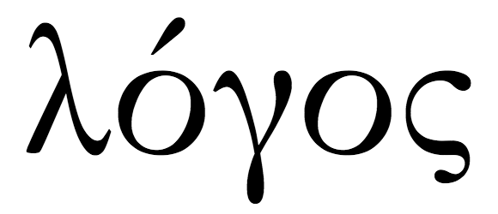
LOGOS

Slide 20
LOGOS
“BIOLOGY”
“GEOLOGY”
“PSYCHOLOGY”
“SOCIOLOGY”

Slide 21
LOGOS
“BIOLOGY”
“GEOLOGY”
“PSYCHOLOGY”
“SOCIOLOGY”

Slide 22
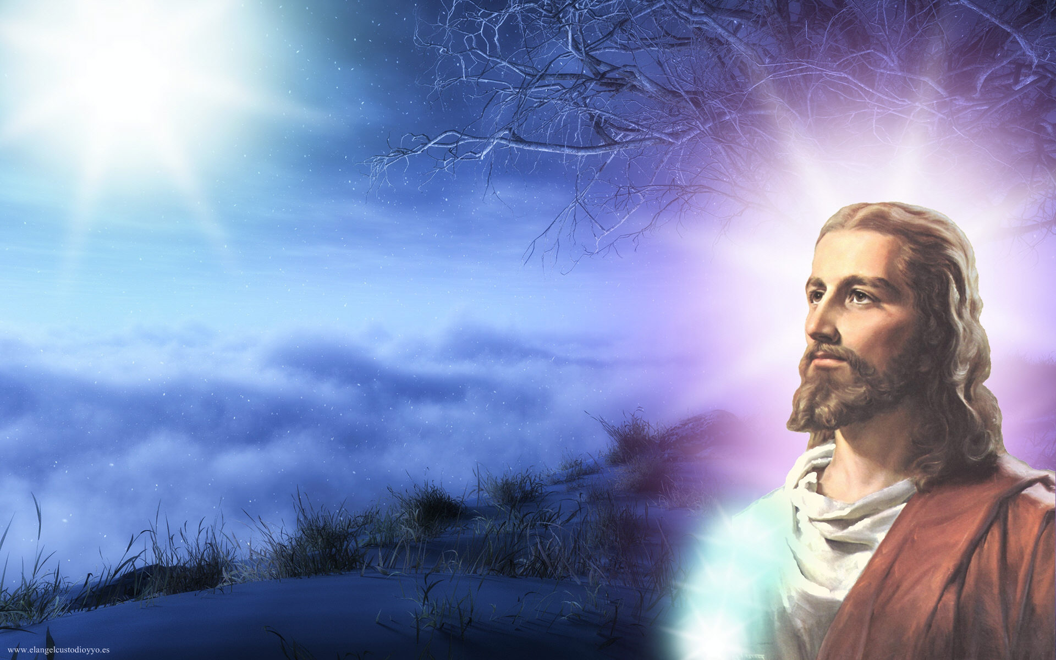
Jesus Holds All
Things Together!

Slide 23
Colossians 1:15-20 (ESV)
¹⁵ He is the image of the invisible God, the firstborn of all creation.
¹⁶ For by him all things were created, in heaven and on earth, visible and invisible, whether thrones or dominions or rulers or authorities—all things were created through him and for him.
¹⁷ And he is before all things, and in him all things hold together.

Slide 24
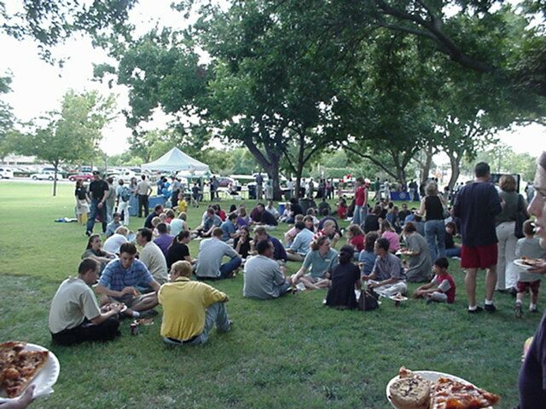

Slide 25
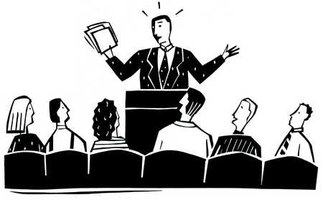

Slide 26
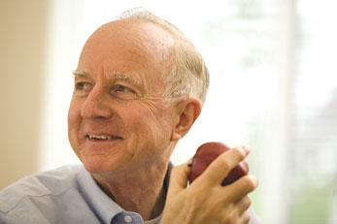

Slide 27
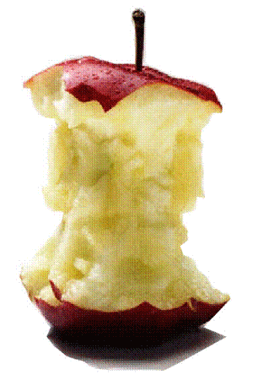

Slide 28
Have you tasted
our Jesus?

