Slide 2
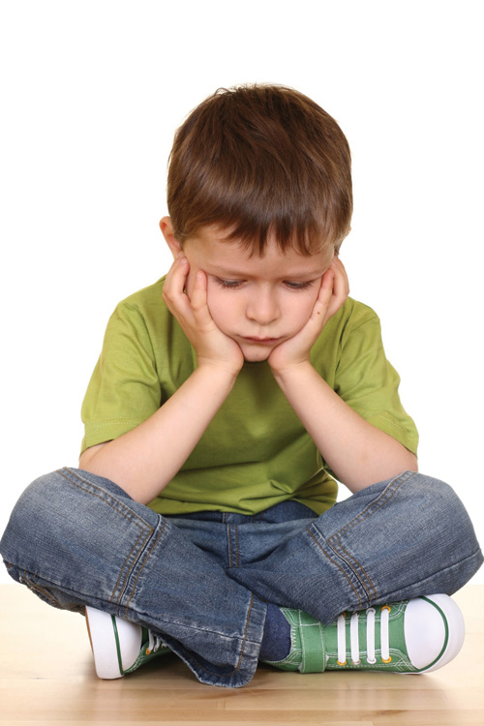

Slide 4
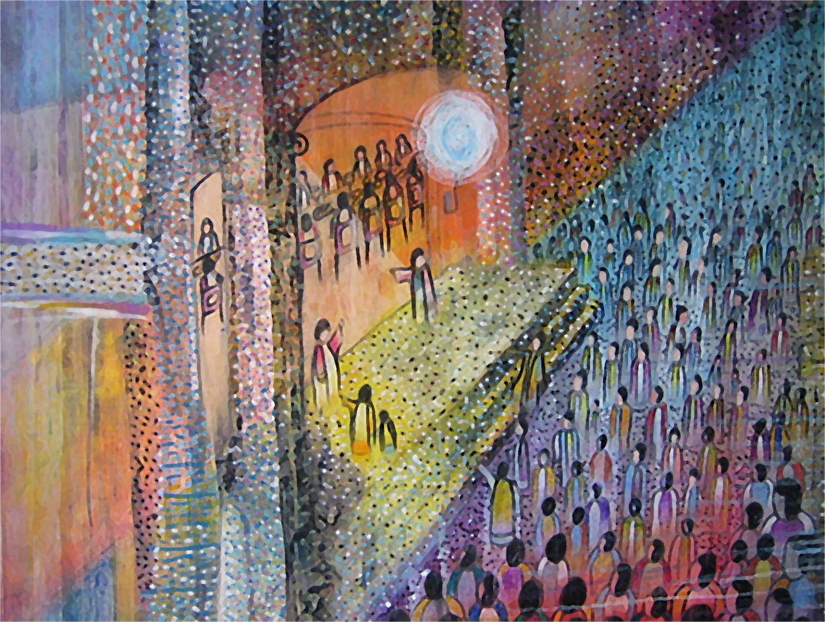

Slide 5
“Don’t Miss Your Own Party”

Slide 6
Revelation 19:6-9

Slide 7
Revelation 19:6-9
⁶ Then I heard what seemed to be the voice of a great multitude, like the roar of many waters and like the sound of mighty peals of thunder, crying out,
“Hallelujah! For the Lord our God the Almighty reigns. ⁷ Let us rejoice and exult and give him the glory, for the marriage of the Lamb has come, and his Bride has made herself ready;

Slide 8
Revelation 19:6-9
⁸ it was granted her to clothe herself with fine linen, bright and pure”—
for the fine linen is the righteous deeds of the saints.
⁹ And the angel said to me, “Write this: Blessed are those who are invited to the marriage supper of the Lamb.” And he said to me, “These are the true words of God.”

Slide 9
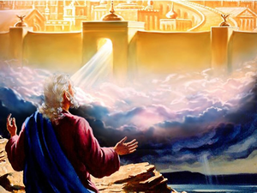
The Book of
Revelation

Slide 10
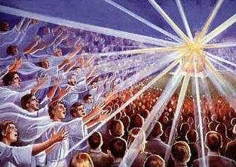

Slide 11
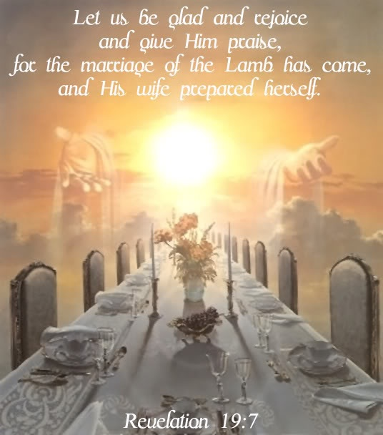

Slide 13
“Blessed are those who are invited to the marriage supper of the Lamb”

Slide 14
Isaiah 25:6-9
⁶ On this mountain the Lord of hosts will make for all peoples a feast of rich food, a feast of well-aged wine, of rich food full of marrow, of aged wine well refined. ⁷ And he will swallow up on this mountain the covering that is cast over all peoples, the veil that is spread over all nations. ⁸ He will swallow up death forever; and the Lord God will wipe away tears from all faces, and the reproach of his people he will take away from all the earth, for the Lord has spoken. ⁹ It will be said on that day, “Behold, this is our God; we have waited for him, that he might save us. This is the Lord; we have waited for him; let us be glad and rejoice in his salvation.”

Slide 16
Revelation 19:6-9
⁶ Then I heard what seemed to be the voice of a great multitude, like the roar of many waters and like the sound of mighty peals of thunder, crying out,
“Hallelujah! For the Lord our God the Almighty reigns. ⁷ Let us rejoice and exult and give him the glory, for the marriage of the Lamb has come, and his Bride has made herself ready;

Slide 17
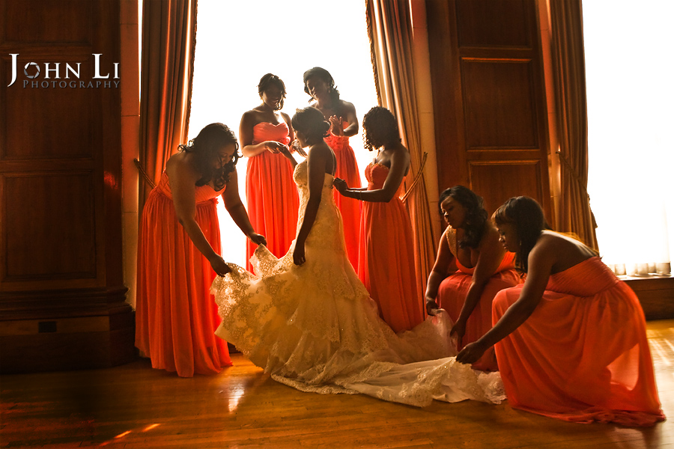

Slide 18
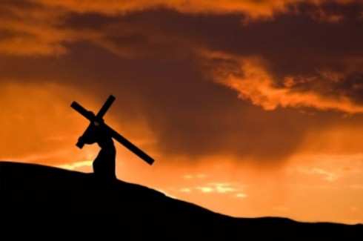

Slide 19
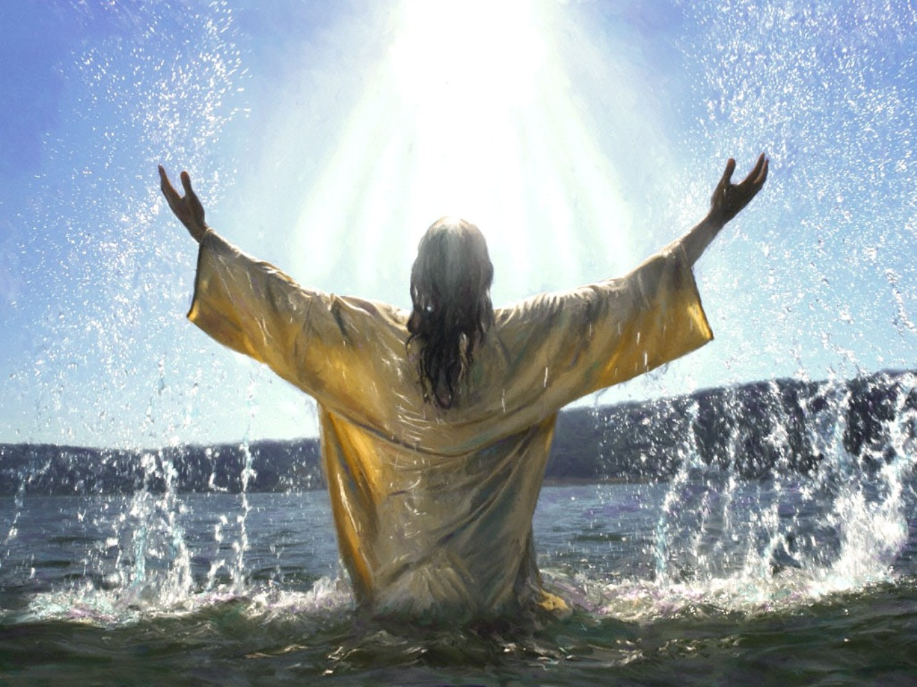

Slide 20
Revelation 19:6-9
⁸ it was granted her to clothe herself with fine linen, bright and pure”—
for the fine linen is the righteous deeds of the saints.
⁹ And the angel said to me, “Write this: Blessed are those who are invited to the marriage supper of the Lamb.” And he said to me, “These are the true words of God.”

Slide 21
Revelation 19:6-9
⁸ it was granted her to clothe herself with fine linen, bright and pure”—
for the fine linen is the righteous deeds of the saints.
⁹ And the angel said to me, “Write this: Blessed are those who are invited to the marriage supper of the Lamb.” And he said to me, “These are the true words of God.”

Slide 22
Are you ready for Him?

