Slide 2
1 John 4:13-21
¹³ By this we know that we abide in him and he in us, because he has given us of his Spirit.
¹⁴ And we have seen and testify that the Father has sent his Son to be the Savior of the world.
¹⁵ Whoever confesses that Jesus is the Son of God, God abides in him, and he in God.
¹⁶ So we have come to know and to believe the love that God has for us. God is love, and whoever abides in love abides in God, and God abides in him.
¹⁷ By this is love perfected with us, so that we may have confidence for the day of judgment, because as he is so also are we in this world.

Slide 3
1 John 4:13-21
¹⁸ There is no fear in love, but perfect love casts out fear. For fear has to do with punishment, and whoever fears has not been perfected in love.
¹⁹ We love because he first loved us.
²⁰ If anyone says, “I love God,” and hates his brother, he is a liar; for he who does not love his brother whom he has seen cannot love God whom he has not seen.
²¹ And this commandment we have from him: whoever loves God must also love his brother.

Slide 4
1 John 4:13-21
¹⁸ There is no fear in love, but perfect love casts out fear. For fear has to do with punishment, and whoever fears has not been perfected in love.
¹⁹ We love because he first loved us.
²⁰ If anyone says, “I love God,” and hates his brother, he is a liar; for he who does not love his brother whom he has seen cannot love God whom he has not seen.
²¹ And this commandment we have from him: whoever loves God must also love his brother.

Slide 6
“To dwell above with saints we love,
that will be grace and glory –
To live below with saints we know . . .
that’s another story!”

Slide 7
1 John 4:13-21
¹⁸ There is no fear in love, but perfect love casts out fear. For fear has to do with punishment, and whoever fears has not been perfected in love.
¹⁹ We love because he first loved us.
²⁰ If anyone says, “I love God,” and hates his brother, he is a liar; for he who does not love his brother whom he has seen cannot love God whom he has not seen.
²¹ And this commandment we have from him: whoever loves God must also love his brother.

Slide 13
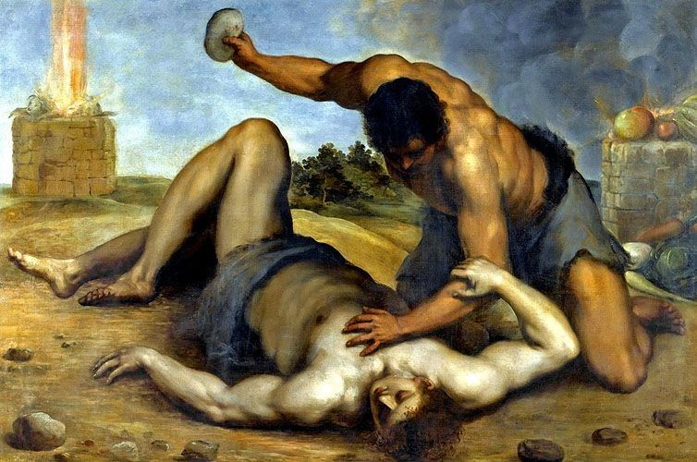

Slide 14
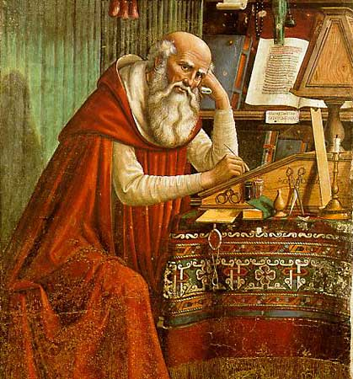
Jerome

Slide 16
²⁰ If anyone says, “I love God,” and hates his brother, he is a liar; for he who does not love his brother whom he has seen cannot love God whom he has not seen.
²¹ And this commandment we have from him: whoever loves God must also love his brother.

Slide 17
“Let us love the brethren.”

