Slide 1
Friday Night Sing
Graduates Recognition
Summer Series
Youth Emphasis Services
Love Your Neighbor (LYN)
3-6-5 Prayer Effort
KidFest
School Store

Slide 4
LIVING AS THE PEOPLE OF GOD IN THIS WORLD
1 Peter

Slide 5
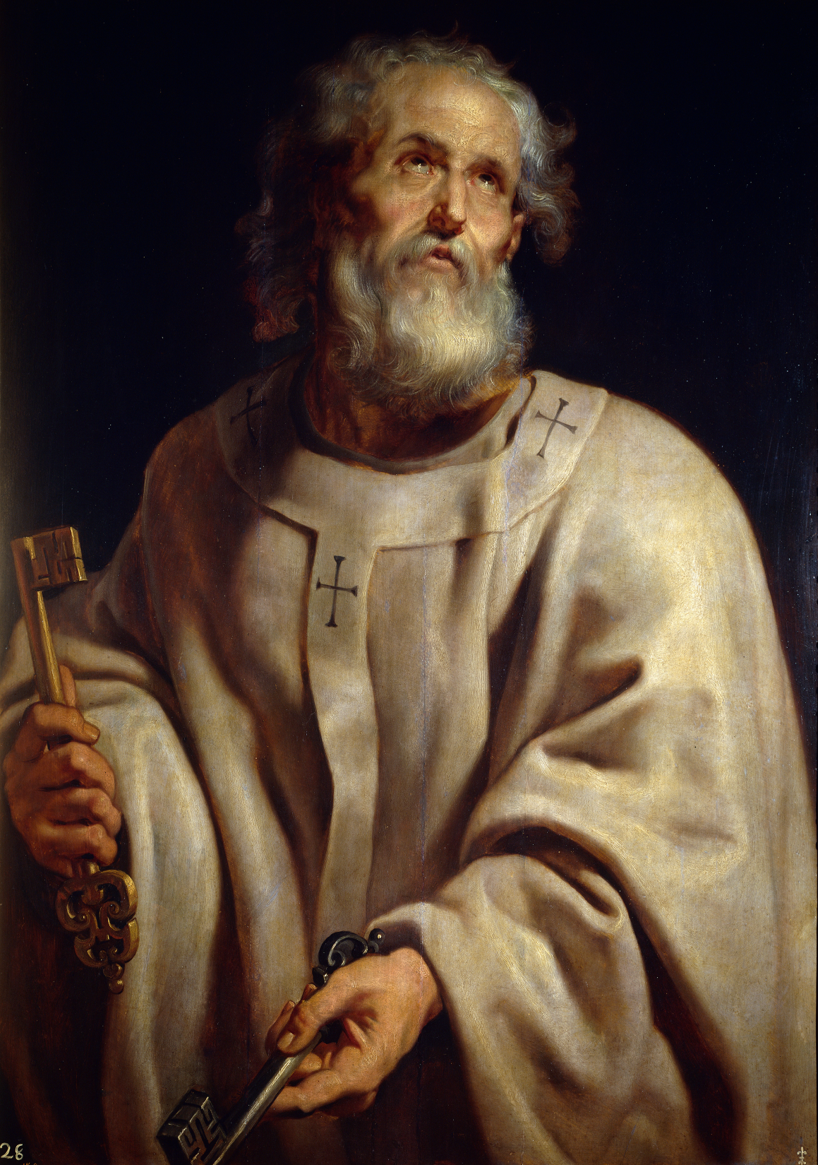
Live in HOPE (1 Peter 1:13)
Live in HOLINESS (1 Peter 1:15)
Live in FEAR (1 Peter 1:17)

Slide 7
Live in HOPE (1 Peter 1:13)
Live in HOLINESS (1 Peter 1:15)
Live in FEAR (1 Peter 1:17)
Live in LOVE

Slide 8
1 Peter 1:22-25
Having purified your souls by your obedience to the truth for a sincere brotherly love, love one another earnestly from a pure heart,
since you have been born again, not of perishable seed but of imperishable, through the living and abiding word of God; for
“All flesh is like grass
and all its glory like the flower of grass.
The grass withers,
and the flower falls,
but the word of the Lord remains forever.”
And this word is the good news that was preached to you.

Slide 9
1 Peter 1:22-25
Having purified your souls by your obedience to the truth for a sincere brotherly love, love one another earnestly from a pure heart,
since you have been born again, not of perishable seed but of imperishable, through the living and abiding word of God; for
“All flesh is like grass
and all its glory like the flower of grass.
The grass withers,
and the flower falls,
but the word of the Lord remains forever.”
And this word is the good news that was preached to you.
LIVE IN LOVE

Slide 10
1 Peter 1:22-25
Having purified your souls by your obedience to the truth for a sincere brotherly love, love one another earnestly from a pure heart,
since you have been born again, not of perishable seed but of imperishable, through the living and abiding word of God; for
“All flesh is like grass
and all its glory like the flower of grass.
The grass withers,
and the flower falls,
but the word of the Lord remains forever.”
And this word is the good news that was preached to you.

Slide 11
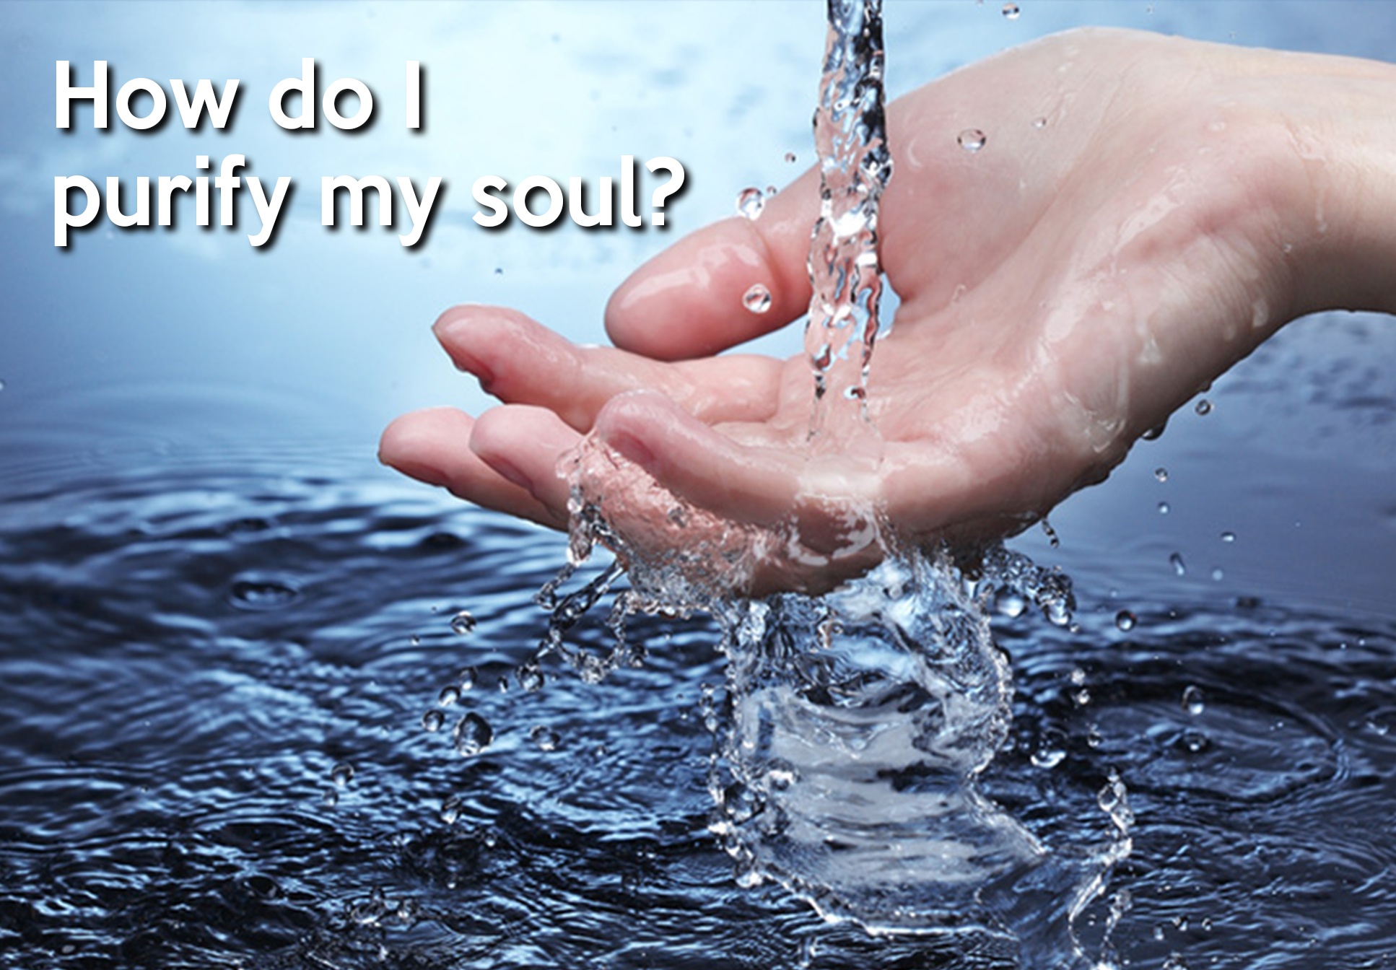
. . . by your obedience to the truth, and
. . . through the living and abiding word of God

Slide 13
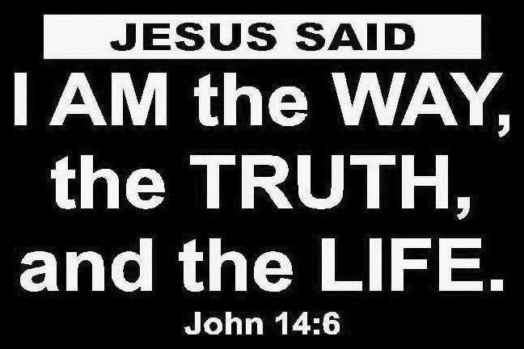

Slide 14
“When we learn the TRUTH, we strive to OBEY IT”

Slide 15
1 Peter 1:22-25
Having purified your souls by your obedience to the truth for a sincere brotherly love, love one another earnestly from a pure heart,
since you have been born again, not of perishable seed but of imperishable, through the living and abiding word of God; for
“All flesh is like grass
and all its glory like the flower of grass.
The grass withers,
and the flower falls,
but the word of the Lord remains forever.”
And this word is the good news that was preached to you.

Slide 18
1 Peter 1:22-25
Having purified your souls by your obedience to the truth for a sincere brotherly love, love one another earnestly from a pure heart,
since you have been born again, not of perishable seed but of imperishable, through the living and abiding word of God; for
“All flesh is like grass
and all its glory like the flower of grass.
The grass withers,
and the flower falls,
but the word of the Lord remains forever.”
And this word is the good news that was preached to you.
LIVE IN LOVE

Slide 19
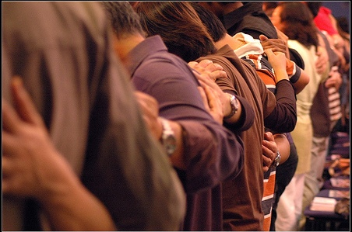
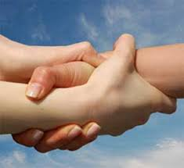
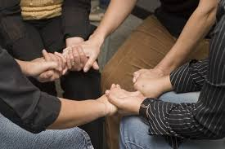
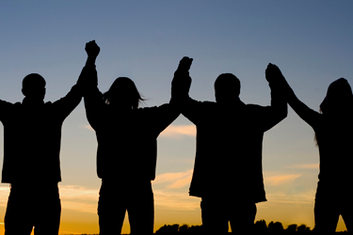
“ . . . Love one another earnestly from a pure heart.”

Slide 20
1 Peter 1:22-25
Having purified your souls by your obedience to the truth for a sincere brotherly love, love one another earnestly from a pure heart,
since you have been born again, not of perishable seed but of imperishable, through the living and abiding word of God; for
“All flesh is like grass
and all its glory like the flower of grass.
The grass withers,
and the flower falls,
but the word of the Lord remains forever.”
And this word is the good news that was preached to you.

Slide 24
Live in Love!

