Slide 3
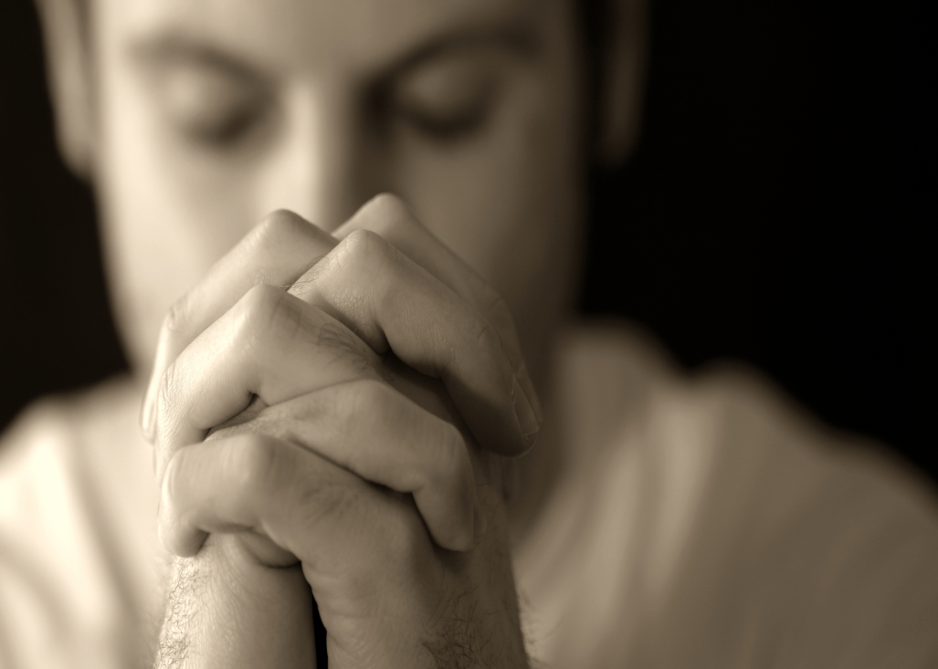
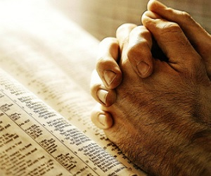
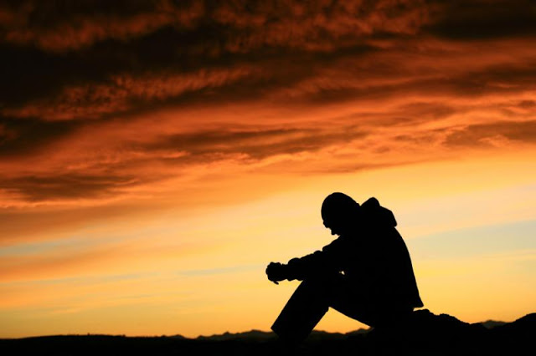
Spiritual Things

Slide 4
Our Physical
Body – is a Key
Part of our
Spirituality!

Slide 5
⁵ For those who live according to the flesh set their minds on the things of the flesh, but those who live according to the Spirit set their minds on the things of the Spirit.
⁶ For to set the mind on the flesh is death, but to set the mind on the Spirit is life and peace.
⁷ For the mind that is set on the flesh is hostile to God, for it does not submit to God's law; indeed, it cannot.

Slide 6
⁸ Those who are in the flesh cannot please God.
⁹ You, however, are not in the flesh but in the Spirit, if in fact the Spirit of God dwells in you. Anyone who does not have the Spirit of Christ does not belong to him.
¹⁰ But if Christ is in you, although the body is dead because of sin, the Spirit is life because of righteousness.

Slide 7
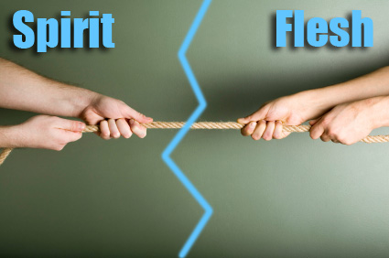

Slide 8
“Do you not know
that your bodies are
members of Christ?”

Slide 9
1 CORINTHIANS 6:15-20
¹⁵Do you not know that your bodies are members of Christ? Shall I then take the members of Christ and make them members of a prostitute? Never!
¹⁶Or do you not know that he who is joined to a prostitute becomes one body with her? For, as it is written, “The two will become one flesh.”
¹⁷But he who is joined to the Lord becomes one spirit with him.
¹⁸Flee from sexual immorality. Every other sin a person commits is outside the body, but the sexually immoral person sins against his own body.
¹⁹Or do you not know that your body is a temple of the Holy Spirit within you, whom you have from God? You are not your own,
²⁰for you were bought with a price. So glorify God in your body.

Slide 11
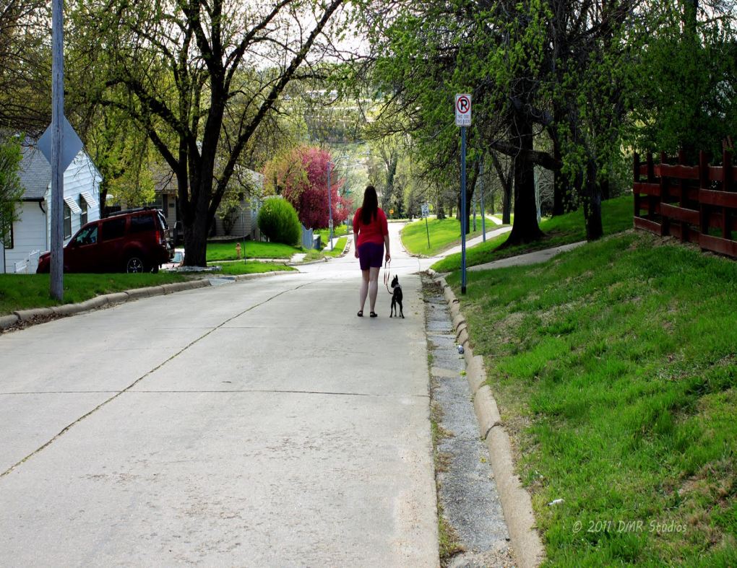
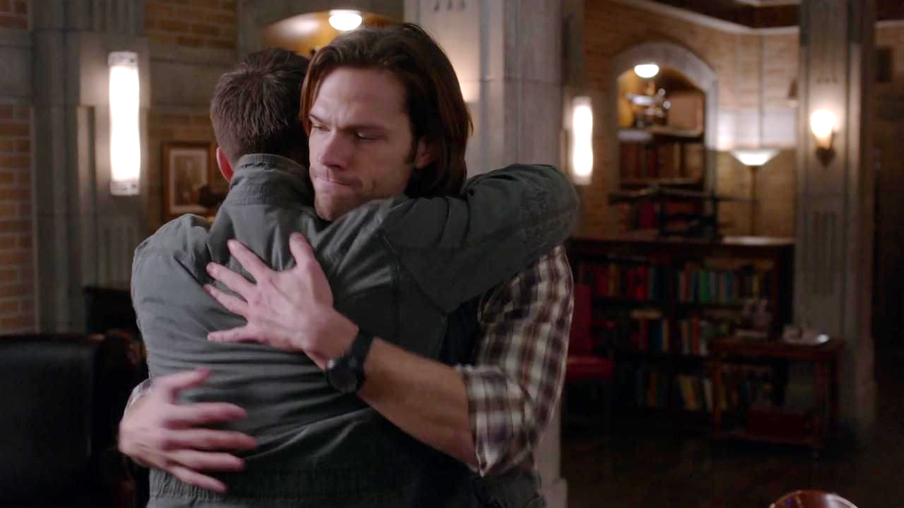
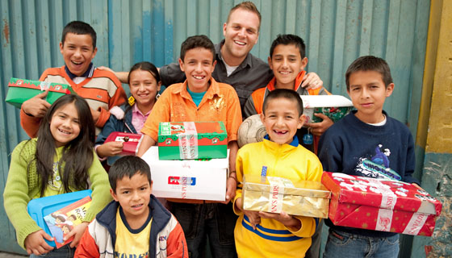

Slide 12
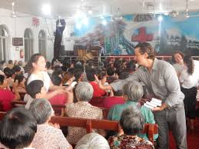

Slide 13
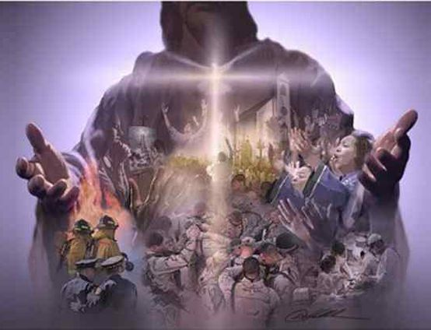
Members of Christ!

Slide 15
⁹ Or do you not know that the unrighteous will not inherit the kingdom of God? Do not be deceived: neither the sexually immoral, nor idolaters, nor adulterers, nor men who practice homosexuality, ¹⁰ nor thieves, nor the greedy, nor drunkards, nor revilers, nor swindlers will inherit the kingdom of God.

Slide 16
. ¹¹ And such were some of you. But you were washed, you were sanctified, you were justified in the name of the Lord Jesus Christ and by the Spirit of our God.

Slide 17
1 CORINTHIANS 6:15-20
¹⁵Do you not know that your bodies are members of Christ? Shall I then take the members of Christ and make them members of a prostitute? Never!
¹⁶Or do you not know that he who is joined to a prostitute becomes one body with her? For, as it is written, “The two will become one flesh.”
¹⁷But he who is joined to the Lord becomes one spirit with him.
¹⁸Flee from sexual immorality. Every other sin a person commits is outside the body, but the sexually immoral person sins against his own body.
¹⁹Or do you not know that your body is a temple of the Holy Spirit within you, whom you have from God? You are not your own,
²⁰for you were bought with a price. So glorify God in your body.

Slide 19
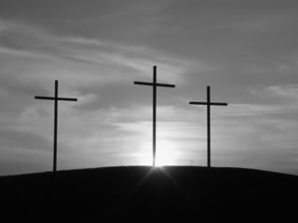

Slide 21
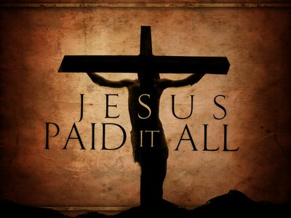

Slide 23
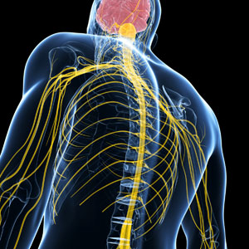

Slide 24
Our Physical
Body – is a Key
Part of our
Spirituality!

