Slide 3
TURNING POINTS IN
“In The Beginning . . .”

Slide 4
TURNING POINTS IN
“In The Beginning . . . GOD”

Slide 6
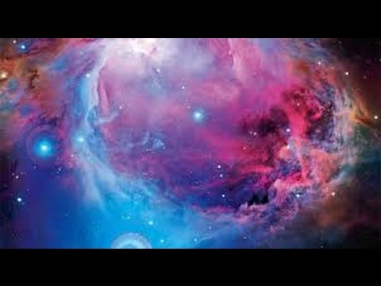
“In the Beginning God CREATED”

Slide 7
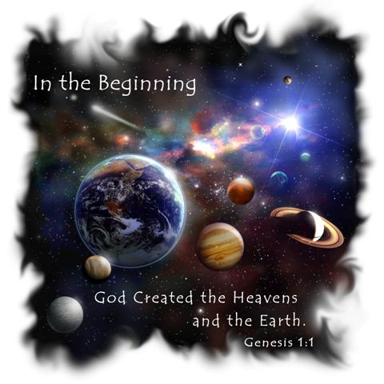

Slide 8
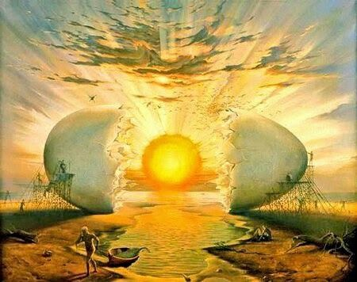
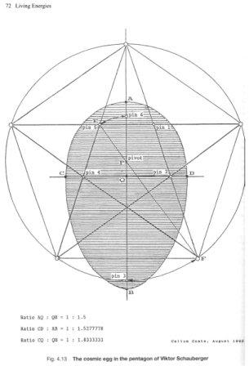
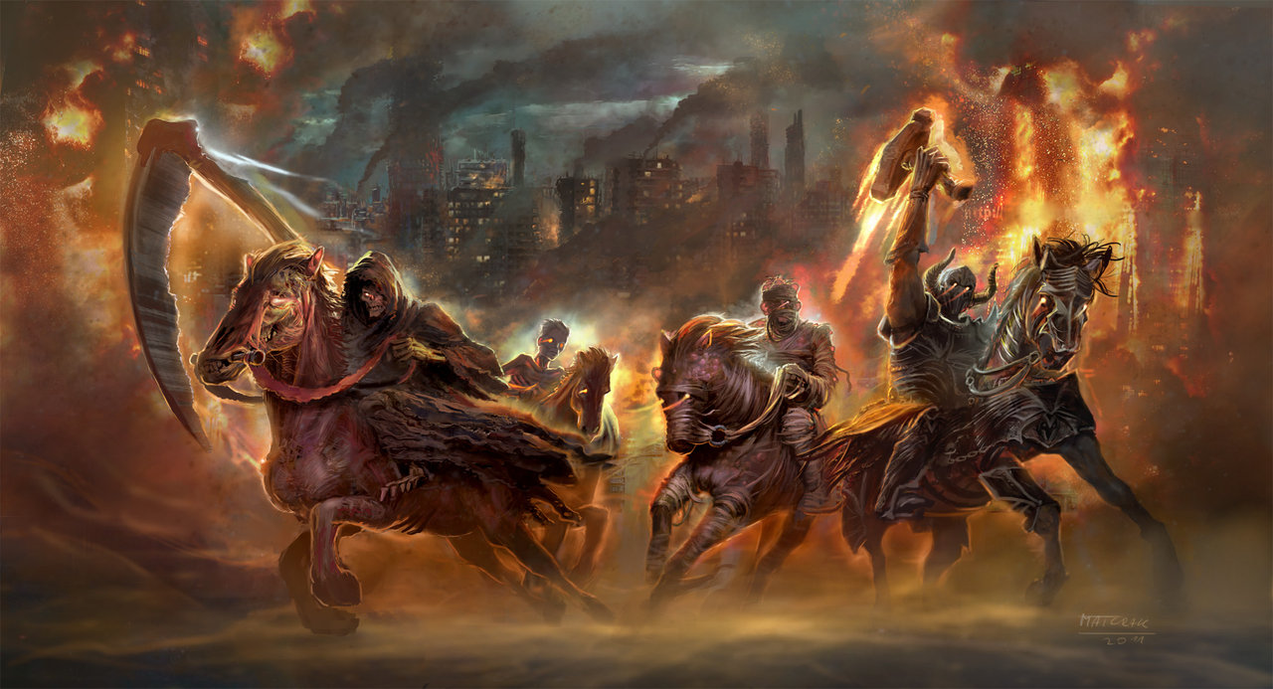

Slide 9
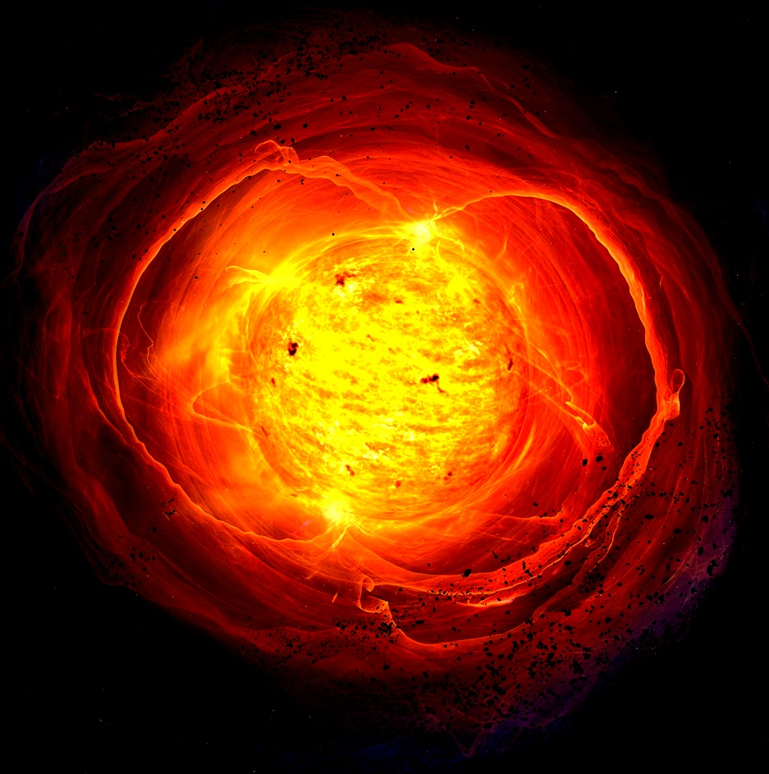
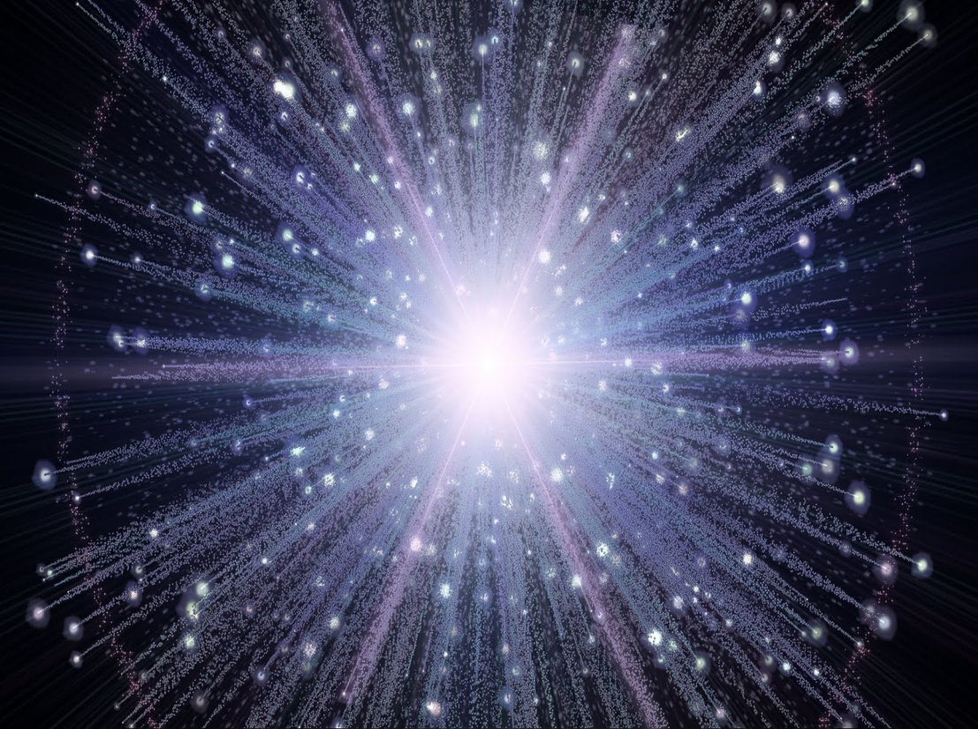
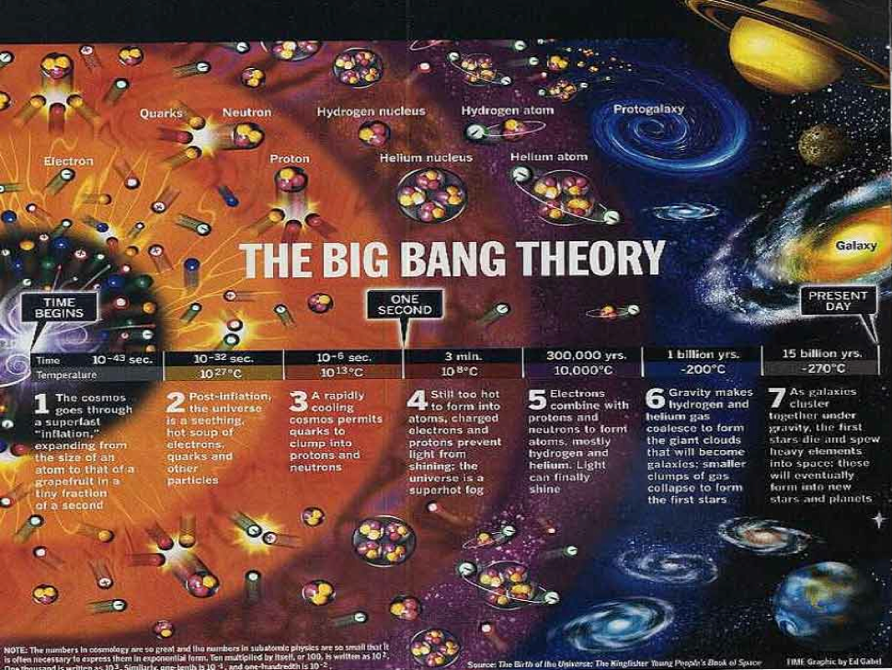

Slide 11
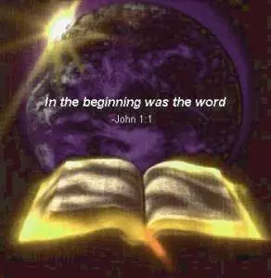
“In the beginning was the Word, and the Word was with God, and the Word was God. He was in the beginning with God. All things were made through him, and without him was not any thing made that was made.”
- John 1:1-3

Slide 15
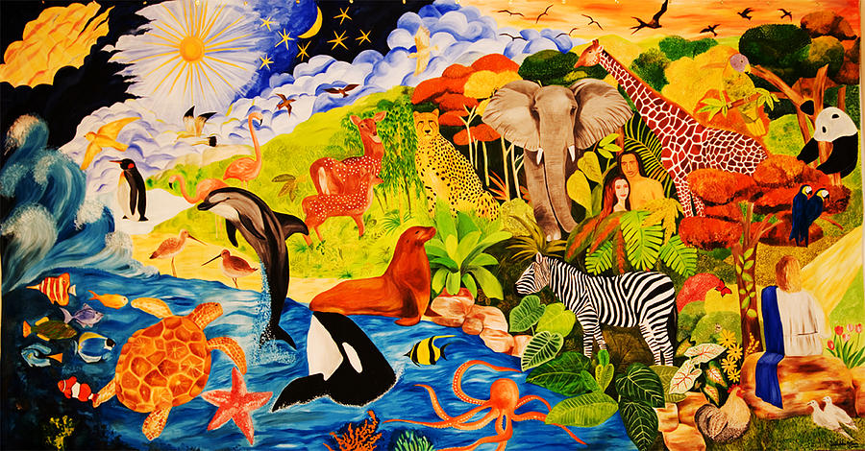

Slide 16
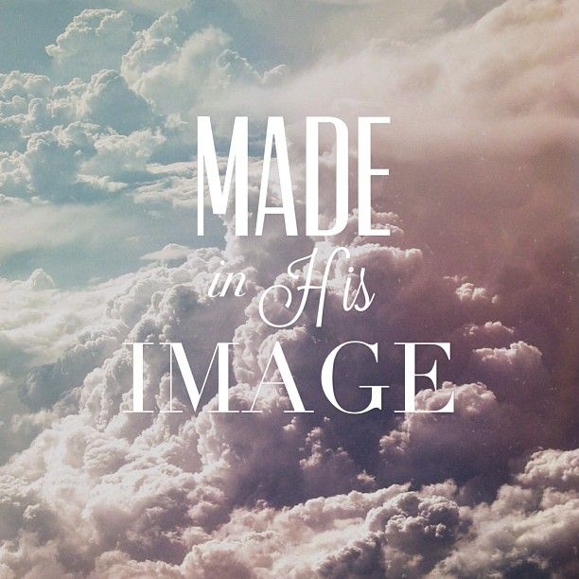

Slide 18
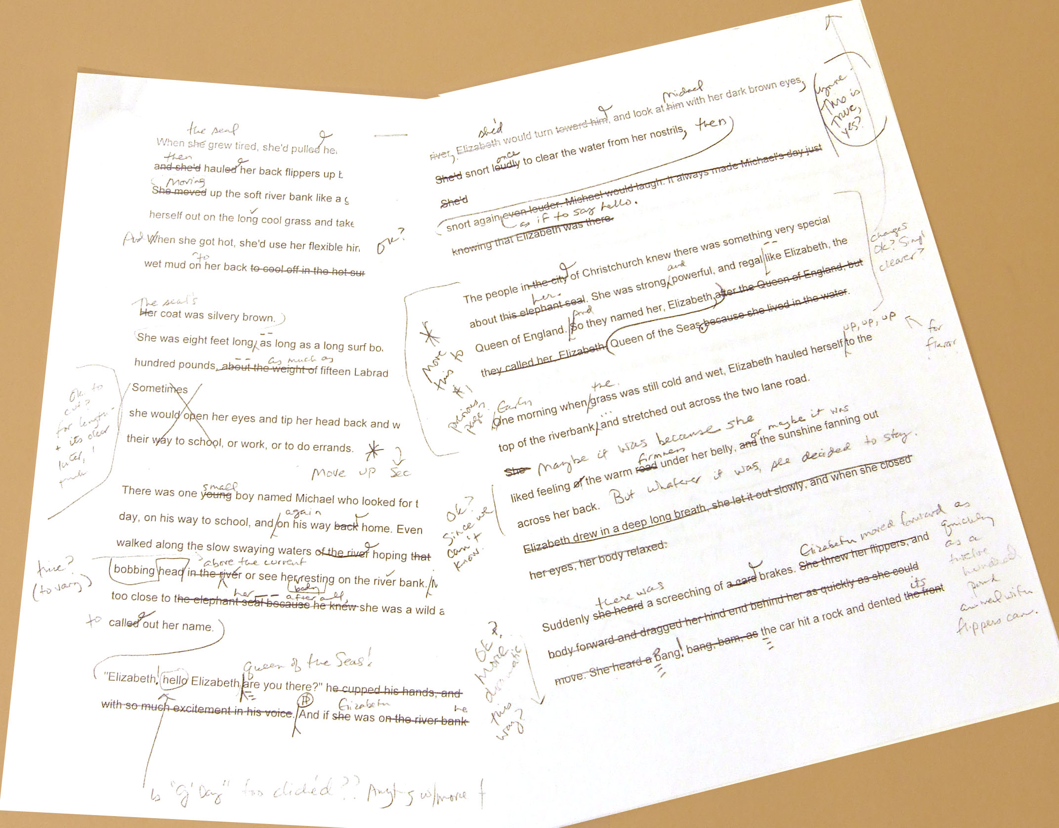

Slide 20
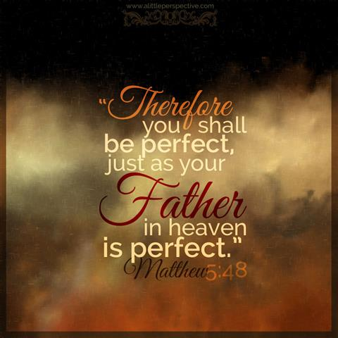

Slide 21
TURNING POINTS IN
“God made everything – and everything He made was GOOD.”

Slide 22
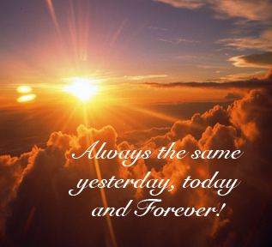

Slide 24
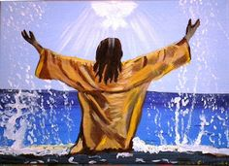

Slide 26
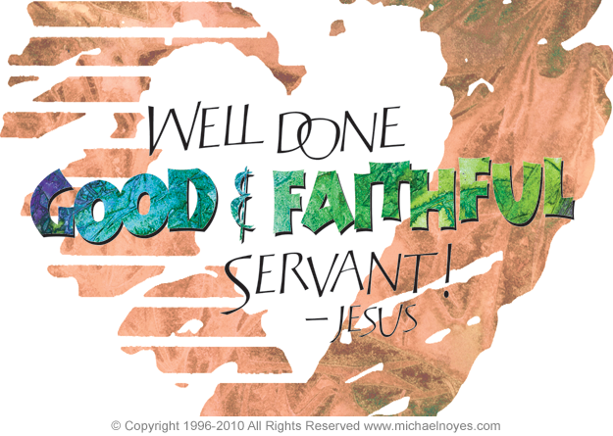

Slide 27
TURNING POINTS IN
“In The Beginning . . .”

