Slide 1
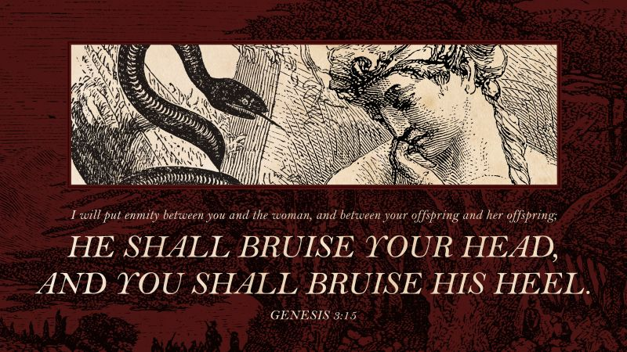
“THE FIRST GOSPEL”

Slide 3
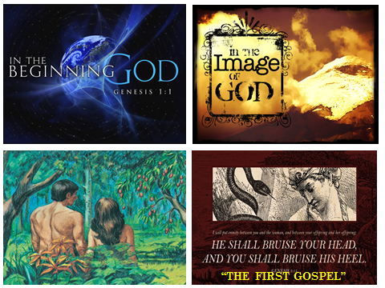

Slide 4
“Turning Toward Heaven”

Slide 5
is “HIS Story”

Slide 8
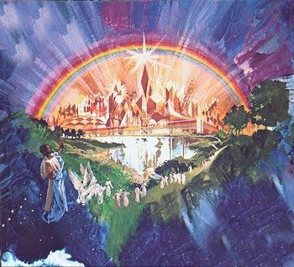

Slide 10
¹Then I saw a new heaven and a new earth, for the first heaven and the first earth had passed away, and the sea was no more.
² And I saw the holy city, new Jerusalem, coming down out of heaven from God, prepared as a bride adorned for her husband.
³ And I heard a loud voice from the throne saying, “Behold, the dwelling place of God is with man. He will dwell with them, and they will be his people, and God himself will be with them as their God.

Slide 11
4 He will wipe away every tear from their eyes, and death shall be no more, neither shall there be mourning, nor crying, nor pain anymore, for the former things have passed away.”
5 And he who was seated on the throne said, “Behold, I am making all things new.” Also he said, “Write this down, for these words are trustworthy and true.”
^{REVELATION 21:1-5}

Slide 12
⁵ And he who was seated on the throne said, “Behold, I am making all things new.”
Also he said, “Write this down, for these words are trustworthy and true.”

Slide 14
¹Then I saw a new heaven and a new earth, for the first heaven and the first earth had passed away, and the sea was no more.
² And I saw the holy city, new Jerusalem, coming down out of heaven from God, prepared as a bride adorned for her husband.
³ And I heard a loud voice from the throne saying, “Behold, the dwelling place of God is with man. He will dwell with them, and they will be his people, and God himself will be with them as their God.

Slide 15
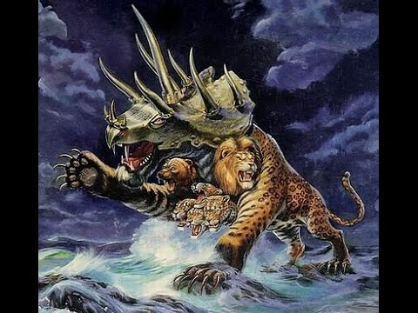

Slide 17
“God makes all things NEW”

Slide 19
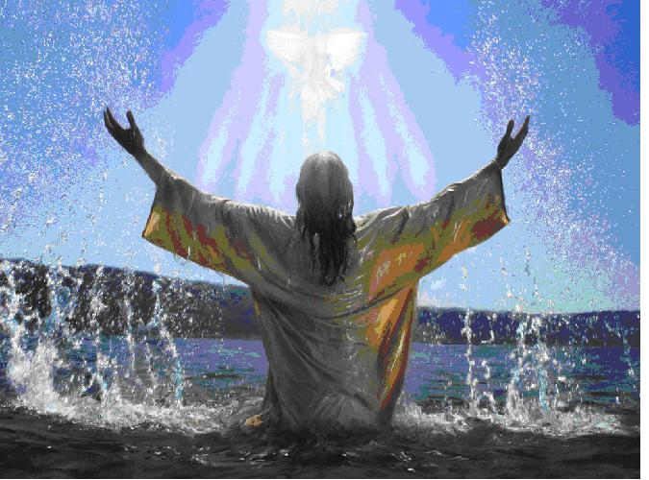

Slide 20
⁵ And he who was seated on the throne said, “Behold, I am making all things new.”
Also he said, “Write this down, for these words are trustworthy and true.”

Slide 22
“Behold, the dwelling place of God is with man. He will dwell with them, and they will be his people, and God himself will be with them as their God.”

Slide 23
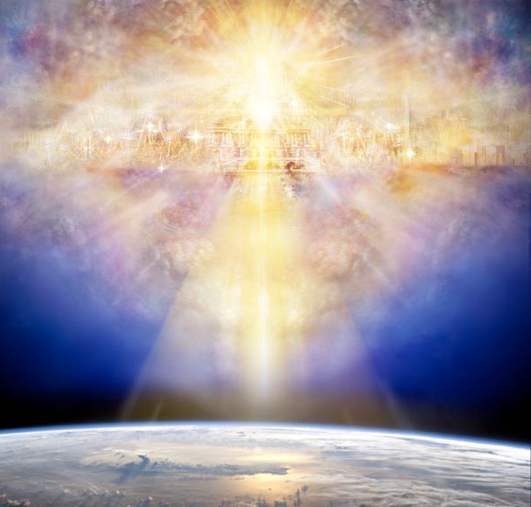
HIS Story

