Slide 1
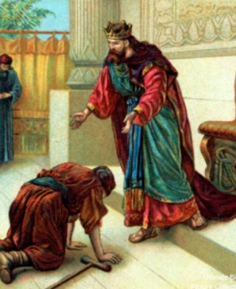
“An Old Testament Story of Grace”
(2 Samuel 9:1-13)
Mark Mason July 5, 2015

Slide 2
Ephesians 4:32 KJV
“And be ye kind one to another, tenderhearted, forgiving one another, even as God for Christ's sake hath forgiven you.”

Slide 3
Be Honest
Speak Truth
Work Hard
Build People Up
Rid Yourself of Bitterness, Wrath, Slander

Slide 5
Luke 6:35 ESV
“But love your enemies, and do good, and lend, expecting nothing in return, and your reward will be great, and you will be sons of the Most High, for he is kind to the ungrateful and the evil.”

Slide 7
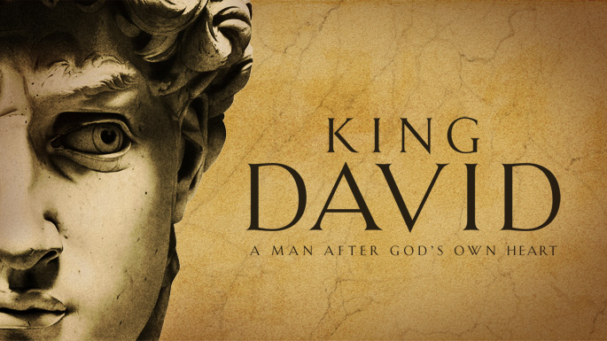

Slide 8
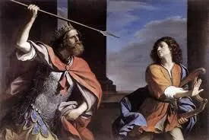

Slide 9
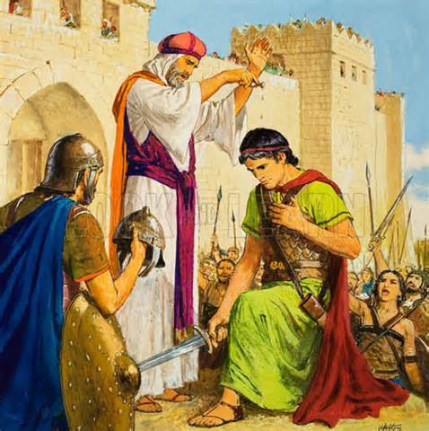

Slide 10
2 Samuel 9:1-13
¹And David said, “Is there still anyone left of the house of Saul, that I may show him kindness for Jonathan's sake?”
²Now there was a servant of the house of Saul whose name was Ziba, and they called him to David. And the king said to him, “Are you Ziba?” And he said, “I am your servant.”
³And the king said, “Is there not still someone of the house of Saul, that I may show the kindness of God to him?” Ziba said to the king, “There is still a son of Jonathan; he is crippled in his feet.”
⁴The king said to him, “Where is he?” And Ziba said to the king, “He is in the house of Machir the son of Ammiel, at Lo-debar.”

Slide 11
2 Samuel 9:1-13
⁵Then King David sent and brought him from the house of Machir the son of Ammiel, at Lo-debar.
⁶And Mephibosheth the son of Jonathan, son of Saul, came to David and fell on his face and paid homage. And David said, “Mephibosheth!” And he answered, “Behold, I am your servant.”
⁷And David said to him, “Do not fear, for I will show you kindness for the sake of your father Jonathan, and I will restore to you all the land of Saul your father, and you shall eat at my table always.”
⁸And he paid homage and said, “What is your servant, that you should show regard for a dead dog such as I?”

Slide 12
2 Samuel 9:1-13
⁹Then the king called Ziba, Saul's servant, and said to him, “All that belonged to Saul and to all his house I have given to your master's grandson.
¹⁰And you and your sons and your servants shall till the land for him and shall bring in the produce, that your master's grandson may have bread to eat. But Mephibosheth your master's grandson shall always eat at my table.” Now Ziba had fifteen sons and twenty servants.
¹¹Then Ziba said to the king, “According to all that my lord the king commands his servant, so will your servant do.” So Mephibosheth ate at David's table, like one of the king's sons.

Slide 13
2 Samuel 9:1-13
¹²And Mephibosheth had a young son, whose name was Mica. And all who lived in Ziba's house became Mephibosheth's servants.
¹³So Mephibosheth lived in Jerusalem, for he ate always at the king's table. Now he was lame in both his feet.

Slide 14
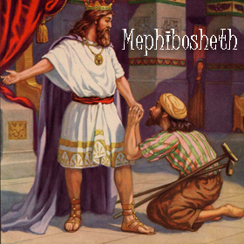

Slide 15
2 Samuel 9:1-13
¹And David said, “Is there still anyone left of the house of Saul, that I may show him kindness for Jonathan's sake?”
²Now there was a servant of the house of Saul whose name was Ziba, and they called him to David. And the king said to him, “Are you Ziba?” And he said, “I am your servant.”
³And the king said, “Is there not still someone of the house of Saul, that I may show the kindness of God to him?” Ziba said to the king, “There is still a son of Jonathan; he is crippled in his feet.”
⁴The king said to him, “Where is he?” And Ziba said to the king, “He is in the house of Machir the son of Ammiel, at Lo-debar.”

Slide 16
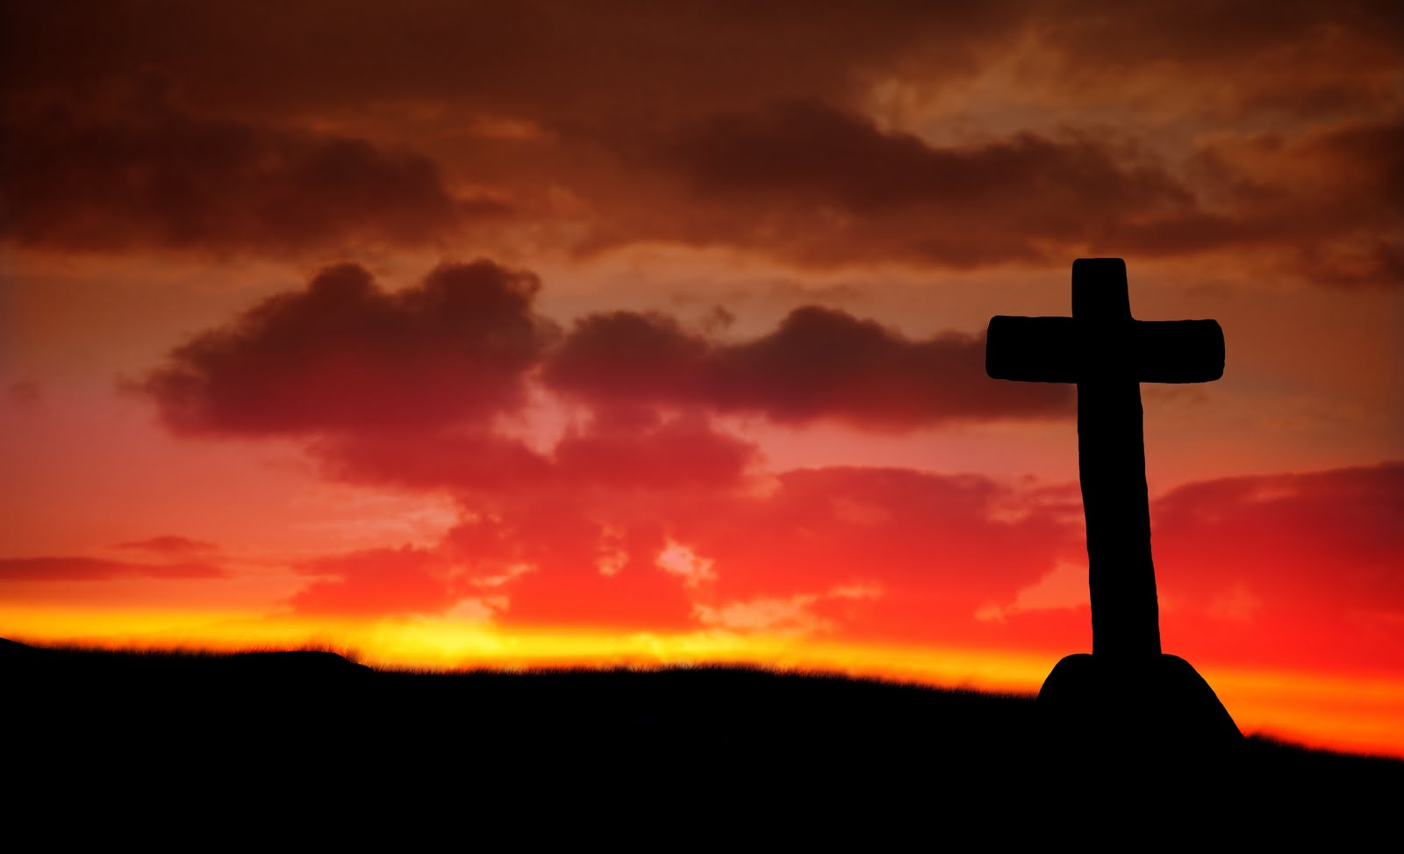
Ephesians 4:32 ESV
“Be kind to one another, tenderhearted, forgiving one another, as God in Christ forgave you.”

Slide 17
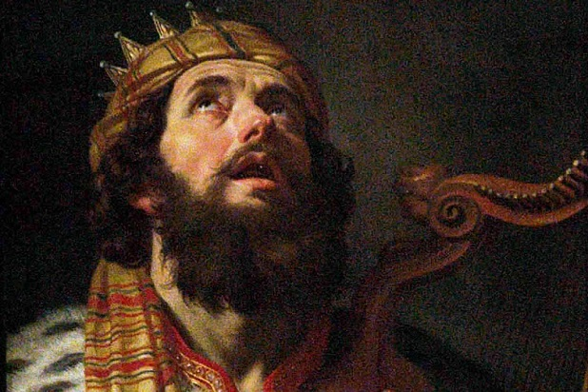
“Is there still anyone left of the house of Saul, that I may show him kindness . . .?” Verse 3

Slide 18
“Is there not still someone of the house of Saul, that I may show the kindness of God to him?” Verse 4

Slide 19
“Do not fear, for I will show you kindness . . .” Verse 7

Slide 20
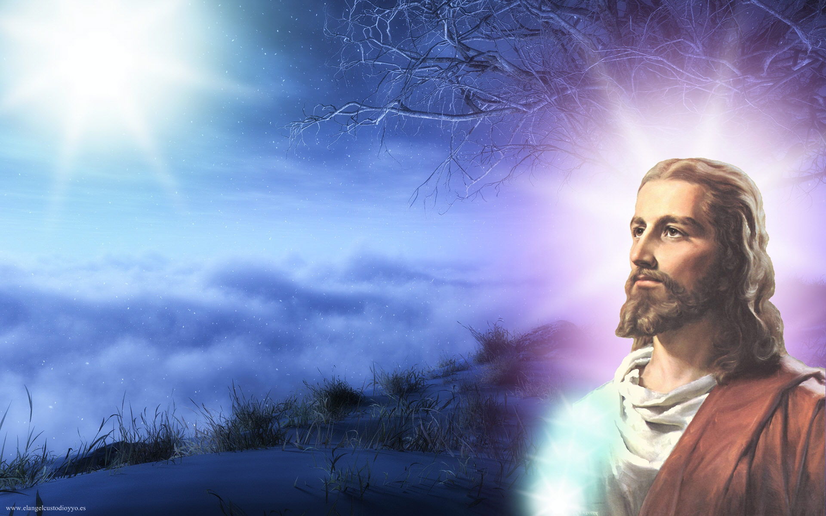
“When He was reviled, He did not revile in return; when He suffered, He did not threaten, but continued entrusting Himself to Him who judges justly.”

Slide 21
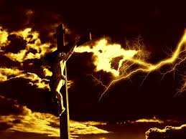
“He himself bore our sins in His body on the tree, that we might die to sin and live to righteousness. By His wounds you have been healed.”

Slide 22
Be Honest
Speak Truth
Work Hard
Build People Up
Rid Yourself of Bitterness, Wrath, Slander

