Slide 1
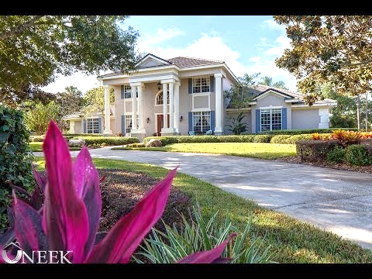

Slide 2
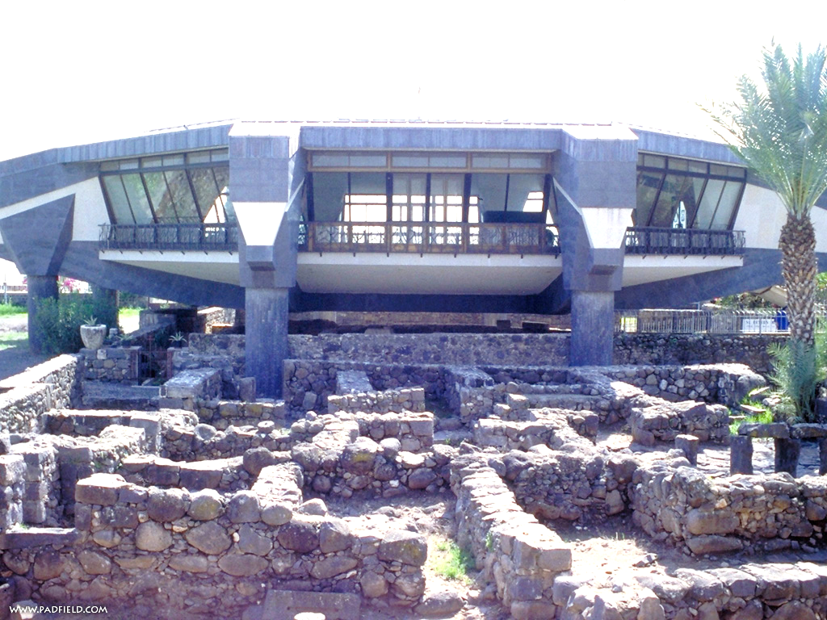

Slide 3
“Building A House Like Mary’s”
(Acts 12:1-17)
Mark Mason Aug. 2, 2015

Slide 4
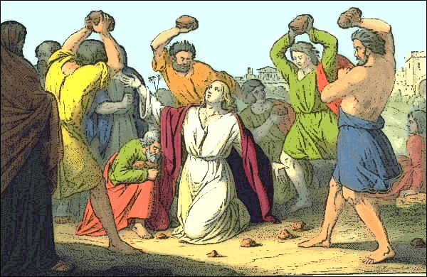

Slide 5
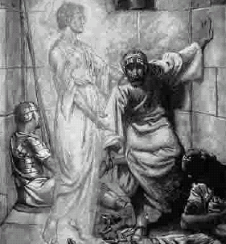
Acts 12:1-5
¹About that time Herod the king laid violent hands on some who belonged to the church.
² He killed James the brother of John with the sword,
³ and when he saw that it pleased the Jews, he proceeded to arrest Peter also. This was during the days of Unleavened Bread.
⁴ And when he had seized him, he put him in prison, delivering him over to four squads of soldiers to guard him, intending after the Passover to bring him out to the people.
⁵ So Peter was kept in prison, but earnest prayer for him was made to God by the church.

Slide 6
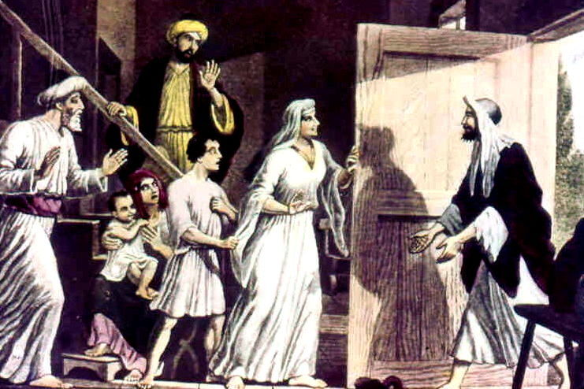
When he realized this, he went to the house of Mary, the mother of John whose other name was Mark, where many were gathered together and were praying.

Slide 7
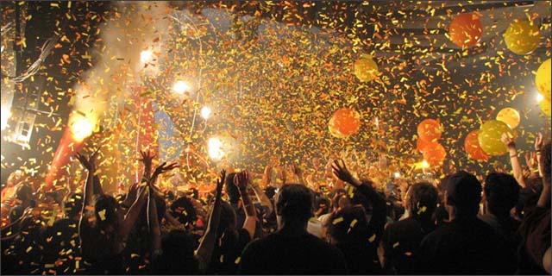
Acts 12:12-17
12 When he realized this, he went to the house of Mary, the mother of John whose other name was Mark, where many were gathered together and were praying.
13 And when he knocked at the door of the gateway, a servant girl named Rhoda came to answer.
14 Recognizing Peter's voice, in her joy she did not open the gate but ran in and reported that Peter was standing at the gate.
15 They said to her, “You are out of your mind.” But she kept insisting that it was so, and they kept saying, “It is his angel!”
16 But Peter continued knocking, and when they opened, they saw him and were amazed.
17 But motioning to them with his hand to be silent, he described to them how the Lord had brought him out of the prison. And he said, “Tell these things to James and to the brothers.” Then he departed and went to another place.

Slide 8
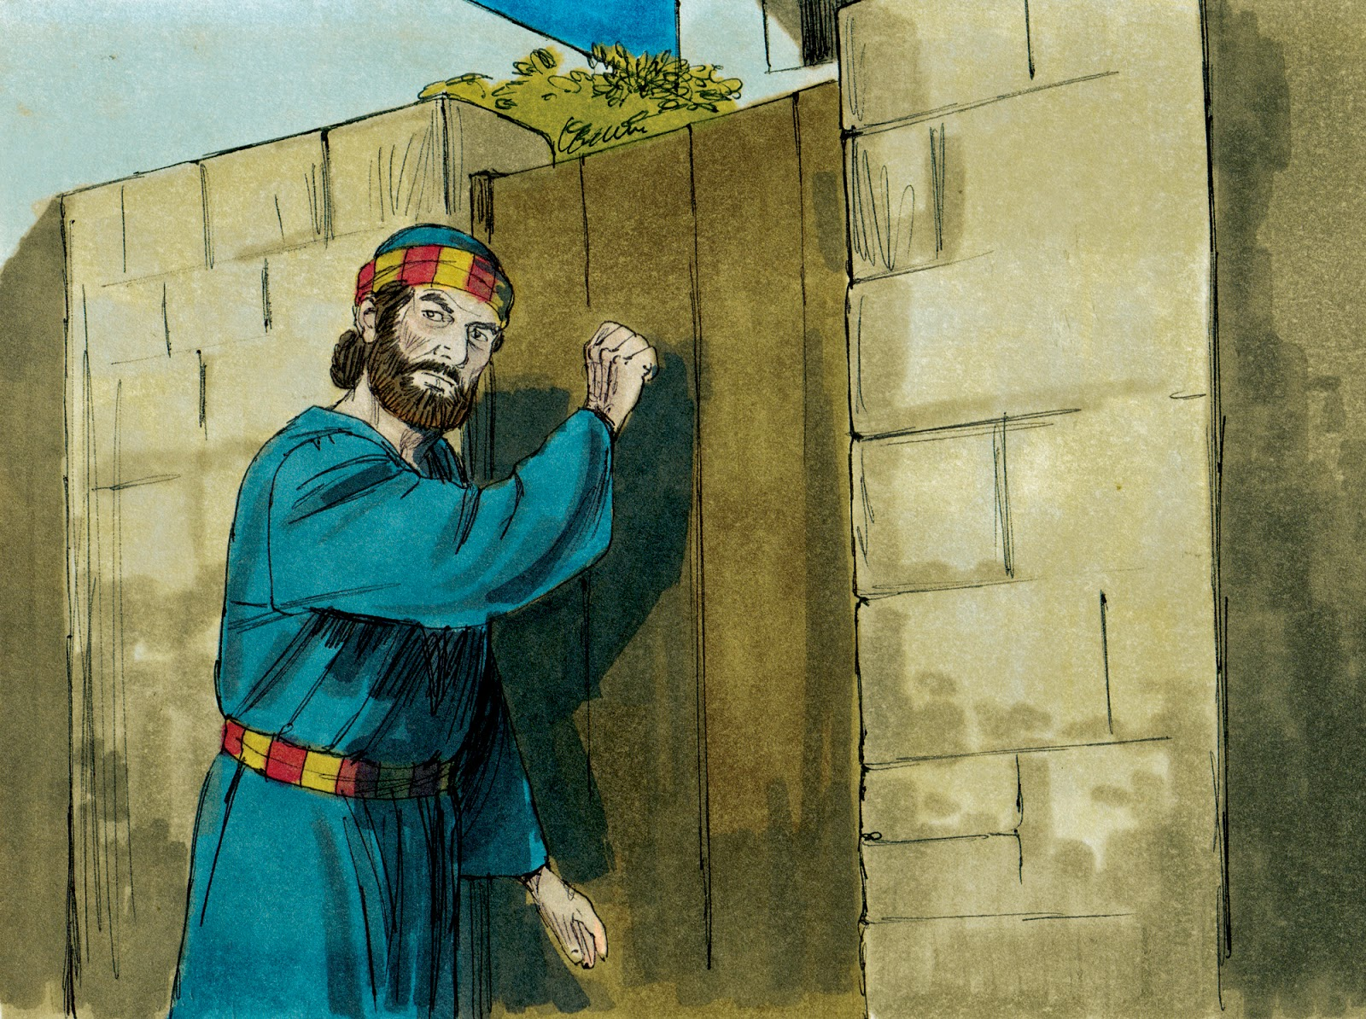

Slide 9
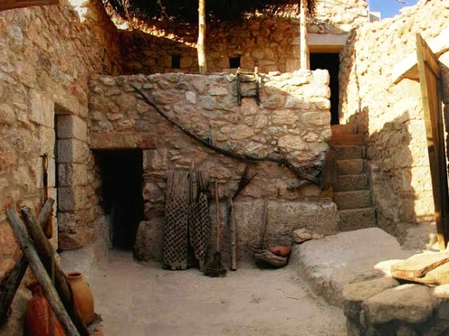

Slide 10
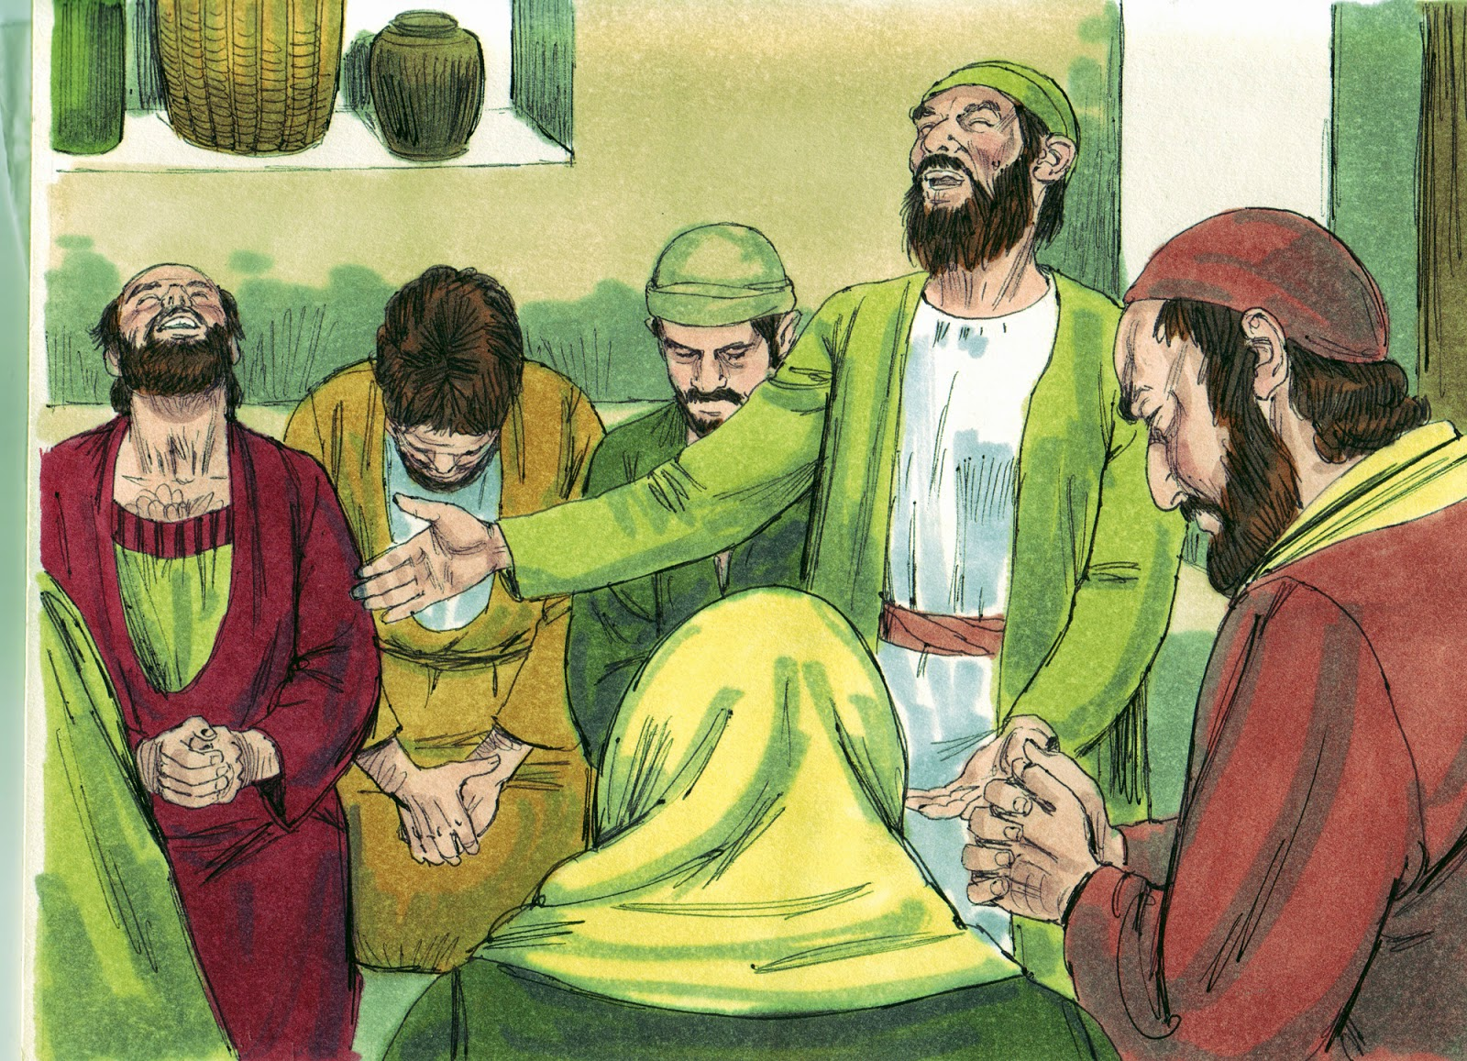

Slide 11
1) A house like Mary’s is one in which Jesus Christ is honored.

Slide 12
2) A house like Mary’s is one in which prayer is offered.

Slide 13
3) A house like Mary’s is one in which hospitality is evident.

Slide 14
4) A house like Mary’s is one in which children are influenced positively for God.

