Slide 1
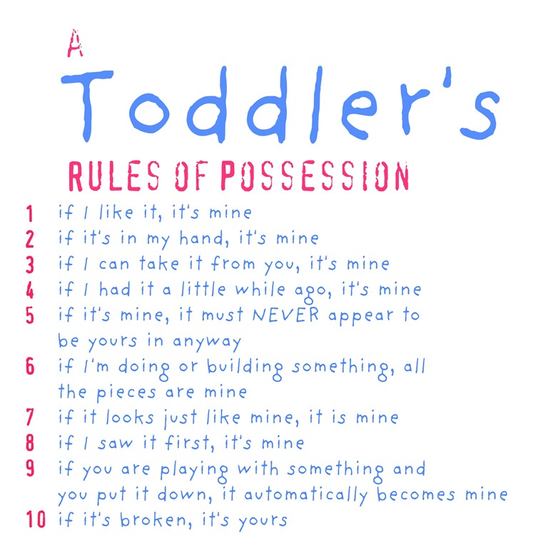

Slide 2
“Not Mine, But His”
Part 1 “Not My Will, But His Will”
Part 2 “Not My Teaching, But His Teaching”
Part 3 “Not My GLORY, But His GLORY”

Slide 4
“Whoever is of God hears the words of God. The reason why you do not hear them is that you are not of God.”
- John 8:47

Slide 5
“Not My Glory, But His Glory”
John 8:48-51
Mark Mason August 23, 2015

Slide 6
“Worthy of Praise”

Slide 7
“So Christ also did not take upon Himself the glory of becoming a high priest.
But God said to Him,
“You are my Son. Today I have become your Father.”
(Hebrews 5:5)
“NOT MY GLORY, BUT HIS GLORY”

Slide 8
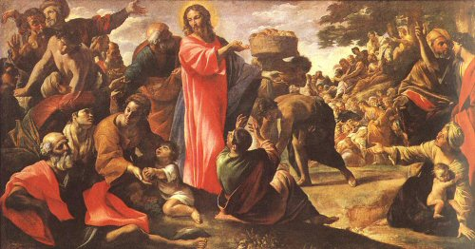
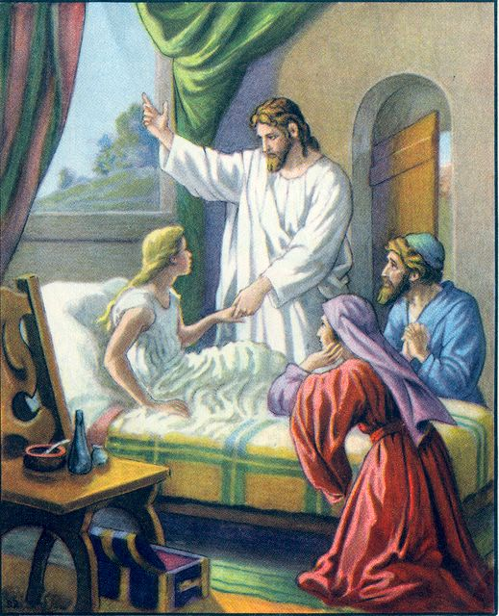
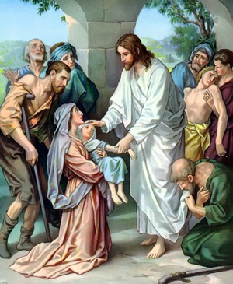
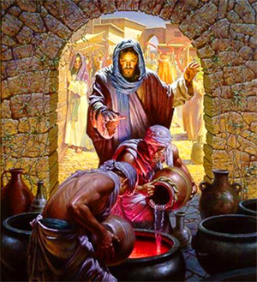

Slide 11
“I do not receive glory from people”
John 5:41
“How can you believe, when you receive glory from one another and do not seek the glory that comes from the only God?”
John 5:44
“NOT MY GLORY, BUT HIS GLORY”

Slide 13
⁴⁸ The Jews answered him, “Are we not right in saying that you are a Samaritan and have a demon?”
⁴⁹ Jesus answered, “I do not have a demon, but I honor my Father, and you dishonor me.
⁵⁰ Yet I do not seek my own glory; there is One who seeks it, and he is the judge.
⁵¹ Truly, truly, I say to you, if anyone keeps my word, he will never see death.”
John 8:48-54

Slide 14
⁵² The Jews said to him, “Now we know that you have a demon! Abraham died, as did the prophets, yet you say, ‘If anyone keeps my word, he will never taste death.’
⁵³ Are you greater than our father Abraham, who died? And the prophets died! Who do you make yourself out to be?”
John 8:48-54

Slide 15
⁵⁴ Jesus answered, “If I glorify myself, my glory is nothing. It is my Father who glorifies me, of whom you say, ‘He is our God.’
John 8:48-54

Slide 16
⁴⁸ The Jews answered him, “Are we not right in saying that you are a Samaritan and have a demon?”
John 8:48-54

Slide 17
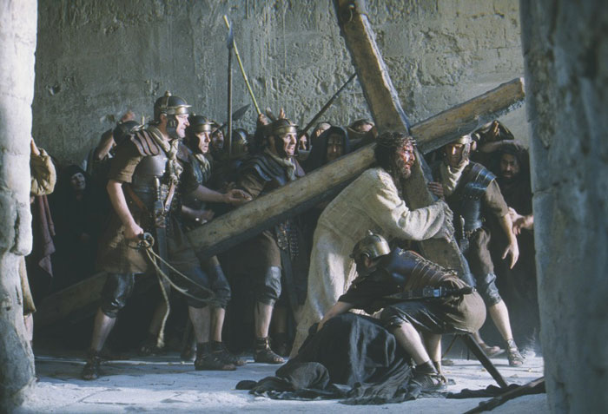
“NOT MY GLORY, BUT HIS GLORY”

Slide 18
⁵⁴ Jesus answered, “If I glorify myself, my glory is nothing. It is my Father who glorifies me . . .”
John 8:48-54

Slide 19
“Not Mine, But His”
Part 1 “Not My Will, But His Will”
Part 2 “Not My Teaching, But His Teaching”
Part 3 “Not My GLORY, But His GLORY”

Slide 20
