Slide 1
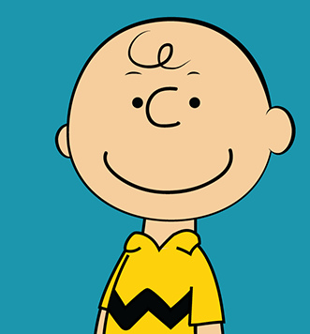

Slide 2
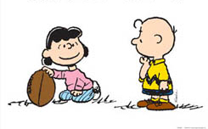

Slide 4
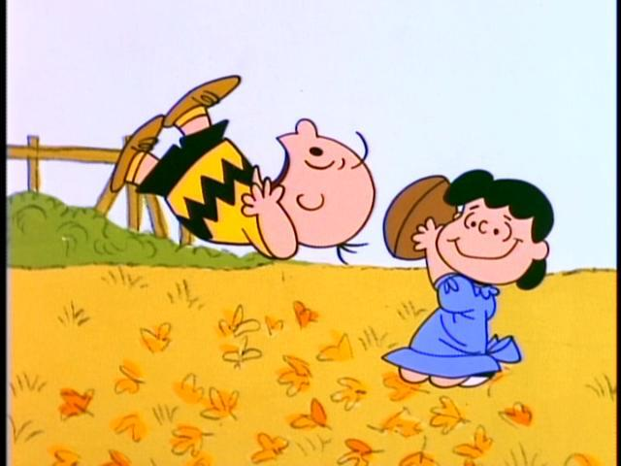
AAARRRGGGHHH!!!

Slide 5
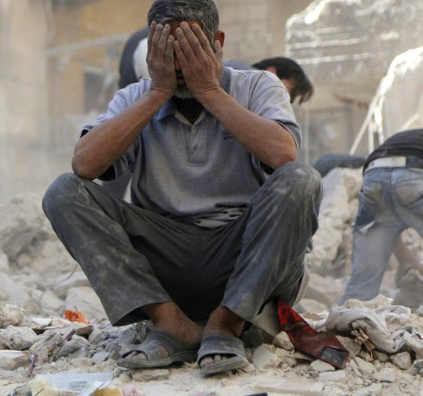
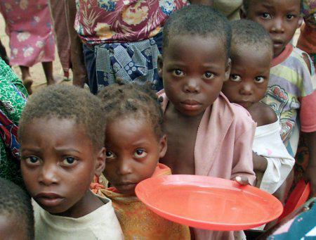
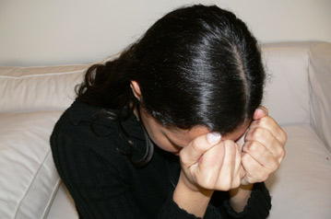
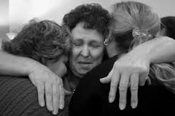
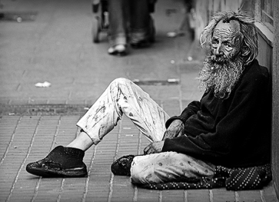
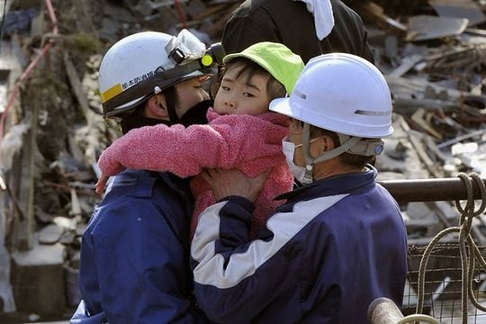

Slide 6
Romans 8:18-26 (ESV)
¹⁸ For I consider that the sufferings of this present time are not worth comparing with the glory that is to be revealed to us.
¹⁹ For the creation waits with eager longing for the revealing of the sons of God.
²⁰ For the creation was subjected to futility, not willingly, but because of him who subjected it, in hope
²¹ that the creation itself will be set free from its bondage to corruption and obtain the freedom of the glory of the children of God.

Slide 7
Romans 8:18-26 (ESV)
²² For we know that the whole creation has been groaning together in the pains of childbirth until now.
²³ And not only the creation, but we ourselves, who have the first fruits of the Spirit, groan inwardly as we wait eagerly for adoption as sons, the redemption of our bodies.
²⁴ For in this hope we were saved. Now hope that is seen is not hope. For who hopes for what he sees?
²⁵ But if we hope for what we do not see, we wait for it with patience.

Slide 8
Romans 8:18-26 (ESV)
²⁶ Likewise the Spirit helps us in our weakness. For we do not know what to pray for as we ought, but the Spirit himself intercedes for us with groanings too deep for words.

Slide 9
¹⁶ To the woman he said,
“I will surely multiply your pain in childbearing; in pain you shall bring forth children. Your desire shall be for your husband, and he shall rule over you.”

Slide 10
¹⁷ And to Adam he said,
“Because you have listened to the voice of your wife and have eaten of the tree of which I commanded you, ‘You shall not eat of it,’ cursed is the ground because of you; in pain you shall eat of it all the days of your life;

Slide 11
¹⁸ thorns and thistles it shall bring forth for you;
- GENESIS 3:16-18a

Slide 12
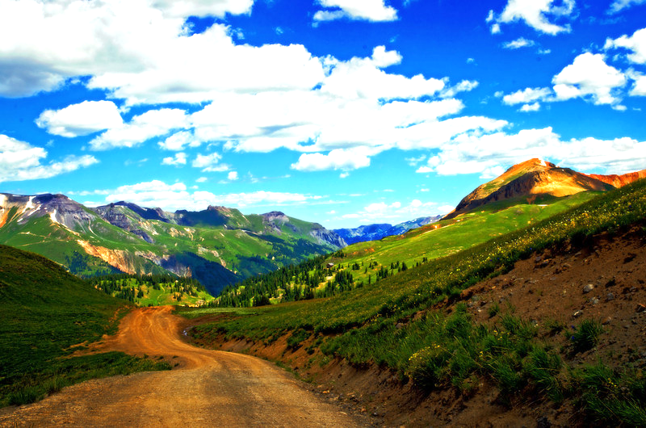

Slide 13
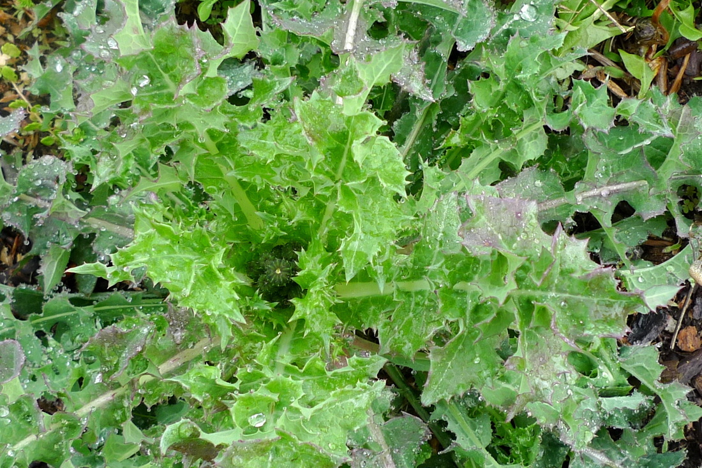
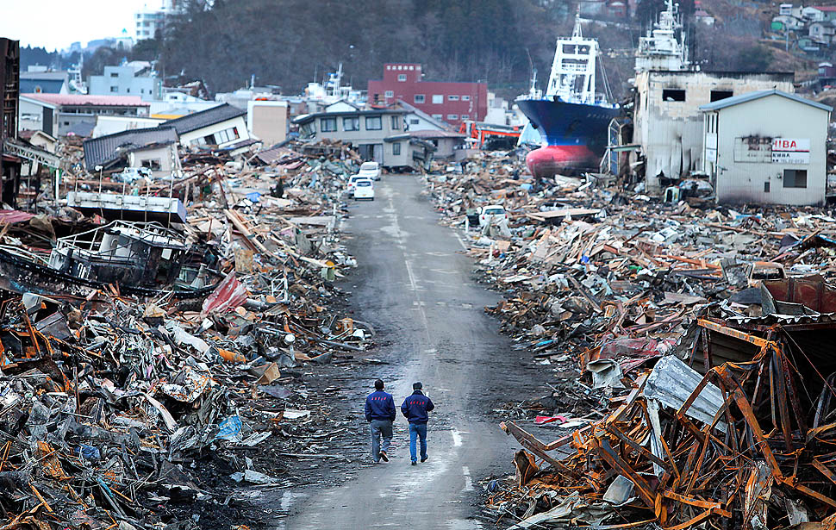
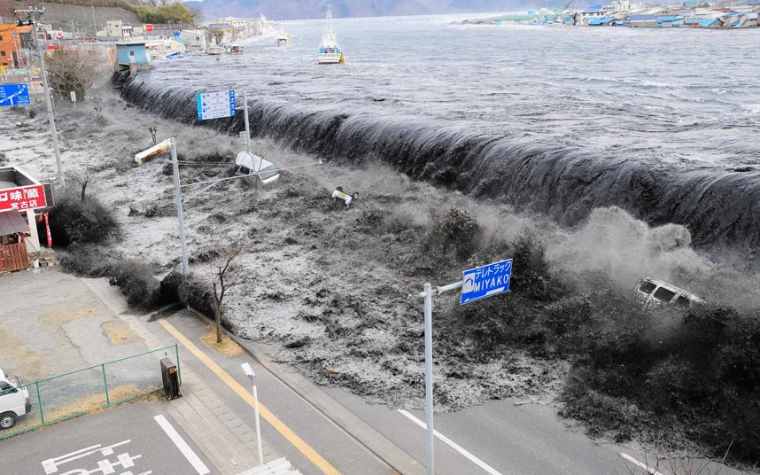
Why Do Such Awful
Things Happen?

Slide 14
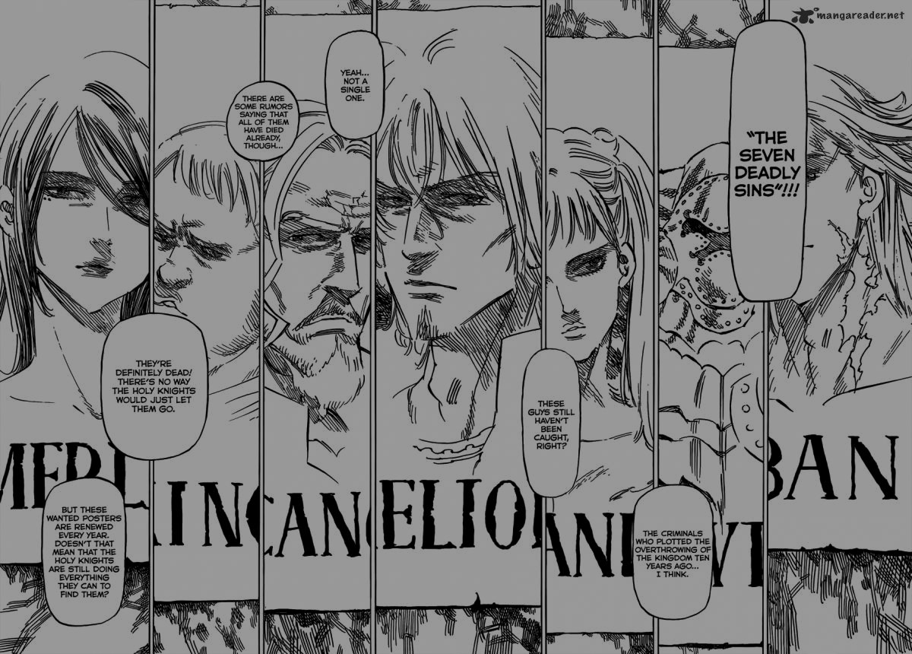
We live in a fallen,
sin-twisted world!

Slide 15
Romans 8:18-26 (ESV)
¹⁸ For I consider that the sufferings of this present time are not worth comparing with the glory that is to be revealed to us.
¹⁹ For the creation waits with eager longing for the revealing of the sons of God.
²⁰ For the creation was subjected to futility, not willingly, but because of him who subjected it, in hope
²¹ that the creation itself will be set free from its bondage to corruption and obtain the freedom of the glory of the children of God.

Slide 16
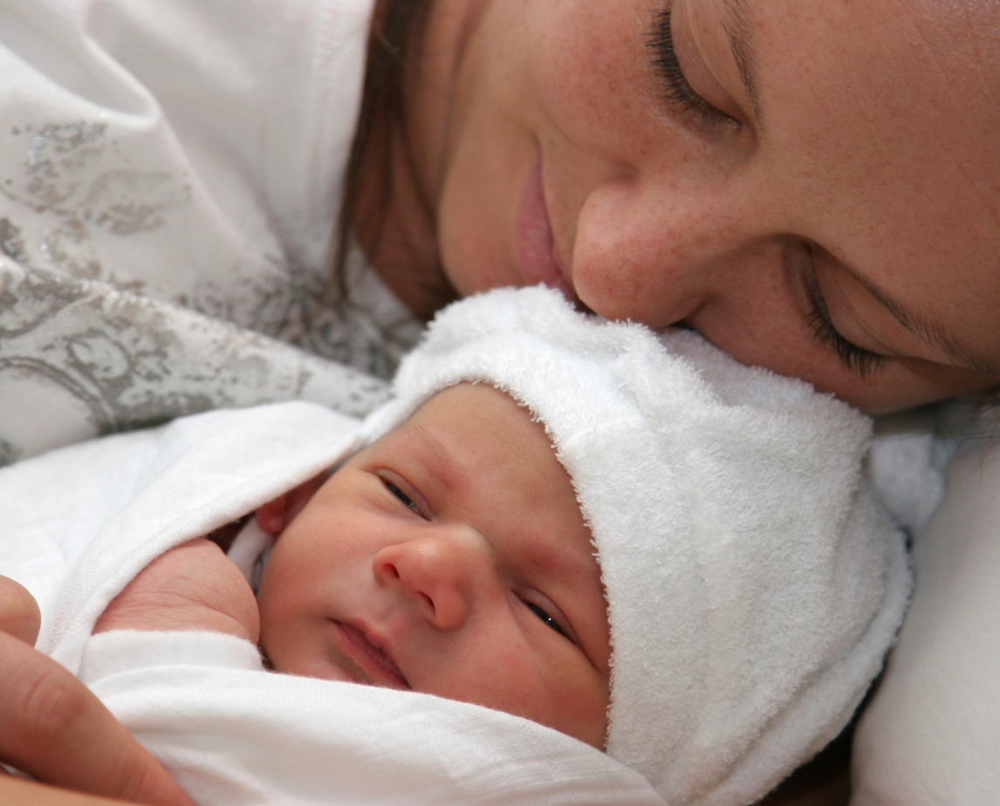
Romans 8:18-26 (ESV)
²² For we know that the whole creation has been groaning together in the pains of childbirth until now.
²³ And not only the creation, but we ourselves, who have the first fruits of the Spirit, groan inwardly as we wait eagerly for adoption as sons, the redemption of our bodies.
²⁴ For in this hope we were saved. Now hope that is seen is not hope. For who hopes for what he sees?
²⁵ But if we hope for what we do not see, we wait for it with patience.
HOPE

Slide 17
¹⁶ To the woman he said,
“I will surely multiply your pain in childbearing; in pain you shall bring forth children. Your desire shall be for your husband, and he shall rule over you.”

Slide 18
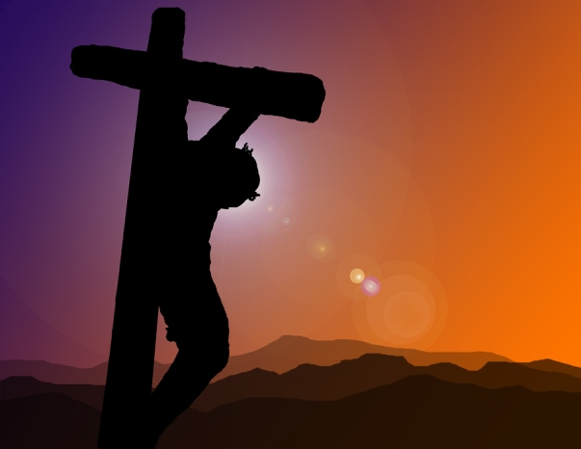

Slide 19
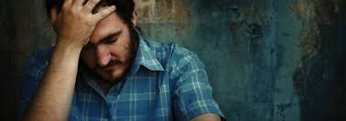
Do We Suffer? Yes.
But We Suffer in HOPE!

Slide 21
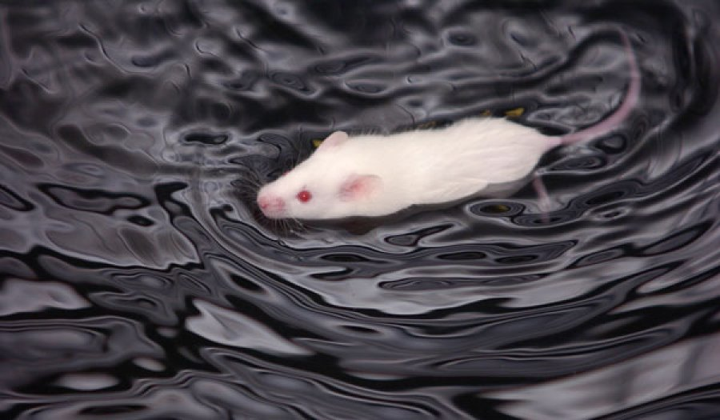

Slide 22
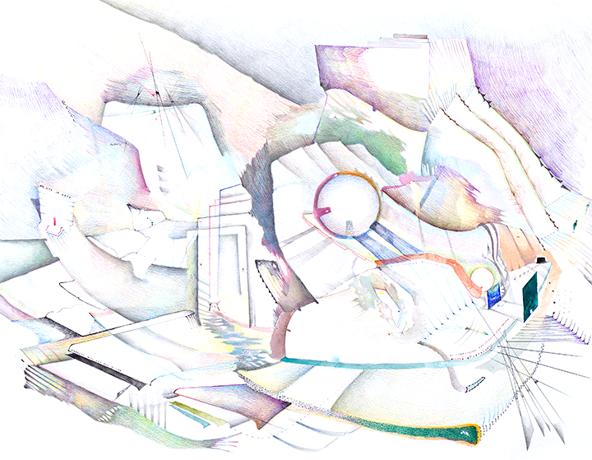
WE LIVE
IN HOPE!

Slide 23
Romans 8:18-26 (ESV)
²² For we know that the whole creation has been groaning together in the pains of childbirth until now.
²³ And not only the creation, but we ourselves, who have the first fruits of the Spirit, groan inwardly as we wait eagerly for adoption as sons, the redemption of our bodies.
²⁴ For in this hope we were saved. Now hope that is seen is not hope. For who hopes for what he sees?
²⁵ But if we hope for what we do not see, we wait for it with patience.

Slide 24
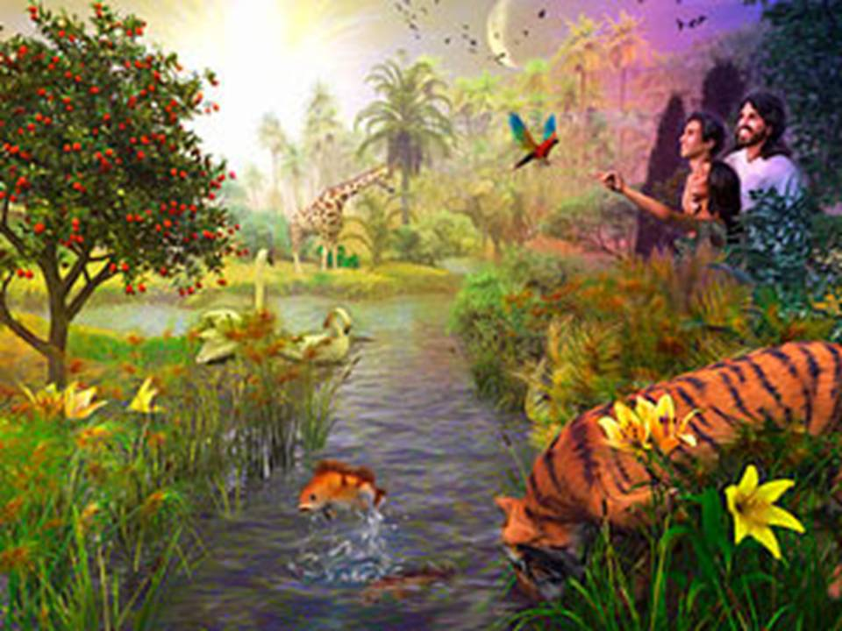

Slide 25
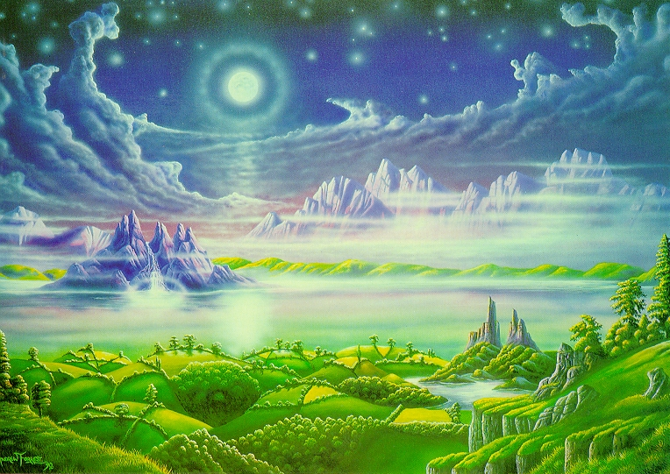
“A New Heaven and A New Earth, Where Righteousness Dwells.”

Slide 26
Romans 8:18-26 (ESV)
²² For we know that the whole creation has been groaning together in the pains of childbirth until now.
²³ And not only the creation, but we ourselves, who have the first fruits of the Spirit, groan inwardly as we wait eagerly for adoption as sons, the redemption of our bodies.
²⁴ For in this hope we were saved. Now hope that is seen is not hope. For who hopes for what he sees?
²⁵ But if we hope for what we do not see, we wait for it with patience.

Slide 28
2 Corinthians 5: 2-4 (ESV)
²For in this tent we groan, longing to put on our heavenly dwelling,
³if indeed by putting it on we may not be found naked.
⁴For while we are still in this tent, we groan, being burdened—not that we would be unclothed, but that we would be further clothed, so that what is mortal may be swallowed up by life.

Slide 29
Romans 8:18-26 (ESV)
²⁶ Likewise the Spirit helps us in our weakness. For we do not know what to pray for as we ought, but the Spirit himself intercedes for us with groanings too deep for words.

Slide 31
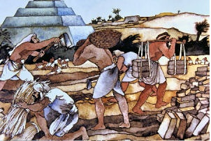

Slide 32
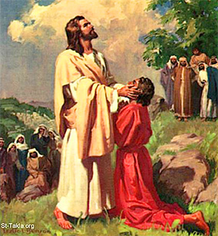

Slide 35
AAARRRGGGHHH!!!

Slide 36
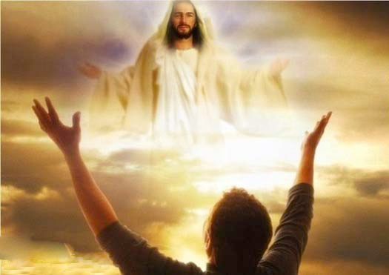
Hallelujah

