Slide 1
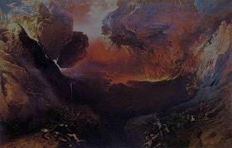
“But the day of the Lord will come like a thief, and then the heavens will pass away with a roar, and the heavenly bodies will be burned up and dissolved, and the earth and the works that are done on it will be exposed.”
“For the Lord himself will descend from heaven with a cry of command, with the voice of an archangel, and with the sound of the trumpet of God.”
“For we must all appear before the judgment seat of Christ, so that each one may receive what is due for what he has done in the body, whether good or evil.”

Slide 2
“The great mass of men will die and go to hell – trying to figure out what the preacher was talking about!”

Slide 3
ARE YOU PREPARED TODAY TO MEET YOUR GOD?
“It All Comes
Down To This”

Slide 4
PREPARE TO MEET THY GOD
“Careless soul, O heed the warning, For your life will soon be gone; Oh, how sad to face the judgment, Unprepared to meet thy God.”

Slide 5
Philippians 2:5-8 (ESV)
⁵ Have this mind among yourselves, which is yours in Christ Jesus,
⁶ who, though he was in the form of God, did not count equality with God a thing to be grasped,
⁷ but emptied himself, by taking the form of a servant, being born in the likeness of men.
⁸ And being found in human form, he humbled himself by becoming obedient to the point of death, even death on a cross.

Slide 6
Philippians 2:9 (ESV)
“Therefore God has highly exalted him and bestowed on him the name that is above every name . . .”

Slide 7
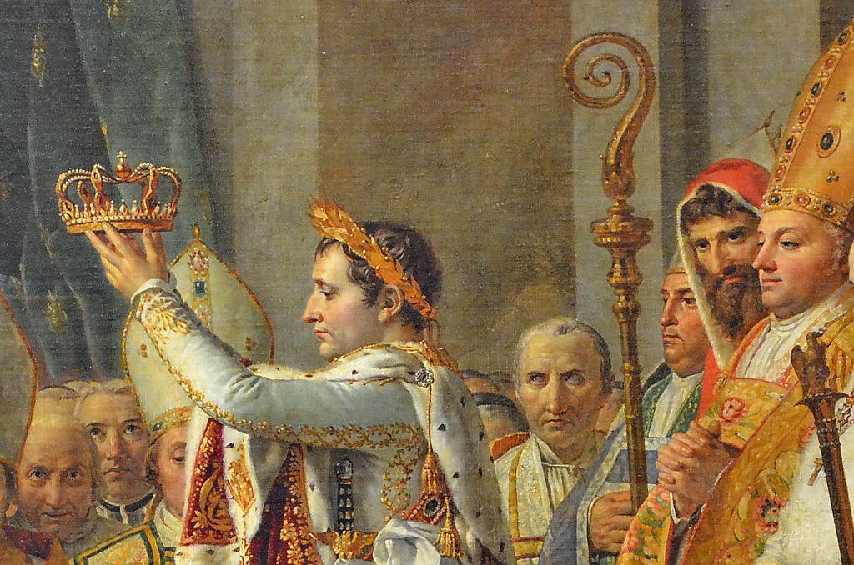
“I, Napoleon,
crown myself Emperor
of France!”

Slide 9
Abraham
Moses
Michelangelo
Caesar
Churchill
Washington
Jefferson
Lincoln
Einstein

Slide 10
“LORD, REDEEMER, SAVIOUR, LAMB OF GOD, MEDIATOR, PRINCE OF PEACE”

Slide 11
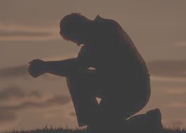
“We must be willing
to humble ourselves”

Slide 12
¹⁰ so that at the name of Jesus every knee should bow, in heaven and on earth and under the earth,
¹¹ and every tongue confess that Jesus Christ is Lord, to the glory of God the Father.
Hebrews 2:10-11

Slide 14
“Yes – the Lord is Jesus!
Jesus is the Christ!”

Slide 15
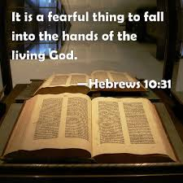

Slide 16
⁸ “And I tell you, everyone who acknowledges me before men, the Son of Man also will acknowledge before the angels of God,
⁹ but the one who denies me before men will be denied before the angels of God.”
Luke 12:8-9

Slide 20
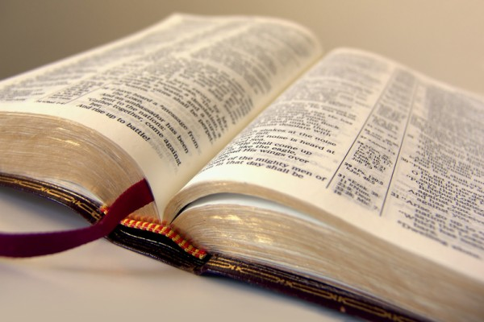

Slide 21
“IT ALL COMES
DOWN TO THIS”

