Slide 3
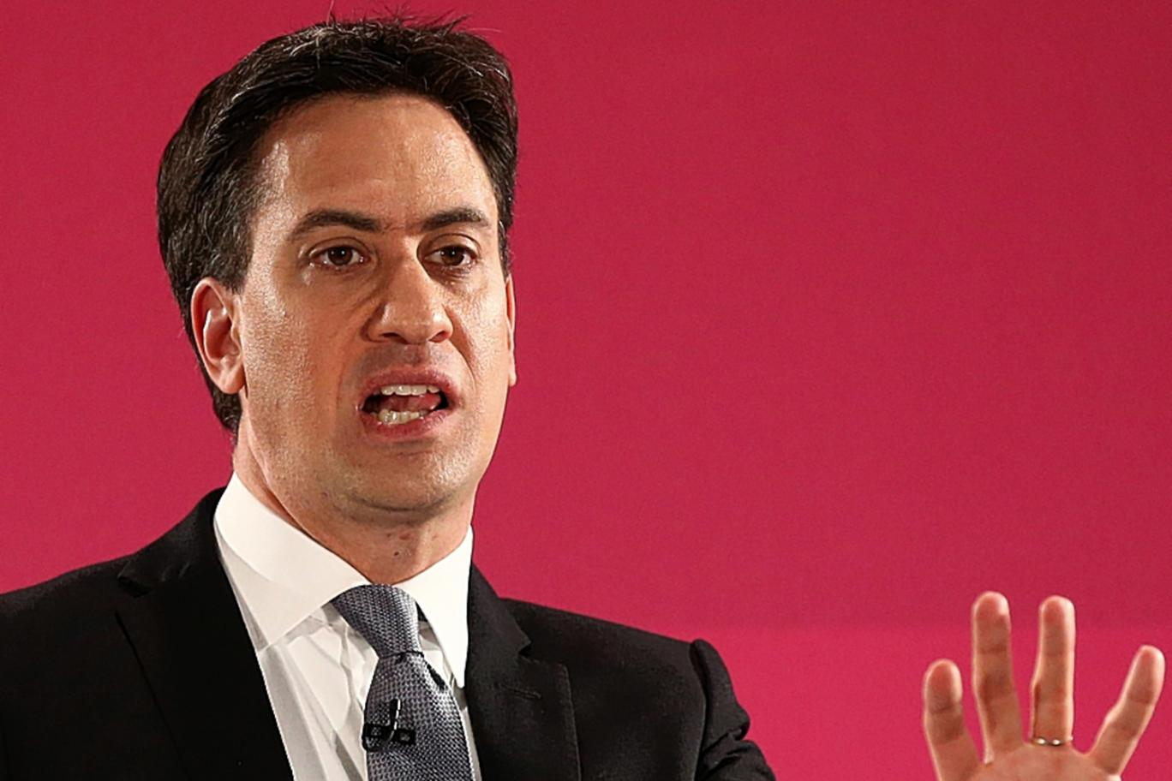

Slide 4
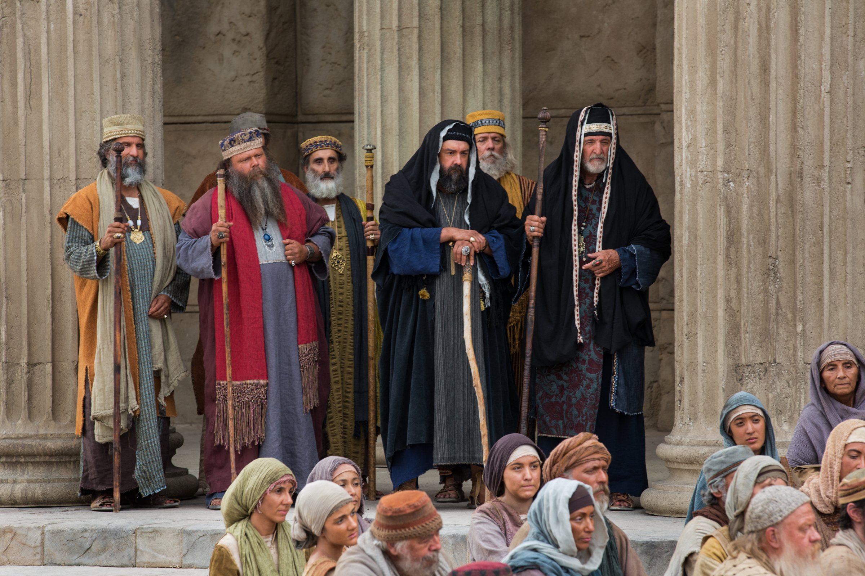

Slide 5
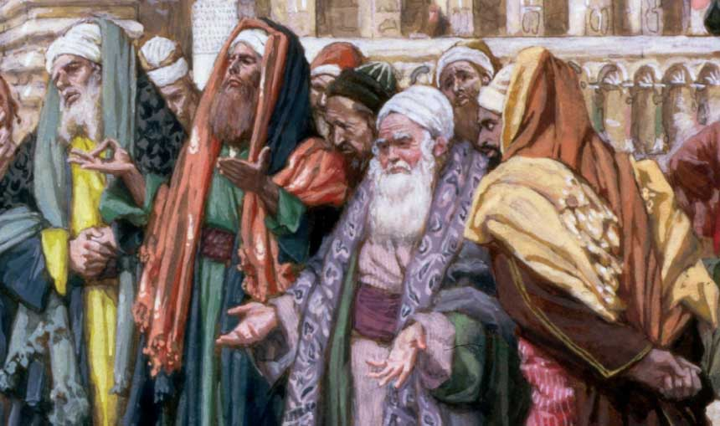

Slide 6
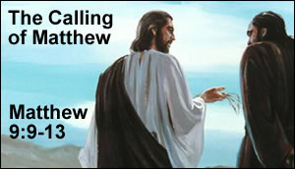

Slide 7
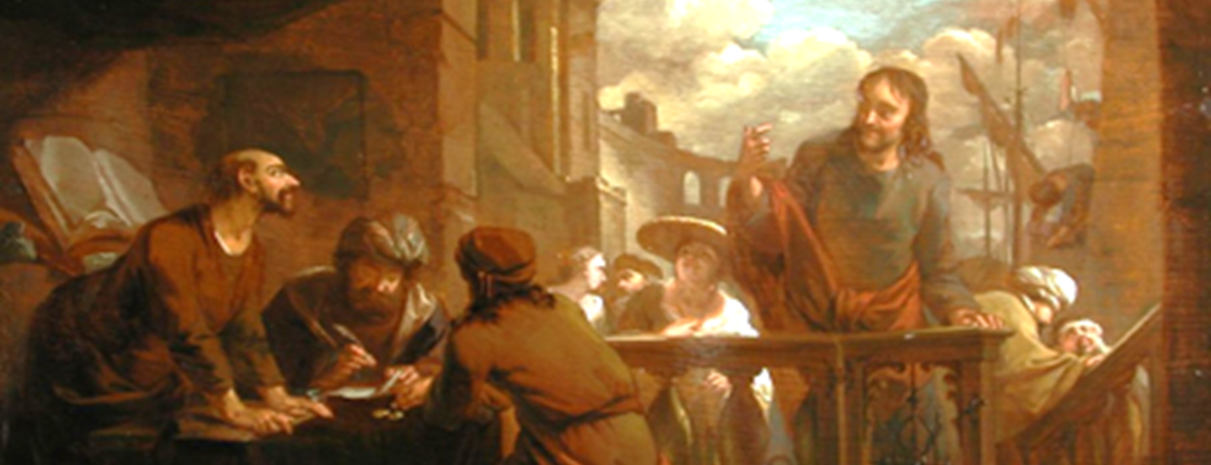
⁹ As Jesus passed on from there, he saw a man called Matthew sitting at the tax booth, and he said to him, “Follow me.” And he rose and followed him.

Slide 8
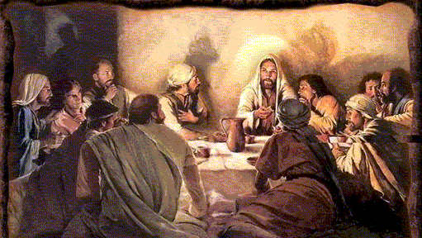
¹⁰ And as Jesus reclined at table in the house, behold, many tax collectors and sinners came and were reclining with Jesus and his disciples.

Slide 9
¹¹ And when the Pharisees saw this, they said to his disciples, “Why does your teacher eat with tax collectors and sinners?”

Slide 10
¹² But when he heard it, he said, “Those who are well have no need of a physician, but those who are sick.

Slide 11
¹³ Go and learn what this means, ‘I desire mercy, and not sacrifice.’ For I came not to call the righteous, but sinners.”

Slide 12
“The Person
Jesus Calls”
Matthew 9:9-13
Mark Mason Oct. 25, 2015

Slide 13
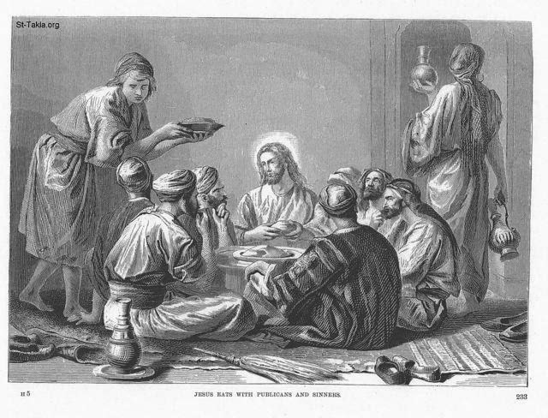

Slide 17
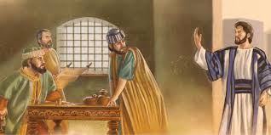
“This is the person Jesus calls”

Slide 19
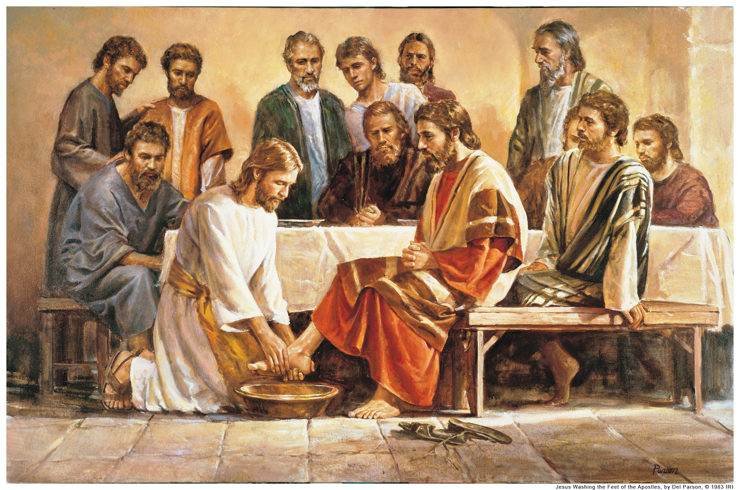

Slide 20
And he called to him his twelve disciples and gave them authority over unclean spirits, to cast them out, and to heal every disease and every affliction.
The names of the twelve apostles are these: first, Simon, who is called Peter, and Andrew his brother; James the son of Zebedee, and John his brother; Philip and Bartholomew; Thomas and Matthew the tax collector; James the son of Alphaeus, and Thaddaeus; 4 Simon the Zealot, and Judas Iscariot, who betrayed him.

Slide 22
¹¹ And when the Pharisees saw this, they said to his disciples, “Why does your teacher eat with tax collectors and sinners?”

Slide 24
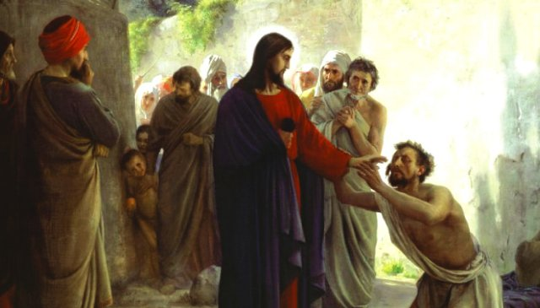
Jesus, the Great Physician

Slide 25
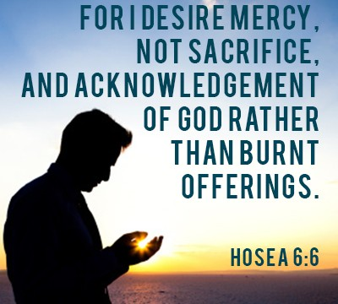

Slide 26
¹³ Go and learn what this means, ‘I desire mercy, and not sacrifice.’ For I came not to call the righteous, but sinners.”

Slide 27
¹³ Go and learn what this means, ‘I desire mercy, and not sacrifice.’ For I came not to call the righteous, but sinners.”

Slide 29
“FOR I CAME NOT TO CALL THE RIGHTEOUS, BUT SINNERS”
Matthew 9:13

Slide 32
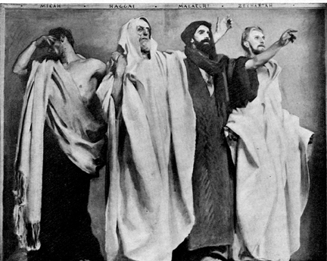
The Essenes

Slide 33
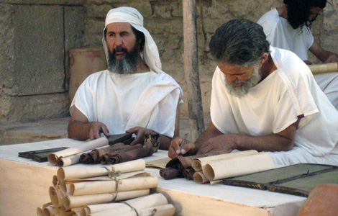

Slide 34
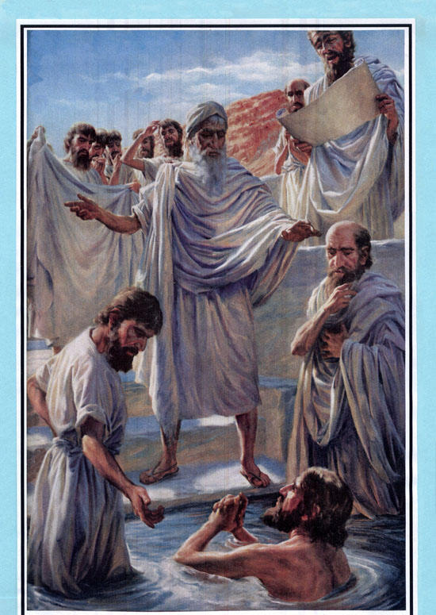
The Essenes
“Get right first, then you are welcome in the club.”

Slide 35
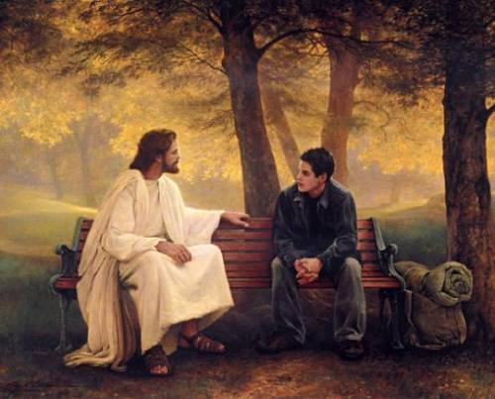

Slide 36
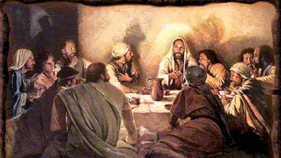

Slide 37
¹³ Go and learn what this means, ‘I desire mercy, and not sacrifice.’ For I came not to call the righteous, but sinners.”

