Slide 3
“I Thank My God For You”
(Philippians 1:3-11)
Mark Mason
November 22, 2015

Slide 5
The Apostle Paul to Timothy:
Convince – Rebuke - Encourage
- 2 Timothy 4:2

Slide 6
The Apostle Paul to Timothy:
Convince – Rebuke - Encourage
- 2 Timothy 4:2

Slide 9
Philippians 1:3-11
³ I thank my God in all my remembrance of you,
⁴ always in every prayer of mine for you all making my prayer with joy,
⁵ because of your partnership in the gospel from the first day until now.
⁶ And I am sure of this, that he who began a good work in you will bring it to completion at the day of Jesus Christ.
⁷ It is right for me to feel this way about you all, because I hold you in my heart, for you are all partakers with me of grace, both in my imprisonment and in the defense and confirmation of the gospel.

Slide 10
Philippians 1:3-11
⁸ For God is my witness, how I yearn for you all with the affection of Christ Jesus.
⁹ And it is my prayer that your love may abound more and more, with knowledge and all discernment,
¹⁰ so that you may approve what is excellent, and so be pure and blameless for the day of Christ,
¹¹ filled with the fruit of righteousness that comes through Jesus Christ, to the glory and praise of God.

Slide 11
#1 – because of our PARTNERSHIP IN THE GOSPEL
koinonia

Slide 12
#1 – because of our PARTNERSHIP IN THE GOSPEL
Philippians 4:15-16
¹⁵ And you Philippians yourselves know that in the beginning of the gospel, when I left Macedonia, no church entered into partnership with me in giving and receiving, except you only.
¹⁶ Even in Thessalonica you sent me help for my needs once and again.

Slide 13
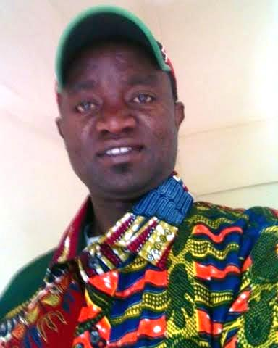
#1 – because of our PARTNERSHIP IN THE GOSPEL
Geoffrey Njoroge

Slide 14
#2 – because of your GOOD WORKS
⁶ And I am sure of this, that he who began a good work in you will bring it to completion at the day of Jesus Christ.

Slide 15
#2 – because of your GOOD WORKS

Slide 16
#3 – because of our GENUINE LOVE FOR EACH OTHER
⁷ It is right for me to feel this way about you all, because I hold you in my heart, for you are all partakers with me of grace, both in my imprisonment and in the defense and confirmation of the gospel.

Slide 17
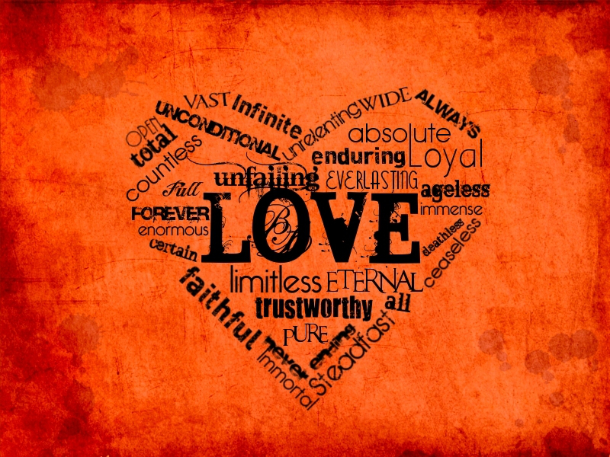
#3 – because of our GENUINE LOVE FOR EACH OTHER

Slide 18
Today I am thankful for:
YOUR PARTNERSHIP
YOUR GOOD WORKS
YOUR LOVE

Slide 19
1) I pray THAT THIS LOVE WILL GROW;
2) I pray THAT YOUR KNOWLEDGE WILL INCREASE;
3) I pray THAT YOUR DISCERNMENT WILL INCREASE;
4) I pray THAT ON THE DAY OF JUDGMENT YOU EACH WILL APPEAR PURE AND BLAMELESS BEFORE GOD!

Slide 20
