Slide 4
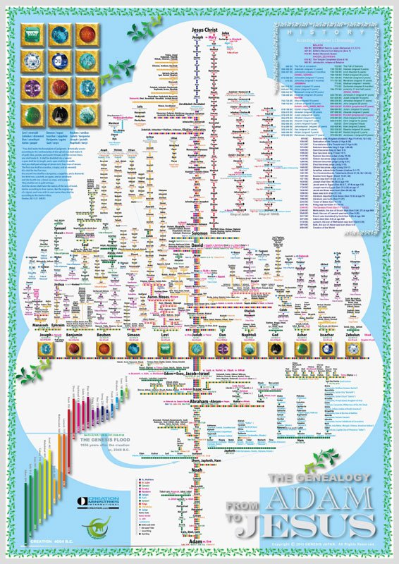

Slide 5
Abraham
Adam
Noah
Jorim
Jonam
Neri

Slide 6
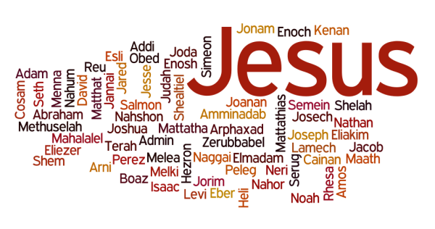

Slide 7
“ Jesus, when he began his ministry, was about thirty years of age, . . . .”

Slide 8
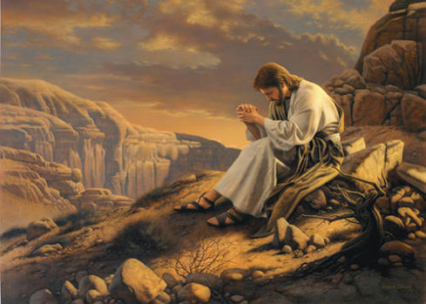

Slide 9
Luke 3:23
“Jesus, when he began his ministry, was about thirty years of age, being the son (as was supposed) of Joseph, the son of Heli . . .”

Slide 10
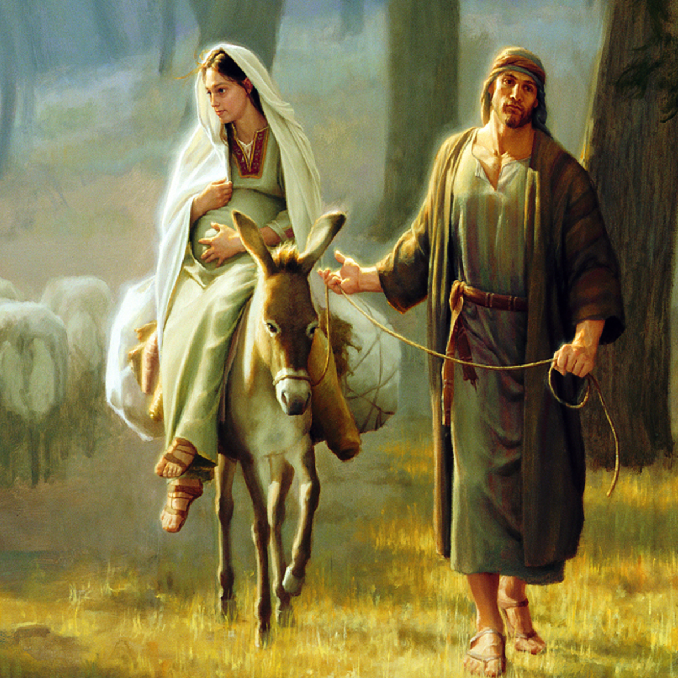

Slide 11
²¹ Now when all the people were baptized, and when Jesus also had been baptized and was praying, the heavens were opened, ²² and the Holy Spirit descended on him in bodily form, like a dove; and a voice came from heaven, “You are my beloved Son; with you I am well pleased.”

Slide 12
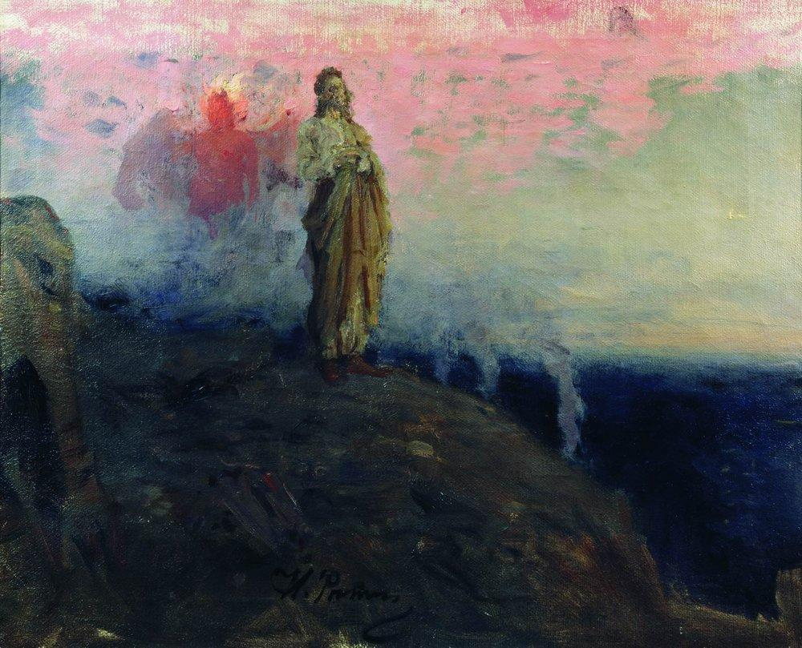
“IF you are the Son of God . . .”

Slide 14
23 Jesus, when he began his ministry, was about thirty years of age, being the son (as was supposed) of Joseph, the son of Heli, 24 the son of Matthat, the son of Levi, the son of Melchi, the son of Jannai, the son of Joseph, 25 the son of Mattathias, the son of Amos, the son of Nahum, the son of Esli, the son of Naggai, 26 the son of Maath, the son of Mattathias, the son of Semein, the son of Josech, the son of Joda, 27 the son of Joanan, the son of Rhesa, the son of Zerubbabel, the son of Shealtiel, the son of Neri, 28 the son of Melchi, the son of Addi, the son of Cosam, the son of Elmadam, the son of Er, 29 the son of Joshua, the son of Eliezer, the son of Jorim, the son of Matthat, the son of Levi, 30 the son of Simeon, the son of Judah, the son of Joseph, the son of Jonam, the son of Eliakim, 31 the son of Melea, the son of Menna, the son of Mattatha, the son of Nathan, the son of David, 32 the son of Jesse, the son of Obed, the son of Boaz, the son of Sala, the son of Nahshon, 33 the son of Amminadab, the son of Admin, the son of Arni, the son of Hezron, the son of Perez, the son of Judah, 34 the son of Jacob, the son of Isaac, the son of Abraham, the son of Terah, the son of Nahor, 35 the son of Serug, the son of Reu, the son of Peleg, the son of Eber, the son of Shelah, 36 the son of Cainan, the son of Arphaxad, the son of Shem, the son of Noah, the son of Lamech, 37 the son of Methuselah, the son of Enoch, the son of Jared, the son of Mahalaleel, the son of Cainan, 38 the son of Enos, the son of Seth, the son of Adam, the son of God..

Slide 15
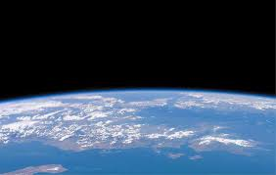
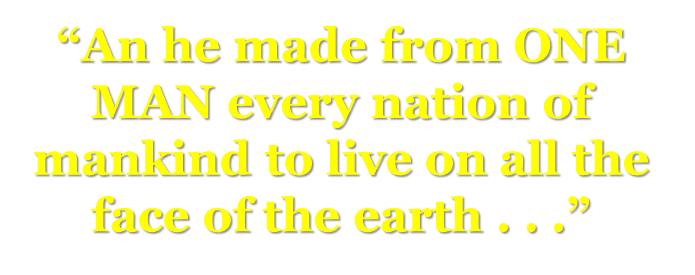

Slide 16
Jesus is a son of Adam

Slide 17
Jesus is the Son of God!

Slide 18
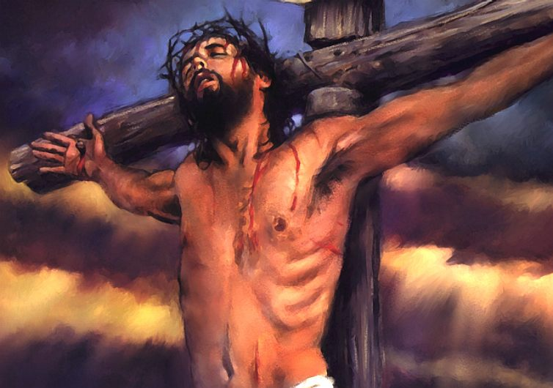

Slide 19
SON OF GOD
SON OF ADAM

