Slide 4
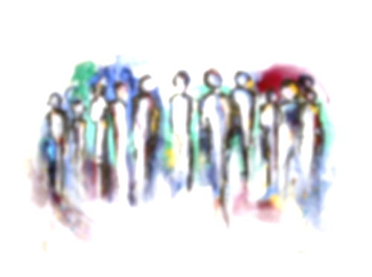
“HE WOULD NEVER JUDGE ME”
“HE MUST APPROVE OF WHAT I AM DOING”
“HE WILL SAVE EVERYONE”

Slide 6
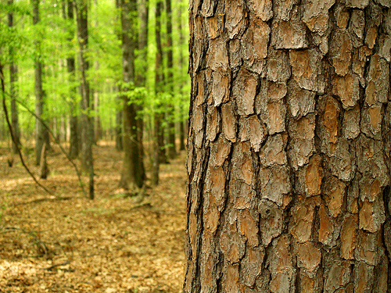

Slide 8
“Love God with all your
heart, soul, mind,
and strength”

Slide 9
1 John 5: 1-3

Slide 10
“Everyone who believes that Jesus is the Christ has been born of God, and everyone who loves the Father loves whoever has been born of him.
By this we know that we love the children of God, when we love God and obey his commandments.
For this is the love of God, that we keep his commandments. And his commandments are not burdensome.”

Slide 11
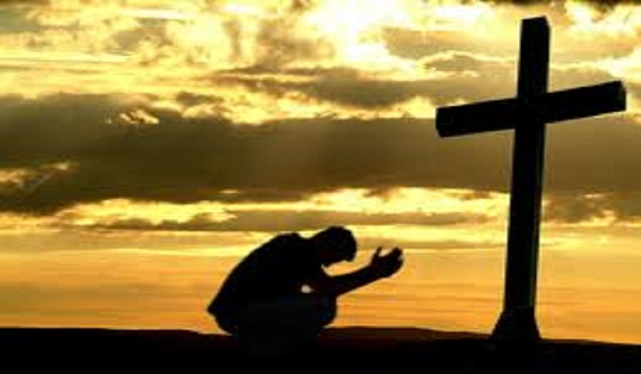
“an attitude of submission and obedience”

Slide 14
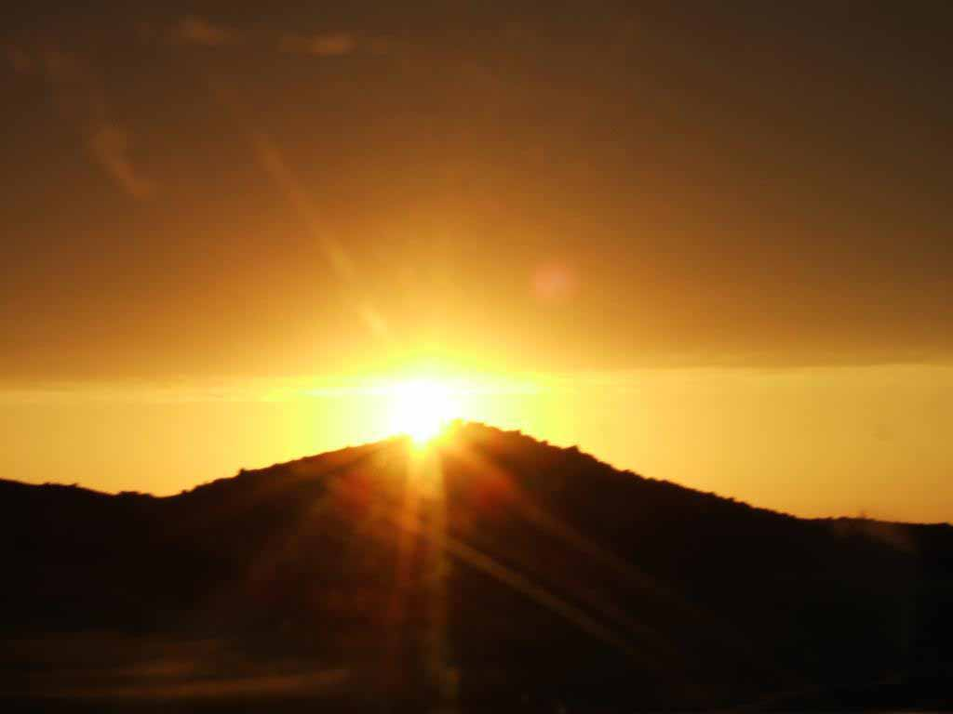
“Whoever has my commandments and keeps them, he it is who loves me.”
John 14:21

Slide 15
”Jesus answered him, “If anyone loves me, he will keep my word, and my Father will love him, and we will come to him and make our home with him. Whoever does not love me does not keep my words . . .” John 14:23-24

Slide 16
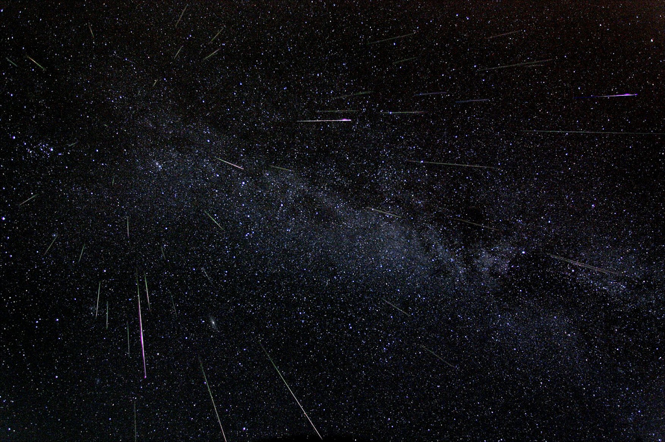
” . . . but I do as the Father has commanded me, so that the world may know that I love the Father. “
John 14:31

Slide 17
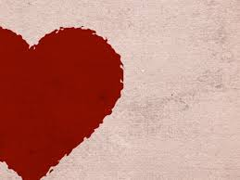
“If you keep my commandments, you will abide in my love, just as I have kept my Father's commandments and abide in his love.”
John 15:10

Slide 18
“Everyone who believes that Jesus is the Christ has been born of God, and everyone who loves the Father loves whoever has been born of him.
By this we know that we love the children of God, when we love God and obey his commandments.
For this is the love of God, that we keep his commandments. And his commandments are not burdensome.”
1 John 5 :1-3

Slide 19
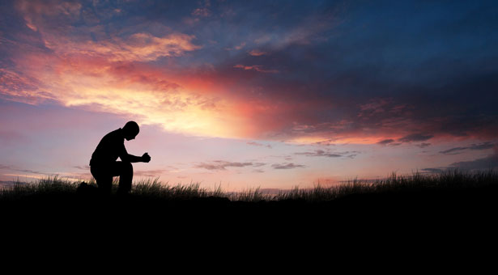
“FOR THIS IS THE LOVE OF GOD . . .”
. . . THAT WE KEEP HIS COMMANDMENTS.”

Slide 21
“Everyone who believes that Jesus is the Christ has been born of God, and everyone who loves the Father loves whoever has been born of him.
By this we know that we love the children of God, when we love God and obey his commandments.
For this is the love of God, that we keep his commandments. And his commandments are not burdensome.”
1 John 5 :1-3

Slide 24
DO YOU
OBEY GOD?

