Slide 6
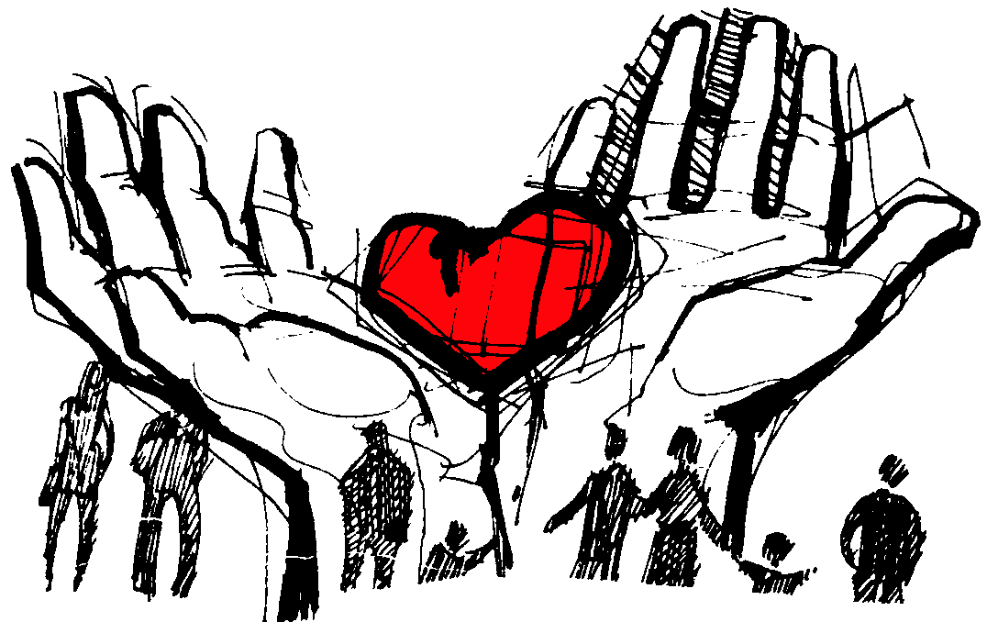

Slide 7
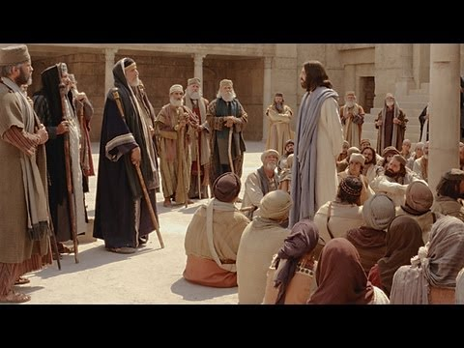
Mark 12

Slide 8
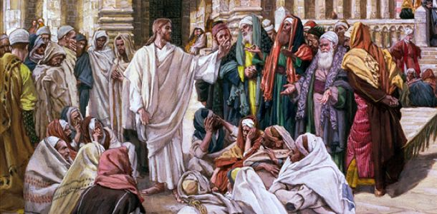
“And one of the scribes came up and heard them disputing with one another . . .”

Slide 9
“WHICH COMMANDMENT IS THE MOST IMPORTANT OF ALL?”

Slide 10
“Jesus answered, The most important is, ‘Hear, O Israel: The Lord our God, the Lord is one’
and you shall love the Lord your God with all your heart and with all your soul and with all your mind and with all your strength.”

Slide 11
“You are right Teacher! You have truly said that he is one, and there is no other besides him.”

Slide 12
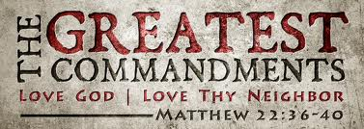

Slide 13
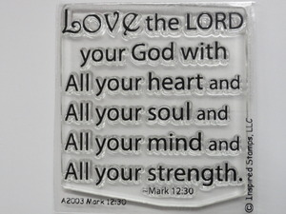

Slide 15
“You are not far from the Kingdom of God.”
“To love God and to love one’s neighbor is much more than all whole burnt offerings and sacrifices.”

Slide 16
“How can the scribes say that the Christ is the son of David?”

Slide 17
