Slide 5
“FOR THIS IS THE LOVE OF GOD . . .”
. . . THAT WE KEEP HIS COMMANDMENTS.”

Slide 7
1 John 2:15-17
¹⁵Do not love the world or the things in the world. If anyone loves the world, the love of the Father is not in him.
¹⁶For all that is in the world—the desires of the flesh and the desires of the eyes and pride of life—is not from the Father but is from the world.
¹⁷And the world is passing away along with its desires, but whoever does the will of God abides forever.

Slide 8
“KOSMOS”
1 John 2:15-17
¹⁵Do not love the world or the things in the world. If anyone loves the world, the love of the Father is not in him.
¹⁶For all that is in the world—the desires of the flesh and the desires of the eyes and pride of life—is not from the Father but is from the world.
¹⁷And the world is passing away along with its desires, but whoever does the will of God abides forever.

Slide 9
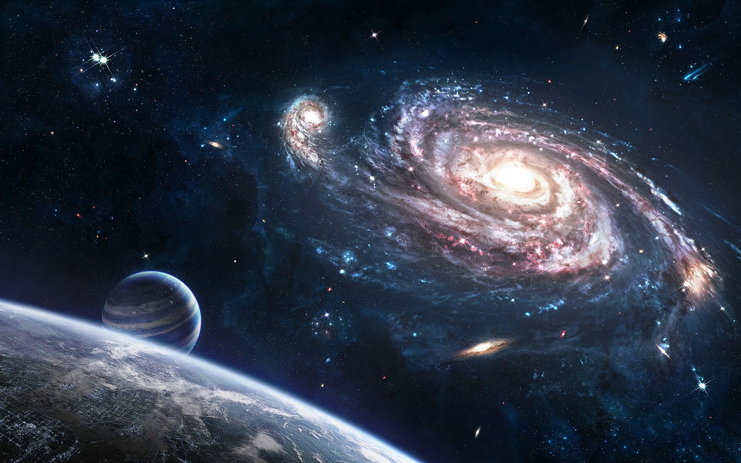
“KOSMOS”

Slide 11
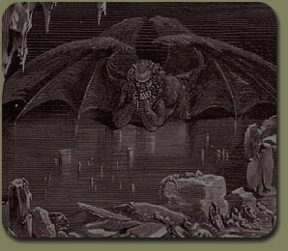
“We know that we are from God, and the whole world (KOSMOS) lies in the power of the evil one.”

Slide 12
“WORLDLINESS”

Slide 13
”You adulterous people! Do you not know that friendship with the world is enmity with God? Therefore whoever wishes to be a friend of the world makes himself an enemy of God.”
James 4:4

Slide 14
”You adulterous people! Do you not know that friendship with the world is enmity with God? Therefore whoever wishes to be a friend of the world makes himself an enemy of God.”
James 4:4

Slide 15
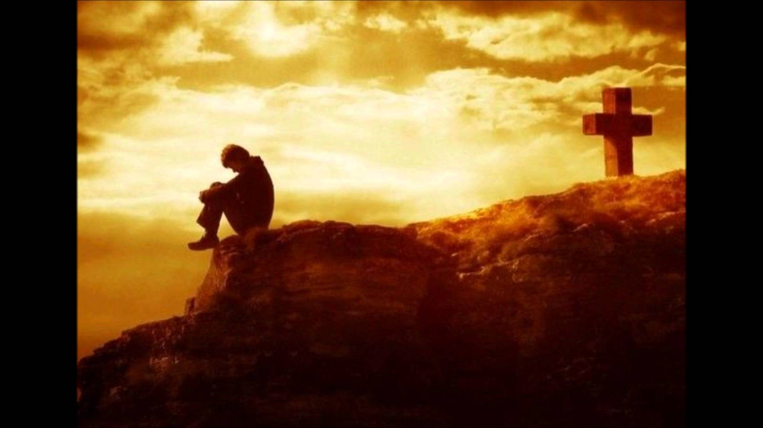
“worldly Christian”

Slide 16
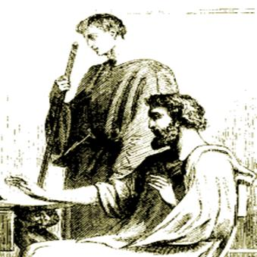
DEMAS

Slide 17
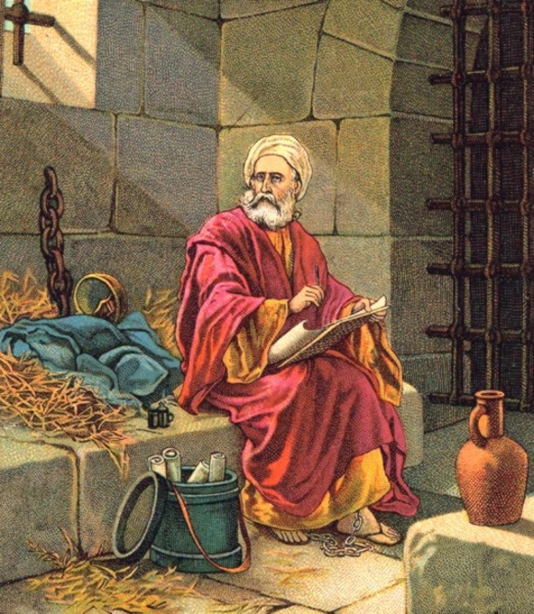
“Demas, in love with this present world, has deserted me . . .”

Slide 18
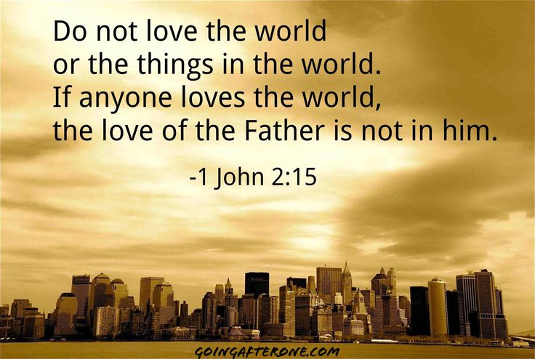

Slide 19
1 John 2:15-17
¹⁵Do not love the world or the things in the world. If anyone loves the world, the love of the Father is not in him.
¹⁶For all that is in the world—the desires of the flesh and the desires of the eyes and pride of life—is not from the Father but is from the world.
¹⁷And the world is passing away along with its desires, but whoever does the will of God abides forever.

Slide 22
1 John 2:15-17
¹⁵Do not love the world or the things in the world. If anyone loves the world, the love of the Father is not in him.
¹⁶For all that is in the world—the desires of the flesh and the desires of the eyes and pride of life—is not from the Father but is from the world.
¹⁷And the world is passing away along with its desires, but whoever does the will of God abides forever.

Slide 24
“God Is Eternal”

Slide 25
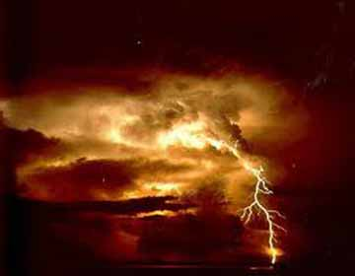
What sort of people
ought we to be…
...waiting for the
day of God to come?

