Slide 1
Our God Is Sovereign!

Slide 2
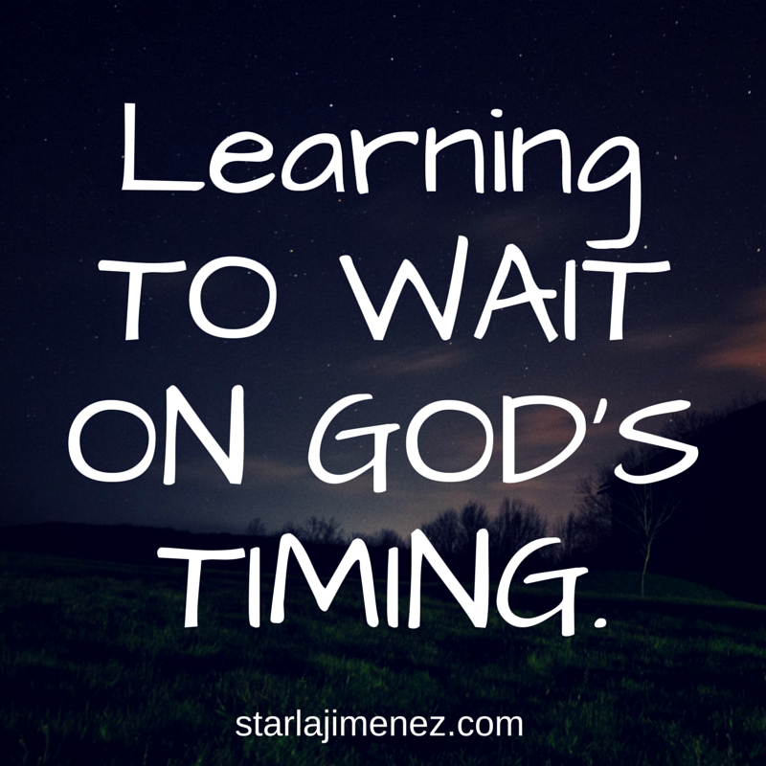

Slide 3
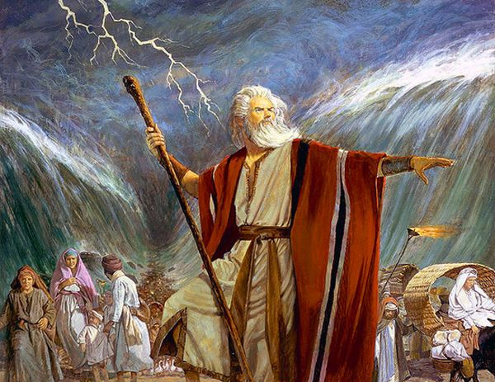

Slide 4
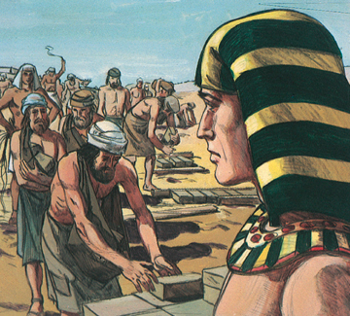

Slide 5
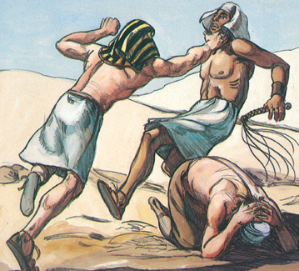
“One day, when Moses had grown up, he went out to his people and looked on their burdens, and he saw an Egyptian beating a Hebrew, one of his people.

Slide 6
He looked this way and that, and seeing no one, he struck down the Egyptian and hid him in the sand.
When he went out the next day, behold, two Hebrews were struggling together.
And he said to the man in the wrong, “Why do you strike your companion?”
He answered, “Who made you a prince and a judge over us?
Do you mean to kill me as you killed the Egyptian?”

Slide 7
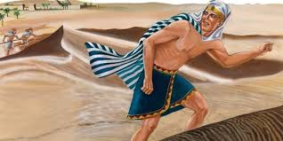
Then Moses was afraid, and thought, “Surely the thing is known.”
When Pharaoh heard of it, he sought to kill Moses.
But Moses fled from Pharaoh and stayed in the land of Midian.
And he sat down by a well.”

Slide 8
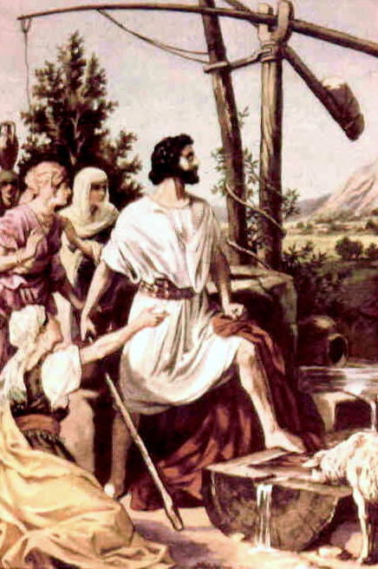
Moses has
compassion
on his people
(but he moved without God)

Slide 10
“It was stepping out without God – rather than stepping out in faith”

Slide 12
He looked this way and that, and seeing no one, he struck down the Egyptian and hid him in the sand.
When he went out the next day, behold, two Hebrews were struggling together.
And he said to the man in the wrong, “Why do you strike your companion?”
He answered, “Who made you a prince and a judge over us?
Do you mean to kill me as you killed the Egyptian?”

Slide 13
Exodus 2:11-14 (ESV)
“One day, when Moses had grown up, he went out to his people and looked on their burdens, and he saw an Egyptian beating a Hebrew, one of his people. He looked this way and that, and seeing no one, he struck down the Egyptian and hid him in the sand. When he went out the next day, behold, two Hebrews were struggling together. And he said to the man in the wrong, “Why do you strike your companion?” He answered, “Who made you a prince and a judge over us? Do you mean to kill me as you killed the Egyptian?” Then Moses was afraid, and thought, “Surely the thing is known.”

Slide 14
Exodus 2:11-14 (ESV)
“One day, when Moses had grown up, he went out to his people and looked on their burdens, and he saw an Egyptian beating a Hebrew, one of his people. He looked this way and that, and seeing no one, he struck down the Egyptian and hid him in the sand. When he went out the next day, behold, two Hebrews were struggling together. And he said to the man in the wrong, “Why do you strike your companion?” He answered, “Who made you a prince and a judge over us? Do you mean to kill me as you killed the Egyptian?” Then Moses was afraid, and thought, “Surely the thing is known.”

Slide 16
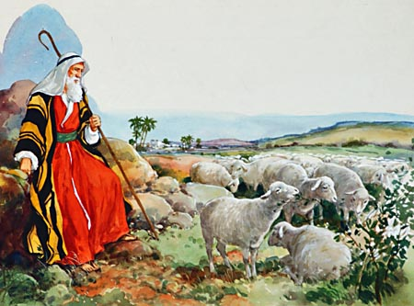
“. . . for every shepherd is an abomination to the Egyptians.”

Slide 17
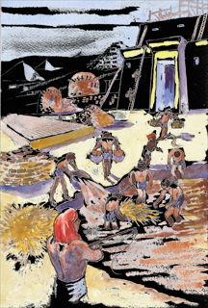
²³ During those many days the king of Egypt died, and the people of Israel groaned because of their slavery and cried out for help. Their cry for rescue from slavery came up to God.
²⁴ And God heard their groaning, and God remembered his covenant with Abraham, with Isaac, and with Jacob.
²⁵ God saw the people of Israel—and God knew.

Slide 18
²³ During those many days the king of Egypt died, and the people of Israel groaned because of their slavery and cried out for help. Their cry for rescue from slavery came up to God.
²⁴ And God heard their groaning, and God remembered his covenant with Abraham, with Isaac, and with Jacob.
²⁵ God saw the people of Israel—and God knew.

Slide 19
