Slide 1
“TWO BY TWO”
(Luke 10:1-12)
36th Street Church of Christ
March 13, 2016
Mark E. Mason

Slide 2
“Two By Two”
Luke 10:25-37 – the Good Samaritan
“Are You Busier Than Jesus?”
Build in some MARGINS – time that God can use to help us love people better.

Slide 3
“Two By Two”
Luke 10:1-12
The Lord sends out a big group of disciples – 72 of them!
He sends them out 2 by 2.
(Jesus is always sending people out)
They say: “I will follow you wherever you go!”

Slide 4
“Two By Two”
“I will follow Jesus to Heaven”

Slide 5
“Two By Two”
Luke 10:1-12
¹After this the Lord appointed seventy-two others and sent them on ahead of him, two by two, into every town and place where he himself was about to go.
² And he said to them, “The harvest is plentiful, but the laborers are few. Therefore pray earnestly to the Lord of the harvest to send out laborers into his harvest.
³ Go your way; behold, I am sending you out as lambs in the midst of wolves.
⁴ Carry no moneybag, no knapsack, no sandals, and greet no one on the road.

Slide 6
“Two By Two”
Luke 10:1-12
⁵ Whatever house you enter, first say, ‘Peace be to this house!’
⁶ And if a son of peace is there, your peace will rest upon him. But if not, it will return to you.
⁷ And remain in the same house, eating and drinking what they provide, for the laborer deserves his wages. Do not go from house to house.
⁸ Whenever you enter a town and they receive you, eat what is set before you.

Slide 7
“Two By Two”
Luke 10:1-12
⁹ Heal the sick in it and say to them, ‘The kingdom of God has come near to you.’
¹⁰ But whenever you enter a town and they do not receive you, go into its streets and say,
¹¹ ‘Even the dust of your town that clings to our feet we wipe off against you. Nevertheless know this, that the kingdom of God has come near.’
¹² I tell you, it will be more bearable on that day for Sodom than for that town.

Slide 8
“Two By Two”
That passage seems like a foreign world to us
American Restoration Movement
Scott – Stone – Campbell
Primary mode of outreach = public meetings or gatherings
People were called on to respond to the “Good News” – Jesus and the Cross!

Slide 9
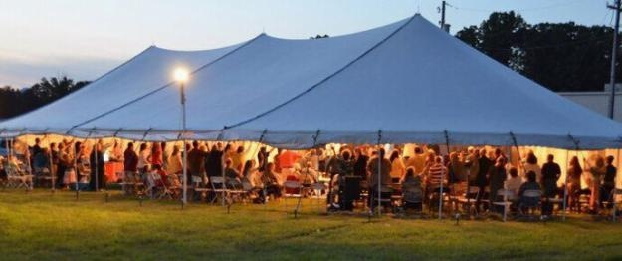
“Two By Two”
No criticism of that heritage
“There’s going to be preaching here”

Slide 10
“Two By Two”
Everybody at that time believed in God.
Everyone had at least a passing interest in the Bible.
If you announced the Bible was going to be preached – people would come!

Slide 11
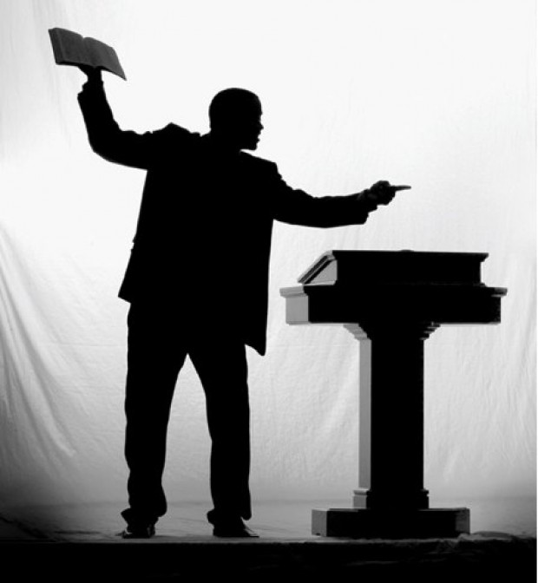
“Two By Two”
That has NOT been the case in America for decades!

Slide 12
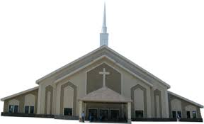
“Two By Two”
They will drive right past the building on Sunday morning!

Slide 13
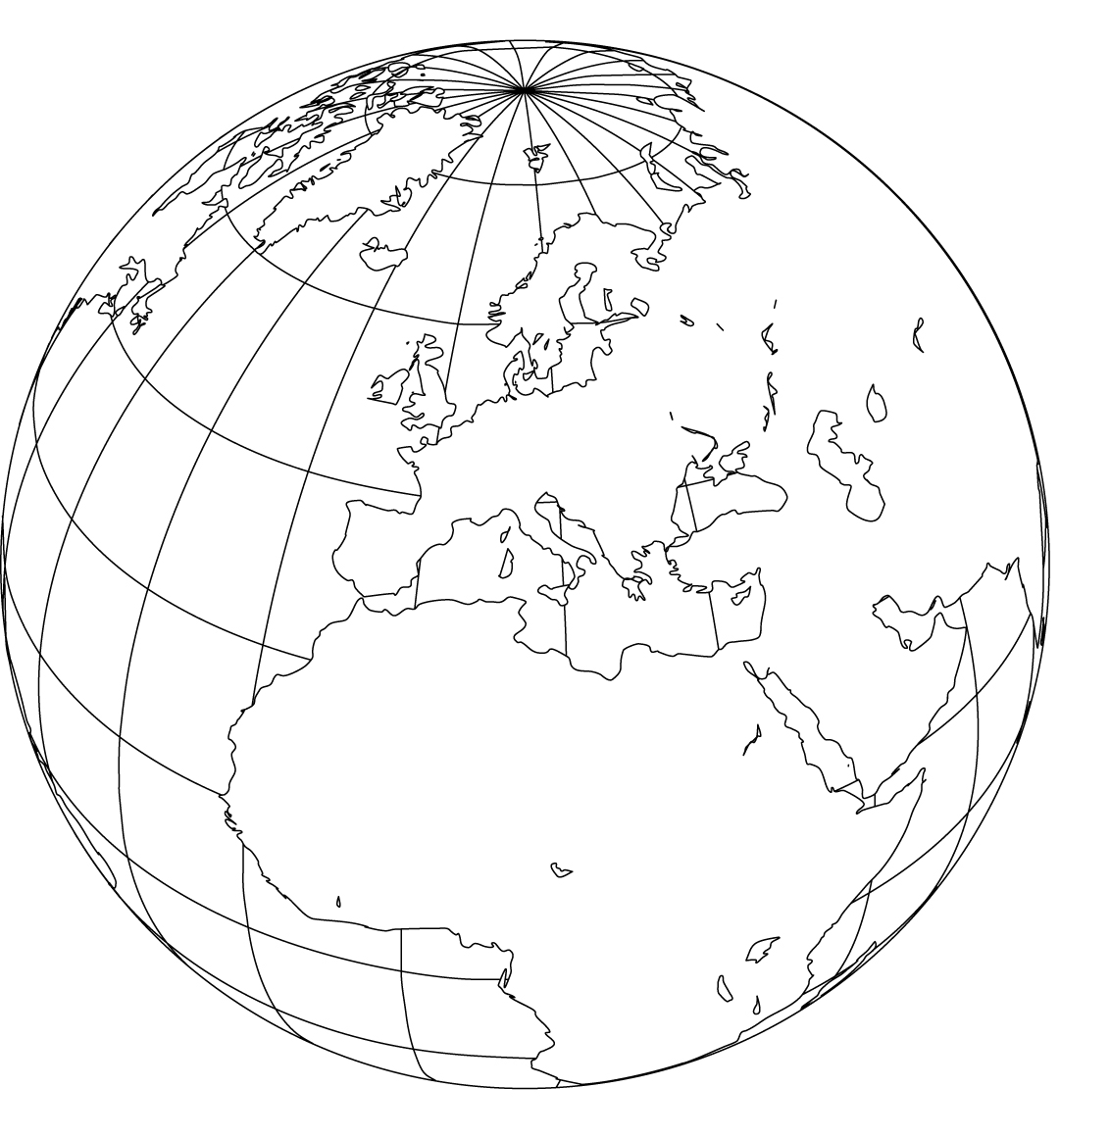
“Two By Two”
We could go places in the world where revival still works:
Central America - Africa – India
It just doesn’t work here (for the most part)!
American Christians still have a revivalist hangover that has lasted almost half a century.

Slide 14
“Two By Two”
All will be right again!
That is a dream! Fantasy land!

Slide 15
“Two By Two”
We need to live in reality!
The message of Jesus has not lost its power.
The need has not changed – but the method certainly has.
Back to the begin- ning -
returning to the Bible -
seeking old paths.

Slide 16
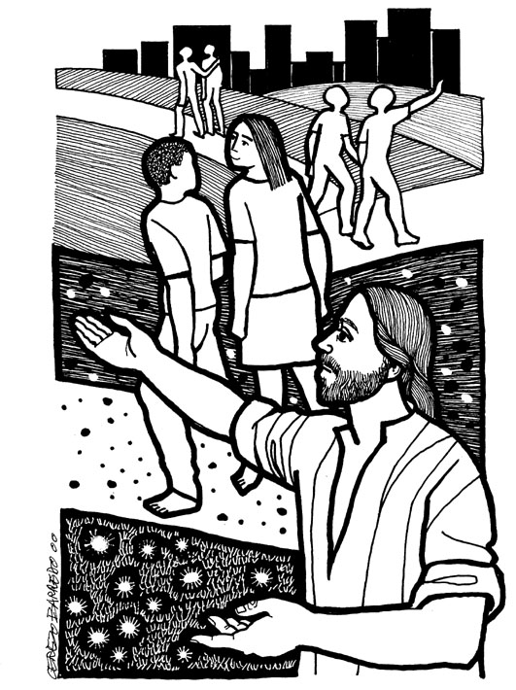
“Two By Two”
What did Jesus do?
He called 72 disciples together.
He told them to GO!
Luke 10:1
Go and prepare the way for Jesus to come!

Slide 17
“Two By Two”
“Evangelism is building a bridge from your heart to mine and letting Jesus walk across.”

Slide 18
“Two By Two”
That is truly loving your neighbor!
Jesus has sent you to your neighborhood to prepare the way for Him to visit it.
“Lord, I will follow you
wherever you go!”
Jesus has sent me
and you to our neighbors.

Slide 19
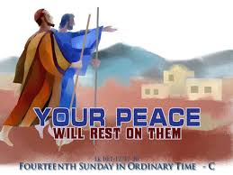
“Two By Two”
“Pray a blessing for the people they are sent to.”
Pray for peace – SHALOM
How to start loving your
neighbor – pray the peace
of God for them.
That is part of preparing the way for Jesus.

Slide 20
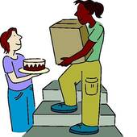
“Two By Two”
Jesus encourages fellowship – eating and drinking with these people as you go.
Have you shared food with a neighbor?
We tend to stay within our walls and behind our doors.
“Jesus is the same yesterday, today, and forever” (Hebrews 13:8)

Slide 21
“Two By Two”
Jesus tells them to heal the sick.
Can’t do that!
Help people with their needs.
It might be any number of things we can do to meet a need.
Offer healing to a hurting soul - and prepare the way for Jesus to come.

Slide 22
“Two By Two”
Take a message to people – we have a Kingdom gospel to proclaim.
Jesus did not start the church to be a social services agency.
We have a message to take – a gospel to preach.
. . . say to them, “The Kingdom of God has come near to you.”
“We’re from the Church of Christ” or “I do this in the name of Jesus”

Slide 23
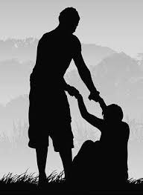
“Two By Two”
Prayer – fellowship – healing/meeting needs.
Delivering the message of Jesus.
Steps Jesus taught in preparing the way for Him to meet your neighbor.
It’s time we got back to the first century way of doing things!

