Slide 1
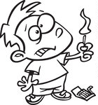
Good Morning

Slide 2
In the reaction chain, one thing leads to another . . .

Slide 5
“Salvation
Chain
Reaction”

Slide 6
1 Peter 1: 3-9
³ Blessed be the God and Father of our Lord Jesus Christ! According to his great mercy, he has caused us to be born again to a living hope through the resurrection of Jesus Christ from the dead,
⁴ to an inheritance that is imperishable, undefiled, and unfading, kept in heaven for you,
⁵ who by God's power are being guarded through faith for a salvation ready to be revealed in the last time.

Slide 7
1 Peter 1: 3-9
⁶ In this you rejoice, though now for a little while, if necessary, you have been grieved by various trials,
⁷ so that the tested genuineness of your faith—more precious than gold that perishes though it is tested by fire—may be found to result in praise and glory and honor at the revelation of Jesus Christ.

Slide 8
1 Peter 1: 3-9
⁸ Though you have not seen him, you love him. Though you do not now see him, you believe in him and rejoice with joy that is inexpressible and filled with glory,
⁹ obtaining the outcome of your faith, the salvation of your souls.

Slide 9
⁹ obtaining the outcome of your faith, the salvation of your souls.
⁵ who by God's power are being guarded through faith for a salvation ready to be revealed in the last time.
³ Blessed be the God and Father of our Lord Jesus Christ! According to his great mercy, he has caused us to be born again to a living hope through the resurrection of Jesus Christ from the dead,

Slide 10
“Chain
Reaction of
Salvation”

Slide 11
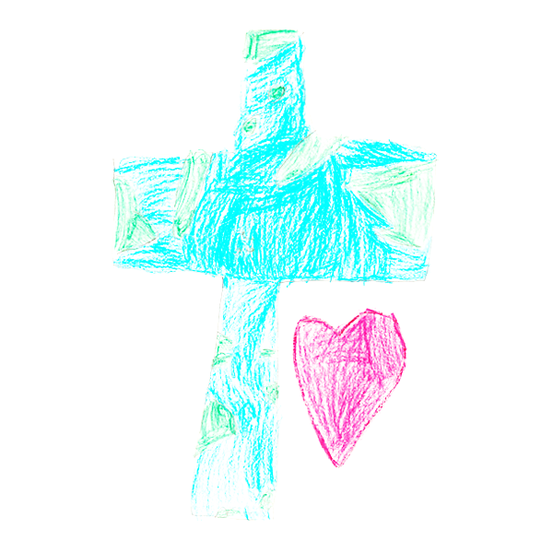
“For God so loved the world that He gave His only begotten Son, that whosoever believes in Him should not perish but have everlasting life.
But God, being rich in mercy, because of the great love with which He loved us, even when we were dead in our trespasses, made us alive together with Christ – by grace you have been saved.”

Slide 12
the words of Peter
“Blessed be the God and Father of our Lord Jesus Christ! According to his great mercy, he has caused us to be born again to a living hope through the resurrection of Jesus Christ from the dead . . .”

Slide 13
the words of Peter
“Blessed be the God and Father of our Lord Jesus Christ! According to his great mercy, he has caused us to be born again to a living hope through the resurrection of Jesus Christ from the dead . . .”

Slide 14
Living Hope
³ Blessed be the God and Father of our Lord Jesus Christ! According to his great mercy, he has caused us to be born again to a living hope through the resurrection of Jesus Christ from the dead,
⁴ to an inheritance that is imperishable, undefiled, and unfading, kept in heaven for you,
⁵ who by God's power are being guarded through faith for a salvation ready to be revealed in the last time.

Slide 15
Living Hope
³ Blessed be the God and Father of our Lord Jesus Christ! According to his great mercy, he has caused us to be born again to a living hope through the resurrection of Jesus Christ from the dead,
⁴ to an inheritance that is imperishable, undefiled, and unfading, kept in heaven for you,
⁵ who by God's power are being guarded through faith for a salvation ready to be revealed in the last time.

Slide 17
God guards His people!

Slide 18
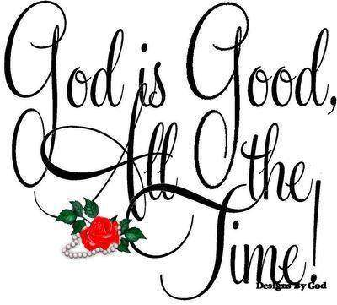
1 Peter 1: 3-9
⁶ In this you rejoice, though now for a little while, if necessary, you have been grieved by various trials,
“No eye has seen,
No ear has heard,
No mind has conceived
What God has prepared
For those who
love Him . . .”

Slide 19
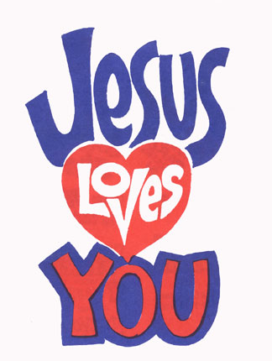
1 Peter 1: 3-9
⁸ Though you have not seen him, you love him. Though you do not now see him, you believe in him and rejoice with joy that is inexpressible and filled with glory,

Slide 20
We believe the eyewitnesses . . .

Slide 21
A living hope!

Slide 22
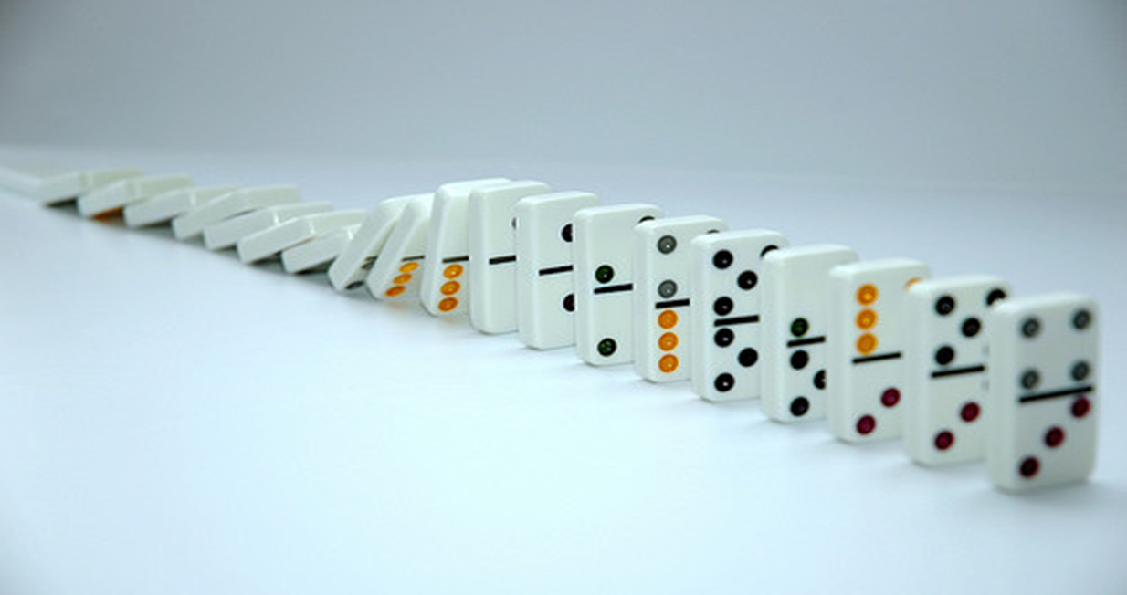
1 Peter 1: 3-9
⁸ Though you have not seen him, you love him. Though you do not now see him, you believe in him and rejoice with joy that is inexpressible and filled with glory,

Slide 23
1 Peter 1: 3-9
⁹ obtaining the outcome of your faith, the salvation of your souls.
“Chain
Reaction
Salvation”

Slide 24
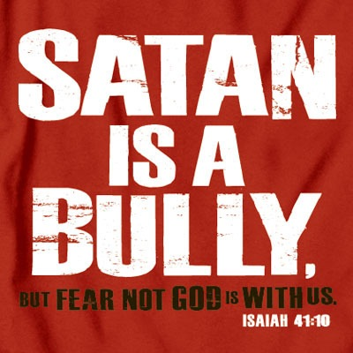

Slide 25
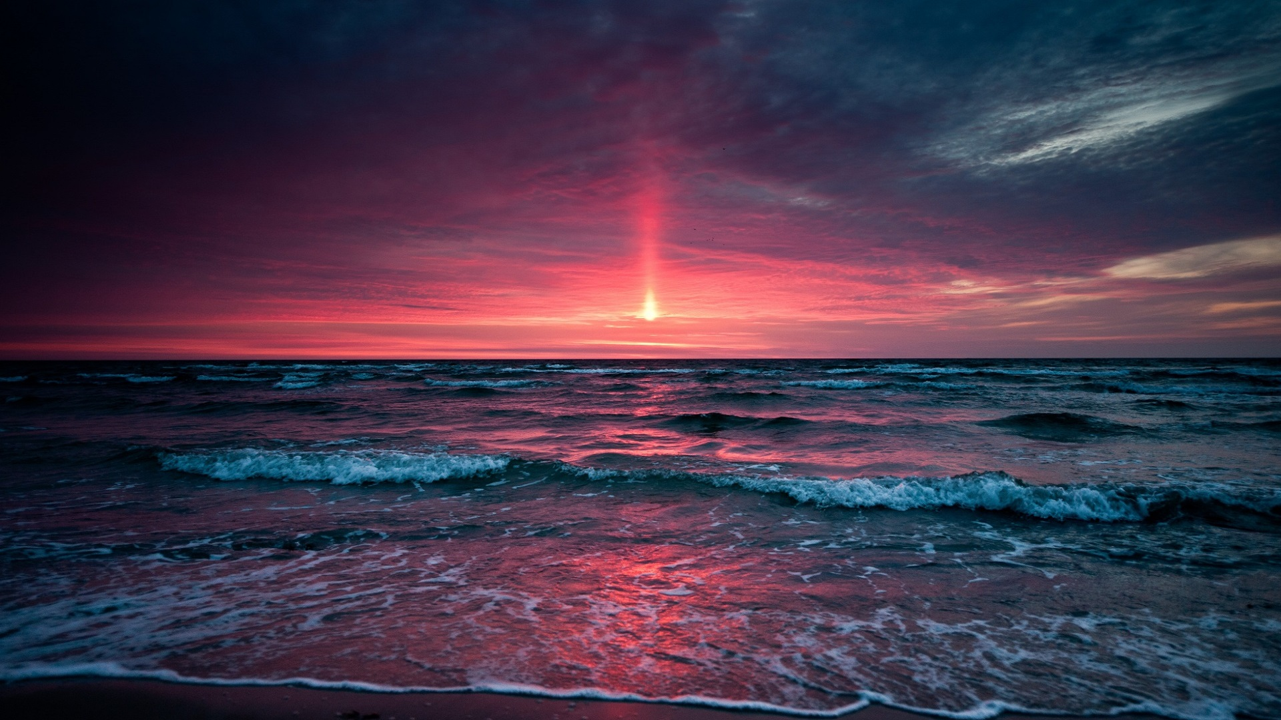
Blessed be the God and Father of our Lord Jesus Christ!

