Slide 1
#1 – you need to know where you are going;
#2 – you need to know what to expect
when you get there;

Slide 4
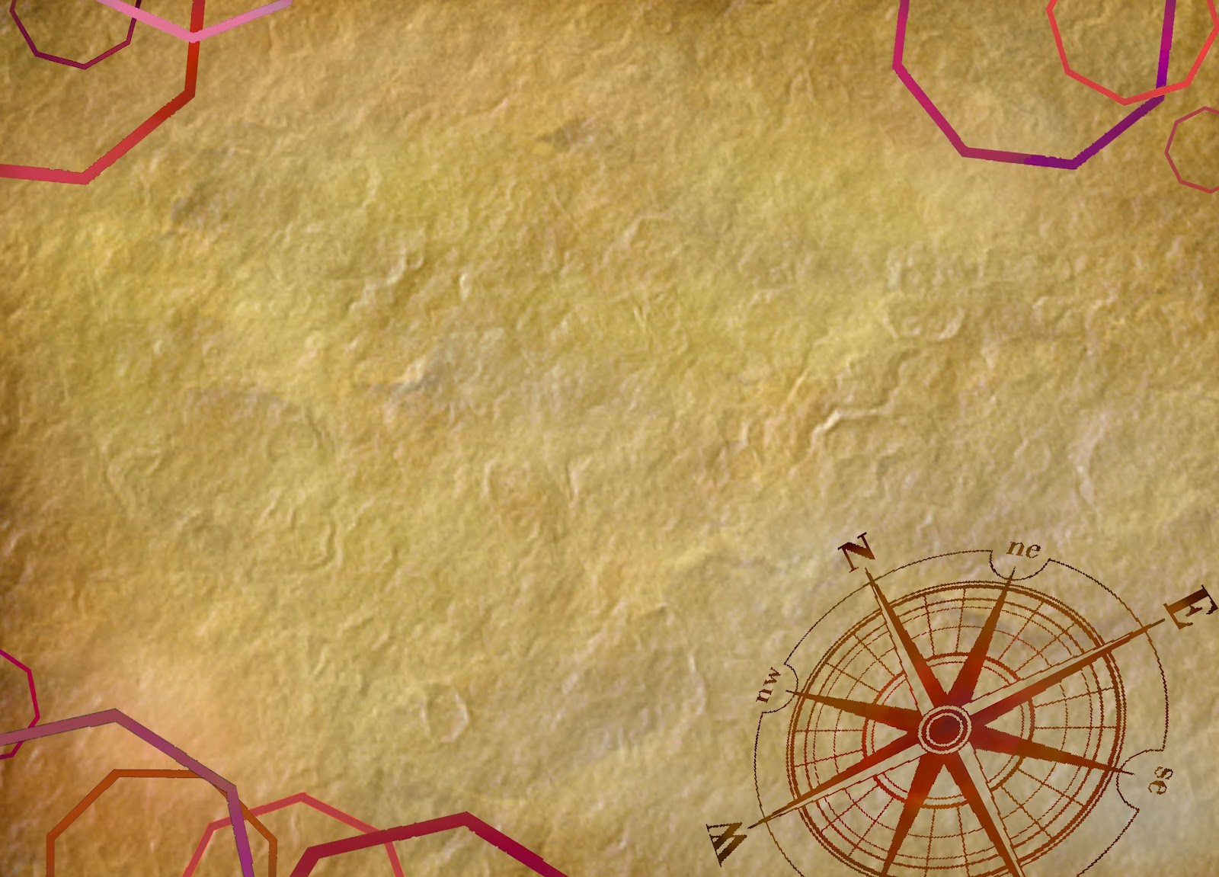
“elect exiles of the dispersion”
“sojourners of the dispersion”
“strangers scattered throughout”
“strangers in the world scattered
throughout”
“aliens scattered throughout”

Slide 5
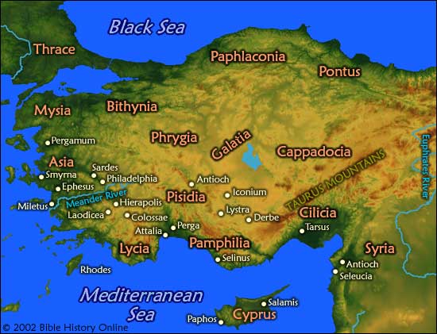

Slide 7
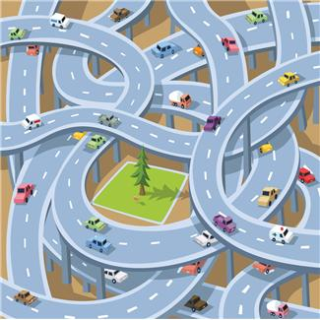
know where you are going; and
know what to expect when you get there

Slide 8
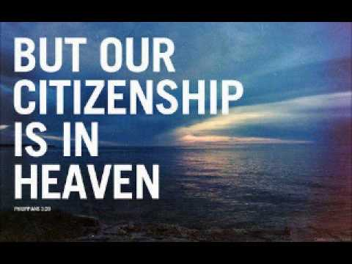

Slide 10
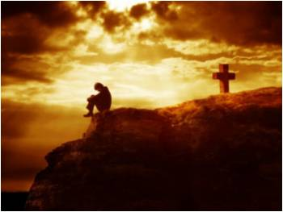

Slide 11
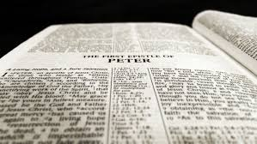
Peter, an apostle of Jesus Christ,
To those who are elect exiles of the Dispersion in Pontus, Galatia, Cappadocia, Asia, and Bithynia, according to the foreknowledge of God the Father, in the sanctification of the Spirit, for obedience to Jesus Christ and for sprinkling with his blood:
May grace and peace be multiplied to you.

Slide 12
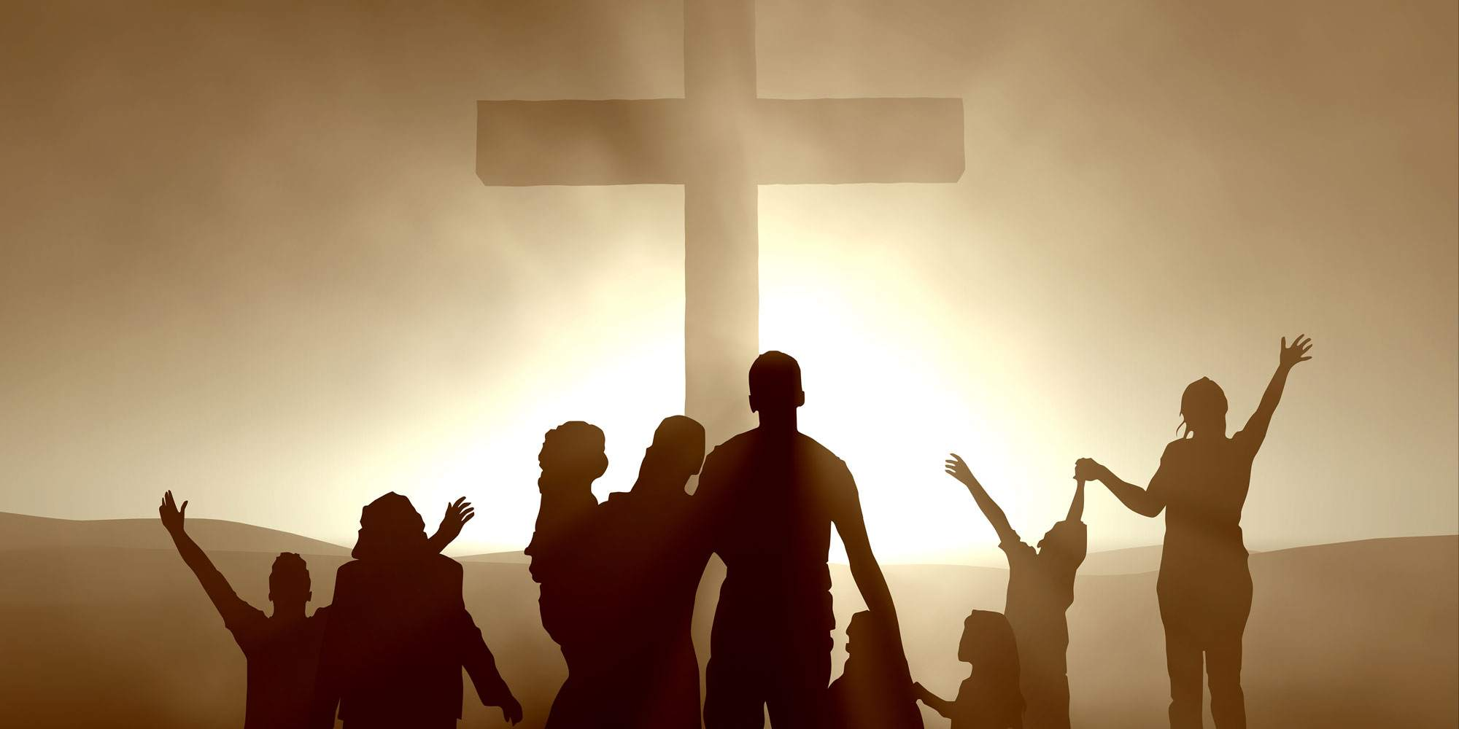
“chosen ones”

Slide 13
Peter, an apostle of Jesus Christ,
To those who are elect exiles of the Dispersion in Pontus, Galatia, Cappadocia, Asia, and Bithynia, according to the foreknowledge of God the Father, in the sanctification of the Spirit, for obedience to Jesus Christ and for sprinkling with his blood:
May grace and peace be multiplied to you.

Slide 15
Peter, an apostle of Jesus Christ,
To those who are elect exiles of the Dispersion in Pontus, Galatia, Cappadocia, Asia, and Bithynia, according to the foreknowledge of God the Father, in the sanctification of the Spirit, for obedience to Jesus Christ and for sprinkling with his blood:
May grace and peace be multiplied to you.

Slide 16
“being holy”

Slide 17
Peter, an apostle of Jesus Christ,
To those who are elect exiles of the Dispersion in Pontus, Galatia, Cappadocia, Asia, and Bithynia, according to the foreknowledge of God the Father, in the sanctification of the Spirit, for obedience to Jesus Christ and for sprinkling with his blood:
May grace and peace be multiplied to you.

Slide 19
Peter, an apostle of Jesus Christ,
To those who are elect exiles of the Dispersion in Pontus, Galatia, Cappadocia, Asia, and Bithynia, according to the foreknowledge of God the Father, in the sanctification of the Spirit, for obedience to Jesus Christ and for sprinkling with his blood:
May grace and peace be multiplied to you.

Slide 20
“The People of God”

