Slide 2
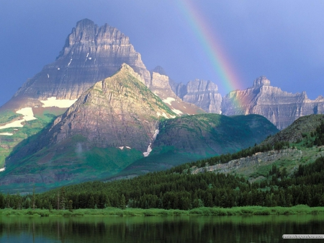

Slide 3
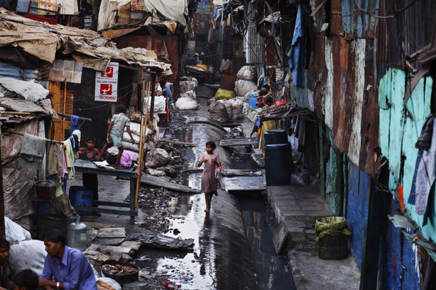
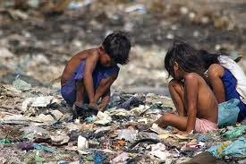
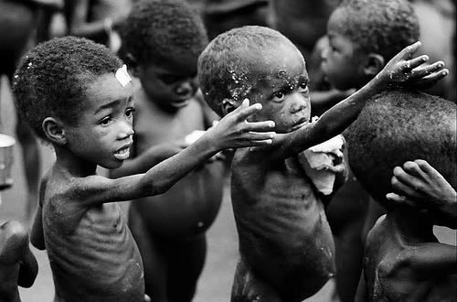
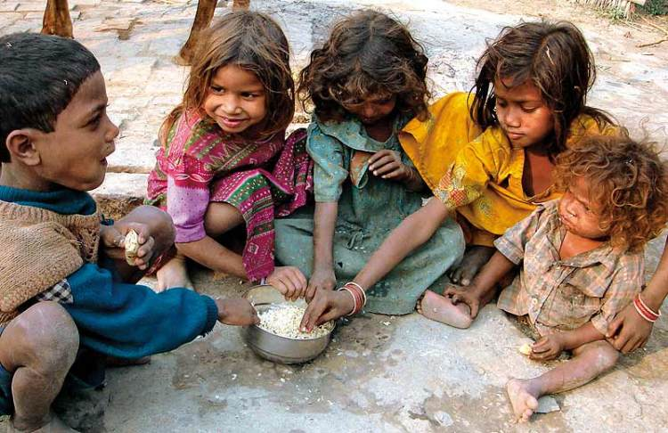

Slide 4
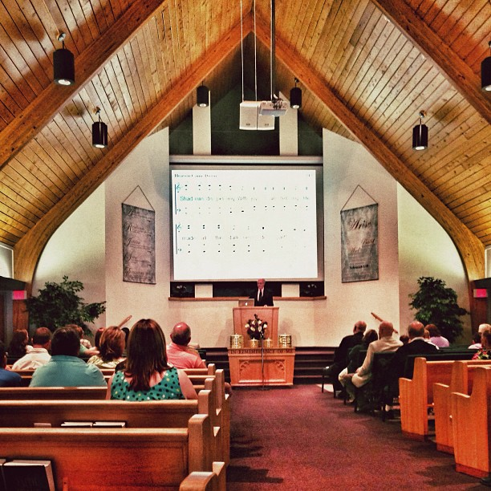

Slide 5
SALVATION!

Slide 6
“Chain
Reaction
Salvation”

Slide 8
1:10-12
¹⁰ Concerning this salvation, the prophets who prophesied about the grace that was to be yours searched and inquired carefully,
¹¹ inquiring what person or time the Spirit of Christ in them was indicating when he predicted the sufferings of Christ and the subsequent glories.
¹² It was revealed to them that they were serving not themselves but you, in the things that have now been announced to you through those who preached the good news to you by the Holy Spirit sent from heaven, things into which angels long to look.

Slide 10
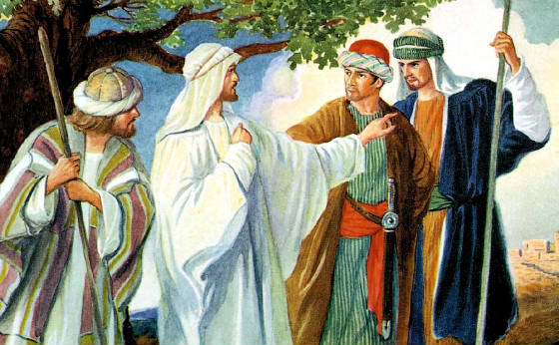
“Blessed are the eyes that see what you see!”

Slide 11
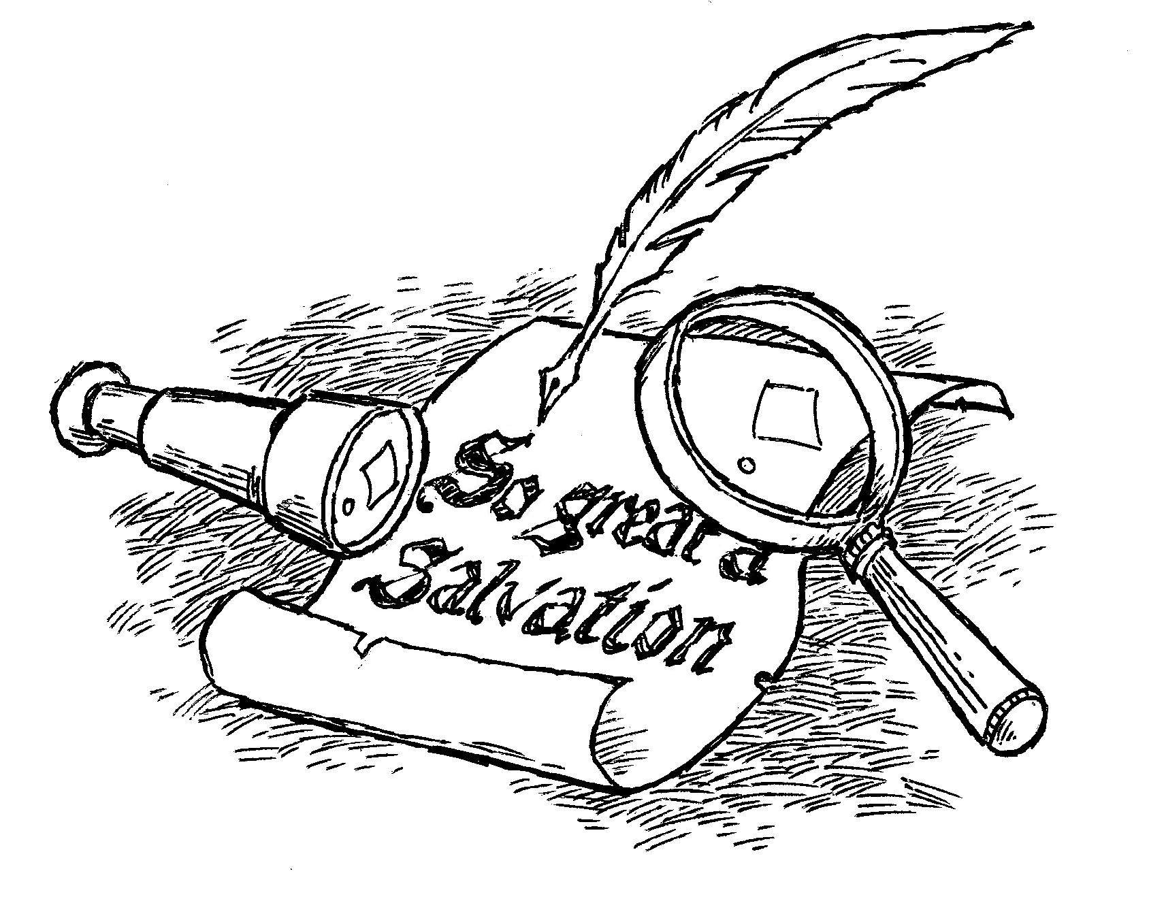

Slide 12
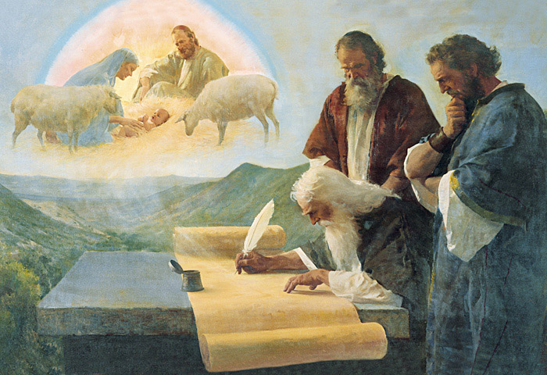

Slide 14
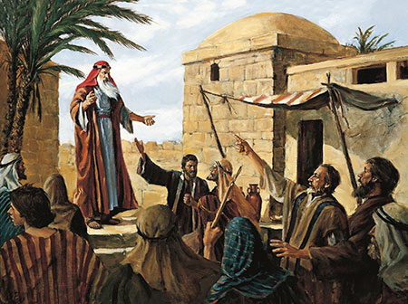

Slide 16
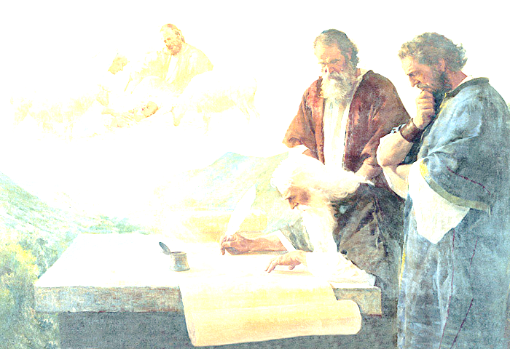
Isaiah said that the Messiah would be:
Born of a virgin (7:14)
He would be rejected (53:1-3)
He would bear our sins and sorrows (53:4-5)
He would be spat on and struck (50:6)
He would be disfigured by suffering (52:14)
He would make a blood atonement (53:5)
He would be our substitute (53:6)
He would save those who believe in Him (53:12)
He would heal the broken hearted (61:1-2)

Slide 17
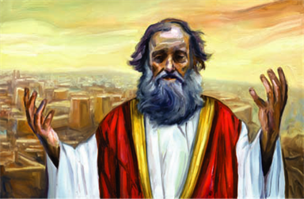
Jeremiah told us that:
The Messiah would be a descendant of David (23:5-6)
The Messiah would be both God and Man (23:5-6)
He said that the Messiah would bring a New Covenant (31:31)

Slide 18
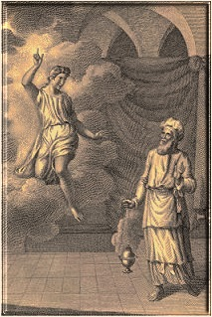
Zechariah told us that:
The Messiah would be God’s servant (3:8)
The Messiah would be Priest and King (6:12-13)
He would be greeted with rejoicing in Jerusalem (9:9)
He would bring salvation (9:9)
The Messiah would come into Jerusalem riding on a donkey (9:9)
The Messiah would be the cornerstone (10:4)

Slide 20
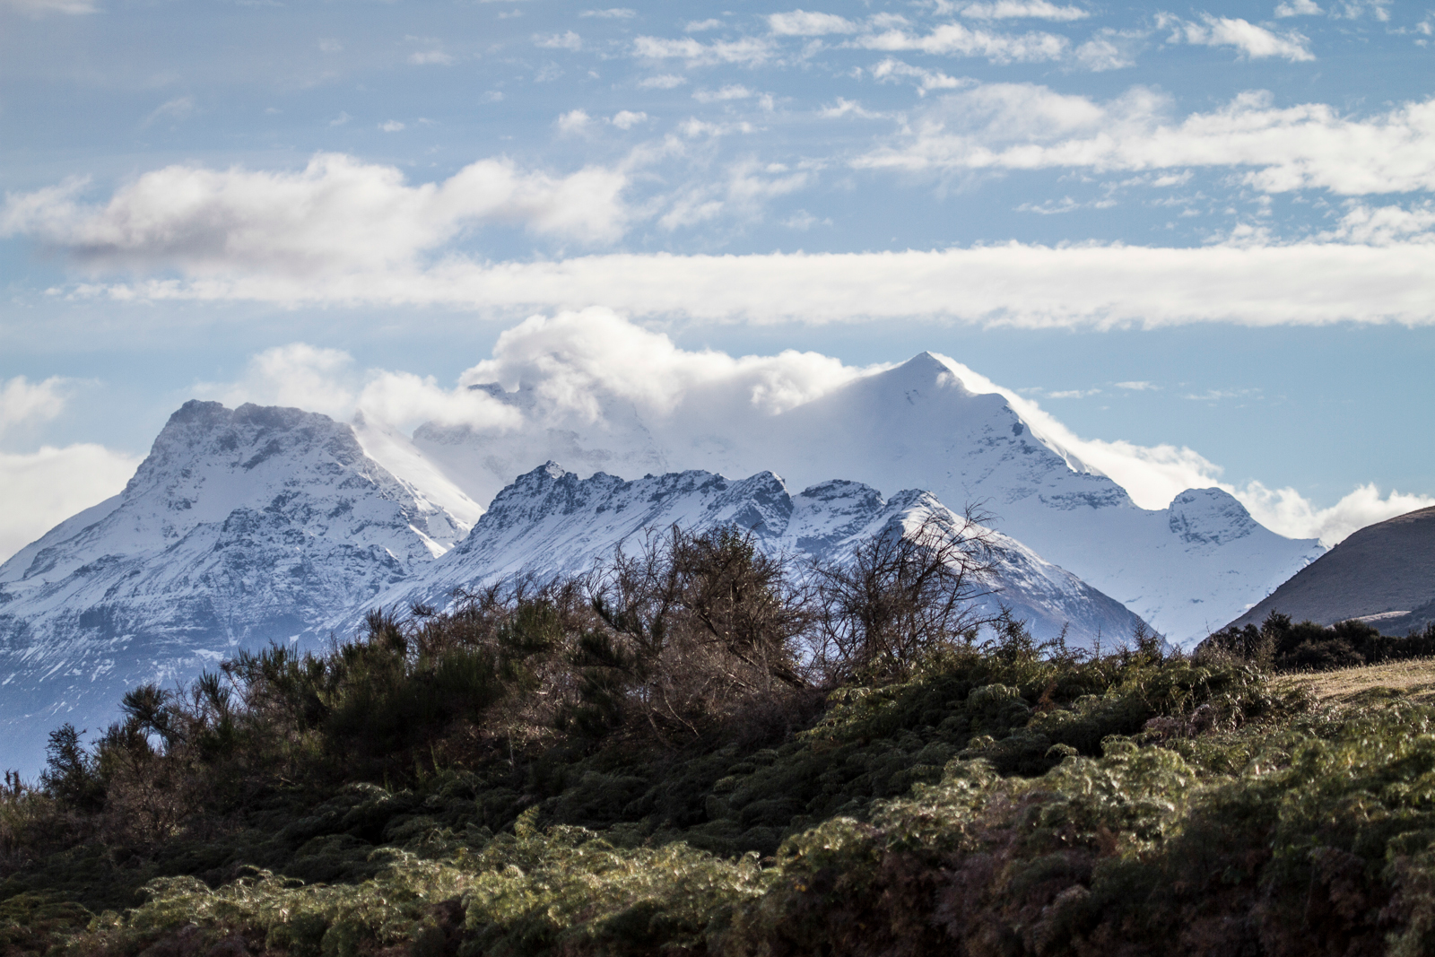
Do you know how
privileged you are?

Slide 21
1:10-12
¹⁰ Concerning this salvation, the prophets who prophesied about the grace that was to be yours searched and inquired carefully,
¹¹ inquiring what person or time the Spirit of Christ in them was indicating when he predicted the sufferings of Christ and the subsequent glories.
¹² It was revealed to them that they were serving not themselves but you, in the things that have now been announced to you through those who preached the good news to you by the Holy Spirit sent from heaven, things into which angels long to look.

Slide 22
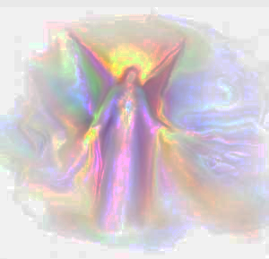
“Angels are amazed!”

