Slide 2
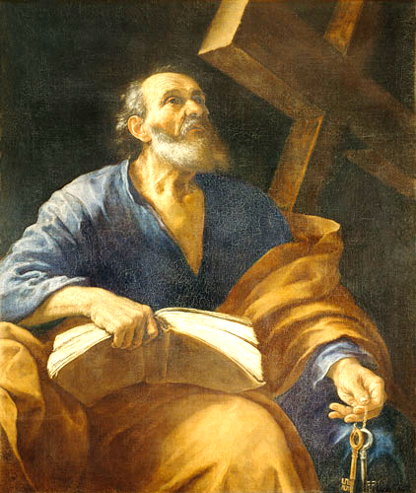
“Living As The
People of God”
Lessons from the
Letters of Peter

Slide 3
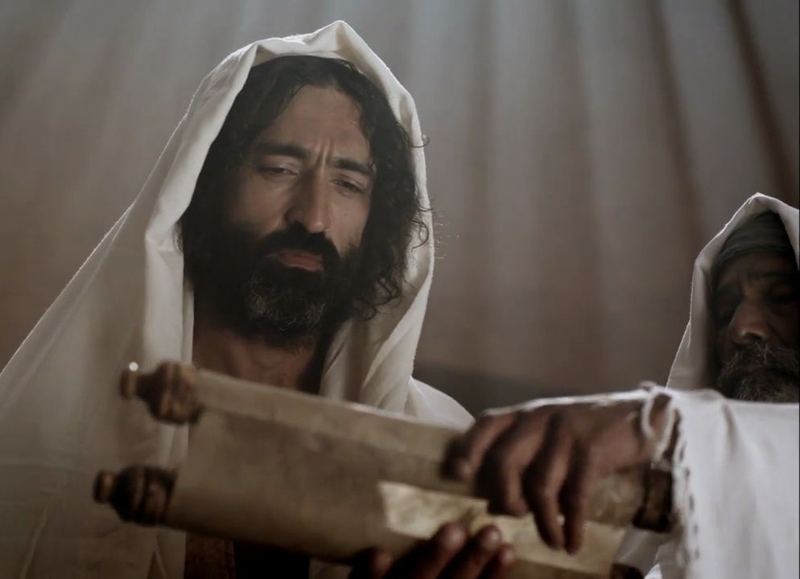
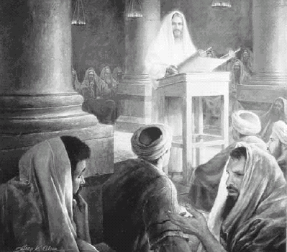
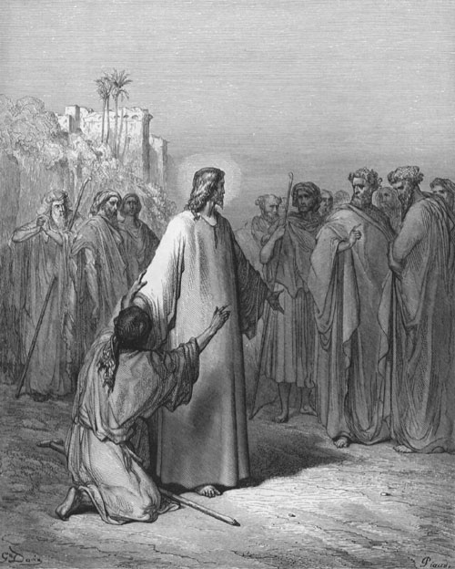

Slide 4
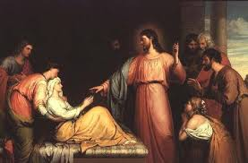
Luke 4:38-41
³⁸ And he arose and left the synagogue and entered Simon's house. Now Simon's mother-in-law was ill with a high fever, and they appealed to him on her behalf.
³⁹ And he stood over her and rebuked the fever, and it left her, and immediately she rose and began to serve them.

Slide 5
Luke 4:38-41
40 Now when the sun was setting, all those who had any who were sick with various diseases brought them to him, and he laid his hands on every one of them and healed them.
41 And demons also came out of many, crying, “You are the Son of God!” But he rebuked them and would not allow them to speak, because they knew that he was the Christ.

Slide 6
“Do we not have the right to take along a believing wife, as do the other apostles and the brothers of the Lord and Cephas?”

Slide 7
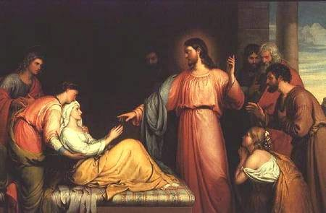

Slide 8
“And he stood over her and rebuked the fever . . .”

Slide 9
“ . . . and immediately she rose and began to serve them.”

Slide 10
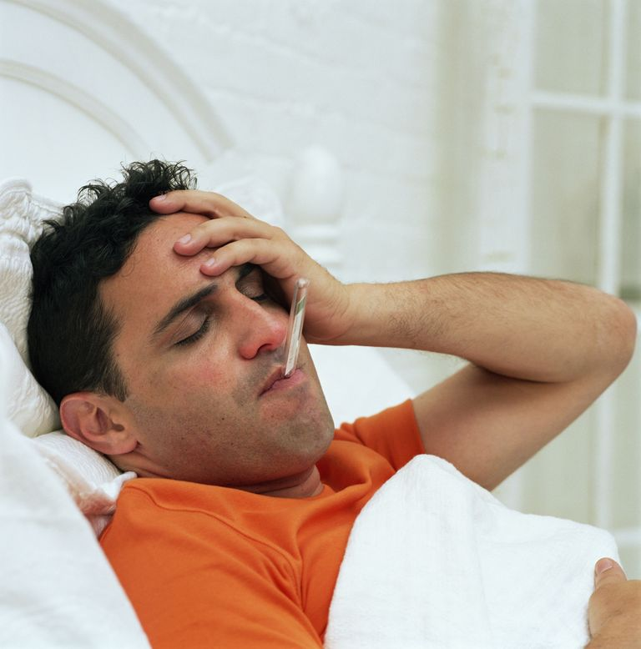

Slide 11
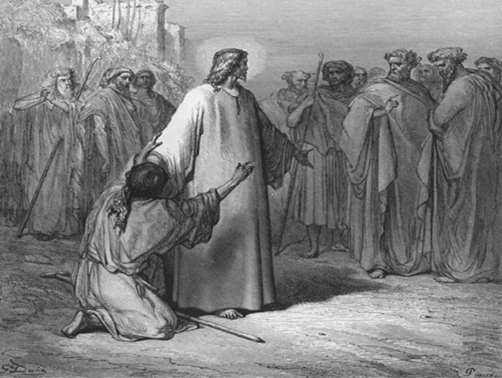
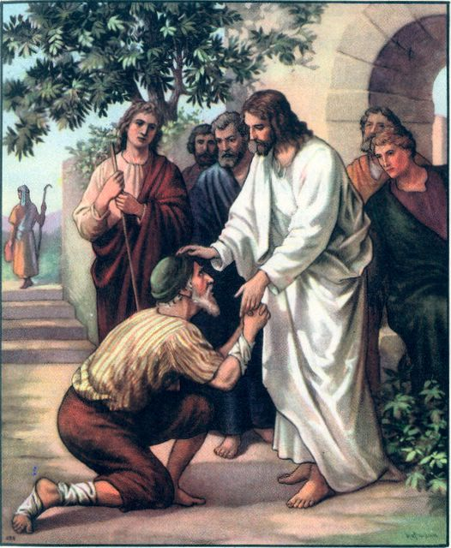
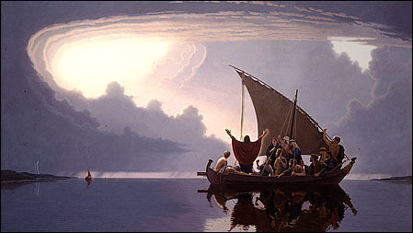

Slide 13
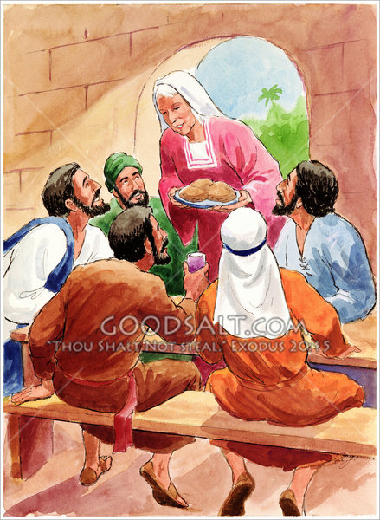
“She got up and
began to serve them”

Slide 14
------- Qualifications for Deacons -------
⁸Deacons likewise must be dignified, not double-tongued, not addicted to much wine, not greedy for dishonest gain. ⁹ They must hold the mystery of the faith with a clear conscience. ¹⁰ And let them also be tested first; then let them serve as deacons if they prove themselves blameless. ¹¹ Their wives likewise must be dignified, not slanderers, but sober-minded, faithful in all things. ¹² Let deacons each be the husband of one wife, managing their children and their own households well.¹³ For those who serve well as deacons gain a good standing for themselves and also great confidence in the faith that is in Christ Jesus.
1 Timothy 3

Slide 15
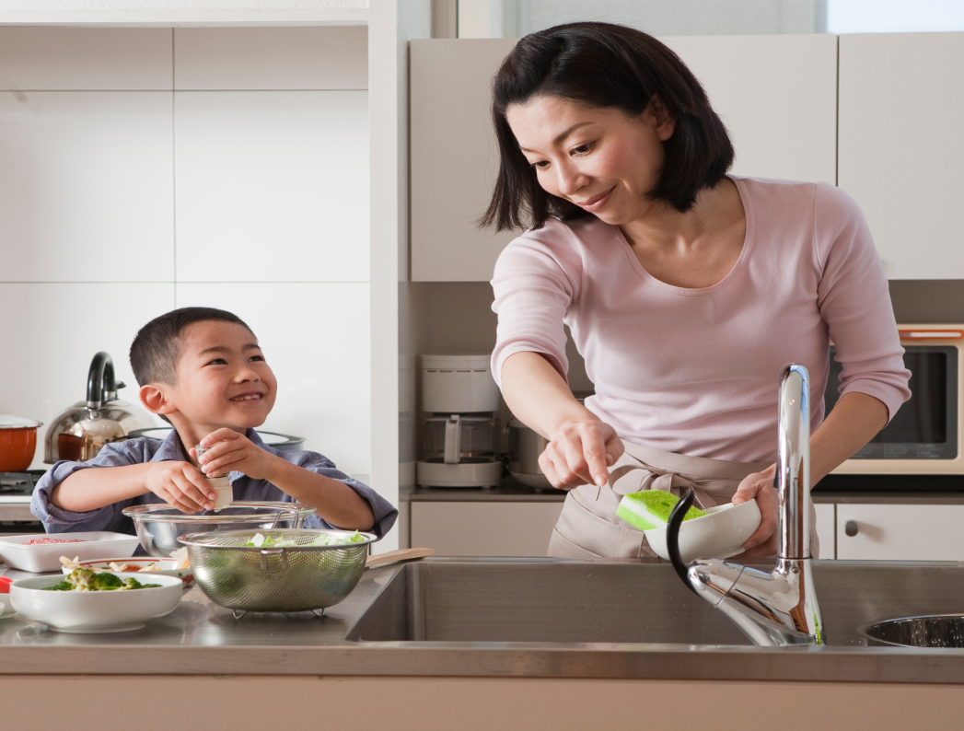
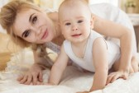

Slide 16
Rise up
And serve!!

Slide 17
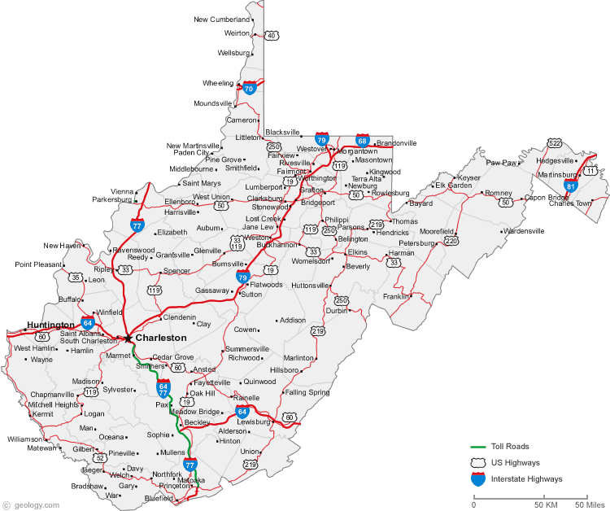
“Jesus came to her house, too!”

Slide 18
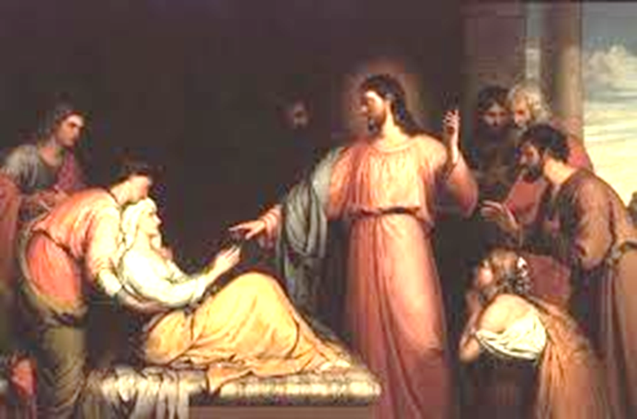
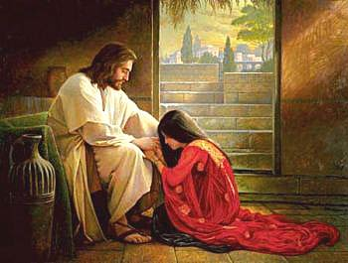
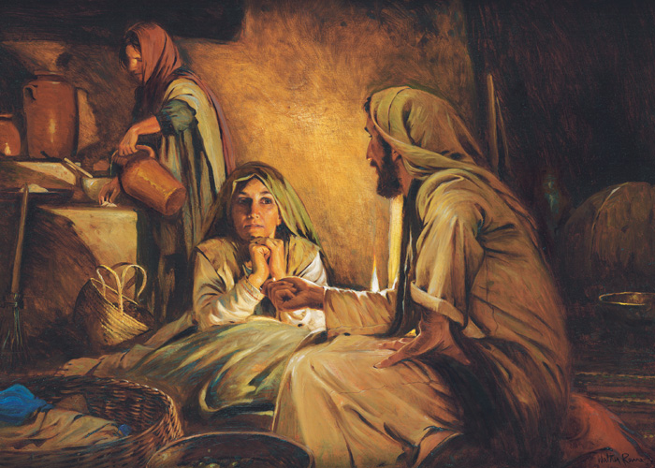
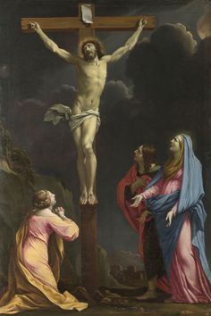
Luke 4
Luke 8
Luke 10
Luke 23

