Slide 1
“God’s True Priesthood”
(1 Peter 2:4-10)

Slide 2
Three terms that at least ought to be applied to all Christians:
“Holy”
“Saint”
“Priest”

Slide 3
Three terms that at least ought to be applied to all Christians:
“Holy”
“Saint”
“Priest”

Slide 4
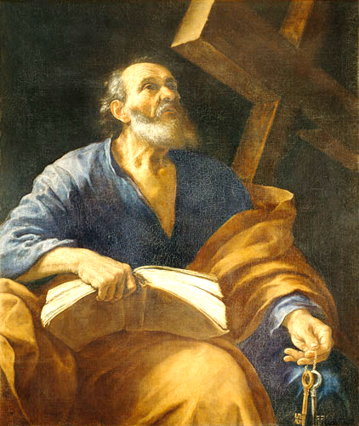
“Living As The
People of God”
“Holy
Priesthood”

Slide 5
1 Peter 2:4-10

Slide 6
⁴As you come to him, a living stone rejected by men but in the sight of God chosen and precious,
⁵ you yourselves like living stones are being built up as a spiritual house, to be a holy priesthood, to offer spiritual sacrifices acceptable to God through Jesus Christ.
⁶ For it stands in Scripture:
“Behold, I am laying in Zion a stone, a cornerstone chosen and precious, and whoever believes in him will not be put to shame.”

Slide 7
⁷ So the honor is for you who believe, but for those who do not believe,
“The stone that the builders rejected has become the cornerstone,”
⁸ and “A stone of stumbling, and a rock of offense.”
They stumble because they disobey the word, as they were destined to do.
⁹ But you are a chosen race, a royal priesthood, a holy nation, a people for his own possession, that you may proclaim the excellencies of him who called you out of darkness into his marvelous light.

Slide 8
¹⁰ Once you were not a people, but now you are God's people; once you had not received mercy, but now you have received mercy.
1 Peter 2:4-10

Slide 9
“Living As The
People of God”
Christians as PRIESTS in this world.

Slide 10
^{1 PETER 2:4-10}
⁴ As you come to him, a living stone rejected by men but in the sight of God chosen and precious, ⁵ you yourselves like living stones are being built up as a spiritual house, to be a holy priesthood, to offer spiritual sacrifices acceptable to God through Jesus Christ. ⁶ For it stands in Scripture:
“Behold, I am laying in Zion a stone, a cornerstone chosen and precious, and whoever believes in him will not be put to shame.”
⁷ So the honor is for you who believe, but for those who do not believe,
“The stone that the builders rejected has become the cornerstone,”
⁸ and
“A stone of stumbling, and a rock of offense.”
They stumble because they disobey the word, as they were destined to do.
⁹ But you are a chosen race, a royal priesthood, a holy nation, a people for his own possession, that you may proclaim the excellencies of him who called you out of darkness into his marvelous light. ¹⁰ Once you were not a people, but now you are God's people; once you had not received mercy, but now you have received mercy.
Isaiah
Hosea
Psalms
Exodus

Slide 11
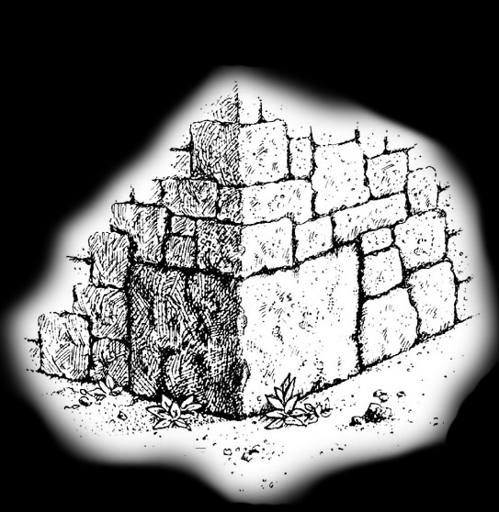

Slide 13
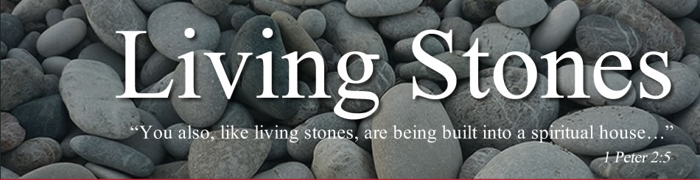
What do we do in God’s House?
We serve as a HOLY PRIESTHOOD.

Slide 15
When one comes to Christ, they come into the church.
The church is a temple and should behave like one.
Jesus is at the center of it all.

Slide 16
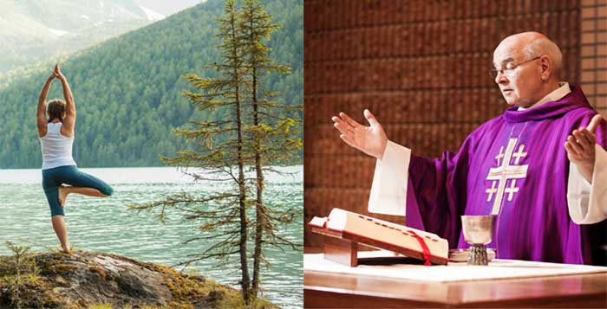

Slide 17
⁹ But you are a chosen race, a royal priesthood, a holy nation, a people for his own possession, that you may proclaim the excellencies of him who called you out of darkness into his marvelous light.
1 Peter 2:9

Slide 18
⁹ But you are a chosen race, a royal priesthood, a holy nation, a people for his own possession, that you may proclaim the excellencies of him who called you out of darkness into his marvelous light.
“ . . . A priest is one who serves God and has the right of access to Him.”

Slide 19
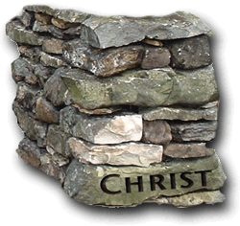
As a priesthood we focus on Jesus Christ.
“And whatever you do, in word or deed, do everything in the name of the Lord Jesus, giving thanks to God the Father through Him.” – Colossians 3:17

Slide 20
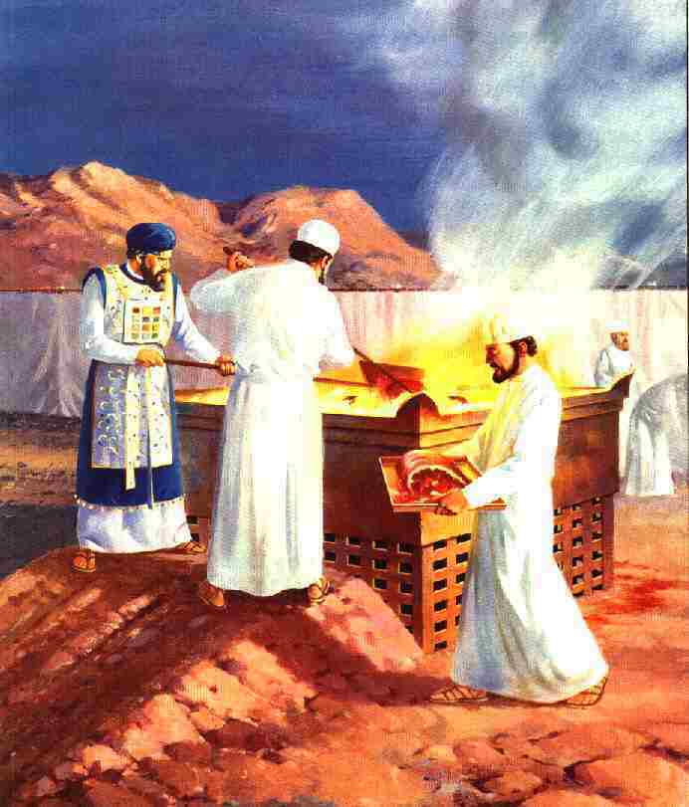
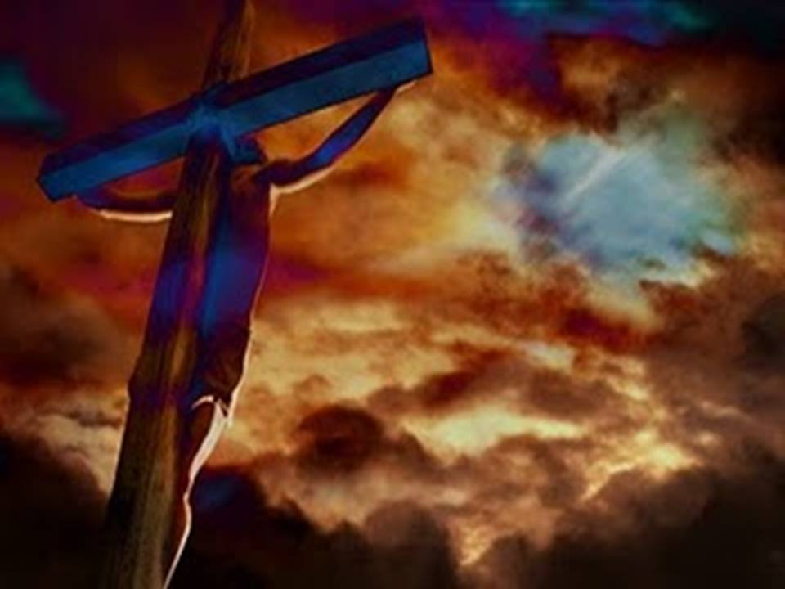
As a priesthood we focus on Jesus Christ.
As priests, we offer spiritual sacrifices acceptable to God.

Slide 21
Consider some of the sacrifices we do offer up as we live as the people of God in this world:
Regular praise and worship of God – Hebrews 13:15
Good works – Hebrews 13:16
Supporting the preaching of the gospel to all the world – Philippians 4:18
The act of preaching itself – Romans 15:16
Christian living in general – Romans 12:1
Just being thankful – Hebrews 12:28

Slide 22
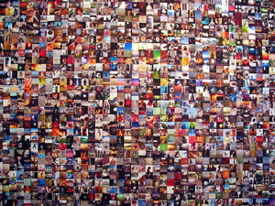
“this holy and royal priesthood of all believers.”

Slide 23
Regular praise and worship of God – Hebrews 13:15
Good works – Hebrews 13:16
Supporting the preaching of the gospel to all the world – Philippians 4:18
The act of preaching itself – Romans 15:16
Christian living in general – Romans 12:1
Just being thankful – Hebrews 12:28
Are you routinely offering up these spiritual sacrifices acceptable to God through Jesus Christ?

Slide 24
⁹ But you are a chosen race, a royal priesthood, a holy nation, a people for his own possession, that you may proclaim the excellencies of him who called you out of darkness into his marvelous light.
1 Peter 2:9

Slide 25
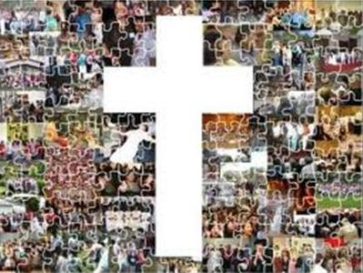
God’s True Priesthood

