Slide 4
“¹So put away all malice and all deceit and hypocrisy and envy and all slander.
²Like newborn infants, long for the pure spiritual milk, that by it you may grow up into salvation— ³if indeed you have tasted that the Lord is good.”
1 Peter 2:1-3

Slide 10
“. . .since you have been born again, not of perishable seed but of imperishable, through the living and abiding word of God”
1 Peter 1:23

Slide 11
Crave the pure spiritual milk
of the Word of God

Slide 12
Do you crave the Word of God?

Slide 13
“So put away all malice and all deceit and hypocrisy and envy and all slander.
Like newborn infants, long for the pure spiritual milk, that by it you may grow up into salvation— if indeed you have tasted that the Lord is good.”
1 Peter 2:1-3

Slide 16
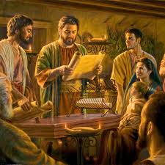

Slide 20
“So put away all malice and all deceit and hypocrisy and envy and all slander.
Like newborn infants, long for the pure spiritual milk, that by it you may grow up into salvation— if indeed you have tasted that the Lord is good.”
1 Peter 2:1-3

Slide 21
Do you hunger
for the
Word of God?

Slide 22
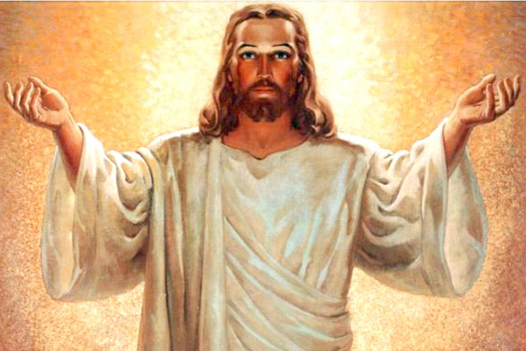

Slide 23
Jesus is the Word of God
The Word of God is the Bible
Bible Study is Jesus Study

Slide 25
Putting away sin;
Feeding on the Word of God;
Experiencing Jesus

