Slide 2
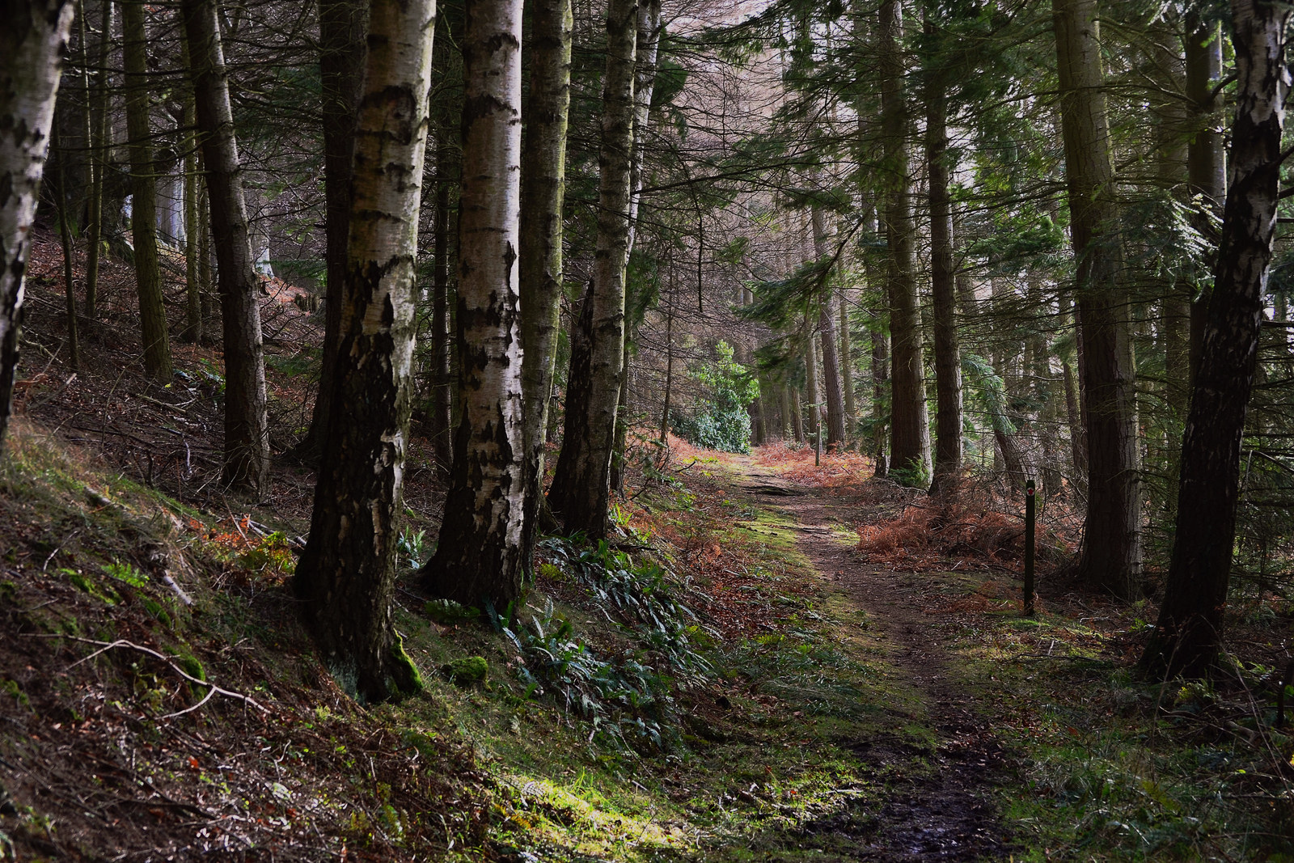
“How to live as the people of God in a world in which we are strangers at best.”

Slide 3
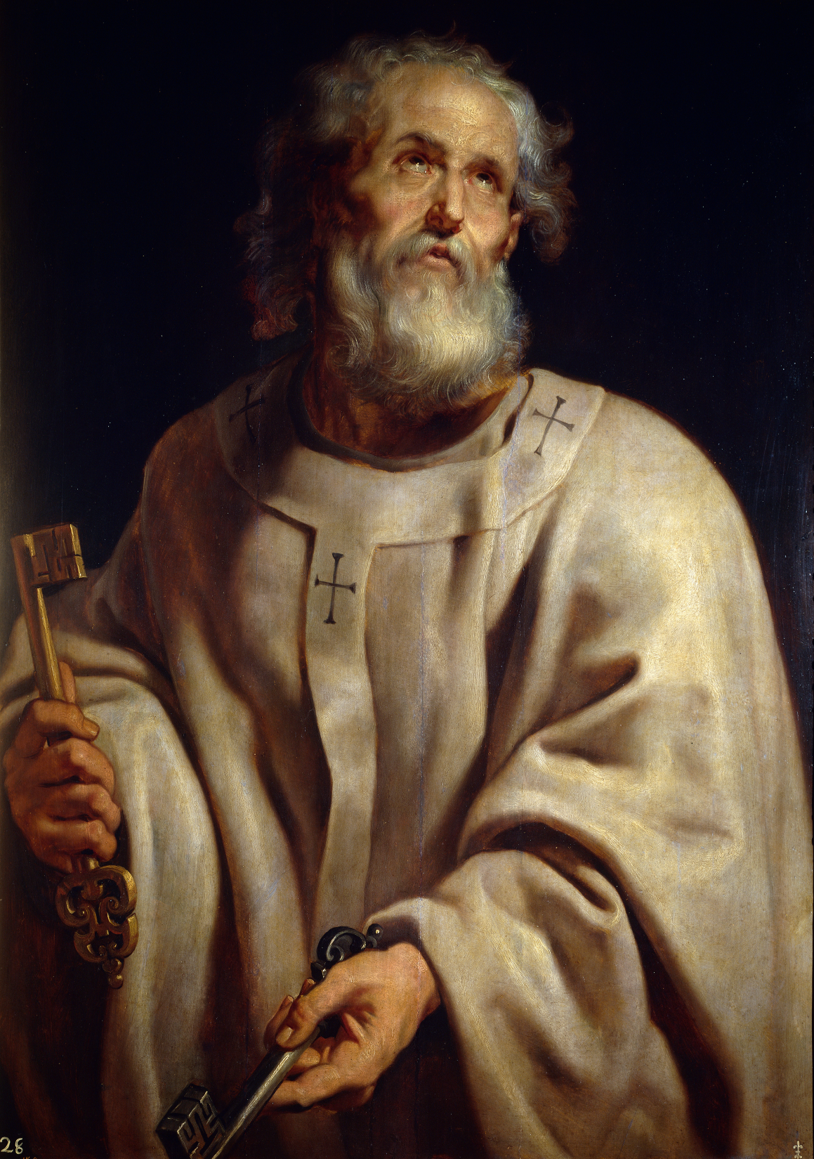
Living in HOPE
Living in HOLINESS
Living in FEAR
(1 Peter 1:17-21)

Slide 4
¹⁷And if you call on him as Father who judges impartially according to each one's deeds, conduct yourselves with fear throughout the time of your exile,
¹⁸knowing that you were ransomed from the futile ways inherited from your forefathers, not with perishable things such as silver or gold,
¹⁹but with the precious blood of Christ, like that of a lamb without blemish or spot.
²⁰He was foreknown before the foundation of the world but was made manifest in the last times for the sake of you
²¹who through him are believers in God, who raised him from the dead and gave him glory, so that your faith and hope are in God.
1 Peter 1:17-21 (ESV)

Slide 6
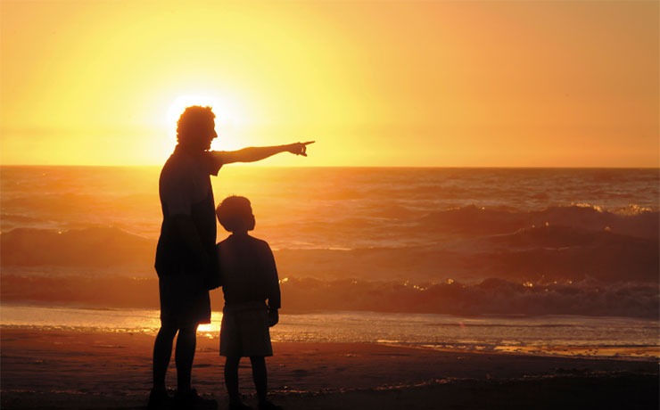

Slide 7
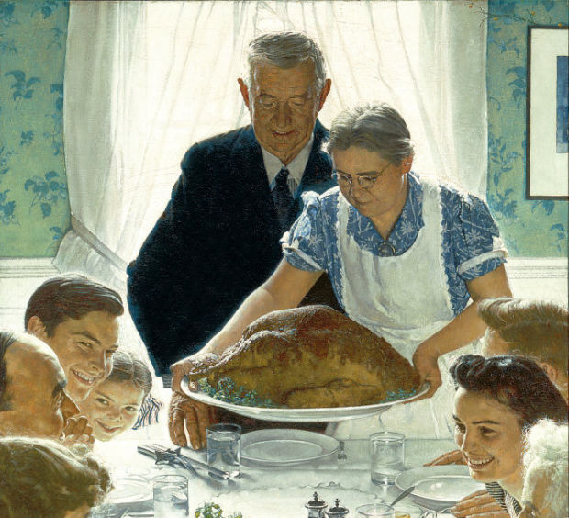
“Quaint”

Slide 9
“If you call on Him as Father . . .”

Slide 11
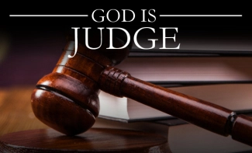
“We ought to live in FEAR as we live as exiles in this world.”

Slide 12
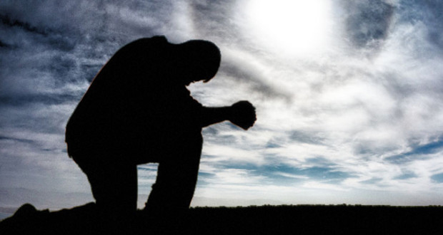

Slide 13
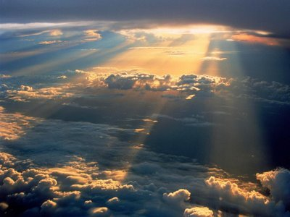
“Father”

Slide 14
¹⁷And if you call on him as Father who judges impartially according to each one's deeds, conduct yourselves with fear throughout the time of your exile,
¹⁸knowing that you were ransomed from the futile ways inherited from your forefathers, not with perishable things such as silver or gold,
¹⁹but with the precious blood of Christ, like that of a lamb without blemish or spot.
²⁰He was foreknown before the foundation of the world but was made manifest in the last times for the sake of you
²¹who through him are believers in God, who raised him from the dead and gave him glory, so that your faith and hope are in God.
1 Peter 1:17-21 (ESV)

Slide 15
¹⁷And if you call on him as Father who judges impartially according to each one's deeds, conduct yourselves with fear throughout the time of your exile,
¹⁸knowing that you were ransomed from the futile ways inherited from your forefathers, not with perishable things such as silver or gold,
¹⁹but with the precious blood of Christ, like that of a lamb without blemish or spot.
²⁰He was foreknown before the foundation of the world but was made manifest in the last times for the sake of you
²¹who through him are believers in God, who raised him from the dead and gave him glory, so that your faith and hope are in God.
1 Peter 1:17-21 (ESV)

Slide 16
Is that a Father worth fearing?
Worth Loving?
Worth Serving?
Are you willing to submit to a Father like that?
Can you respect that God?

Slide 17
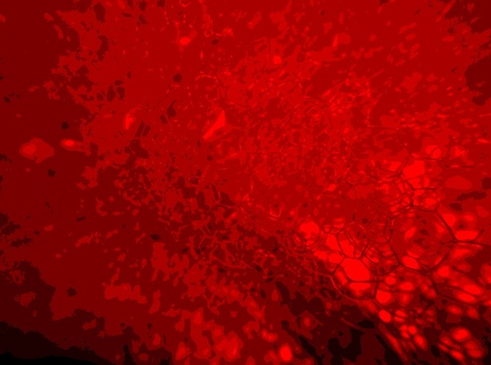
Why blood?
Through God’s amazing love we were redeemed with the precious blood of Christ.

Slide 18
“We will live in HOPE, in HOLINESS, and in FEAR.”

