Slide 3
1 Peter 2:11-12 (ESV)
¹¹Beloved, I urge you as sojourners and exiles to abstain from the passions of the flesh, which wage war against your soul.
¹²Keep your conduct among the Gentiles honorable, so that when they speak against you as evildoers, they may see your good deeds and glorify God on the day of visitation.

Slide 4
1 Peter 2:11-12 (ESV)
¹¹Beloved, I urge you as sojourners and exiles to abstain from the passions of the flesh, which wage war against your soul.
¹²Keep your conduct among the Gentiles honorable, so that when they speak against you as evildoers, they may see your good deeds and glorify God on the day of visitation.

Slide 5
1 Peter 2:11-12 (ESV)
¹¹Beloved, I urge you as sojourners and exiles to abstain from the passions of the flesh, which wage war against your soul.
¹²Keep your conduct among the Gentiles honorable, so that when they speak against you as evildoers, they may see your good deeds and glorify God on the day of visitation.

Slide 6
fleshly passions (1 Peter 4:3)
sensuality
passions
drunkenness
orgies
drinking parties
lawless idolatry

Slide 7
“works of the flesh”(Galatians 5)
sorcery
enmity
strife
jealousy
fits of anger
rivalries
dissensions
divisions
envy

Slide 8
“ . . . those who belong to Christ Jesus have crucified the flesh with its passions and desires.”

Slide 9
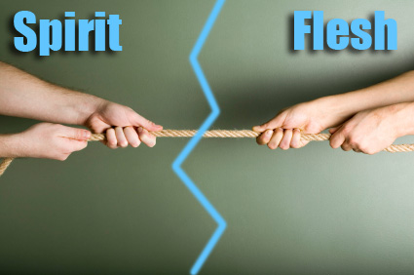

Slide 11
Abstain!
Live Holy Lives!
Be Pure!
Be willing to be different!

Slide 12
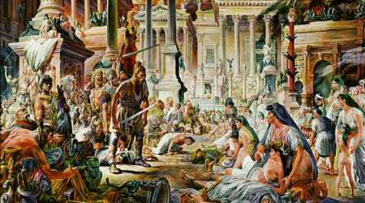
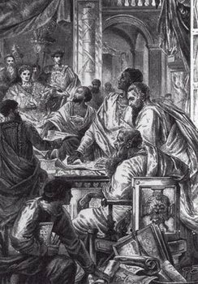
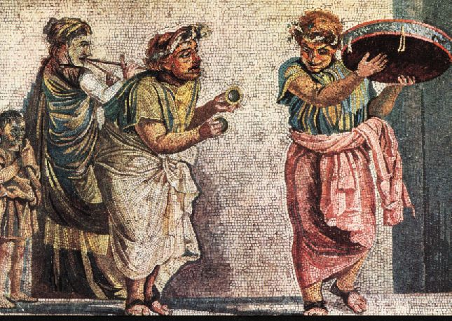
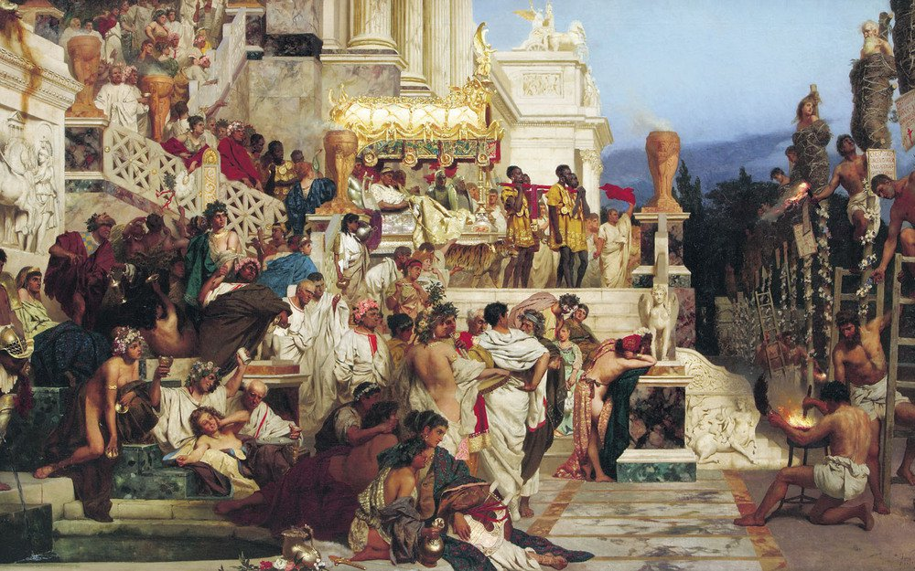
ROMAN EMPIRE

Slide 13
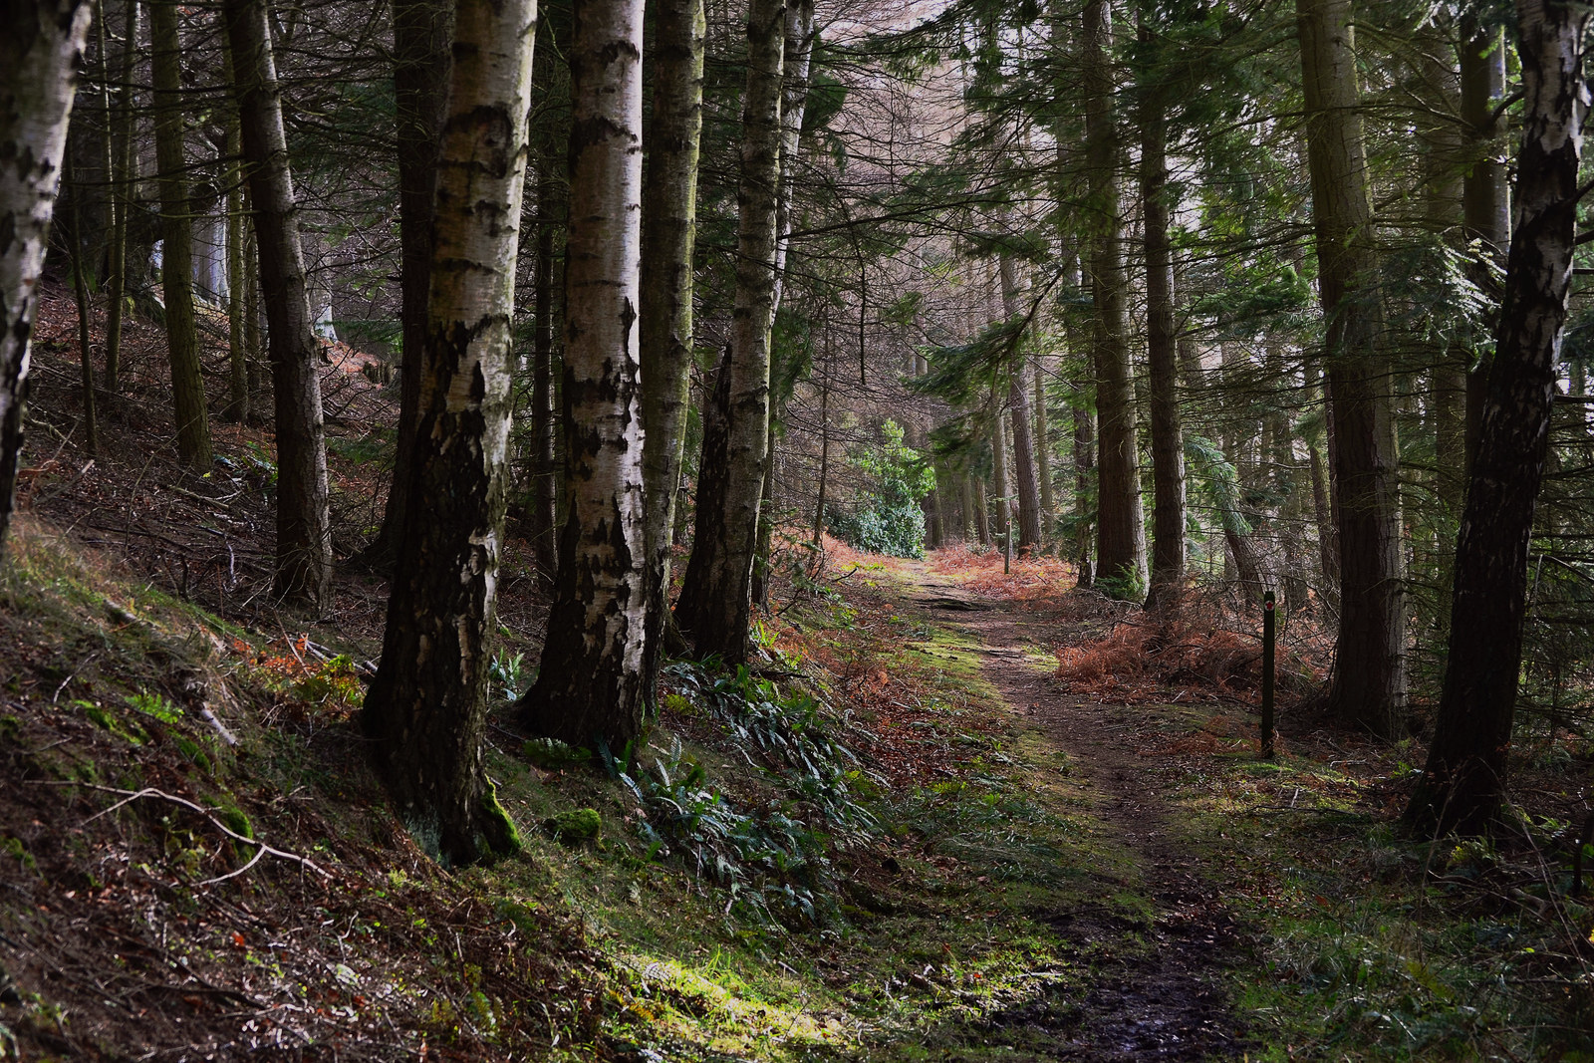
LIVING AS THE PEOPLE OF GOD IN THIS WORLD
1 Peter

Slide 14
“With respect to this they (that is, the world) are surprised when you do not join them in the same flood of debauchery, and they malign you; but they will give account to him who is ready to judge the living and the dead.”
1 Peter 4:4-5

Slide 15
Are we a surprising
people?
Notes:
Are we a surprising people?

Slide 16
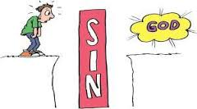
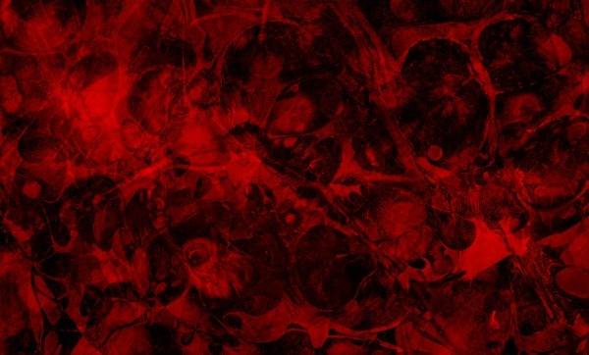
SIN

Slide 17
1 Peter 2:11-12 (ESV)
¹¹Beloved, I urge you as sojourners and exiles to abstain from the passions of the flesh, which wage war against your soul.
¹²Keep your conduct among the Gentiles honorable, so that when they speak against you as evildoers, they may see your good deeds and glorify God on the day of visitation.

Slide 18
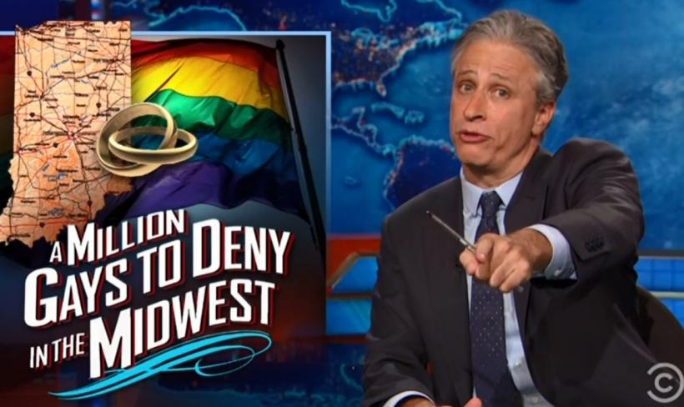
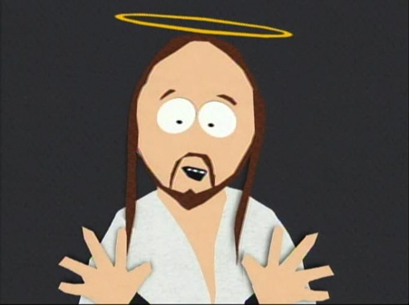
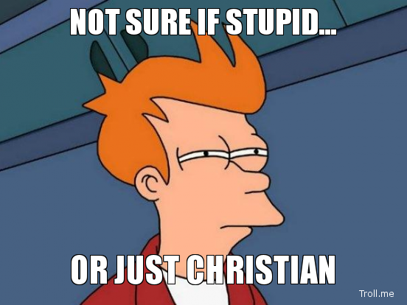
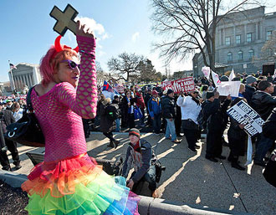

Slide 19
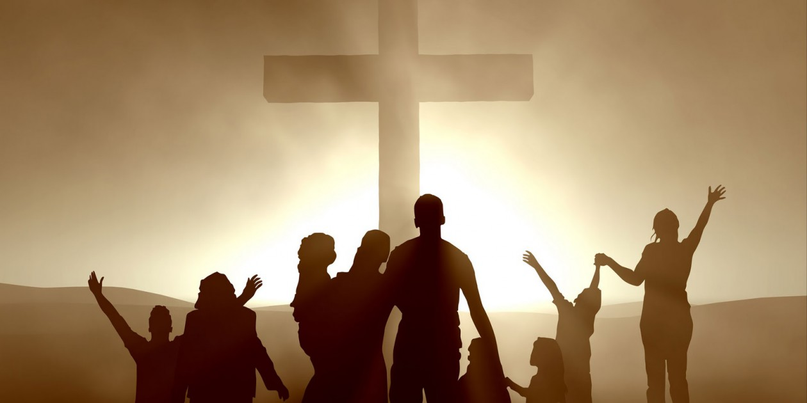
“. . . the lifestyle of Christ will always be resented.”

Slide 22
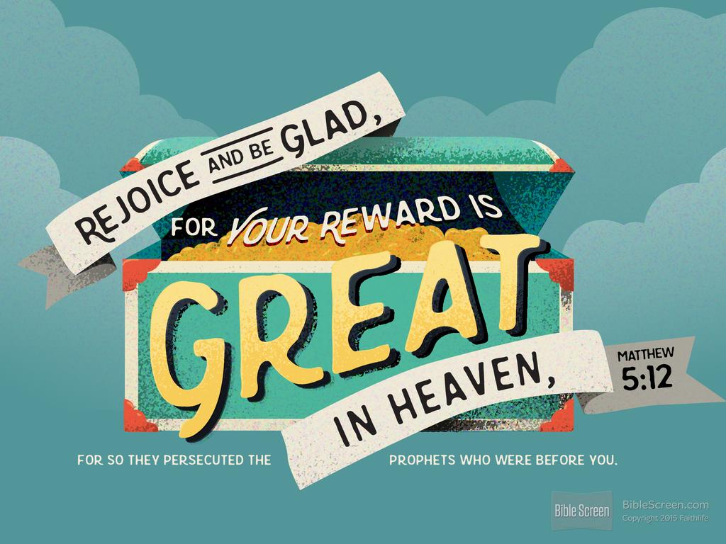

Slide 23
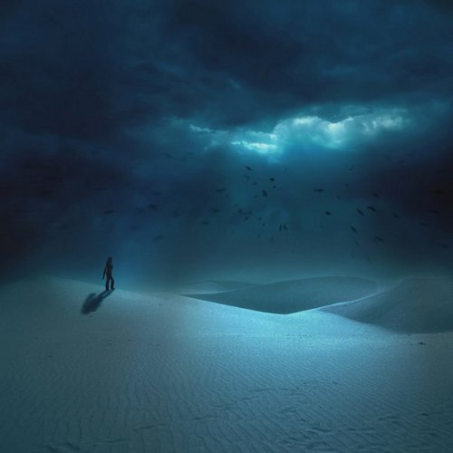
Live Holy Lives;
Do Good.

Slide 24
