Slide 3
1 Peter 3
⁷Likewise, husbands, live with your wives in an understanding way, showing honor to the woman as the weaker vessel, since they are heirs with you of the grace of life, so that your prayers may not be hindered.
⁸Finally, all of you, have unity of mind, sympathy, brotherly love, a tender heart, and a humble mind.
⁹Do not repay evil for evil or reviling for reviling, but on the contrary, bless, for to this you were called, that you may obtain a blessing.
¹⁰For
“Whoever desires to love life
and see good days,
let him keep his tongue from evil
and his lips from speaking deceit;
¹¹let him turn away from evil and do good;
let him seek peace and pursue it.
¹²For the eyes of the Lord are on the righteous,
and his ears are open to their prayer.
But the face of the Lord is against those who do evil.”

Slide 4
1 Peter 3:8-12
⁸Finally, all of you, have unity of mind, sympathy, brotherly love, a tender heart, and a humble mind.
⁹Do not repay evil for evil or reviling for reviling, but on the contrary, bless, for to this you were called, that you may obtain a blessing.
¹⁰For
“Whoever desires to love life
and see good days,
let him keep his tongue from evil
and his lips from speaking deceit;

Slide 5
1 Peter 3:8-12
¹¹let him turn away from evil and do good;
let him seek peace and pursue it.
¹²For the eyes of the Lord are on the righteous,
and his ears are open to their prayer.
But the face of the Lord is against those who do evil.”
“HOW TO LIVE TOGETHER – WHILE UNDER STRESS.”

Slide 6
“How To Live As People Of God In This World”

Slide 7
1 Peter 3:8-12
⁸Finally, all of you, have unity of mind, sympathy, brotherly love, a tender heart, and a humble mind.
⁹Do not repay evil for evil or reviling for reviling, but on the contrary, bless, for to this you were called, that you may obtain a blessing.
¹⁰For
“Whoever desires to love life
and see good days,
let him keep his tongue from evil
and his lips from speaking deceit;

Slide 8
5 Characteristics
unity of mind
sympathy
brotherly love
a tender heart
a humble mind

Slide 9
5 Characteristics
unity of mind
sympathy
brotherly love
a tender heart
a humble mind

Slide 10
5 Characteristics
unity of mind
sympathy
brotherly love
a tender heart
a humble mind

Slide 11
5 Characteristics
unity of mind
sympathy
brotherly love
a tender heart
a humble mind

Slide 12
“So, How Should We Think?”

Slide 13
“True BROTHERLY LOVE allows for some differences, realizing that in the end, we are of the same mind.”

Slide 14
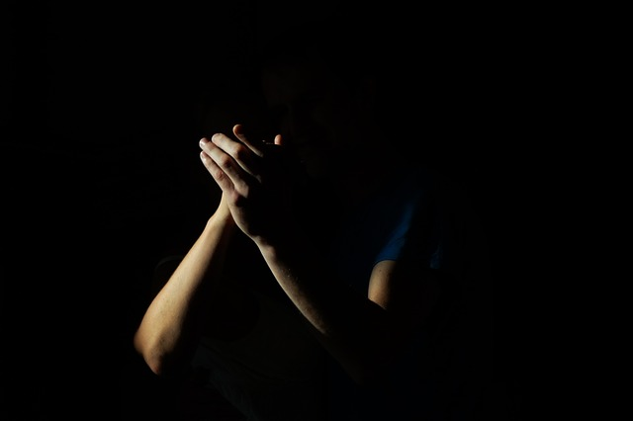
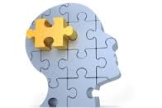

Slide 15
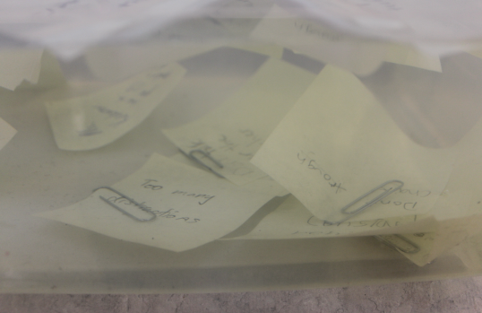
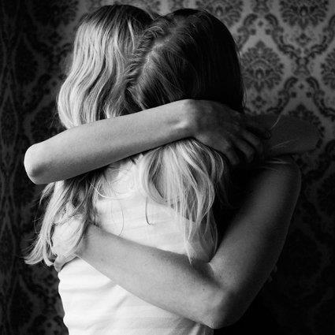
“BE UNDERSTANDING WITH ONE ANOTHER.”

Slide 16
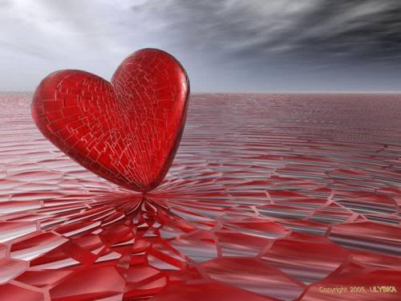
Tender-Hearted

Slide 17
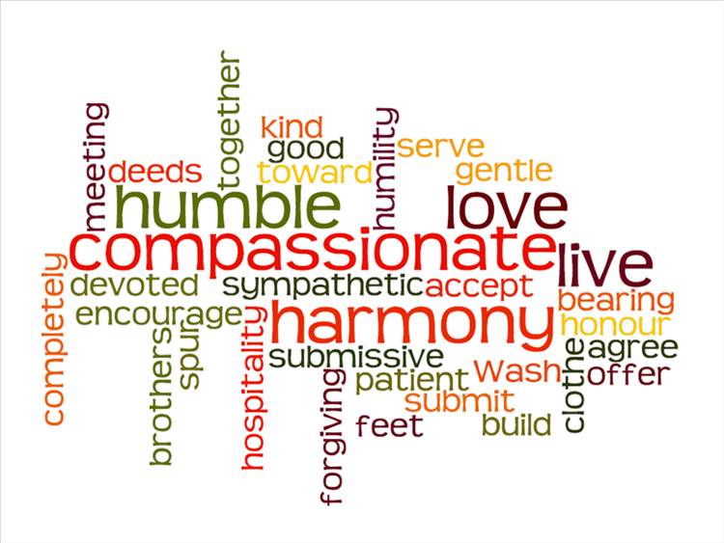

Slide 18
1 Peter 3:8-12
⁸Finally, all of you, have unity of mind, sympathy, brotherly love, a tender heart, and a humble mind.
⁹Do not repay evil for evil or reviling for reviling, but on the contrary, bless, for to this you were called, that you may obtain a blessing.
¹⁰For
“Whoever desires to love life
and see good days,
let him keep his tongue from evil
and his lips from speaking deceit;

Slide 19
1 Peter 3:8-12
⁸Finally, all of you, have unity of mind, sympathy, brotherly love, a tender heart, and a humble mind.
⁹Do not repay evil for evil or reviling for reviling, but on the contrary, bless, for to this you were called, that you may obtain a blessing.
¹⁰For
“Whoever desires to love life
and see good days,
let him keep his tongue from evil
and his lips from speaking deceit;

Slide 20
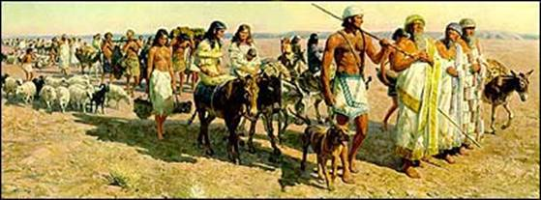
Genesis 12
The Call of Abraham
Now the LORD said to Abram, “Go from your country and your kindred and your father's house to the land that I will show you. And I will make of you a great nation, and I will bless you and make your name great, so that you will be a blessing. I will bless those who bless you, and him who dishonors you I will curse, and in you all the families of the earth shall be blessed.”

Slide 21
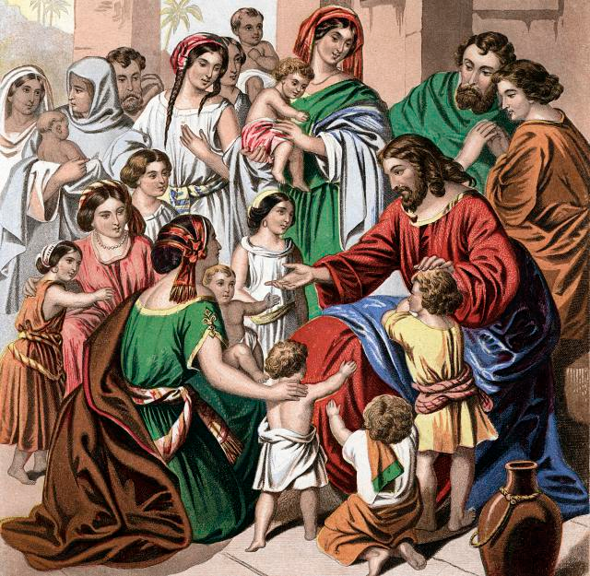

Slide 22
1 Peter 3:10-12
¹⁰For
“Whoever desires to love life
and see good days,
let him keep his tongue from evil
and his lips from speaking deceit;
¹¹let him turn away from evil and do good;
let him seek peace and pursue it.
¹²For the eyes of the Lord are on the righteous,
and his ears are open to their prayer.
But the face of the Lord is against those who do evil.”

Slide 23
“How To Live As People Of God In This World”

