Slide 2
“Baptism Now Saves You!”

Slide 3
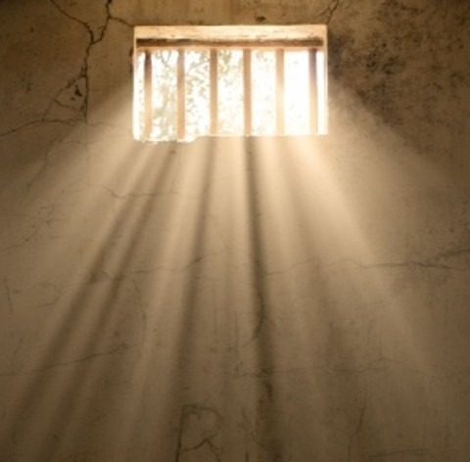
“Jesus Preaching to Spirits in Prison”

Slide 4
“Atonement: The Righteous for the Unrighteous”
- Paul Merideth – Sunday, August 7, 2016

Slide 5
1 Peter 3:18-22
¹⁸ For Christ also suffered once for sins, the righteous for the unrighteous, that he might bring us to God, being put to death in the flesh but made alive in the spirit,
¹⁹ in which he went and proclaimed to the spirits in prison,
²⁰ because they formerly did not obey, when God's patience waited in the days of Noah, while the ark was being prepared, in which a few, that is, eight persons, were brought safely through water.
²¹ Baptism, which corresponds to this, now saves you, not as a removal of dirt from the body but as an appeal to God for a good conscience, through the resurrection of Jesus Christ,
²² who has gone into heaven and is at the right hand of God, with angels, authorities, and powers having been subjected to him.

Slide 6
LIVING AS THE PEOPLE OF GOD IN THIS WORLD
1 Peter

Slide 7
1 Peter 3:18-22
¹⁸ For Christ also suffered once for sins, the righteous for the unrighteous, that he might bring us to God, being put to death in the flesh but made alive in the spirit,
¹⁹ in which he went and proclaimed to the spirits in prison,
²⁰ because they formerly did not obey, when God's patience waited in the days of Noah, while the ark was being prepared, in which a few, that is, eight persons, were brought safely through water.
²¹ Baptism, which corresponds to this, now saves you, not as a removal of dirt from the body but as an appeal to God for a good conscience, through the resurrection of Jesus Christ,
²² who has gone into heaven and is at the right hand of God, with angels, authorities, and powers having been subjected to him.

Slide 8
1 Peter 3:18-22
¹⁸ For Christ also suffered once for sins, the righteous for the unrighteous, that he might bring us to God, being put to death in the flesh but made alive in the spirit,
¹⁹ in which he went and proclaimed to the spirits in prison,
²⁰ because they formerly did not obey, when God's patience waited in the days of Noah, while the ark was being prepared, in which a few, that is, eight persons, were brought safely through water.
²¹ Baptism, which corresponds to this, now saves you, not as a removal of dirt from the body but as an appeal to God for a good conscience, through the resurrection of Jesus Christ,
²² who has gone into heaven and is at the right hand of God, with angels, authorities, and powers having been subjected to him.

Slide 9
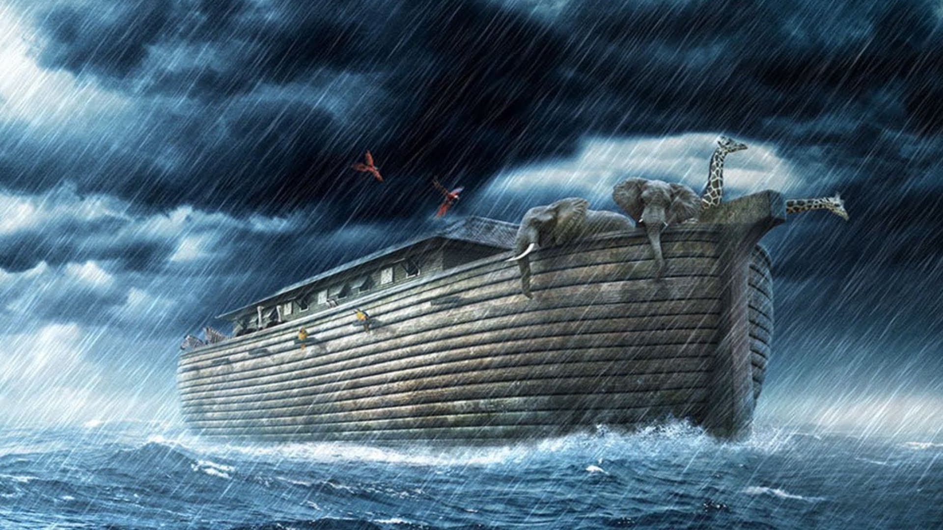
“Jesus preached through Noah to the people of Noah’s day.”

Slide 10
1 Peter 3:18-22
¹⁸ For Christ also suffered once for sins, the righteous for the unrighteous, that he might bring us to God, being put to death in the flesh but made alive in the spirit,
¹⁹ in which he went and proclaimed to the spirits in prison,
²⁰ because they formerly did not obey, when God's patience waited in the days of Noah, while the ark was being prepared, in which a few, that is, eight persons, were brought safely through water.
²¹ Baptism, which corresponds to this, now saves you, not as a removal of dirt from the body but as an appeal to God for a good conscience, through the resurrection of Jesus Christ,
²² who has gone into heaven and is at the right hand of God, with angels, authorities, and powers having been subjected to him.

Slide 11
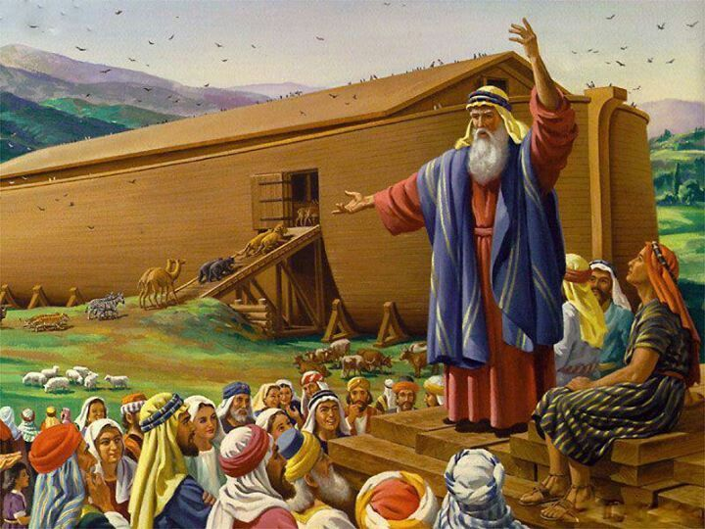

Slide 12
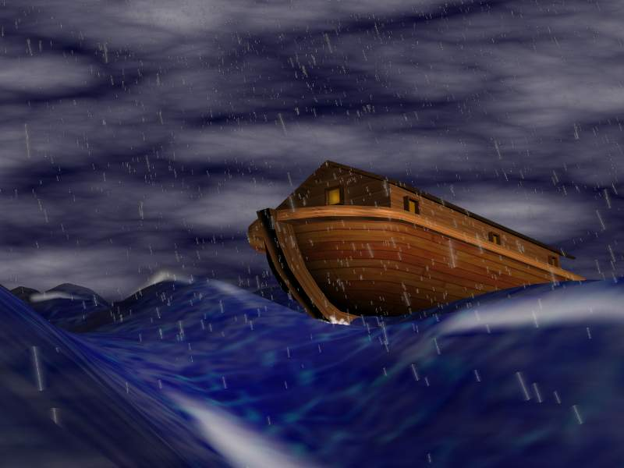
A worldwide cataclysm – that could have been avoided!

Slide 13
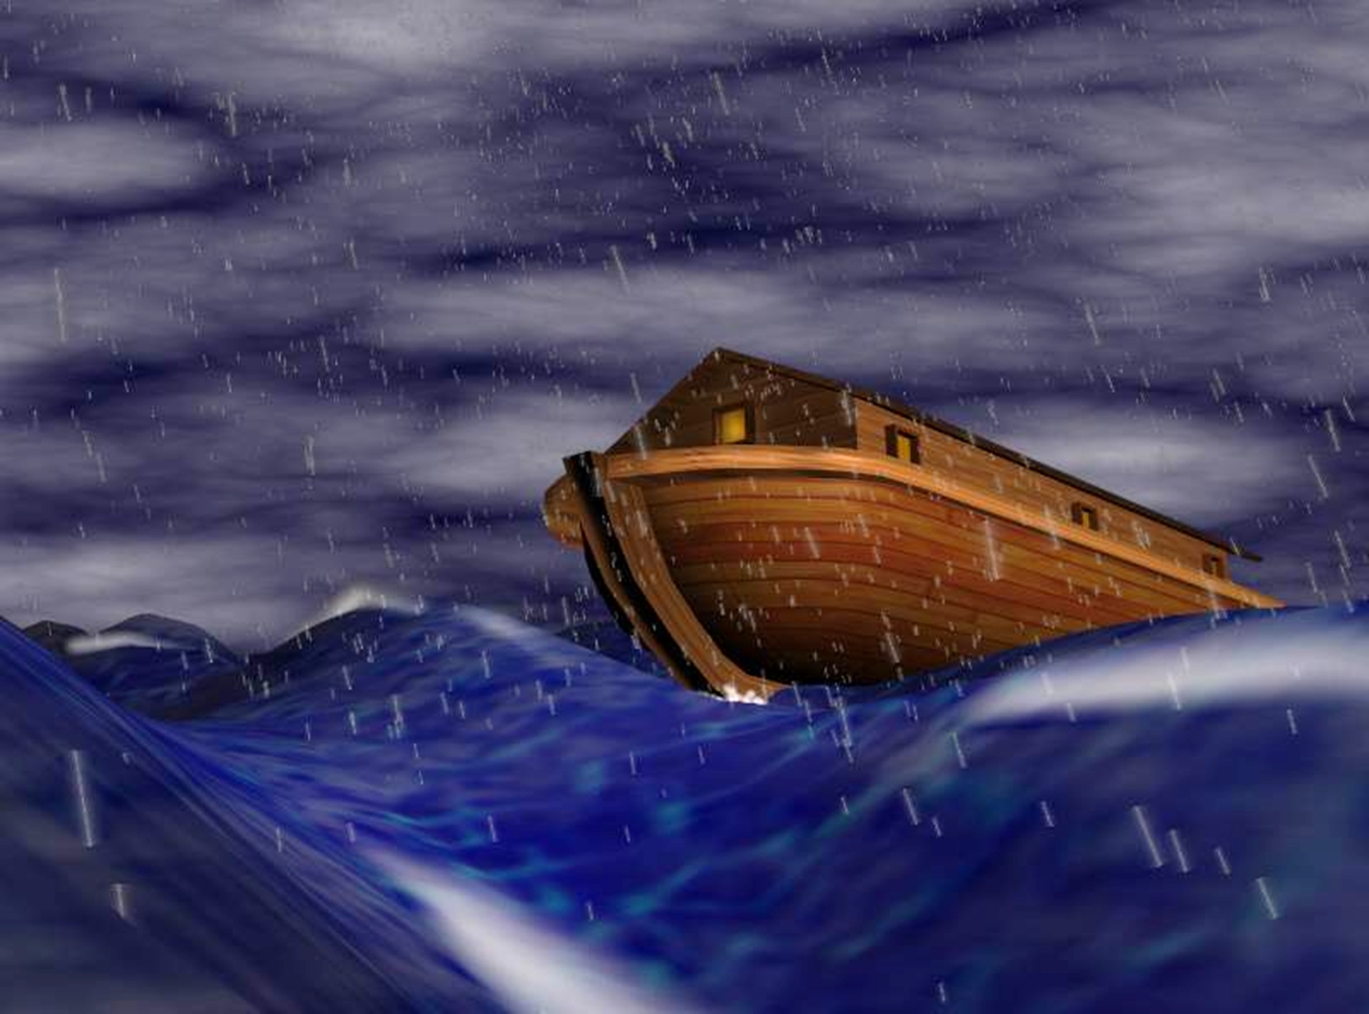
“Baptism, which corresponds
to this, Now Saves You!”

Slide 14
Hear the Gospel;
Believe in Jesus;
Repent of Sin;
Confess faith in Jesus;
________________________________
5) Baptism

Slide 15
Hear the Gospel;
Believe in Jesus;
Repent of Sin;
Confess faith in Jesus;
________________________________
5) “Baptism Now Saves You!”

Slide 16
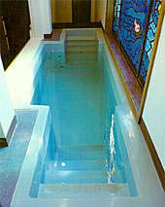
Is Baptism magic?
Are the waters full of some kind of spiritual potion?
CERTAINLY NOT!

Slide 17
1 Peter 3:18-22
¹⁸ For Christ also suffered once for sins, the righteous for the unrighteous, that he might bring us to God, being put to death in the flesh but made alive in the spirit,
¹⁹ in which he went and proclaimed to the spirits in prison,
²⁰ because they formerly did not obey, when God's patience waited in the days of Noah, while the ark was being prepared, in which a few, that is, eight persons, were brought safely through water.
²¹ Baptism, which corresponds to this, now saves you, not as a removal of dirt from the body but as an appeal to God for a good conscience, through the resurrection of Jesus Christ,
²² who has gone into heaven and is at the right hand of God, with angels, authorities, and powers having been subjected to him.

Slide 18
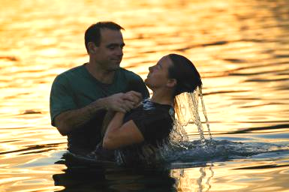

Slide 19
1 Peter 3:18-22
¹⁸ For Christ also suffered once for sins, the righteous for the unrighteous, that he might bring us to God, being put to death in the flesh but made alive in the spirit,
¹⁹ in which he went and proclaimed to the spirits in prison,
²⁰ because they formerly did not obey, when God's patience waited in the days of Noah, while the ark was being prepared, in which a few, that is, eight persons, were brought safely through water.
²¹ Baptism, which corresponds to this, now saves you, not as a removal of dirt from the body but as an appeal to God for a good conscience, through the resurrection of Jesus Christ,
²² who has gone into heaven and is at the right hand of God, with angels, authorities, and powers having been subjected to him.

Slide 21
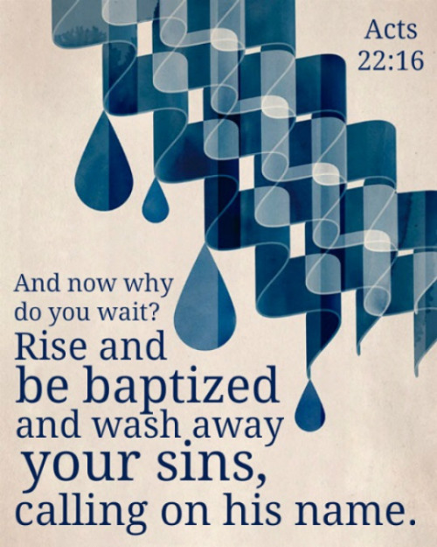
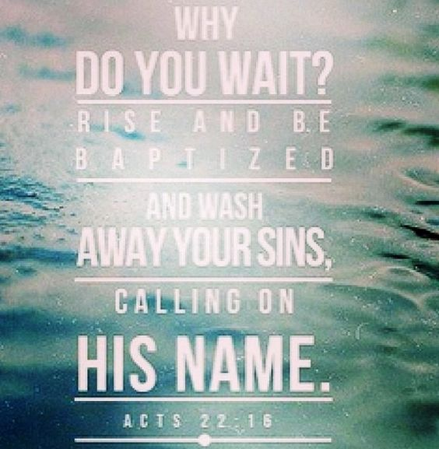

Slide 22
“Baptism Now Saves You!”

Slide 23
Do you believe that Jesus is the Christ, the Son of the Living God?

Slide 24
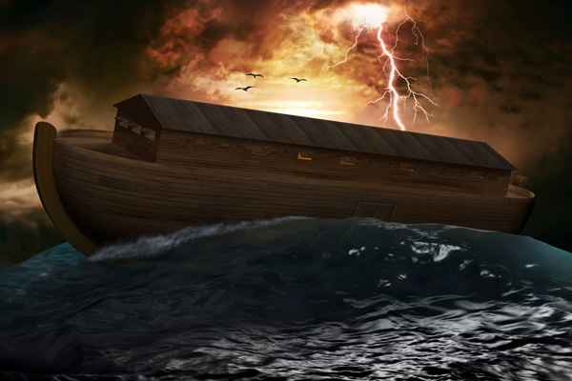

Slide 26
“Baptism Now Saves You!”

