Slide 1
“What the Gentiles Do”
(1 Peter 4:1-6)
Mark E. Mason
August 21, 2016

Slide 2
Hymn # 553
Written in 1911
by William Merrill

Slide 3
Hymn # 553
“Rise up, O men of God!
Have done with lesser things.”
“Give heart and mind and soul and strength to serve the King of Kings!”

Slide 4
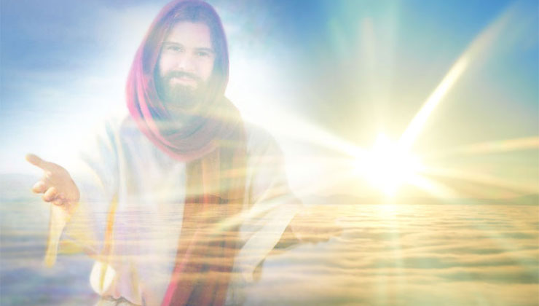
“Is God, Christ, and His Kingdom your #1 Priority?”

Slide 6
1 Peter 4:1-6
¹Since therefore Christ suffered in the flesh, arm yourselves with the same way of thinking, for whoever has suffered in the flesh has ceased from sin,
² so as to live for the rest of the time in the flesh no longer for human passions but for the will of God.
³ For the time that is past suffices for doing what the Gentiles want to do, living in sensuality, passions, drunkenness, orgies, drinking parties, and lawless idolatry.

Slide 7
1 Peter 4:1-6
⁴ With respect to this they are surprised when you do not join them in the same flood of debauchery, and they malign you;
⁵ but they will give account to him who is ready to judge the living and the dead.
⁶ For this is why the gospel was preached even to those who are dead, that though judged in the flesh the way people are, they might live in the spirit the way God does.

Slide 8
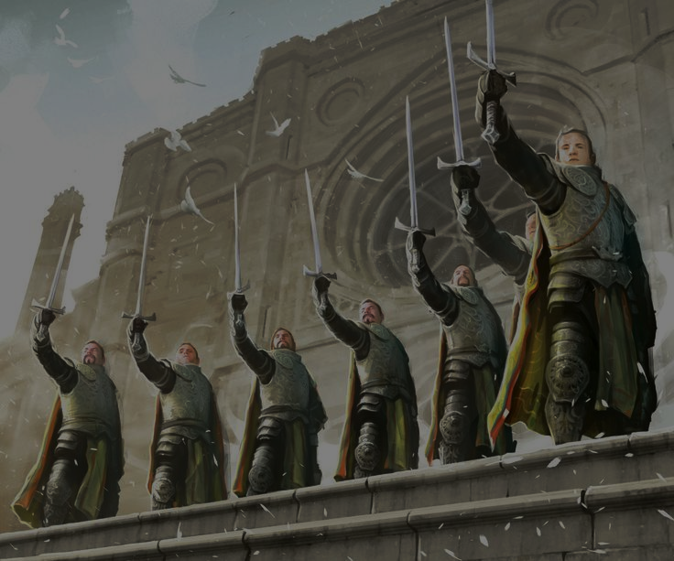
“the Christian Faith is a Militant Faith!”

Slide 10
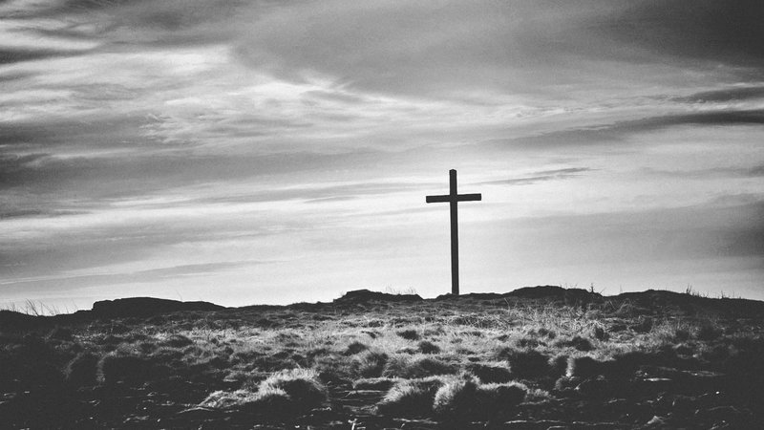
If a person is willing, like Jesus was, to suffer for his/her faith – if they are willing to go that far for what they believe – they really take it seriously, do they not?

Slide 11
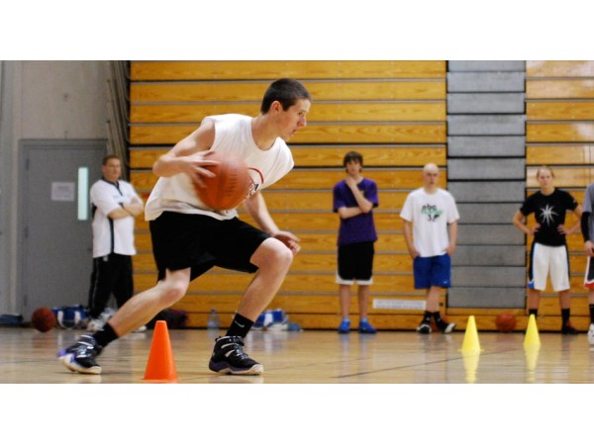

Slide 13
1 Peter 4:3-4
³ For the time that is past suffices for doing what the Gentiles want to do, living in sensuality, passions, drunkenness, orgies, drinking parties, and lawless idolatry
⁴ With respect to this they are surprised when you do not join them in the same flood of debauchery, and they malign you;

Slide 14
First Century World

Slide 15
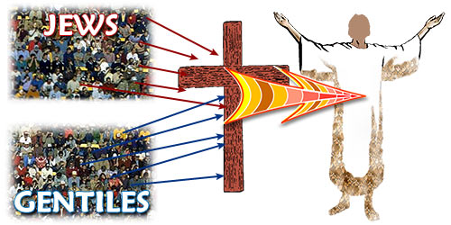

Slide 16
1 Peter 4:1-6
Here in 1 Peter, “Gentile” means:
Non-Christian
Non-Believer
Pagan

Slide 17
1 Peter 4:3-4
³ For the time that is past suffices for doing what the Gentiles want to do, living in sensuality, passions, drunkenness, orgies, drinking parties, and lawless idolatry
⁴ With respect to this they are surprised when you do not join them in the same flood of debauchery, and they malign you;

Slide 18
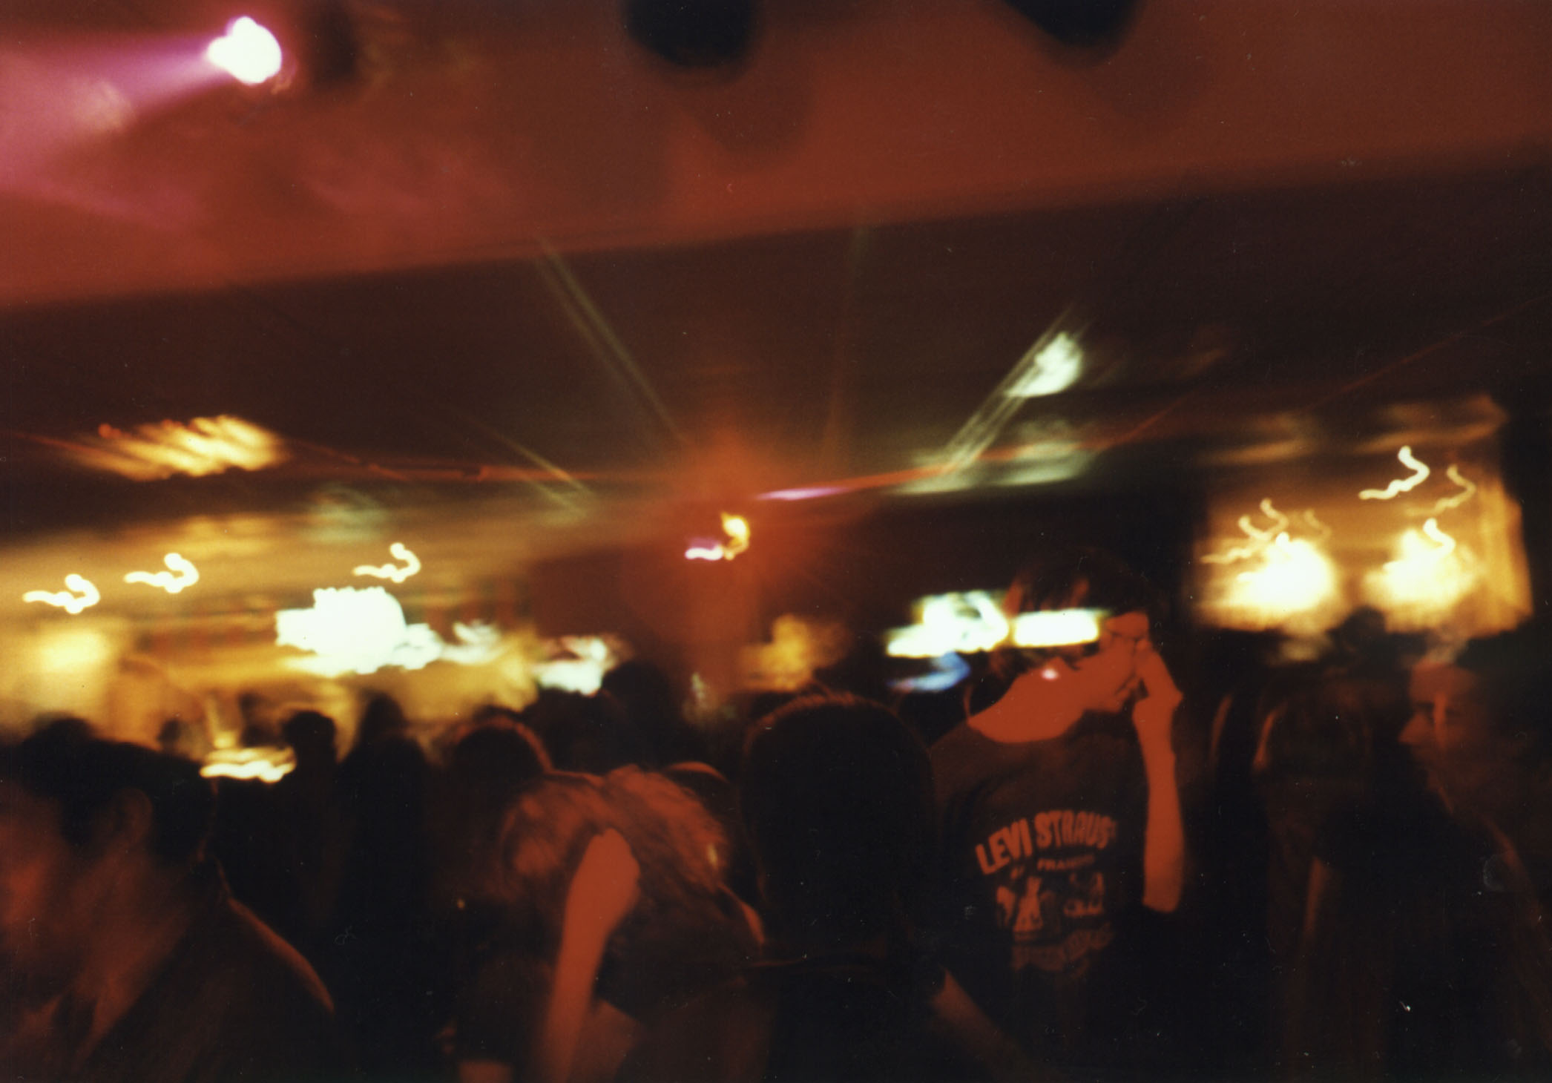
“the party scene”

Slide 19
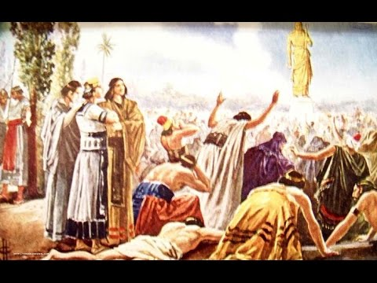

Slide 20
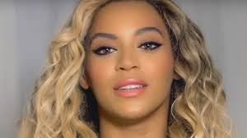
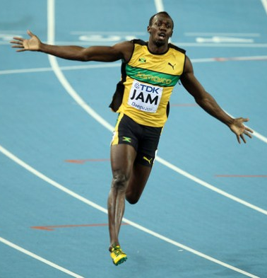
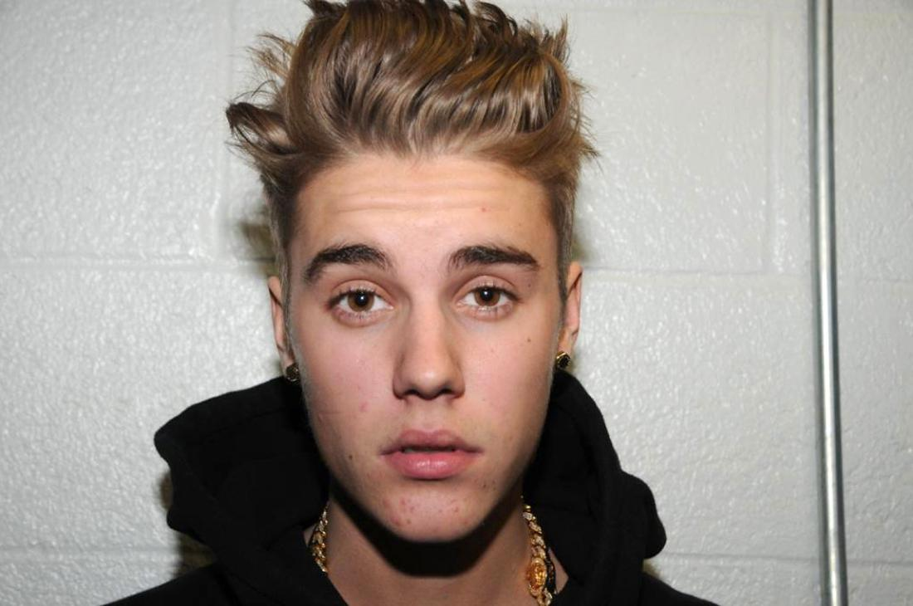
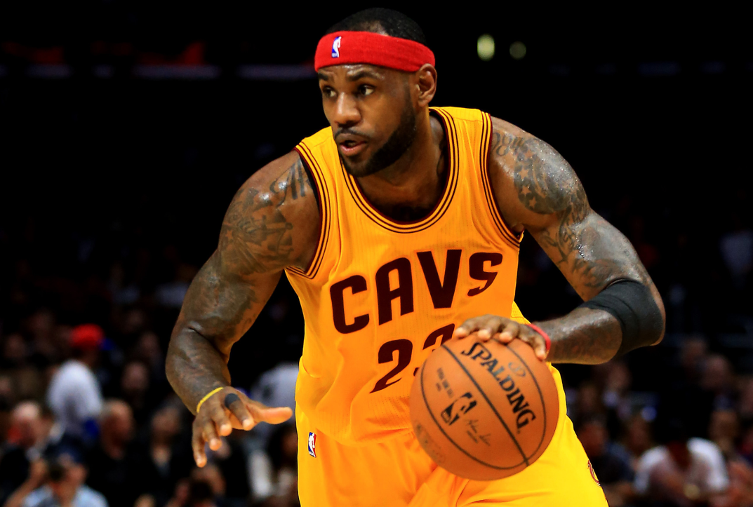
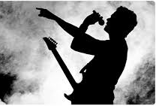

Slide 21
1 Peter 4:3-4
³ For the time that is past suffices for doing what the Gentiles want to do, living in sensuality, passions, drunkenness, orgies, drinking parties, and lawless idolatry
⁴ With respect to this they are surprised when you do not join them in the same flood of debauchery, and they malign you;

Slide 22
“What the Gentiles Do”
“we ought to be living such lives that will indict the immorality of the world around us.”

Slide 23
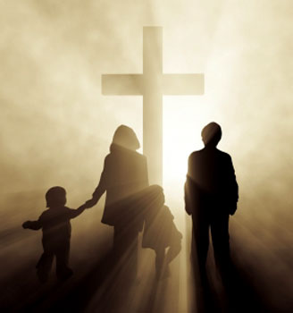
“Living like
Jesus lived.”

Slide 24
“let’s not judge”

Slide 25
“let’s be tolerant”

Slide 26
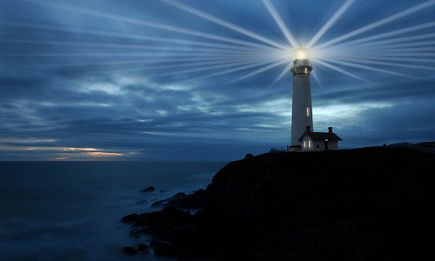

Slide 27
“We should not be like Cain, who was of the evil one and murdered his brother. And why did he murder him? Because his own deeds were evil and his brother's righteous.”
1 John 3:12

Slide 28
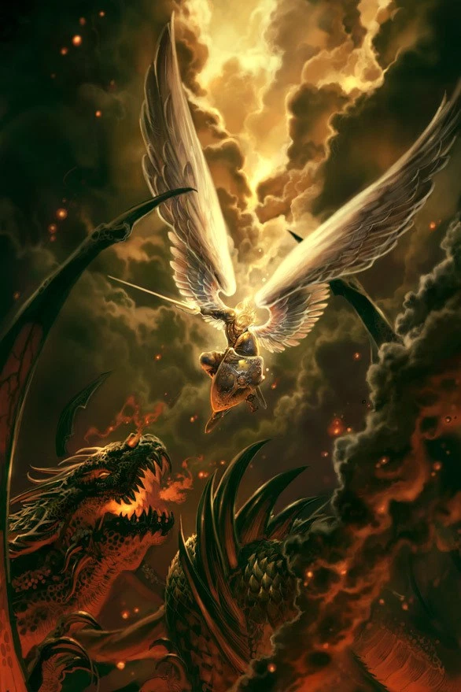

Slide 29
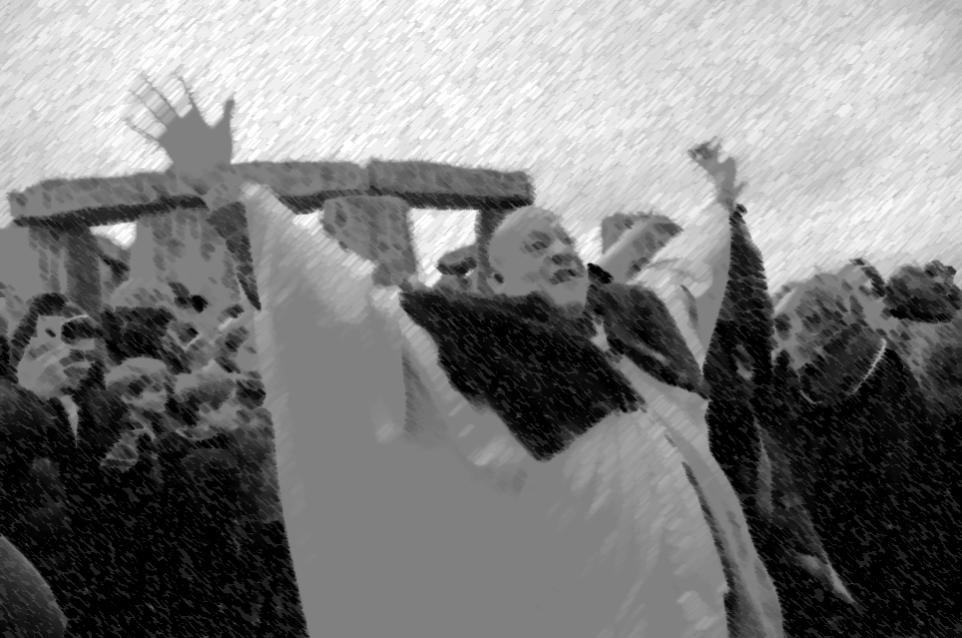
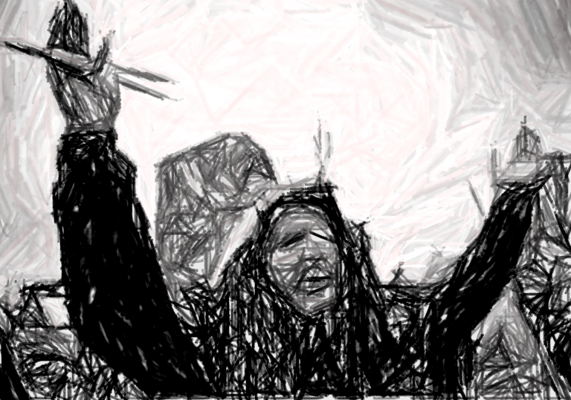
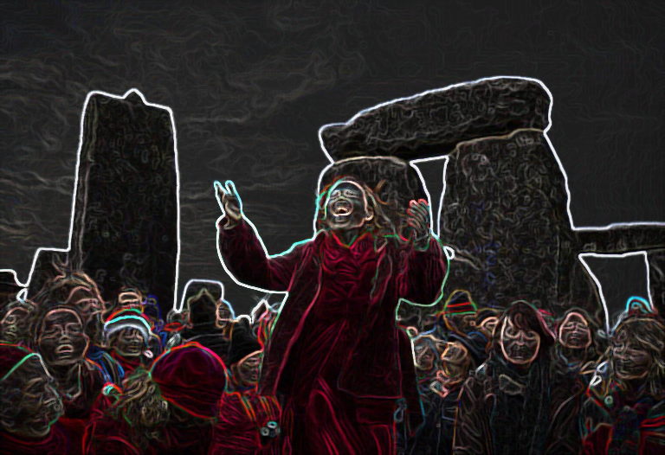
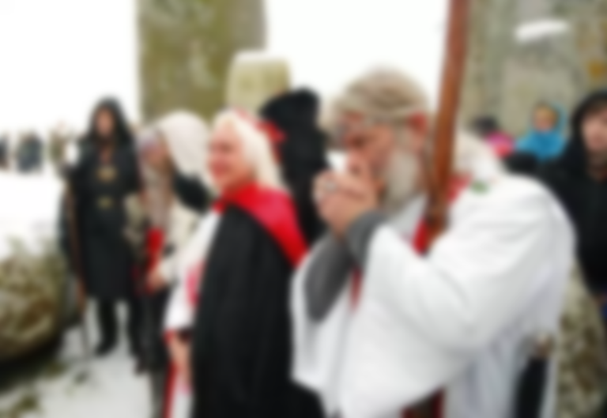

Slide 30
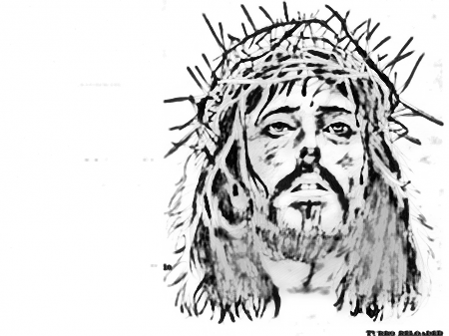
“WOE TO YOU WHEN ALL PEOPLE SPEAK WELL OF YOU”

Slide 32
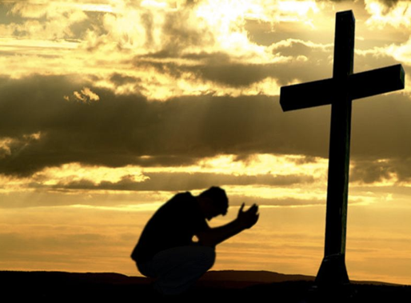

Slide 33
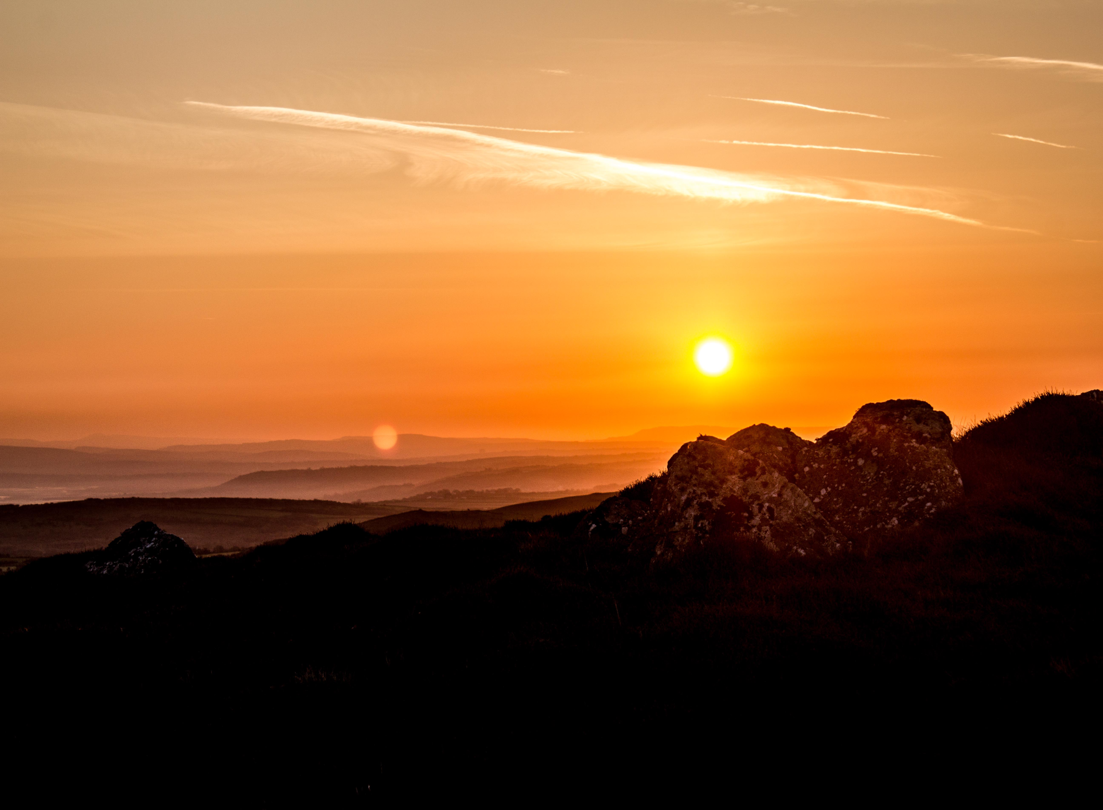
“Rise up, people of God. Have done with the lesser things.
Give Heart and Mind and Soul and Strength to serve the King of Kings.”

