Slide 1
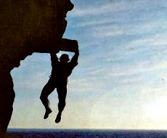
“Barely Saved??”
1 Peter 4:12-19

Slide 2
“My bones stick to my skin and to my flesh,
and I have escaped by the skin of my teeth.”
Job 19:20

Slide 3
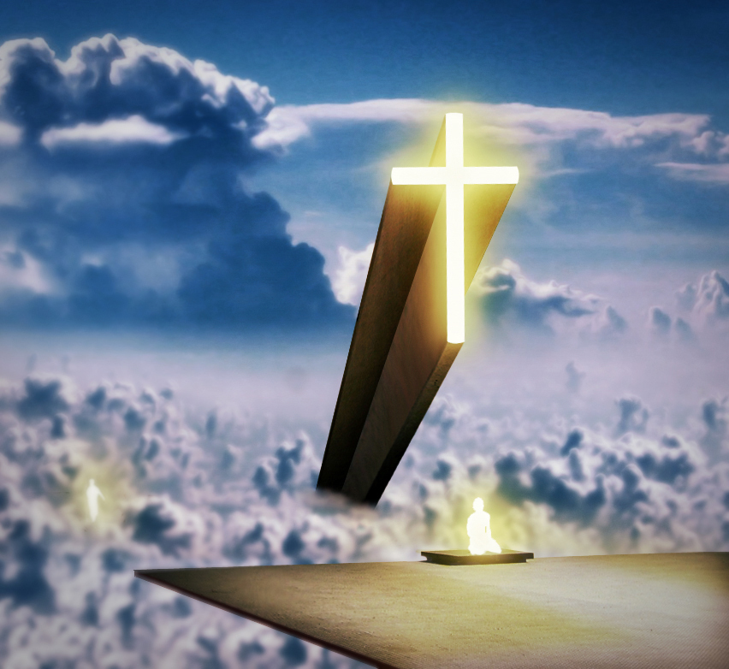
“Once Saved, Always Saved”
“If saved, barely saved”
“If saved, only by the skin of my teeth!”

Slide 4
1 Peter 4:12-19 (ESV)
¹²Beloved, do not be surprised at the fiery trial when it comes upon you to test you, as though something strange were happening to you.
¹³But rejoice insofar as you share Christ's sufferings, that you may also rejoice and be glad when his glory is revealed.
¹⁴If you are insulted for the name of Christ, you are blessed, because the Spirit of glory and of God rests upon you.
¹⁵But let none of you suffer as a murderer or a thief or an evildoer or as a meddler.

Slide 5
1 Peter 4:12-19 (ESV)
¹⁶Yet if anyone suffers as a Christian, let him not be ashamed, but let him glorify God in that name.
¹⁷For it is time for judgment to begin at the household of God; and if it begins with us, what will be the outcome for those who do not obey the gospel of God?
¹⁸And
“If the righteous is scarcely saved,
what will become of the ungodly and the sinner?”
¹⁹Therefore let those who suffer according to God's will entrust their souls to a faithful Creator while doing good.

Slide 6
1 Peter 4:12-19 (ESV)
¹²Beloved, do not be surprised at the fiery trial when it comes upon you to test you, as though something strange were happening to you.
¹³But rejoice insofar as you share Christ's sufferings, that you may also rejoice and be glad when his glory is revealed.
¹⁴If you are insulted for the name of Christ, you are blessed, because the Spirit of glory and of God rests upon you.
¹⁵But let none of you suffer as a murderer or a thief or an evildoer or as a meddler.

Slide 7
1 Peter 4:12-19 (ESV)
¹⁶Yet if anyone suffers as a Christian, let him not be ashamed, but let him glorify God in that name.
¹⁷For it is time for judgment to begin at the household of God; and if it begins with us, what will be the outcome for those who do not obey the gospel of God?
¹⁸And
“If the righteous is scarcely saved,
what will become of the ungodly and the sinner?”
¹⁹Therefore let those who suffer according to God's will entrust their souls to a faithful Creator while doing good.

Slide 9
1 Peter 4:12-19 (ESV)
¹⁶Yet if anyone suffers as a Christian, let him not be ashamed, but let him glorify God in that name.
¹⁷For it is time for judgment to begin at the household of God; and if it begins with us, what will be the outcome for those who do not obey the gospel of God?
¹⁸And
“If the righteous is scarcely saved,
what will become of the ungodly and the sinner?”
¹⁹Therefore let those who suffer according to God's will entrust their souls to a faithful Creator while doing good.

Slide 10
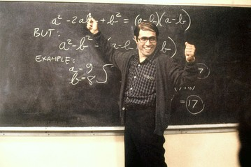

Slide 11
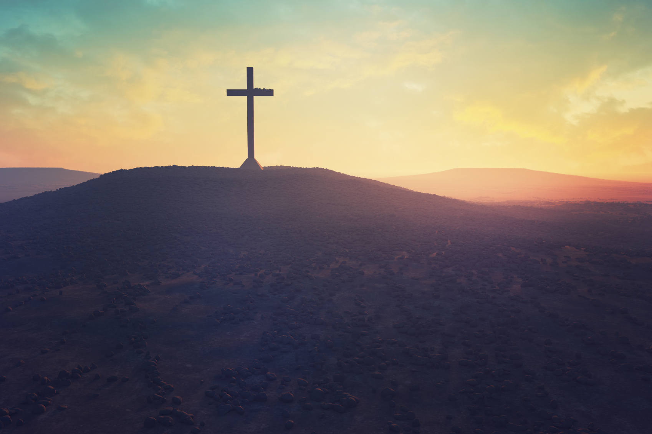
It’s not easy being a Christian – not in the least – not if you are a true disciple!

Slide 12
“Judgement begins at the Household of God – with God’s people.”

Slide 13
“My son, do not take lightly the discipline of the Lord . . . For the Lord disciplines the one He loves, and chastises every son whom He receives.”
Proverbs 3:11-12

Slide 14
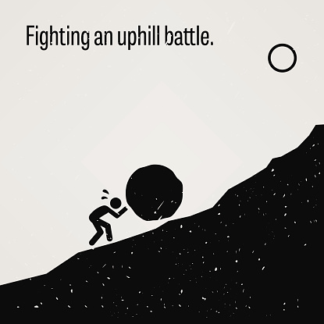

Slide 16
1 Peter 4:12-19 (ESV)
¹⁶Yet if anyone suffers as a Christian, let him not be ashamed, but let him glorify God in that name.
¹⁷For it is time for judgment to begin at the household of God; and if it begins with us, what will be the outcome for those who do not obey the gospel of God?
¹⁸And
“If the righteous is scarcely saved,
what will become of the ungodly and the sinner?”
¹⁹Therefore let those who suffer according to God's will entrust their souls to a faithful Creator while doing good.

Slide 17
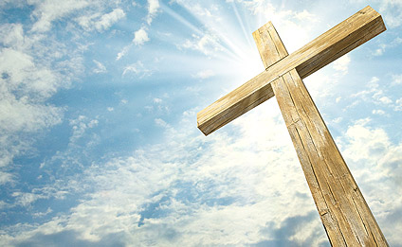
Jesus blood applied to your life – your sins – will indeed give you an abundant entrance into heaven - you’re not going to barely get into heaven if you are a faithful follower of Jesus – you’re not going to sneak in like some stowaway – you will walk in with head held high – nothing doubting!

Slide 18
Testing and Purification
OR
Judgment of Destruction

Slide 19
“If saved, barely saved”
“If saved, only by the skin of my teeth!”

Slide 20
2 Thessalonians 1

Slide 21
The Judgment at Christ's Coming
“This is evidence of the righteous judgment of God, that you may be considered worthy of the kingdom of God, for which you are also suffering— since indeed God considers it just to repay with affliction those who afflict you, and to grant relief to you who are afflicted as well as to us, when the Lord Jesus is revealed from heaven with his mighty angels in flaming fire, inflicting vengeance on those who do not know God and on those who do not obey the gospel of our Lord Jesus.

Slide 22
They will suffer the punishment of eternal destruction, away from the presence of the Lord and from the glory of his might, when he comes on that day to be glorified in his saints, and to be marveled at among all who have believed, because our testimony to you was believed.”

