Slide 1
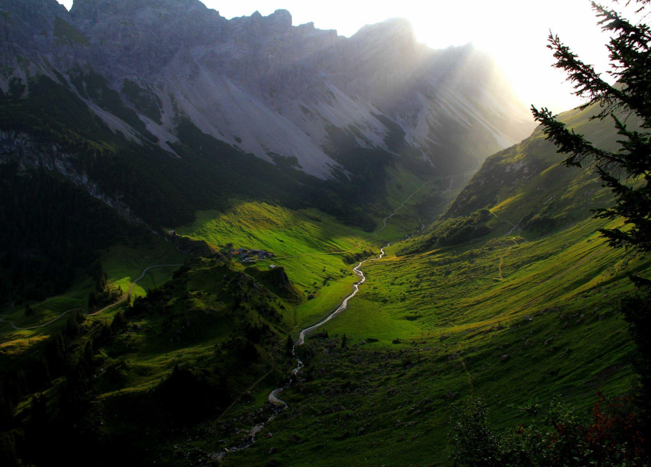
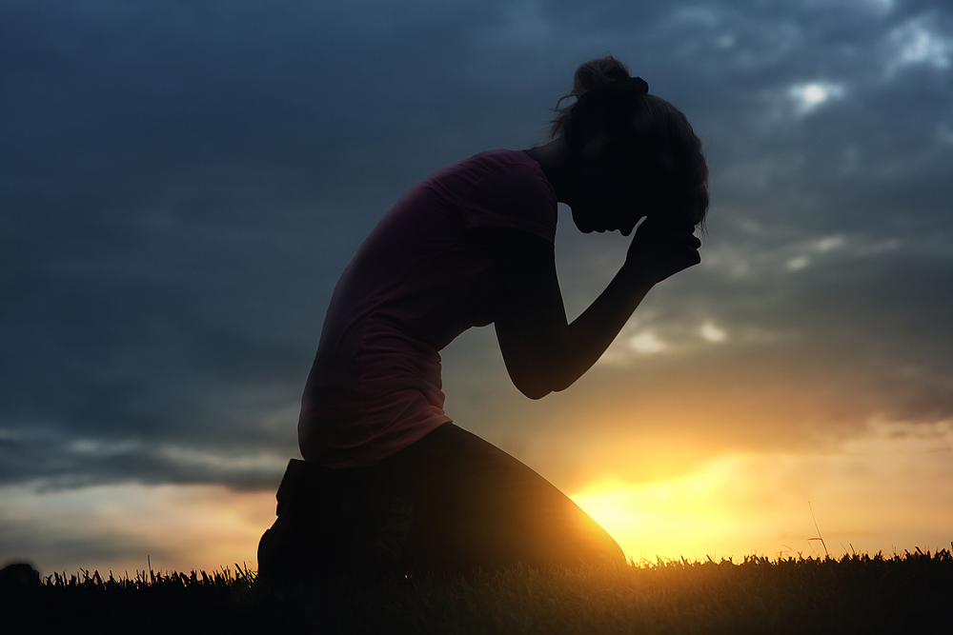
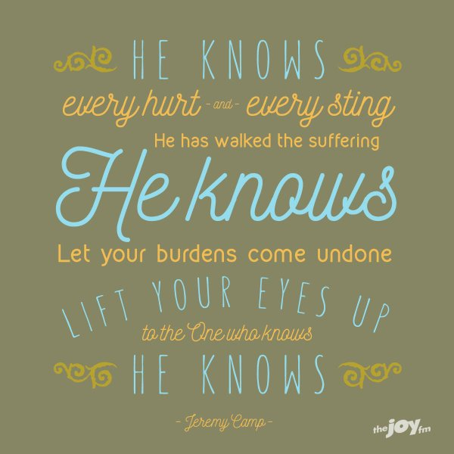

Slide 2
`

Slide 3
“HE CARES”

Slide 7
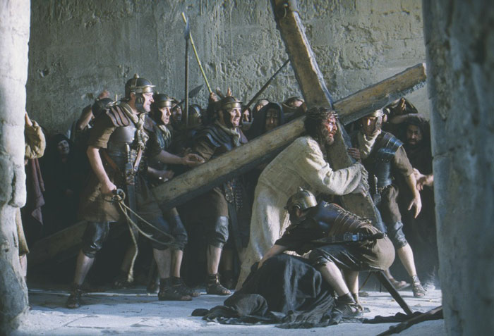

Slide 8
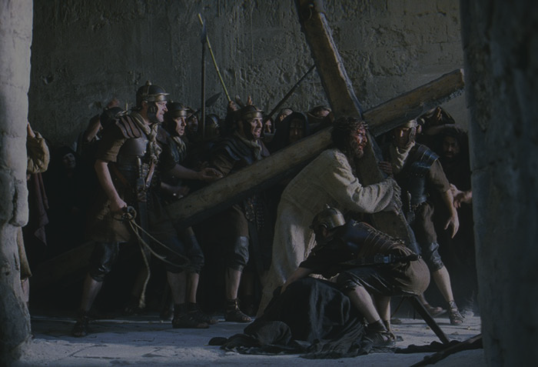
He Cares!
He Knows, and
He Cares!

Slide 9
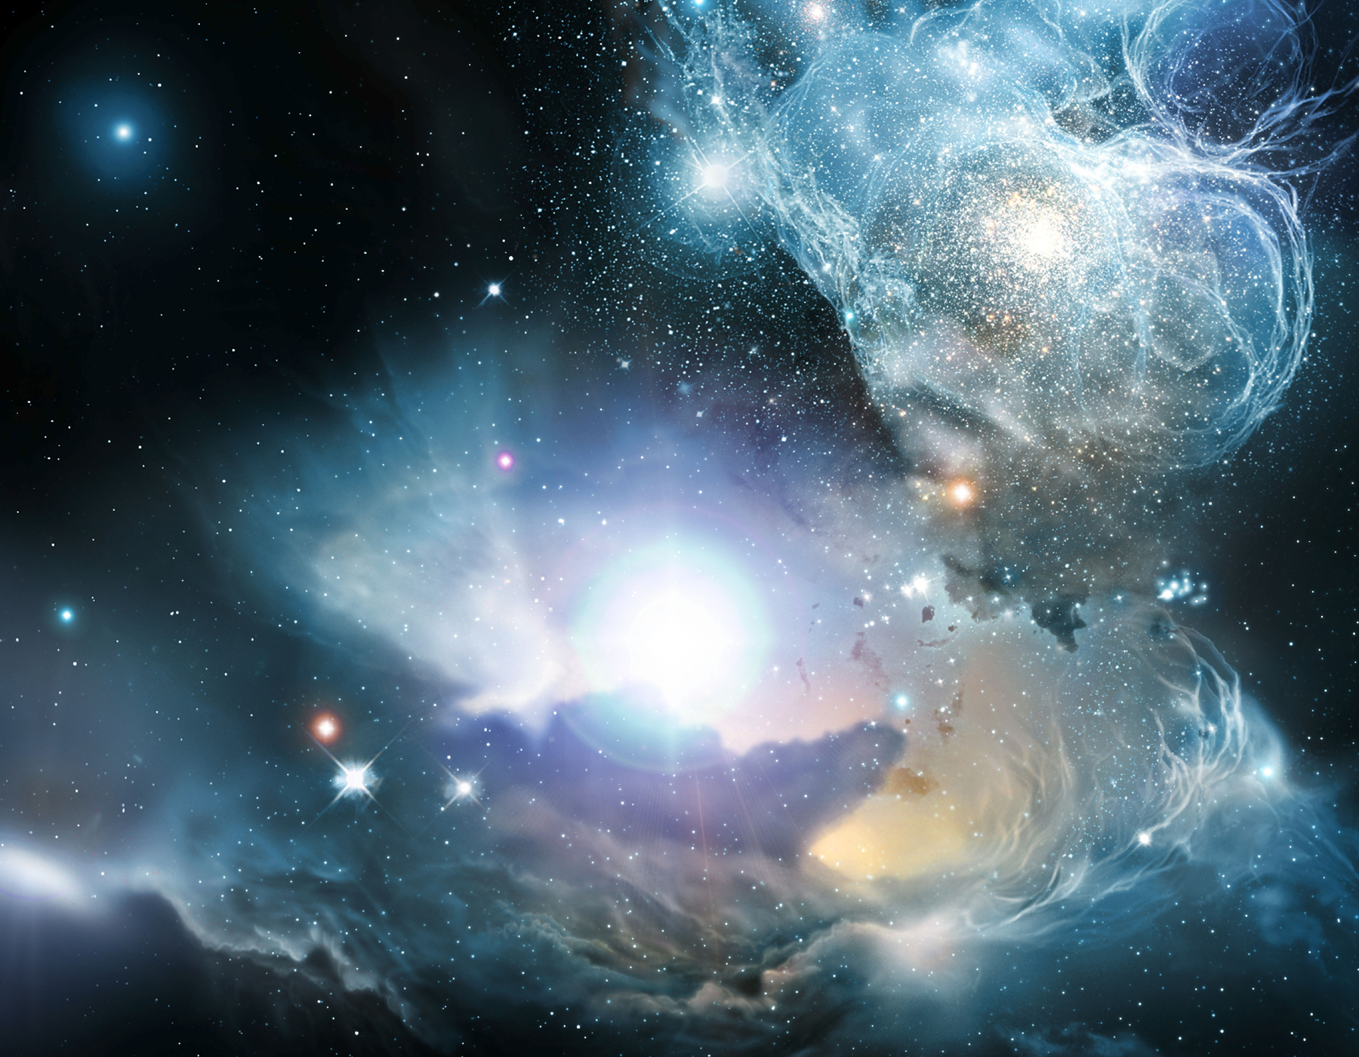

Slide 10
1 Peter 5:6-11
⁶Humble yourselves, therefore, under the mighty hand of God so that at the proper time he may exalt you,
⁷casting all your anxieties on him, because he cares for you.
⁸Be sober-minded; be watchful. Your adversary the devil prowls around like a roaring lion, seeking someone to devour.
⁹Resist him, firm in your faith, knowing that the same kinds of suffering are being experienced by your brotherhood throughout the world.
¹⁰And after you have suffered a little while, the God of all grace, who has called you to his eternal glory in Christ, will himself restore, confirm, strengthen, and establish you.
¹¹To him be the dominion forever and ever. Amen.

Slide 11
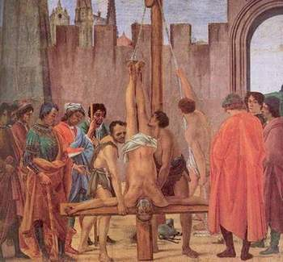
1 Peter 5:6-11
⁶Humble yourselves, therefore, under the mighty hand of God so that at the proper time he may exalt you,
⁷casting all your anxieties on him, because he cares for you.
⁸Be sober-minded; be watchful. Your adversary the devil prowls around like a roaring lion, seeking someone to devour.
⁹Resist him, firm in your faith, knowing that the same kinds of suffering are being experienced by your brotherhood throughout the world.
¹⁰And after you have suffered a little while, the God of all grace, who has called you to his eternal glory in Christ, will himself restore, confirm, strengthen, and establish you.
¹¹To him be the dominion forever and ever. Amen.

Slide 12
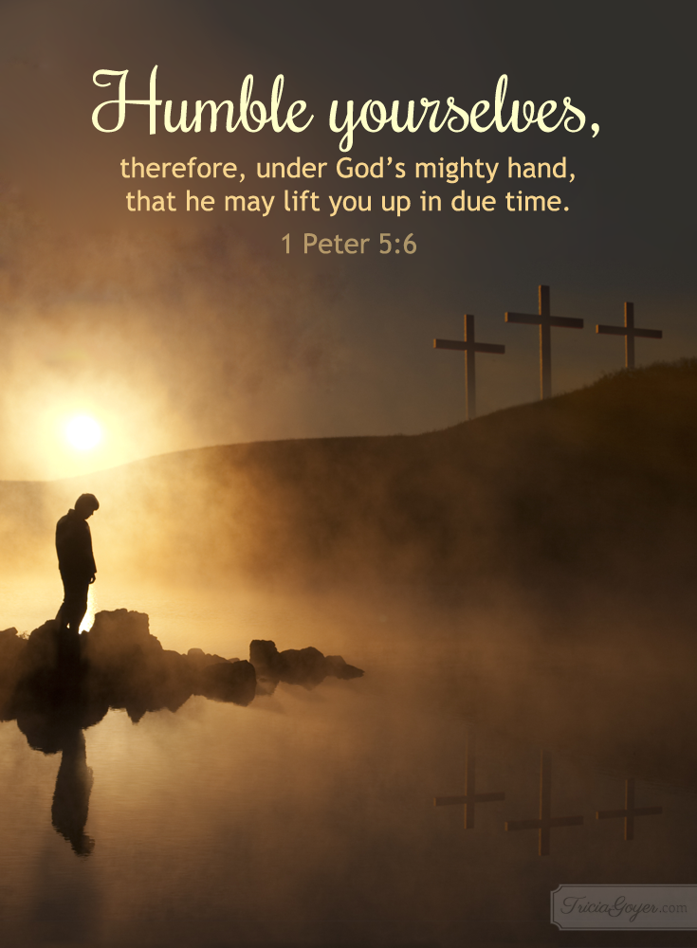

Slide 15
1 Peter 5:6-11
⁶Humble yourselves, therefore, under the mighty hand of God so that at the proper time he may exalt you,
⁷casting all your anxieties on him, because he cares for you.
⁸Be sober-minded; be watchful. Your adversary the devil prowls around like a roaring lion, seeking someone to devour.
⁹Resist him, firm in your faith, knowing that the same kinds of suffering are being experienced by your brotherhood throughout the world.
¹⁰And after you have suffered a little while, the God of all grace, who has called you to his eternal glory in Christ, will himself restore, confirm, strengthen, and establish you.
¹¹To him be the dominion forever and ever. Amen.

Slide 16
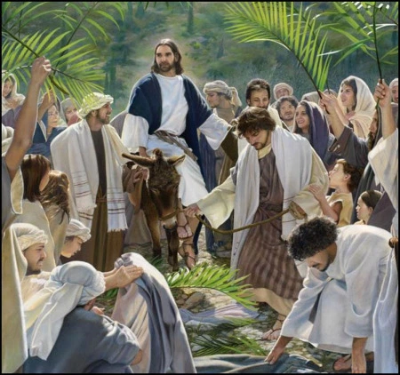

Slide 18
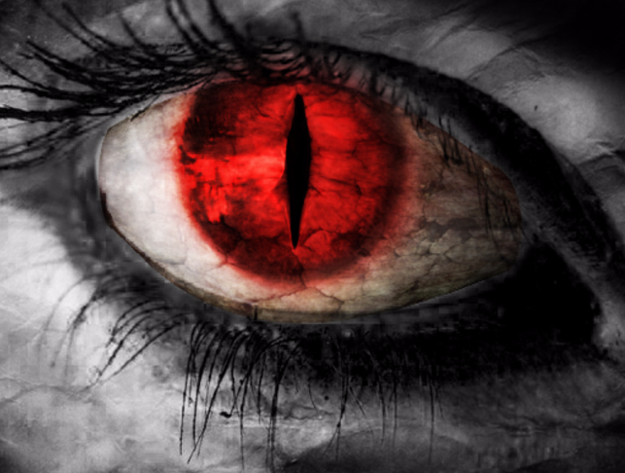
1 Peter 5:6-11
⁶Humble yourselves, therefore, under the mighty hand of God so that at the proper time he may exalt you,
⁷casting all your anxieties on him, because he cares for you.
⁸Be sober-minded; be watchful. Your adversary the devil prowls around like a roaring lion, seeking someone to devour.
⁹Resist him, firm in your faith, knowing that the same kinds of suffering are being experienced by your brotherhood throughout the world.
¹⁰And after you have suffered a little while, the God of all grace, who has called you to his eternal glory in Christ, will himself restore, confirm, strengthen, and establish you.
¹¹To him be the dominion forever and ever. Amen.

Slide 19
1 Peter 5:6-11
⁶Humble yourselves, therefore, under the mighty hand of God so that at the proper time he may exalt you,
⁷casting all your anxieties on him, because he cares for you.
⁸Be sober-minded; be watchful. Your adversary the devil prowls around like a roaring lion, seeking someone to devour.
⁹Resist him, firm in your faith, knowing that the same kinds of suffering are being experienced by your brotherhood throughout the world.
¹⁰And after you have suffered a little while, the God of all grace, who has called you to his eternal glory in Christ, will himself restore, confirm, strengthen, and establish you.
¹¹To him be the dominion forever and ever. Amen.

Slide 20
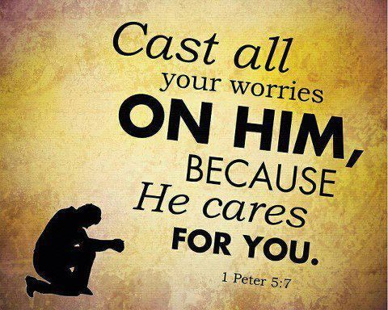

Slide 21
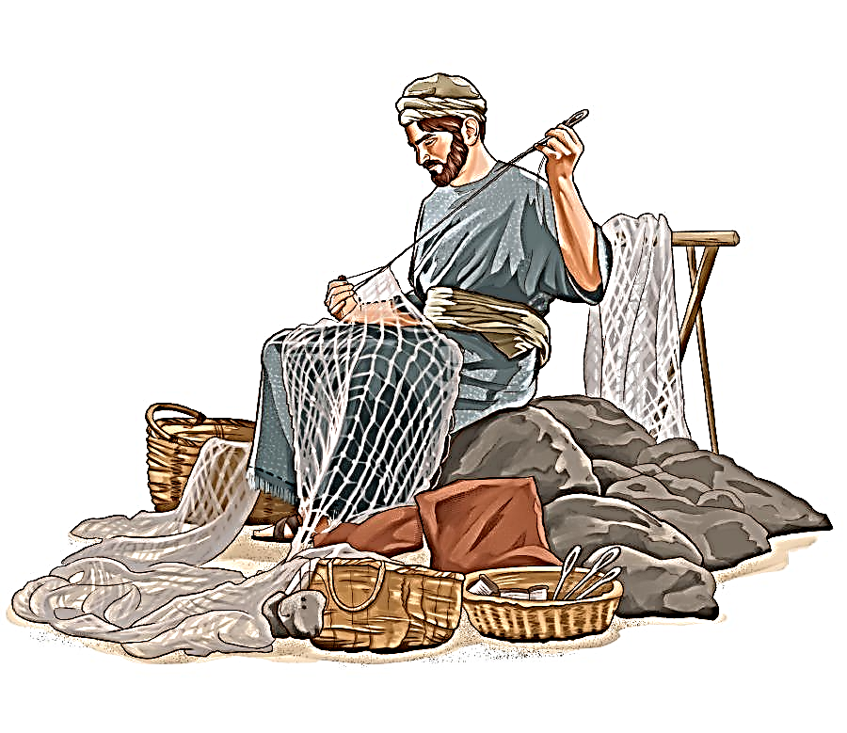
1 Peter 5:6-11
⁶Humble yourselves, therefore, under the mighty hand of God so that at the proper time he may exalt you,
⁷casting all your anxieties on him, because he cares for you.
⁸Be sober-minded; be watchful. Your adversary the devil prowls around like a roaring lion, seeking someone to devour.
⁹Resist him, firm in your faith, knowing that the same kinds of suffering are being experienced by your brotherhood throughout the world.
¹⁰And after you have suffered a little while, the God of all grace, who has called you to his eternal glory in Christ, will himself restore, confirm, strengthen, and establish you.
¹¹To him be the dominion forever and ever. Amen.

Slide 22
1 Peter 5:6-11
⁶Humble yourselves, therefore, under the mighty hand of God so that at the proper time he may exalt you,
⁷casting all your anxieties on him, because he cares for you.
⁸Be sober-minded; be watchful. Your adversary the devil prowls around like a roaring lion, seeking someone to devour.
⁹Resist him, firm in your faith, knowing that the same kinds of suffering are being experienced by your brotherhood throughout the world.
¹⁰And after you have suffered a little while, the God of all grace, who has called you to his eternal glory in Christ, will himself restore, confirm, strengthen, and establish you.
¹¹To him be the dominion forever and ever. Amen.

Slide 23
1 Peter 5:6-11
⁶Humble yourselves, therefore, under the mighty hand of God so that at the proper time he may exalt you,
⁷casting all your anxieties on him, because he cares for you.
⁸Be sober-minded; be watchful. Your adversary the devil prowls around like a roaring lion, seeking someone to devour.
⁹Resist him, firm in your faith, knowing that the same kinds of suffering are being experienced by your brotherhood throughout the world.
¹⁰And after you have suffered a little while, the God of all grace, who has called you to his eternal glory in Christ, will himself restore, confirm, strengthen, and establish you.
¹¹To him be the dominion forever and ever. Amen.

Slide 24
1 Peter 5:6-11
⁶Humble yourselves, therefore, under the mighty hand of God so that at the proper time he may exalt you,
⁷casting all your anxieties on him, because he cares for you.
⁸Be sober-minded; be watchful. Your adversary the devil prowls around like a roaring lion, seeking someone to devour.
⁹Resist him, firm in your faith, knowing that the same kinds of suffering are being experienced by your brotherhood throughout the world.
¹⁰And after you have suffered a little while, the God of all grace, who has called you to his eternal glory in Christ, will himself restore, confirm, strengthen, and establish you.
¹¹To him be the dominion forever and ever. Amen.

