Slide 2
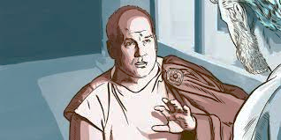

Slide 3
Acts 10:1-8
¹At Caesarea there was a man named Cornelius, a centurion of what was known as the Italian Cohort,
²a devout man who feared God with all his household, gave alms generously to the people, and prayed continually to God.
³About the ninth hour of the day he saw clearly in a vision an angel of God come in and say to him, “Cornelius.”
⁴And he stared at him in terror and said, “What is it, Lord?” And he said to him, “Your prayers and your alms have ascended as a memorial before God.

Slide 4
Acts 10:1-8
⁵ And now send men to Joppa and bring one Simon who is called Peter.
⁶ He is lodging with one Simon, a tanner, whose house is by the sea.”
⁷ When the angel who spoke to him had departed, he called two of his servants and a devout soldier from among those who attended him,
⁸ and having related everything to them, he sent them to Joppa.

Slide 5
Cornelius

Slide 6
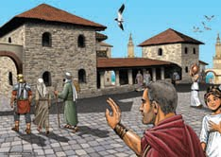
“That is just a good man.”

Slide 7
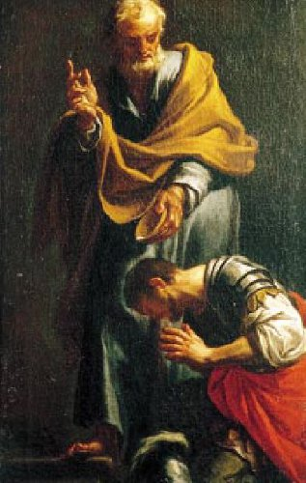
¹At Caesarea there was a man named Cornelius, a centurion of what was known as the Italian Cohort,
²a devout man who feared God with all his household, gave alms generously to the people, and prayed continually to God.

Slide 8
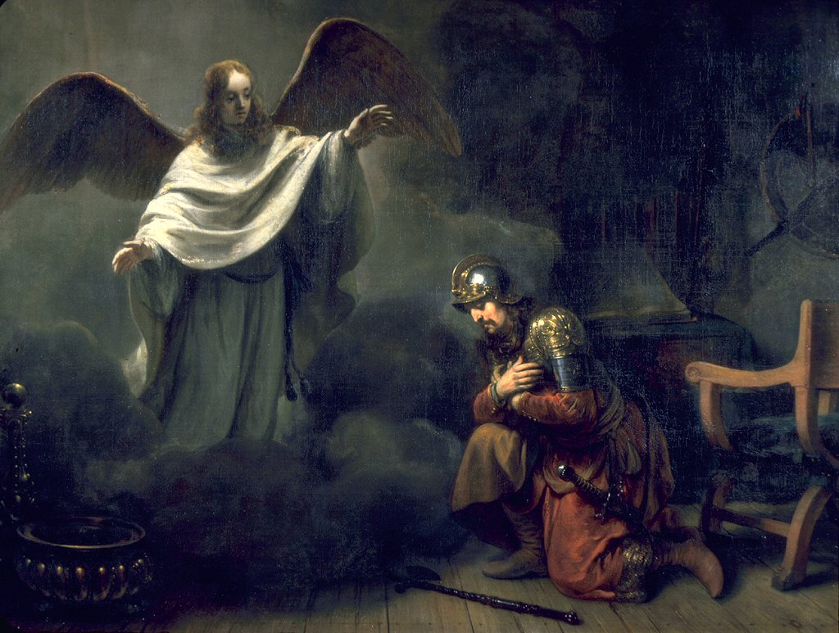
“Your prayers and your alms have ascended as a memorial before God.”

Slide 9
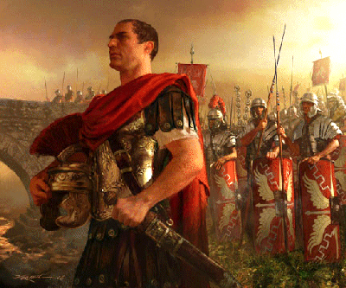

Slide 10
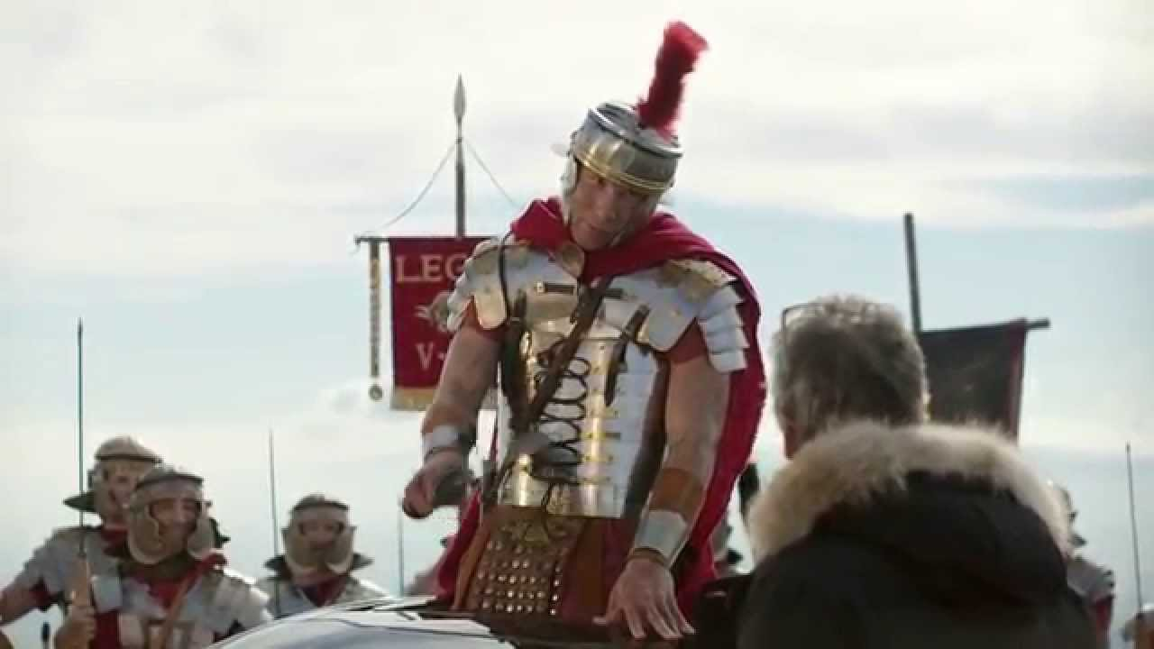
Cornelius:
rejected paganism
rejected idolatry
devoted to God
seeker of God
spiritual
prayerful
generous
successful
military hero
wealthy

Slide 12
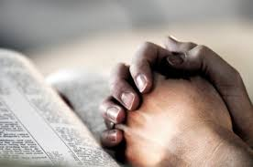

Slide 13
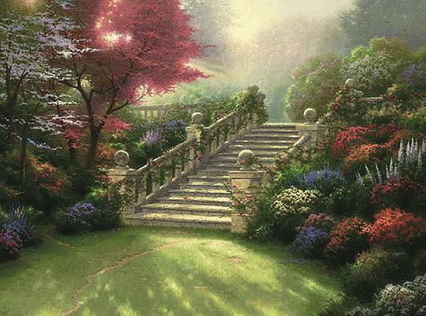
“And he (Cornelius) told us how he had seen the angel stand in his house and say, ‘Send to Joppa and bring Simon who is called Peter; he will declare to you a message by which you will be saved, you and all your household.’ ”
Acts 11:13-14

Slide 14
“And he (Cornelius) told us how he had seen the angel stand in his house and say, ‘Send to Joppa and bring Simon who is called Peter; he will declare to you a message by which you will be saved, you and all your household.’ ”

Slide 15
Cornelius:
rejected paganism
rejected idolatry
devoted to God
seeker of God
spiritual
prayerful
generous
successful
military hero
wealthy

Slide 16
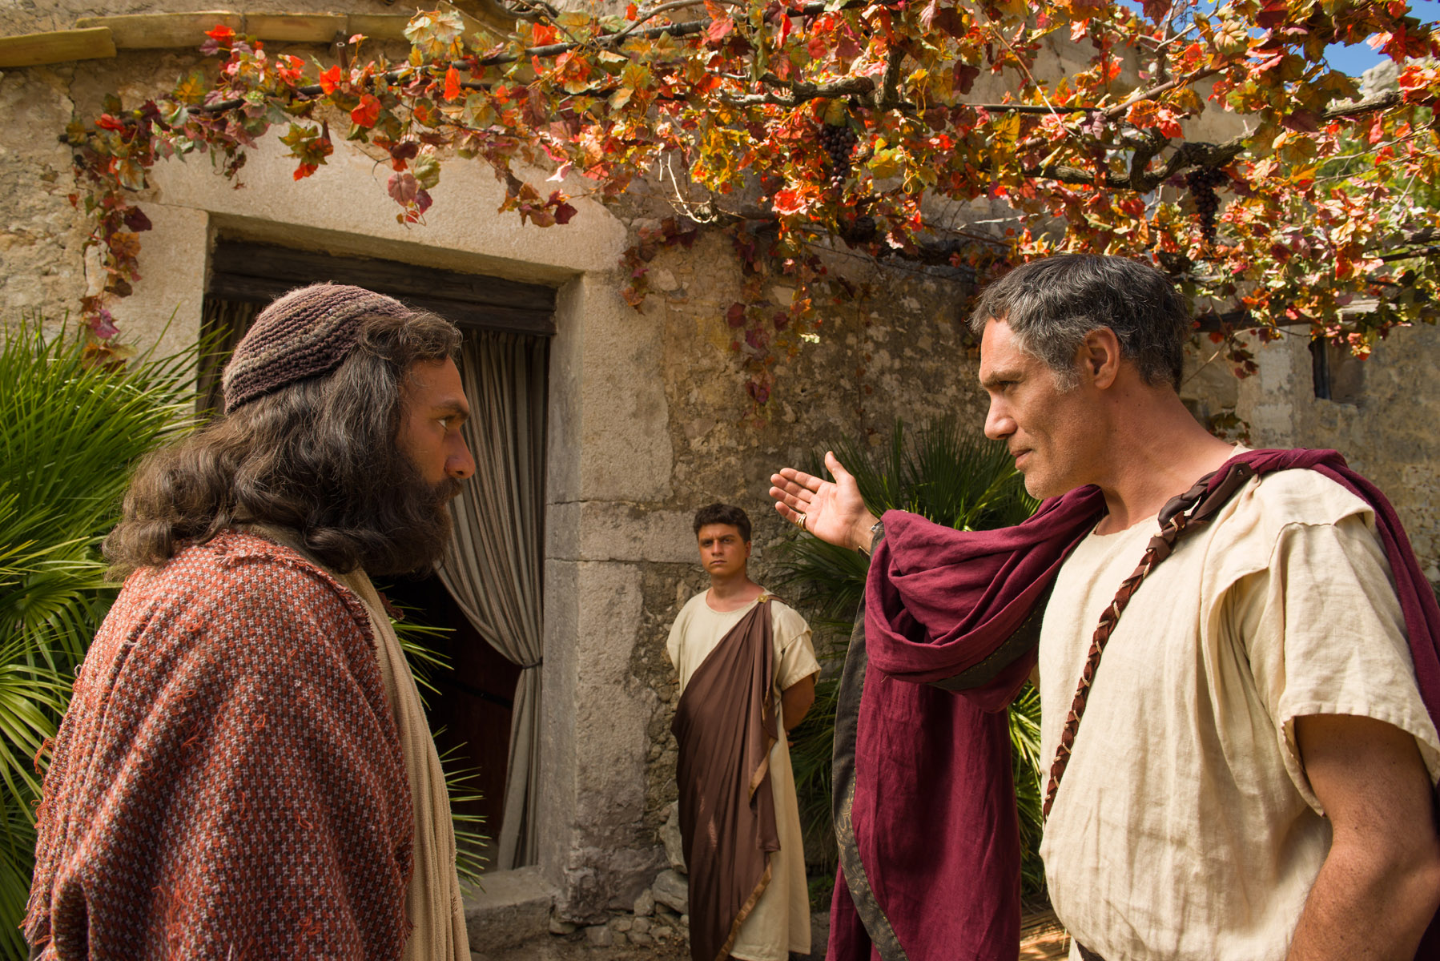

Slide 17
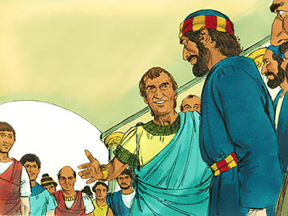
Peter tells him about Jesus’ dying on the cross and being raised up the third day . . .

Slide 18
. . . and that Jesus is coming back to judge the living and the dead.

Slide 19
. . . people need to believe in this Jesus . . .

Slide 20
. . . it is through the name of Jesus that people receive the forgiveness of sins.

Slide 21
. . . be baptized into the name of Jesus Christ!

Slide 22
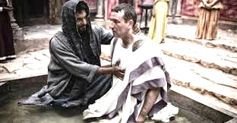

Slide 23
