Slide 2
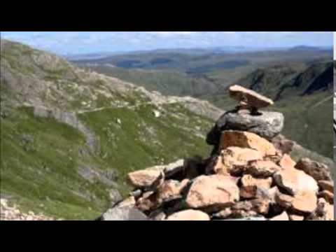

Slide 3
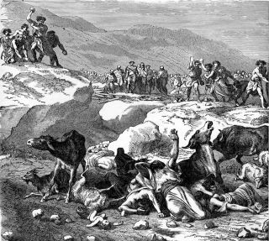

Slide 4
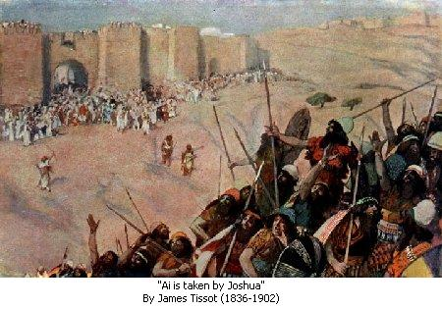

Slide 5
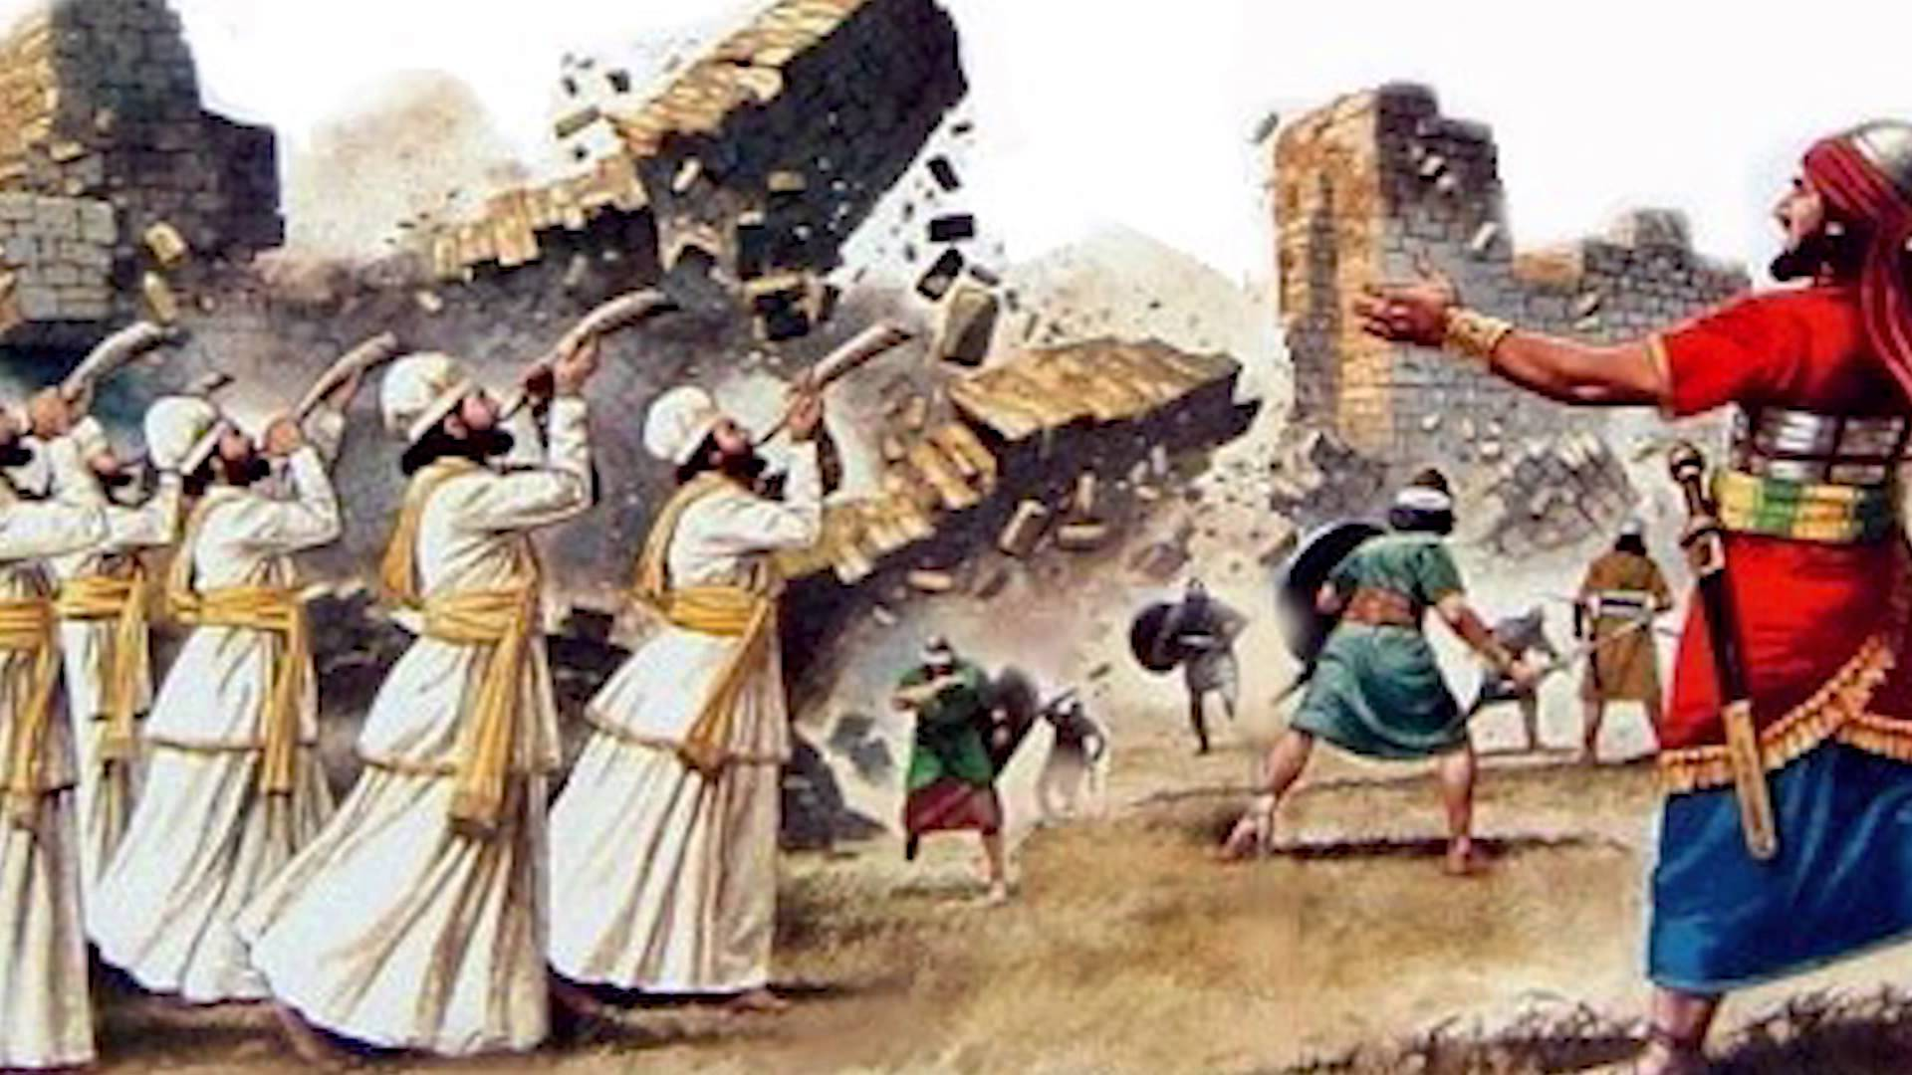

Slide 6
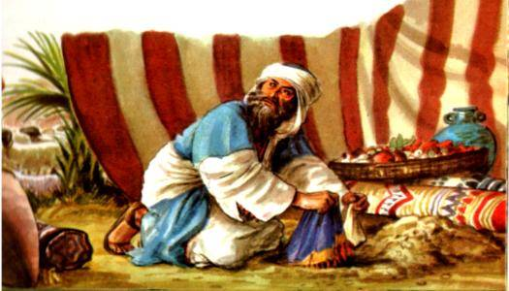

Slide 7
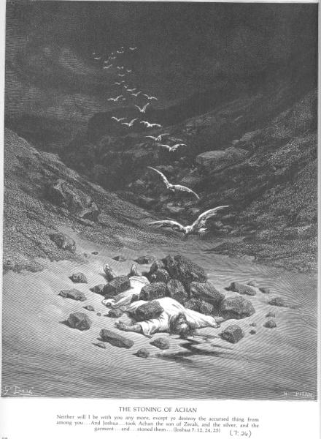

Slide 8
Can one person make a difference?

Slide 9
Can one person make a difference?
for GOOD?
for BAD?

Slide 10
Romans 12:1-2
¹I appeal to you therefore, brothers, by the mercies of God, to present your bodies as a living sacrifice, holy and acceptable to God, which is your spiritual worship.
²Do not be conformed to this world, but be transformed by the renewal of your mind, that by testing you may discern what is the will of God, what is good and acceptable and perfect.

Slide 11
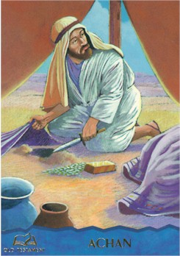
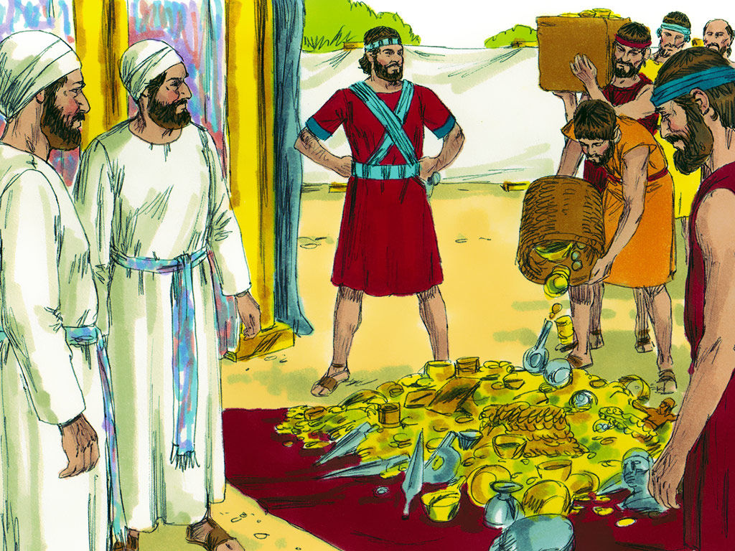
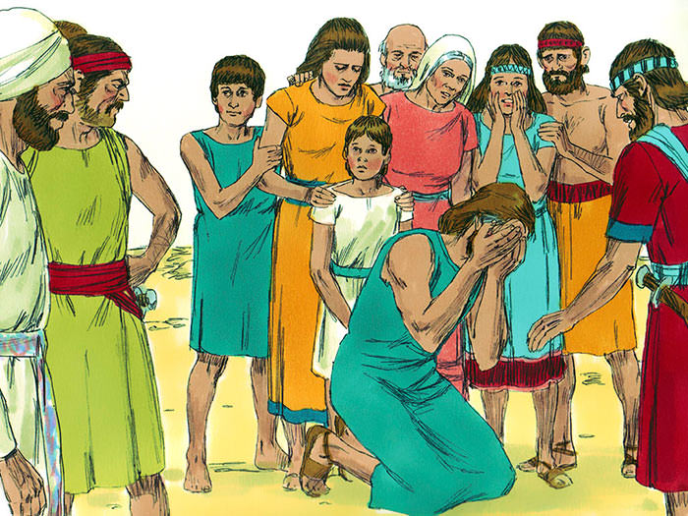
“It was ALL to be sacrificed!”

Slide 12
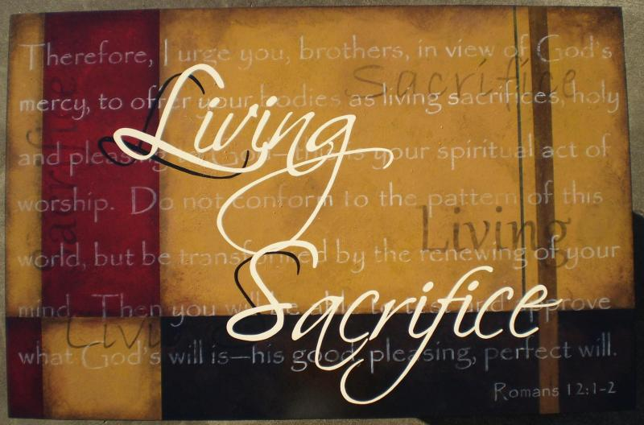

Slide 13
“For by the grace given to me I say to everyone among you not to think of himself more highly than he ought to think, but to think with sober judgment, each according to the measure of faith that God has assigned.”
Romans 1:3
“Be Humble”

Slide 14
“For as in one body we have many members, and the members do not all have the same function, so we, though many, are one body in Christ, and individually members one of another.”
Romans 1:4-5
“God’s people
are like a body”

Slide 15
“Having gifts that differ according to the grace given to us, let us use them: if prophecy, in proportion to our faith; if service, in our serving; the one who teaches, in his teaching; the one who exhorts, in his exhortation; the one who contributes, in generosity; the one who leads, with zeal; the one who does acts of mercy, with cheerfulness.”
Romans 1:6-8
“God blends
people together”

Slide 18
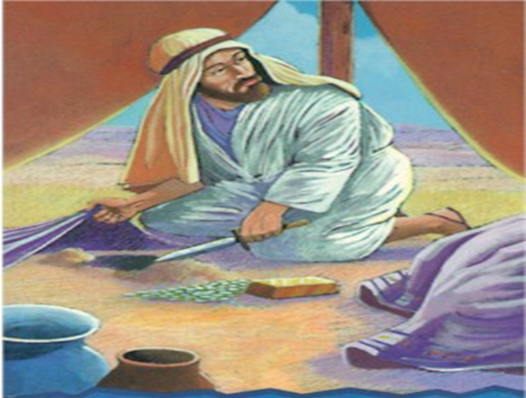
Don’t “pull an Achan”

Slide 19
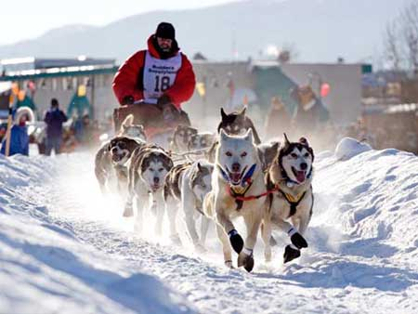

Slide 22
Matthew 25:14-27
THE PARABLE OF THE TALENTS

Slide 23
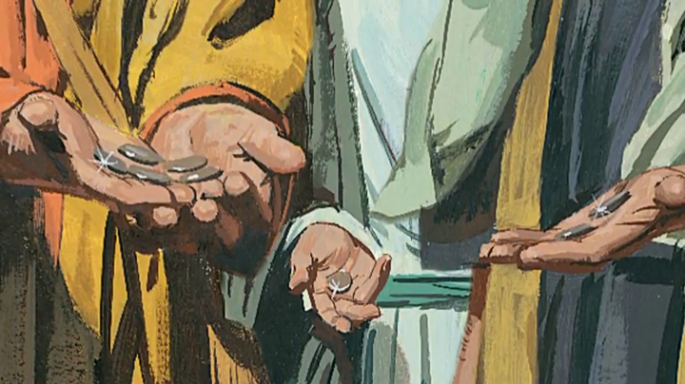

Slide 26
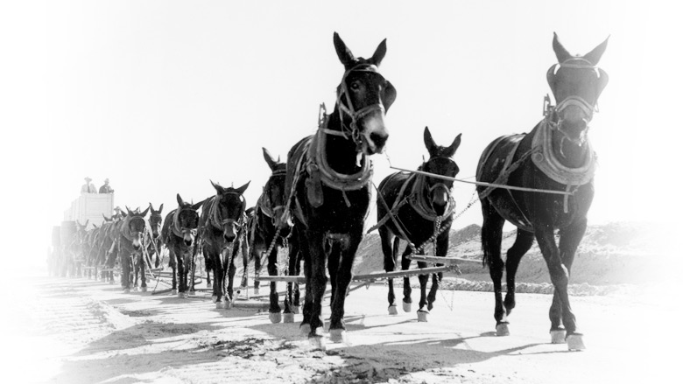

Slide 27
when we pull together . . .

