Slide 2
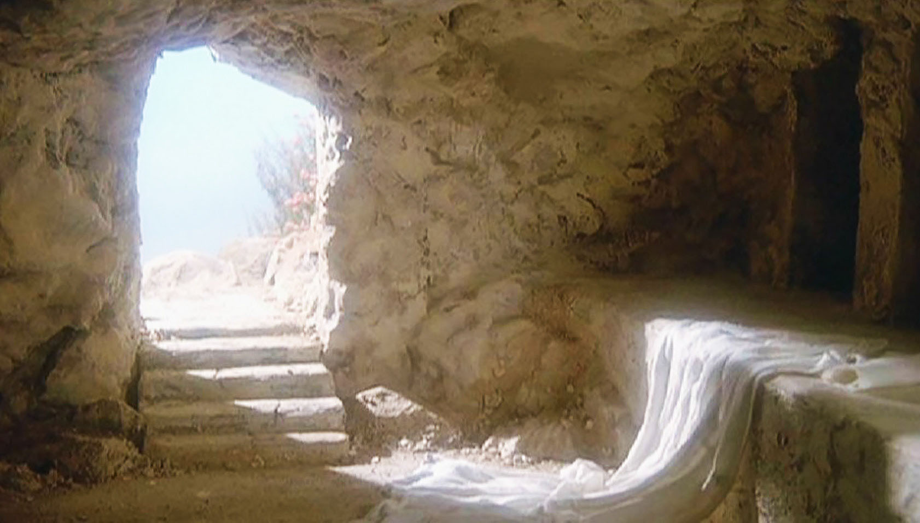

Slide 3
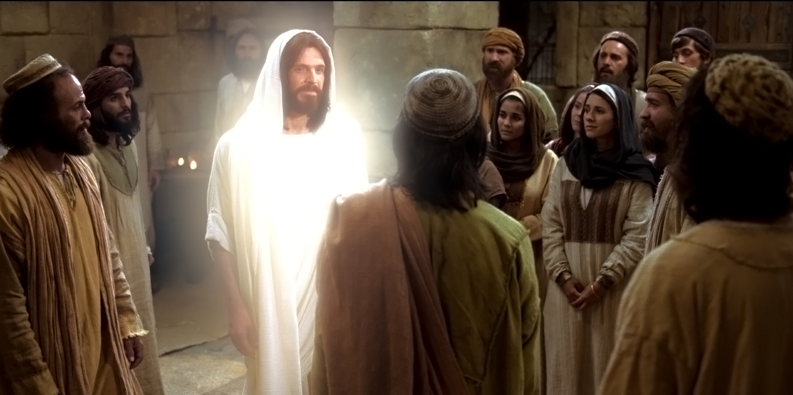

Slide 4
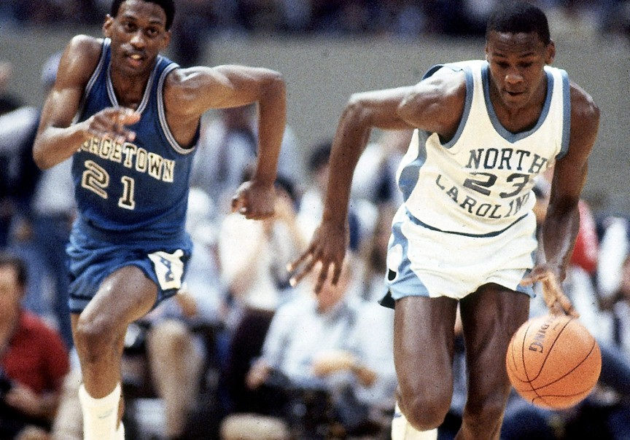

Slide 5
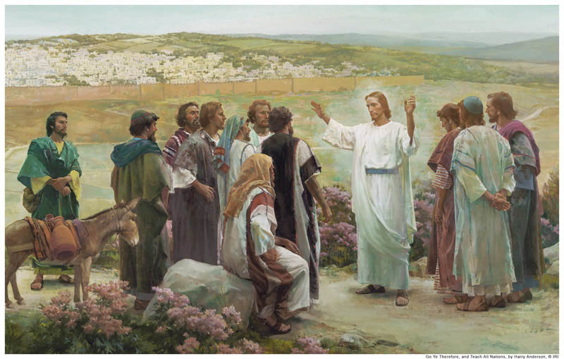

Slide 6
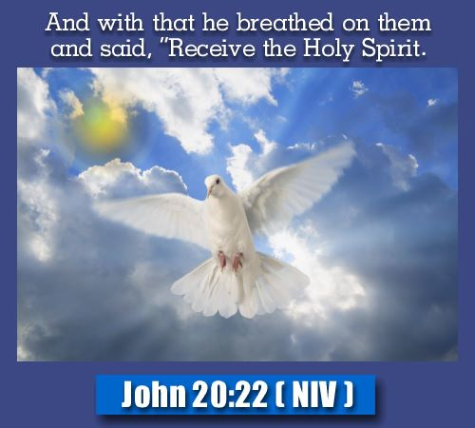
John 20-22

Slide 7
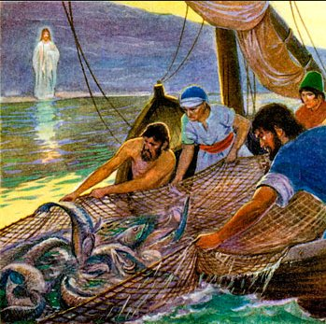
John 21:1-14

Slide 8
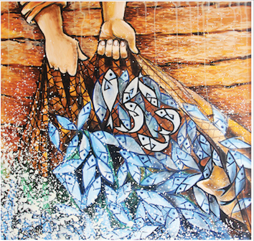
The Disciples recognized Jesus because they remembered the abundant blessing that comes from obeying Jesus

Slide 9
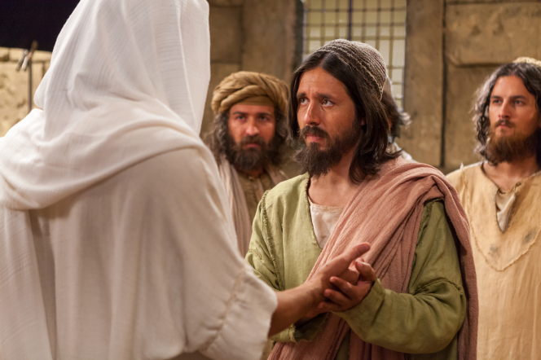
John 20:24-29

Slide 10
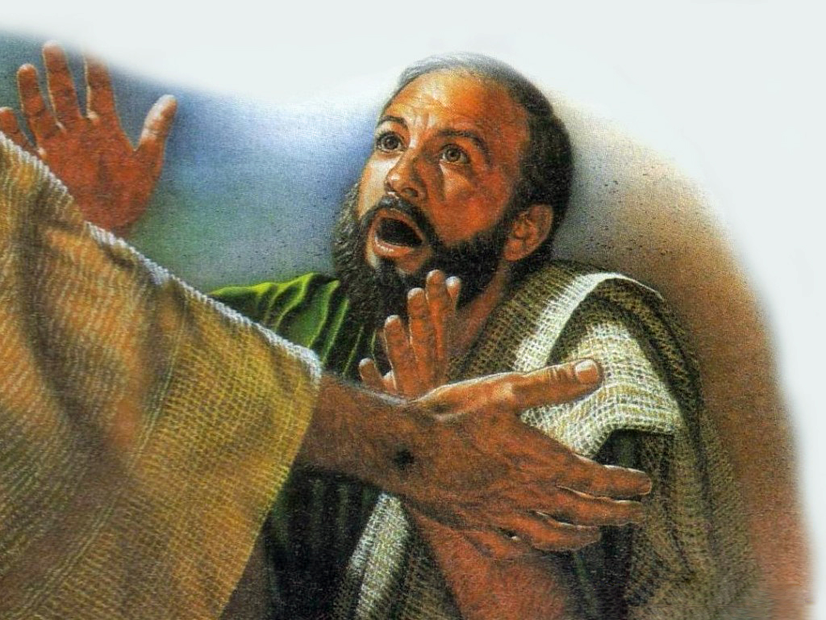
They recognized Jesus because of the wounds that he bore on his body

Slide 11
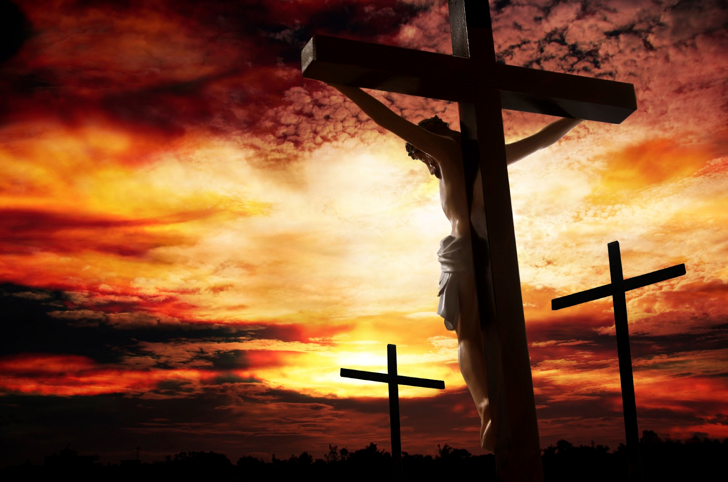
“He Himself bore our sins in His body on the tree, that we might die to sin and live to righteousness. By His wounds you have been healed.”

Slide 12
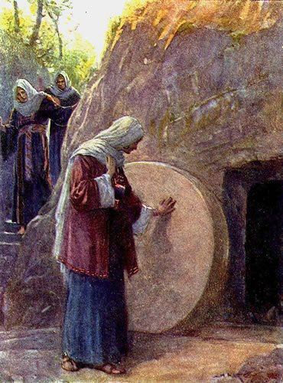
John 20:11-18

Slide 13
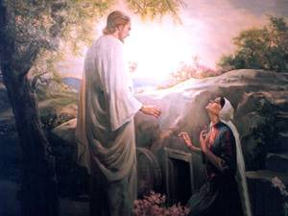
Mary recognized Jesus because he called her by name.

Slide 14
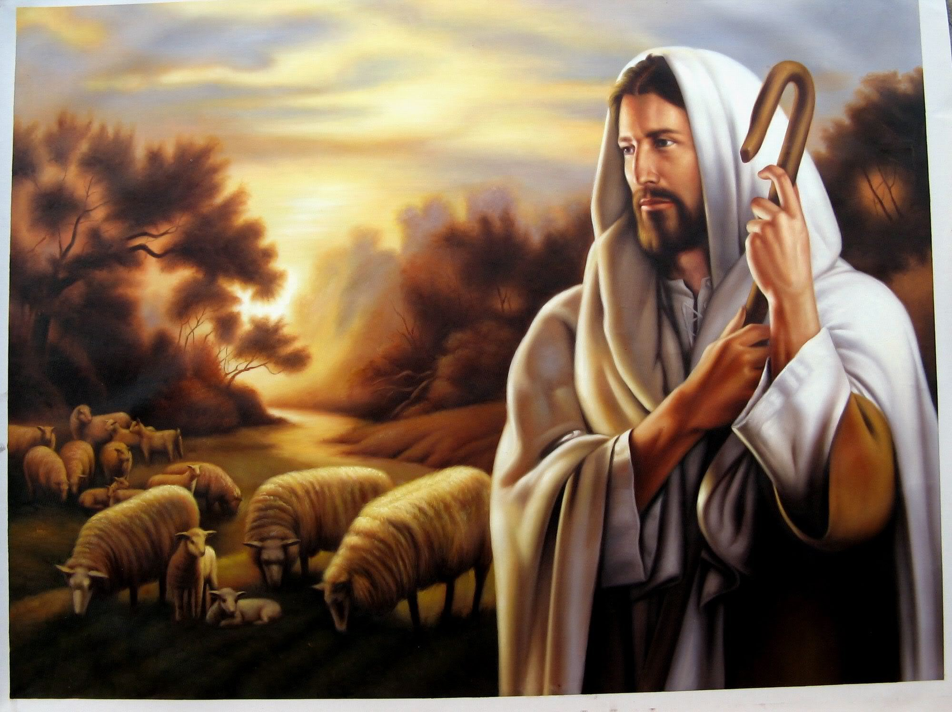
“For they know his voice.”

Slide 15
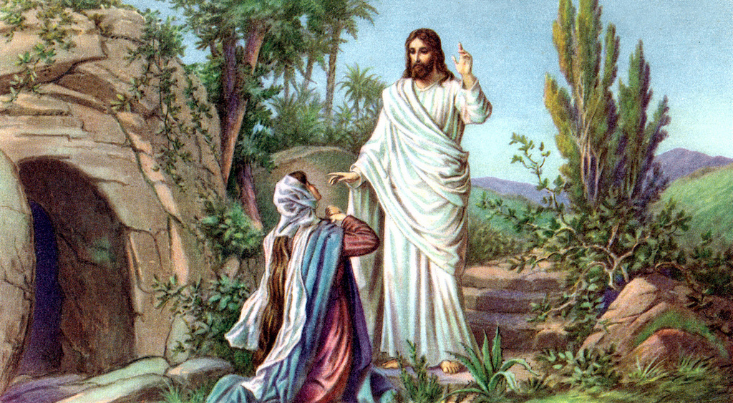
Mary knew his voice when he called her name.

Slide 16
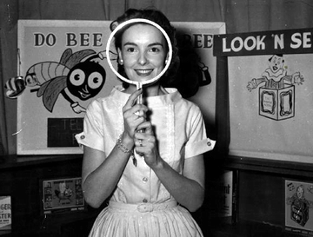

Slide 17
1) The Disciples recognized Jesus because they remembered the abundant blessing that comes from obeying Jesus
2) They recognized Jesus because of the wounds that he bore on his body
3) Mary recognized Jesus because he called her name.

