Slide 3
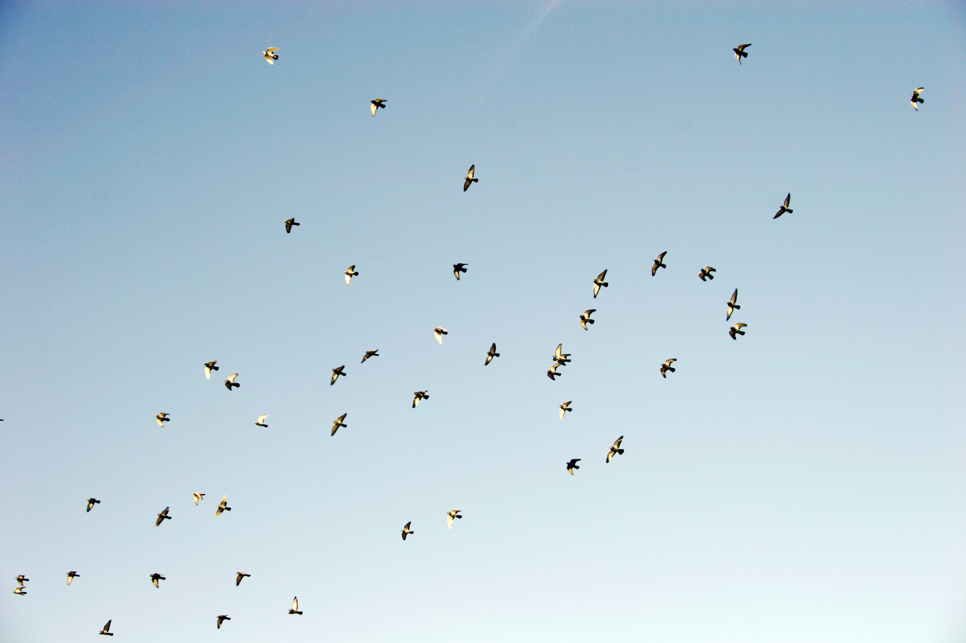
Psalm 11:1-7

Slide 4
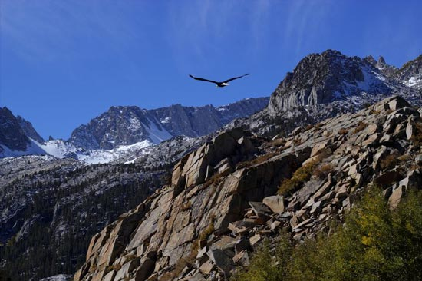
Screen shot F A A B

Slide 5
¹In the Lord I take refuge; how can you say to my soul, “Flee like a bird to your mountain, ² for behold, the wicked bend the bow; they have fitted their arrow to the string to shoot in the dark at the upright in heart; ³ if the foundations are destroyed, what can the righteous do?”
⁴ The Lord is in his holy temple; the Lord's throne is in heaven; his eyes see, his eyelids test the children of man. ⁵ The Lord tests the righteous, but his soul hates the wicked and the one who loves violence. ⁶ Let him rain coals on the wicked; fire and sulfur and a scorching wind shall be the portion of their cup. ⁷ For the Lord is righteous; he loves righteous deeds; the upright shall behold his face.
- PSALM 11:1-7

Slide 6
¹In the Lord I take refuge; how can you say to my soul, “Flee like a bird to your mountain, ² for behold, the wicked bend the bow; they have fitted their arrow to the string to shoot in the dark at the upright in heart; ³ if the foundations are destroyed, what can the righteous do?”
⁴ The Lord is in his holy temple; the Lord's throne is in heaven; his eyes see, his eyelids test the children of man. ⁵ The Lord tests the righteous, but his soul hates the wicked and the one who loves violence. ⁶ Let him rain coals on the wicked; fire and sulfur and a scorching wind shall be the portion of their cup. ⁷ For the Lord is righteous; he loves righteous deeds; the upright shall behold his face.
- PSALM 11:1-7

Slide 7
¹In the Lord I take refuge; how can you say to my soul, “Flee like a bird to your mountain, ² for behold, the wicked bend the bow; they have fitted their arrow to the string to shoot in the dark at the upright in heart; ³ if the foundations are destroyed, what can the righteous do?”
⁴ The Lord is in his holy temple; the Lord's throne is in heaven; his eyes see, his eyelids test the children of man. ⁵ The Lord tests the righteous, but his soul hates the wicked and the one who loves violence. ⁶ Let him rain coals on the wicked; fire and sulfur and a scorching wind shall be the portion of their cup. ⁷ For the Lord is righteous; he loves righteous deeds; the upright shall behold his face.
- PSALM 11:1-7

Slide 8
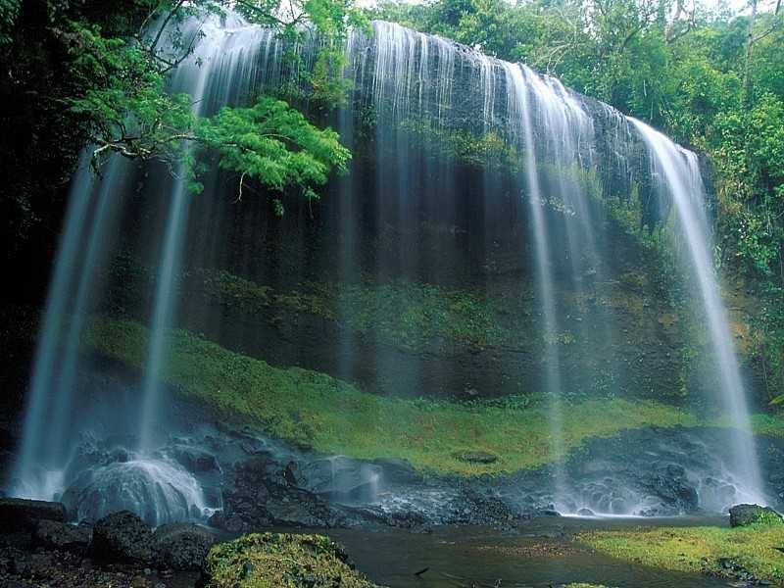
“Faith does not always go around trouble, sometimes it goes through it.”

Slide 10
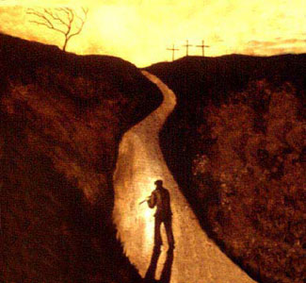

Slide 11
¹In the Lord I take refuge; how can you say to my soul, “Flee like a bird to your mountain, ² for behold, the wicked bend the bow; they have fitted their arrow to the string to shoot in the dark at the upright in heart; ³ if the foundations are destroyed, what can the righteous do?”
⁴ The Lord is in his holy temple; the Lord's throne is in heaven; his eyes see, his eyelids test the children of man. ⁵ The Lord tests the righteous, but his soul hates the wicked and the one who loves violence. ⁶ Let him rain coals on the wicked; fire and sulfur and a scorching wind shall be the portion of their cup. ⁷ For the Lord is righteous; he loves righteous deeds; the upright shall behold his face.
- PSALM 11:1-7

Slide 12
“Nothing can be done!”

Slide 14
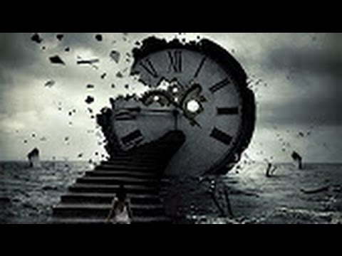
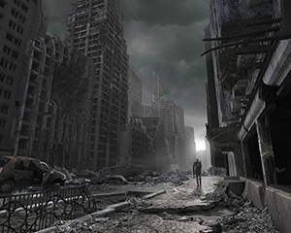
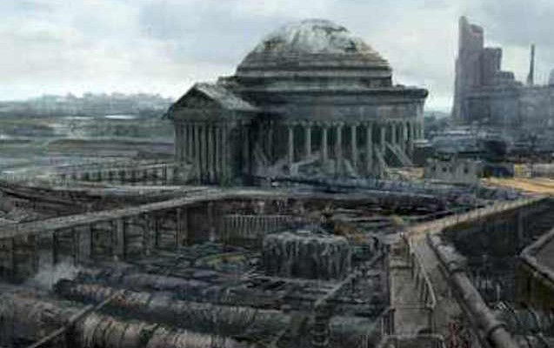
IT’S TOO LATE!

Slide 15
¹In the Lord I take refuge; how can you say to my soul, “Flee like a bird to your mountain, ² for behold, the wicked bend the bow; they have fitted their arrow to the string to shoot in the dark at the upright in heart; ³ if the foundations are destroyed, what can the righteous do?”
⁴ The Lord is in his holy temple; the Lord's throne is in heaven; his eyes see, his eyelids test the children of man. ⁵ The Lord tests the righteous, but his soul hates the wicked and the one who loves violence. ⁶ Let him rain coals on the wicked; fire and sulfur and a scorching wind shall be the portion of their cup. ⁷ For the Lord is righteous; he loves righteous deeds; the upright shall behold his face.
- PSALM 11:1-7

Slide 16
¹In the Lord I take refuge; how can you say to my soul, “Flee like a bird to your mountain, ² for behold, the wicked bend the bow; they have fitted their arrow to the string to shoot in the dark at the upright in heart; ³ if the foundations are destroyed, what can the righteous do?”
⁴ The Lord is in his holy temple; the Lord's throne is in heaven; his eyes see, his eyelids test the children of man. ⁵ The Lord tests the righteous, but his soul hates the wicked and the one who loves violence. ⁶ Let him rain coals on the wicked; fire and sulfur and a scorching wind shall be the portion of their cup. ⁷ For the Lord is righteous; he loves righteous deeds; the upright shall behold his face.
- PSALM 11:1-7

Slide 18
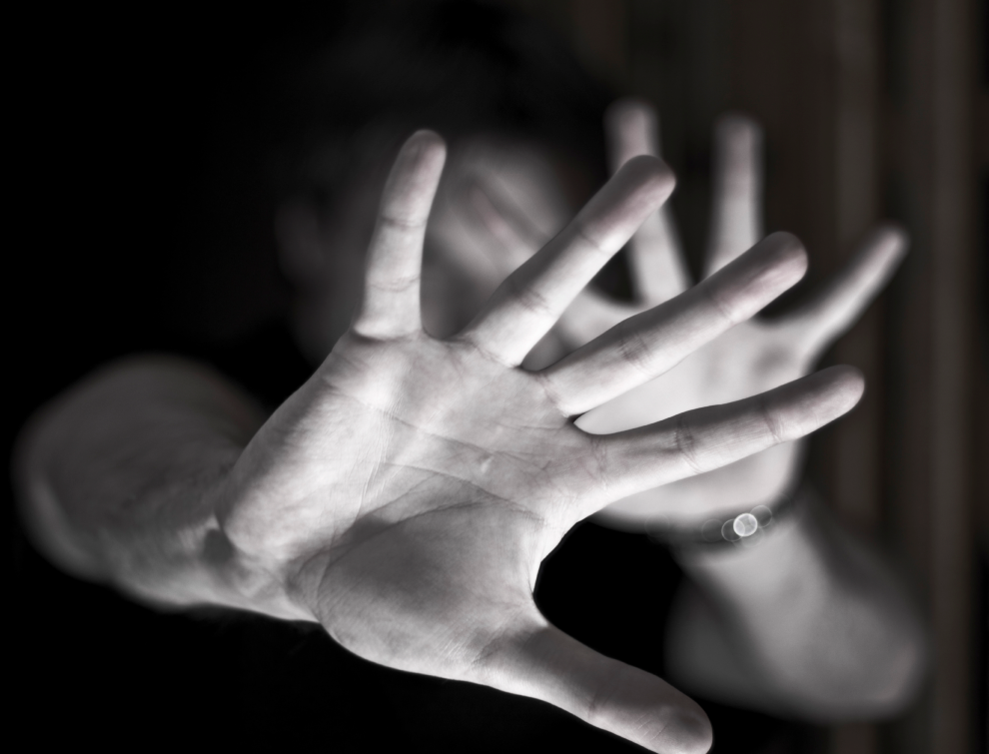
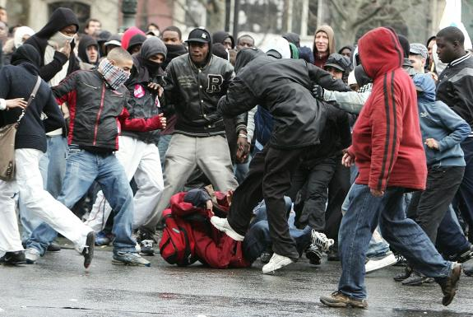
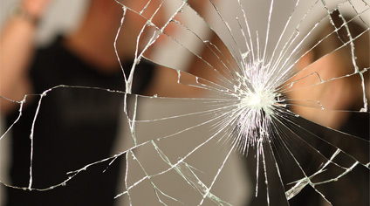

Slide 19
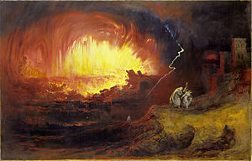
¹In the Lord I take refuge; how can you say to my soul, “Flee like a bird to your mountain, ² for behold, the wicked bend the bow; they have fitted their arrow to the string to shoot in the dark at the upright in heart; ³ if the foundations are destroyed, what can the righteous do?”
⁴ The Lord is in his holy temple; the Lord's throne is in heaven; his eyes see, his eyelids test the children of man. ⁵ The Lord tests the righteous, but his soul hates the wicked and the one who loves violence. ⁶ Let him rain coals on the wicked; fire and sulfur and a scorching wind shall be the portion of their cup. ⁷ For the Lord is righteous; he loves righteous deeds; the upright shall behold his face.
- PSALM 11:1-7

Slide 20
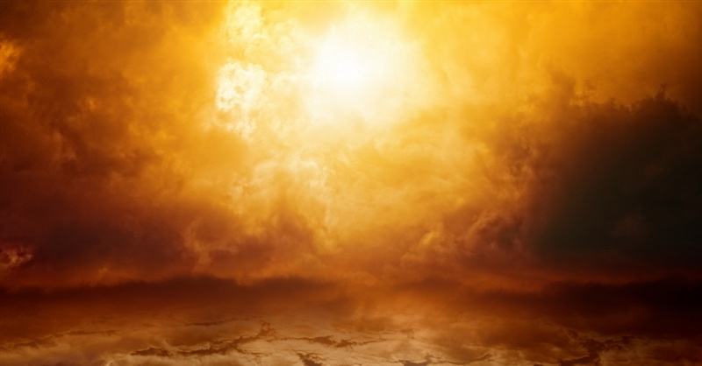
“What can man do?”
“What can God do?”

Slide 21
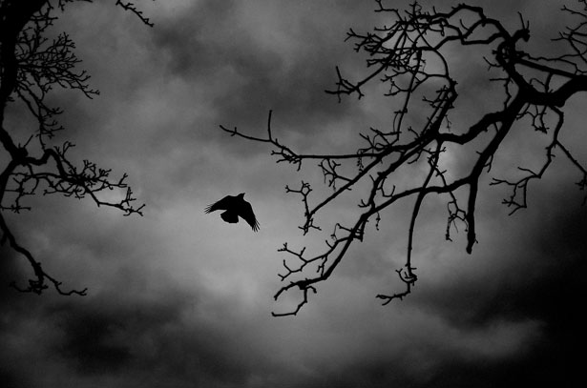
Since God remains involved in this world, we must be also.
We cannot be salt and light in a world we are running away from.
We cannot preach the gospel to people we are frightened to death of.

Slide 22
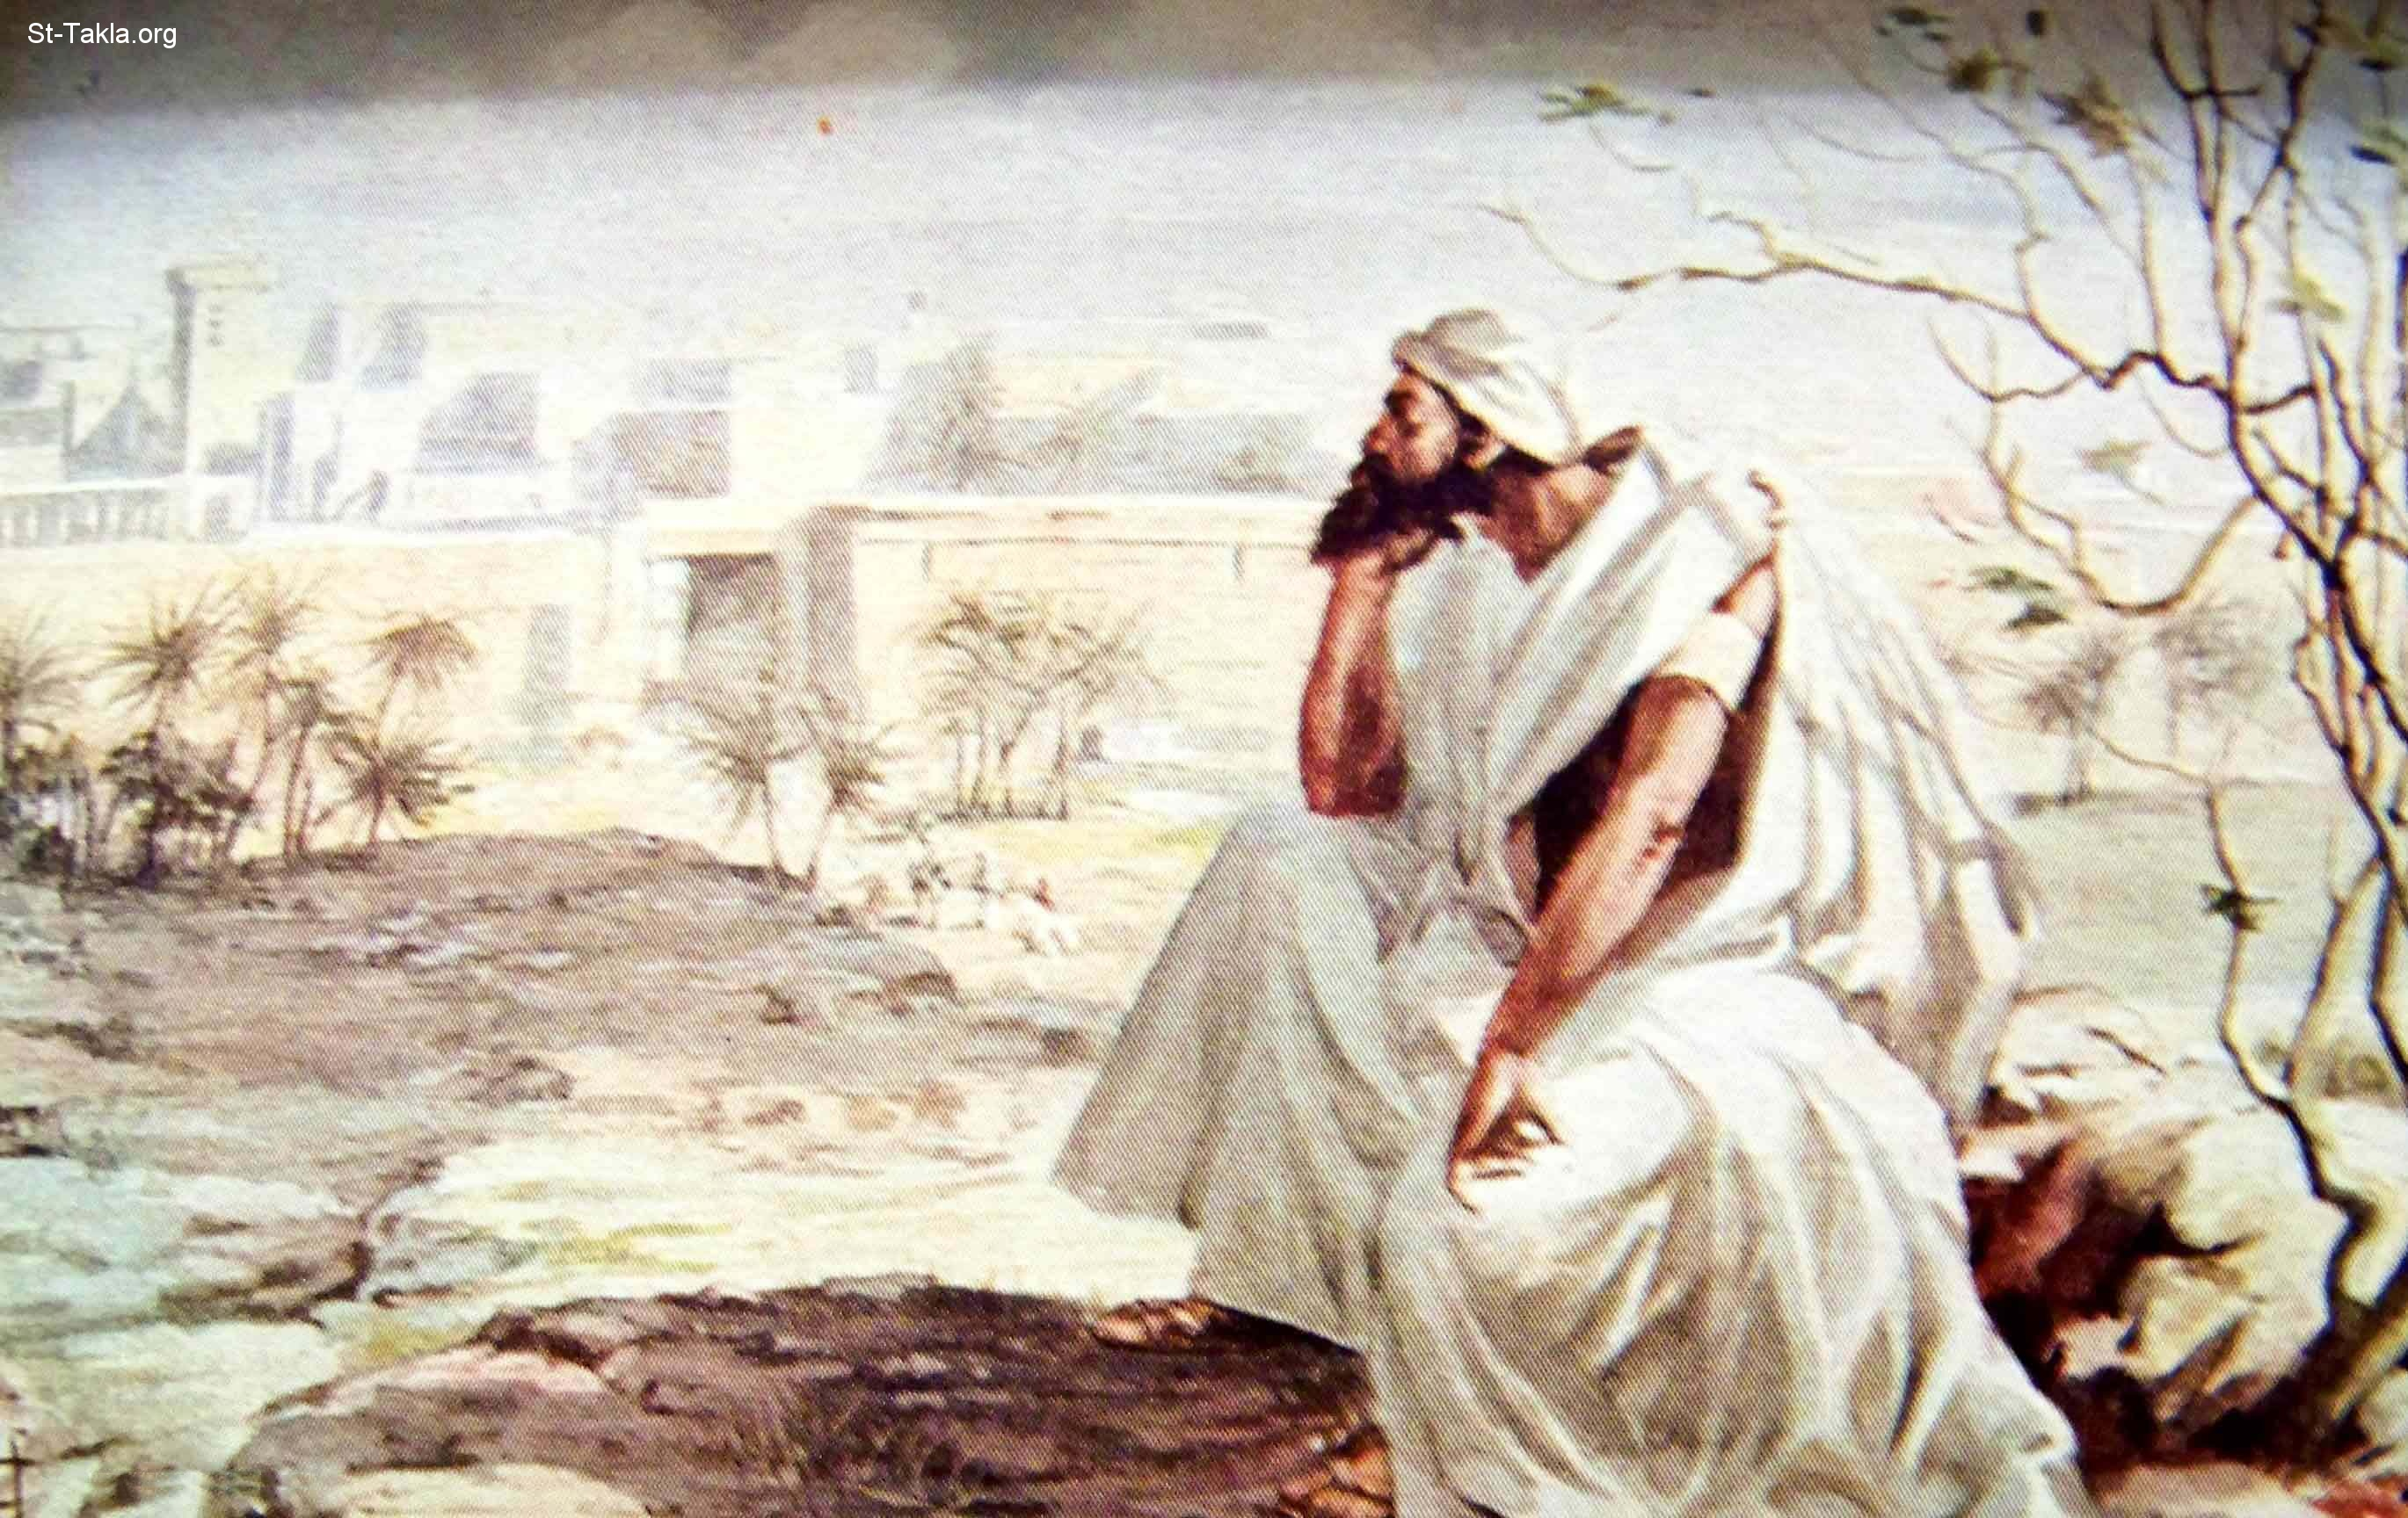
JONAH

Slide 24
Is God Your Refuge?

