Slide 2
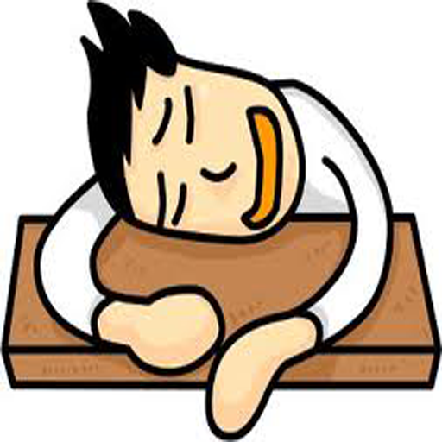
ARE YOU TIRED?

Slide 3
Matthew 11:25-27
Come to Me, and I Will Give You Rest
²⁵At that time Jesus declared, “I thank you, Father, Lord of heaven and earth, that you have hidden these things from the wise and understanding and revealed them to little children;
²⁶ yes, Father, for such was your gracious will.
²⁷All things have been handed over to me by my Father, and no one knows the Son except the Father, and no one knows the Father except the Son and anyone to whom the Son chooses to reveal him.

Slide 4
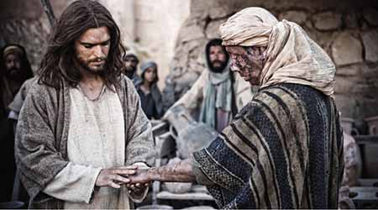

Slide 5
Matthew 11:25-27
Come to Me, and I Will Give You Rest
²⁵At that time Jesus declared, “I thank you, Father, Lord of heaven and earth, that you have hidden these things from the wise and understanding and revealed them to little children;
²⁶ yes, Father, for such was your gracious will.
²⁷All things have been handed over to me by my Father, and no one knows the Son except the Father, and no one knows the Father except the Son and anyone to whom the Son chooses to reveal him.

Slide 6
Matthew 11:28-30
28Come to me, all who labor and are heavy laden, and I will give you rest.
29Take my yoke upon you, and learn from me, for I am gentle and lowly in heart, and you will find rest for your souls.
30For my yoke is easy, and my burden is light.”

Slide 7
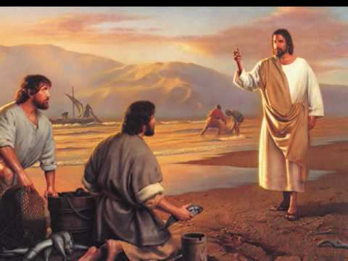
“Come, follow me!”

Slide 8
Matthew 11:28-30
28Come to me, all who labor and are heavy laden, and I will give you rest.
29Take my yoke upon you, and learn from me, for I am gentle and lowly in heart, and you will find rest for your souls.
30For my yoke is easy, and my burden is light.”

Slide 9
ARE YOU TIRED?

Slide 10
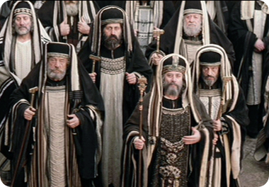

Slide 11
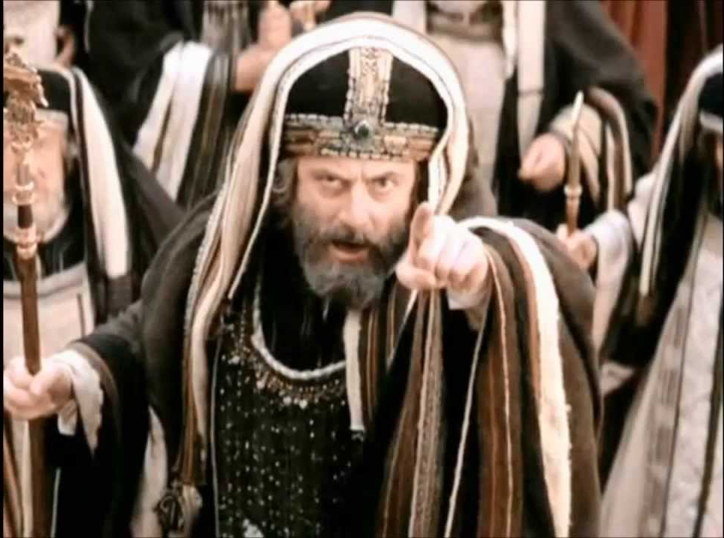

Slide 12
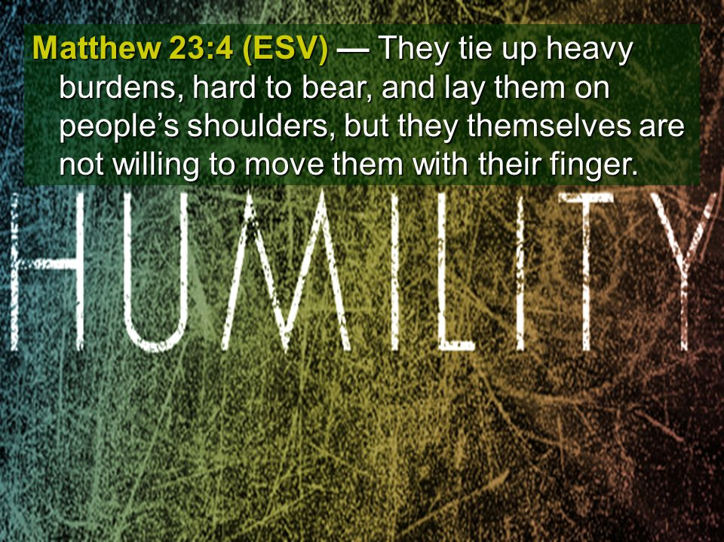

Slide 13
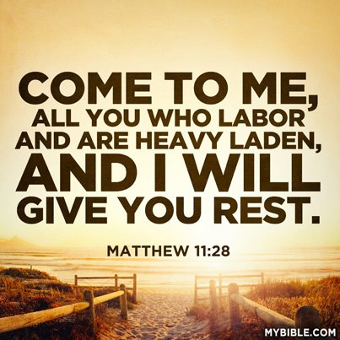

Slide 14
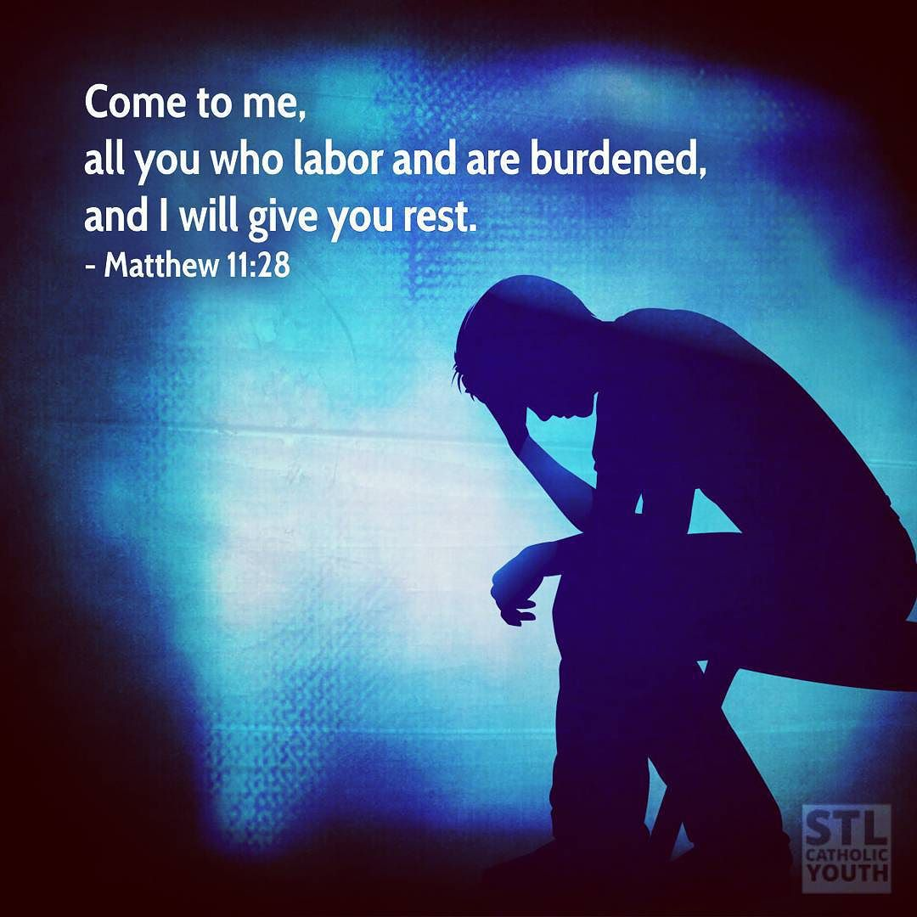
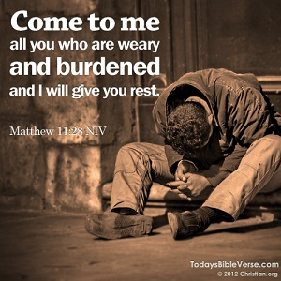
“Don’t Worry –
Don’t Be Anxious!”

Slide 16
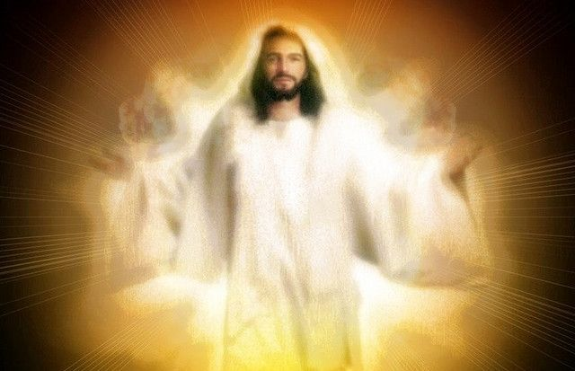

Slide 17
²⁹Take my yoke upon you, and learn from me, for I am gentle and lowly in heart, and you will find rest for your souls.
³⁰For my yoke is easy, and my burden is light.”
Matthew 11:28-29

Slide 18
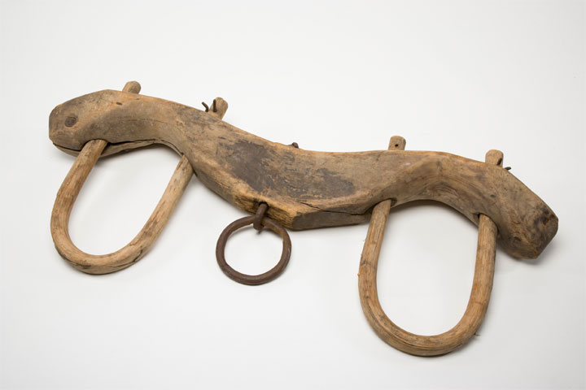
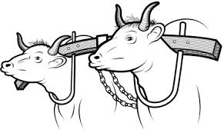
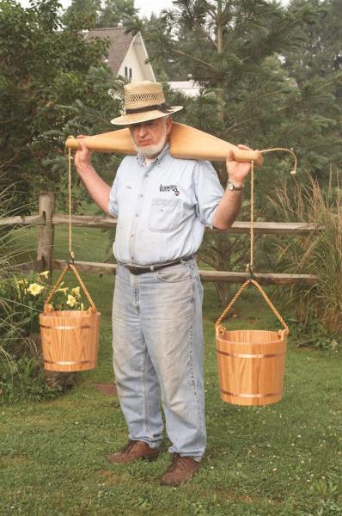
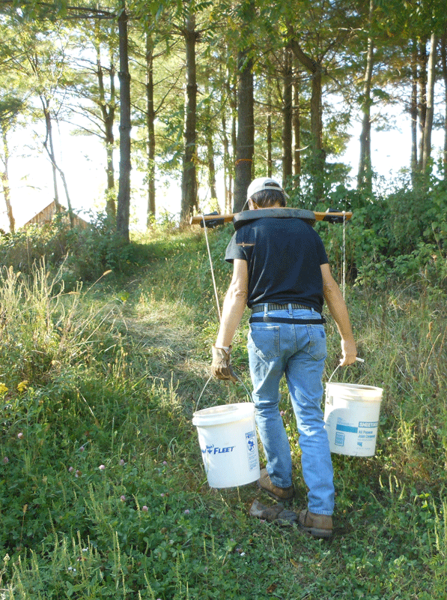
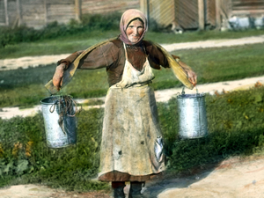

Slide 20
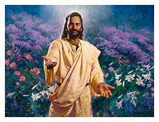
“For I tell you, unless your righteousness exceeds that of the scribes and Pharisees, you will never enter the kingdom of heaven.”
“BE PERFECT!”
“TAKE UP YOUR CROSS DAILY”

Slide 21
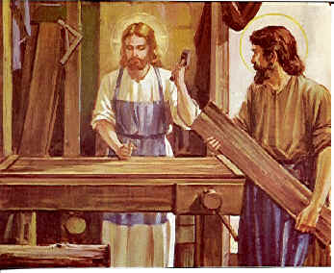
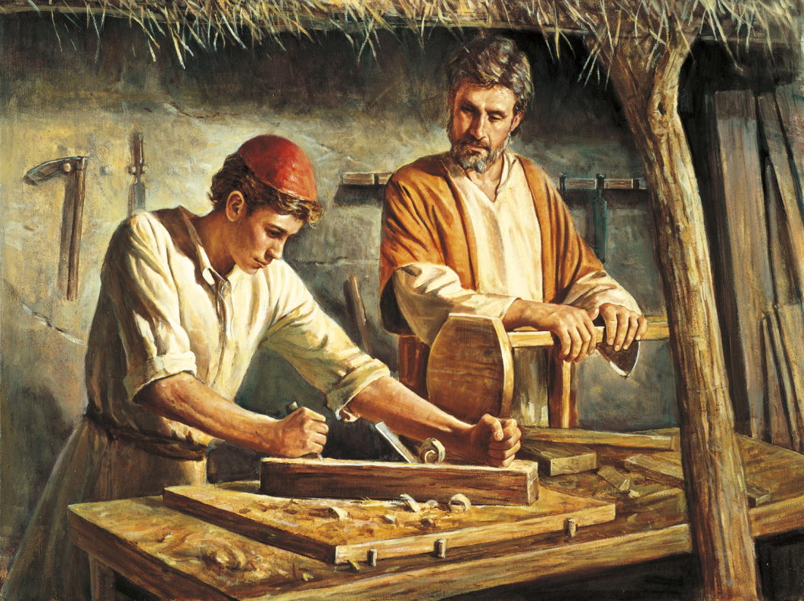
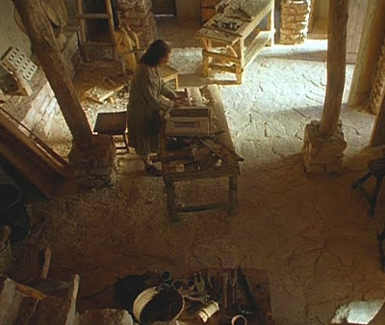
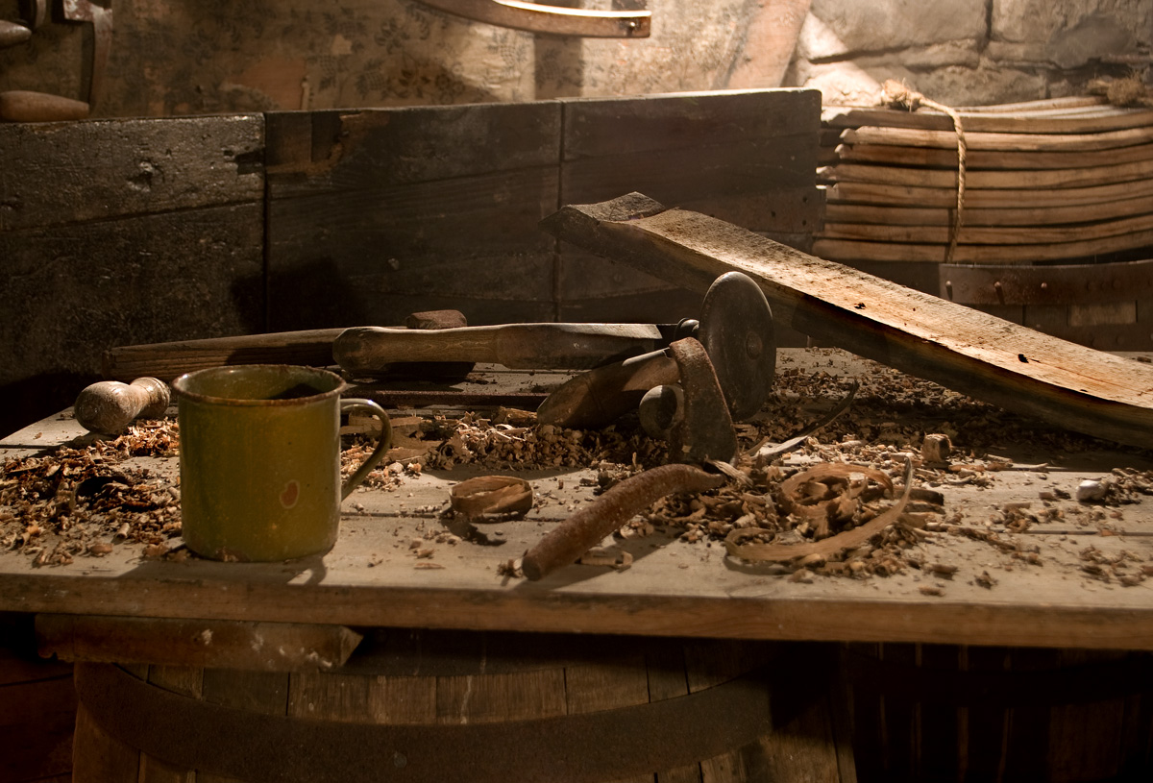

Slide 22
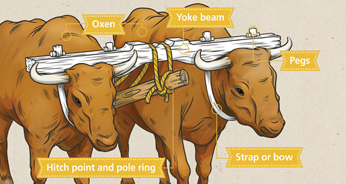

Slide 23
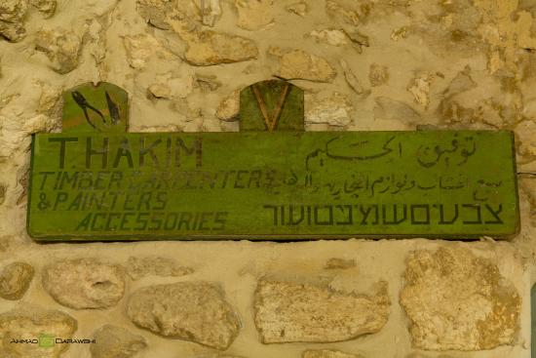
MY YOKE FITS WELL

Slide 25
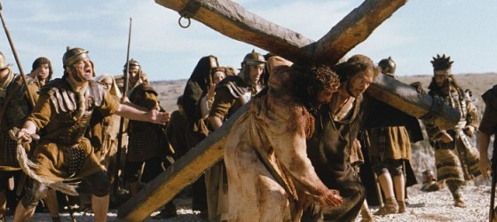

Slide 26
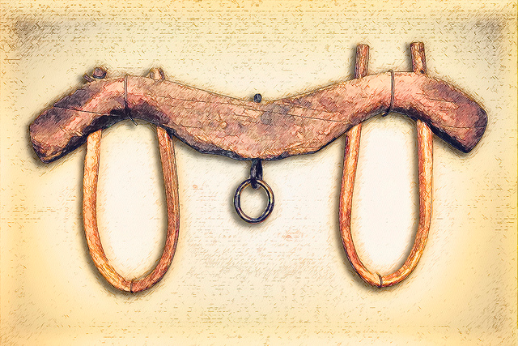
Jesus’ Yoke is loyalty to Him

Slide 27
