Slide 3
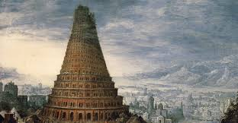
“Come, let us build ourselves a city and a tower with its top in the heavens, and let us make a name for ourselves . . .”

Slide 4
Genesis 12
“make his name great”

Slide 5
Genesis 12:1-3
“make his name great”

Slide 6
Genesis 12:1-3
¹Now the Lord said to Abram, “Go from your country and your kindred and your father's house to the land that I will show you.
² And I will make of you a great nation, and I will bless you and make your name great, so that you will be a blessing.
³ I will bless those who bless you, and him who dishonors you I will curse, and in you all the families of the earth shall be blessed.”

Slide 9
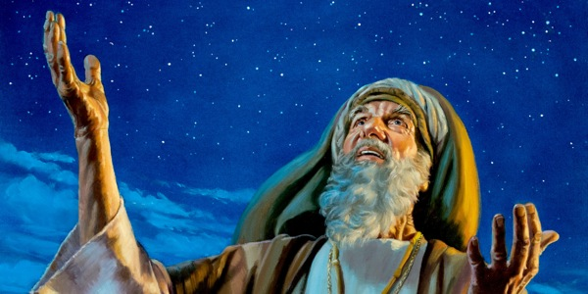
“I will make your name great!”

Slide 10
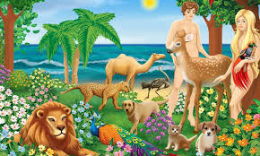
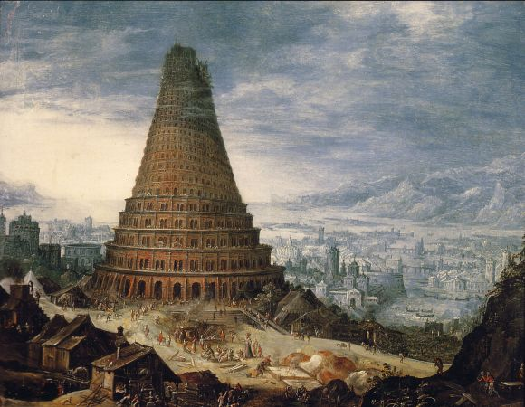

Slide 11
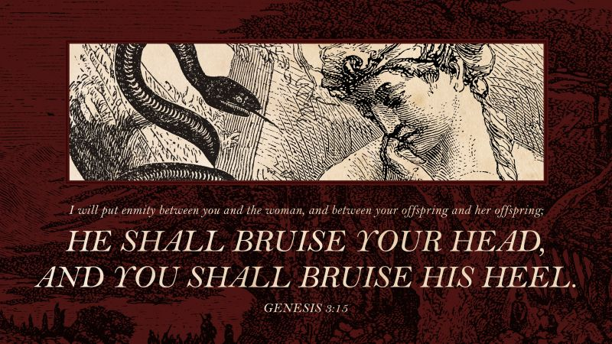
“THE FIRST GOSPEL”

Slide 12
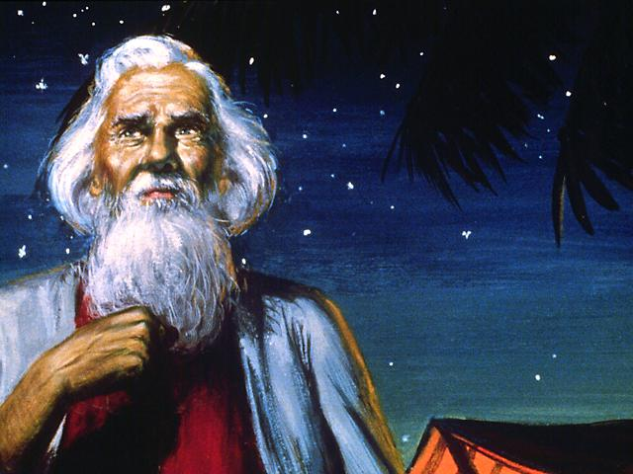
God promises to bless Abram in incredible ways!

Slide 13
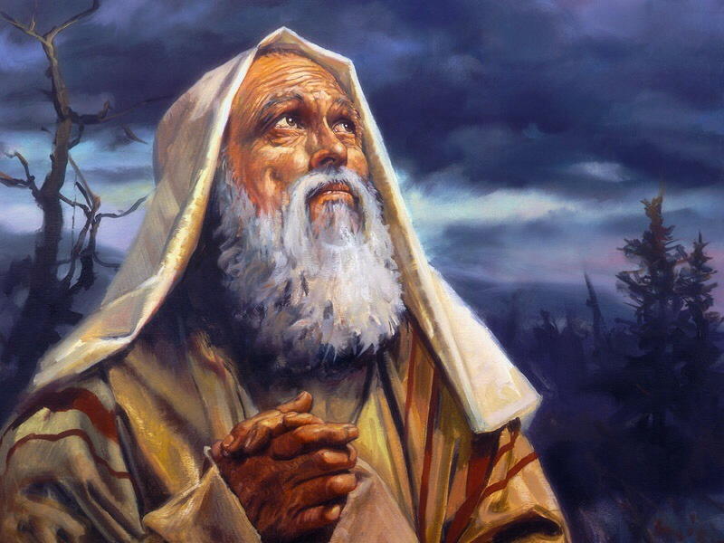
“You need to move, Abram – leave Mesopotamia – leave the great city of Ur of the Chaldees – leave Haran – and you need to leave your family behind there, leave your father’s house – and go to a land I will show you.”

Slide 19
Genesis 12:1-3
¹Now the Lord said to Abram, “Go from your country and your kindred and your father's house to the land that I will show you.
² And I will make of you a great nation, and I will bless you and make your name great, so that you will be a blessing.
³ I will bless those who bless you, and him who dishonors you I will curse, and in you all the families of the earth shall be blessed.”

Slide 20
Genesis 12:1-3
¹Now the Lord said to Abram, “Go from your country and your kindred and your father's house to the land that I will show you.
² And I will make of you a great nation, and I will bless you and make your name great, so that you will be a blessing.
³ I will bless those who bless you, and him who dishonors you I will curse, and in you all the families of the earth shall be blessed.”

Slide 22
BLESSED TO BLESS!
SAVED TO SERVE!

Slide 24
Do you need to make a change today?

