Slide 2
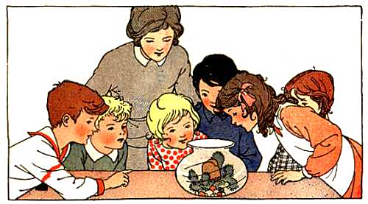
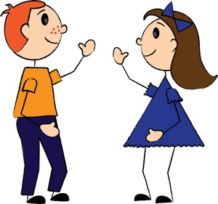
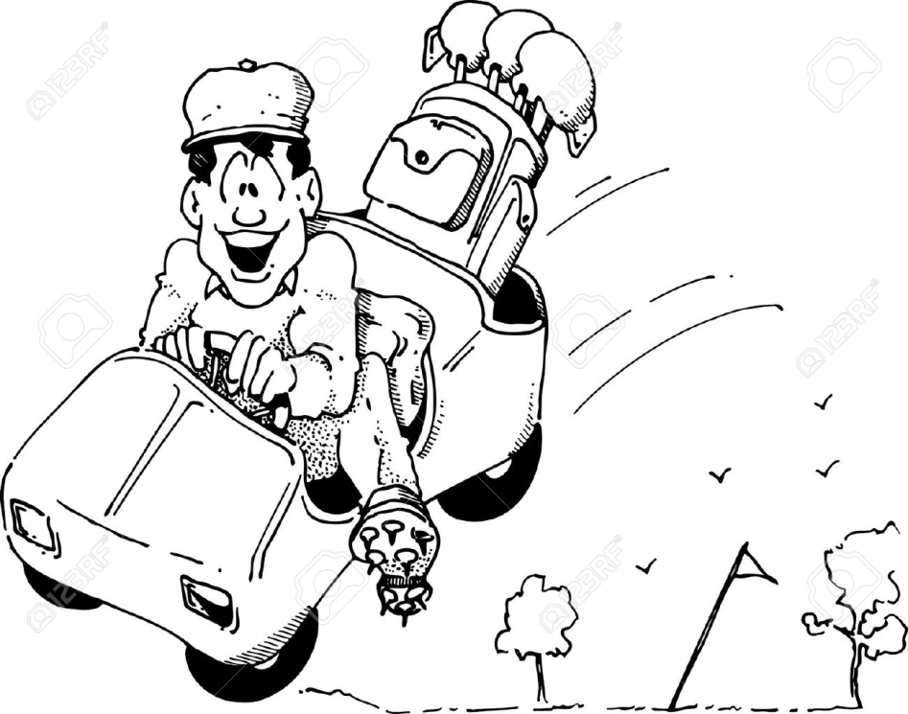

Slide 3
Genesis 3

Slide 4
GREAT TURNING POINTS IN
“God made everything – and everything He made was GOOD.”

Slide 5
GREAT TURNING POINTS IN
God said, “Let us make mankind . . .”

Slide 6
Part 3
“DON’T FALL!!”
Genesis 3

Slide 7
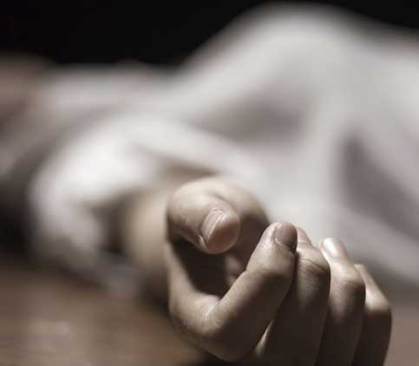
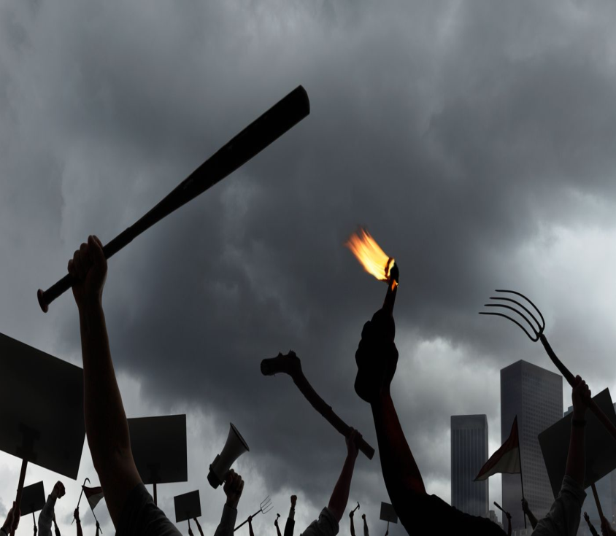
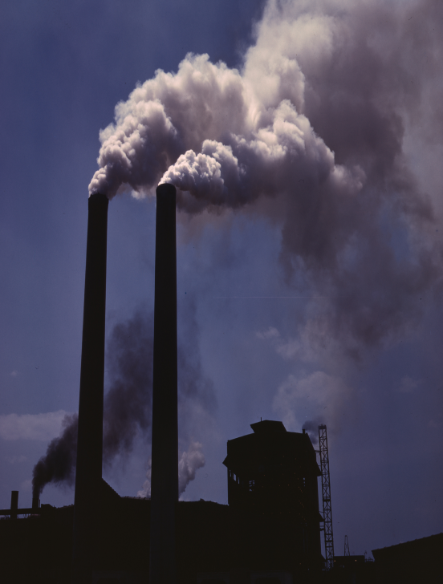
What happened?

Slide 8
Genesis 3

Slide 10
The Garden of Eden
“but of the tree of the knowledge of good and evil you shall not eat, for in the day that you eat of it you shall surely die.” - Genesis 2:17

Slide 11
Genesis 3:1-7 (ESV)
¹Now the serpent was more crafty than any other beast of the field that the Lord God had made.
He said to the woman, “Did God actually say, ‘You shall not eat of any tree in the garden’?”
² And the woman said to the serpent, “We may eat of the fruit of the trees in the garden,
³ but God said, ‘You shall not eat of the fruit of the tree that is in the midst of the garden, neither shall you touch it, lest you die.’”
⁴ But the serpent said to the woman, “You will not surely die.

Slide 12
Genesis 3:1(ESV)
⁵ For God knows that when you eat of it your eyes will be opened, and you will be like God, knowing good and evil.”
⁶ So when the woman saw that the tree was good for food, and that it was a delight to the eyes, and that the tree was to be desired to make one wise, she took of its fruit and ate, and she also gave some to her husband who was with her, and he ate.
⁷ Then the eyes of both were opened, and they knew that they were naked. And they sewed fig leaves together and made themselves loincloths.

Slide 13
the fall of mankind . . . the first sin
Genesis 3

Slide 14
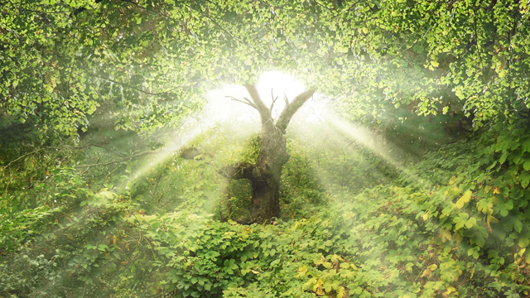
?

Slide 15
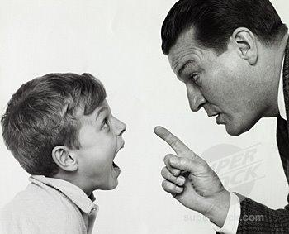

Slide 16
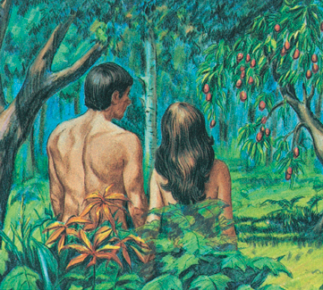

Slide 17
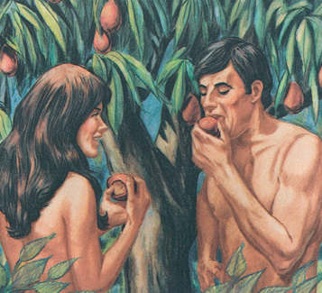

Slide 19
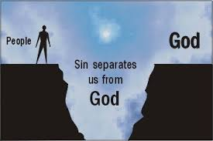

Slide 20
Genesis 3:9-11 (ESV)
9 But the Lord God called to the man and said to him, “Where are you?”
10 And he said, “I heard the sound of you in the garden, and I was afraid, because I was naked, and I hid myself.”
11 He said, “Who told you that you were naked? Have you eaten of the tree of which I commanded you not to eat?”

Slide 21
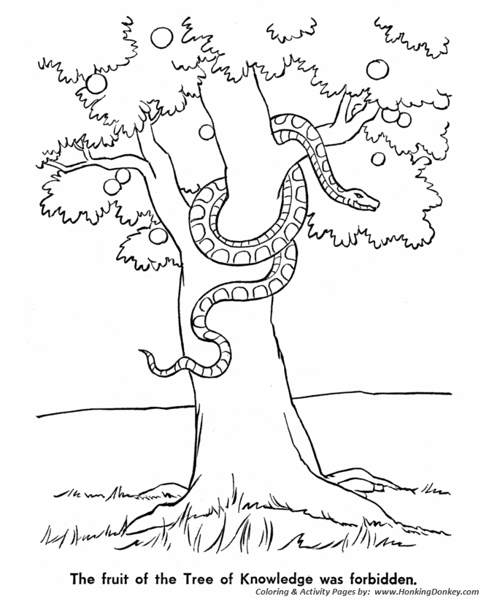
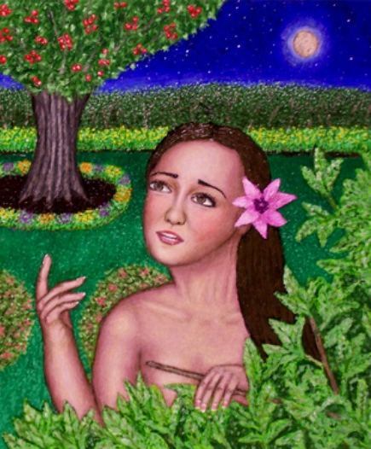
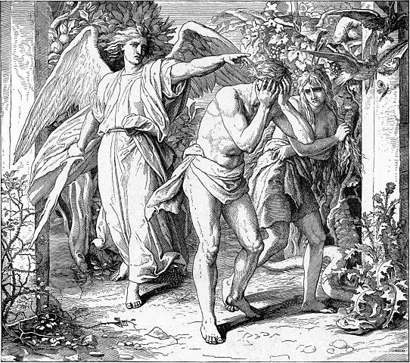
“ . . . therefore the Lord God sent him out from the garden of Eden to work the ground from which he was taken. He drove out the man, and at the east of the garden of Eden he placed the cherubim and a flaming sword that turned every way to guard the way to the tree of life.”

Slide 22
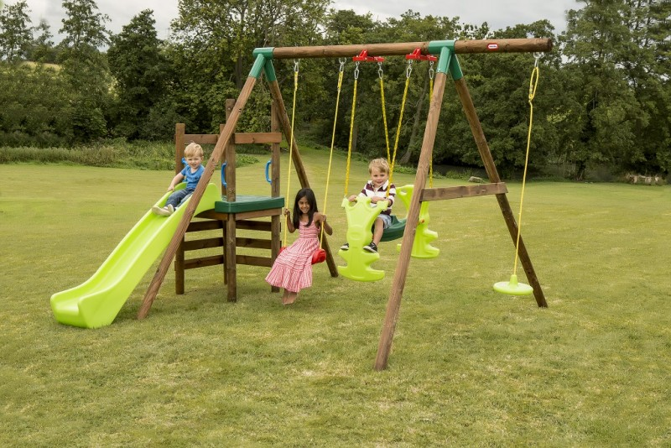

Slide 23
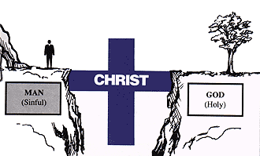

Slide 24
WHERE ARE YOU?
?

