Slide 3
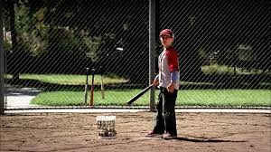
“I’m the greatest pitcher in the world!”

Slide 4
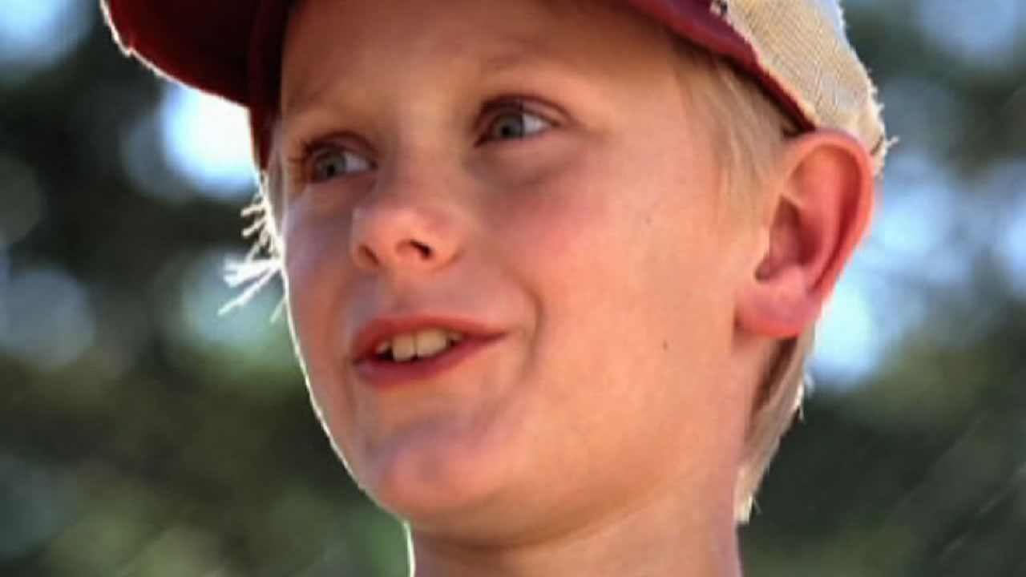
“HOW’S YOUR IMAGE?”

Slide 5
GREAT TURNING POINTS IN

Slide 7
GREAT TURNING POINTS IN
“God made everything – and everything He made was GOOD.”

Slide 8
GREAT TURNING POINTS IN
Part 2
“HOW’S YOUR IMAGE?”

Slide 9
Genesis 1:26-28 (ESV)
²⁶ Then God said, “Let us make man in our image, after our likeness. And let them have dominion over the fish of the sea and over the birds of the heavens and over the livestock and over all the earth and over every creeping thing that creeps on the earth.”
²⁷ So God created man in his own image, in the image of God he created him; male and female he created them.
²⁸ And God blessed them. And God said to them, “Be fruitful and multiply and fill the earth and subdue it, and have dominion over the fish of the sea and over the birds of the heavens and over every living thing that moves on the earth.”

Slide 10
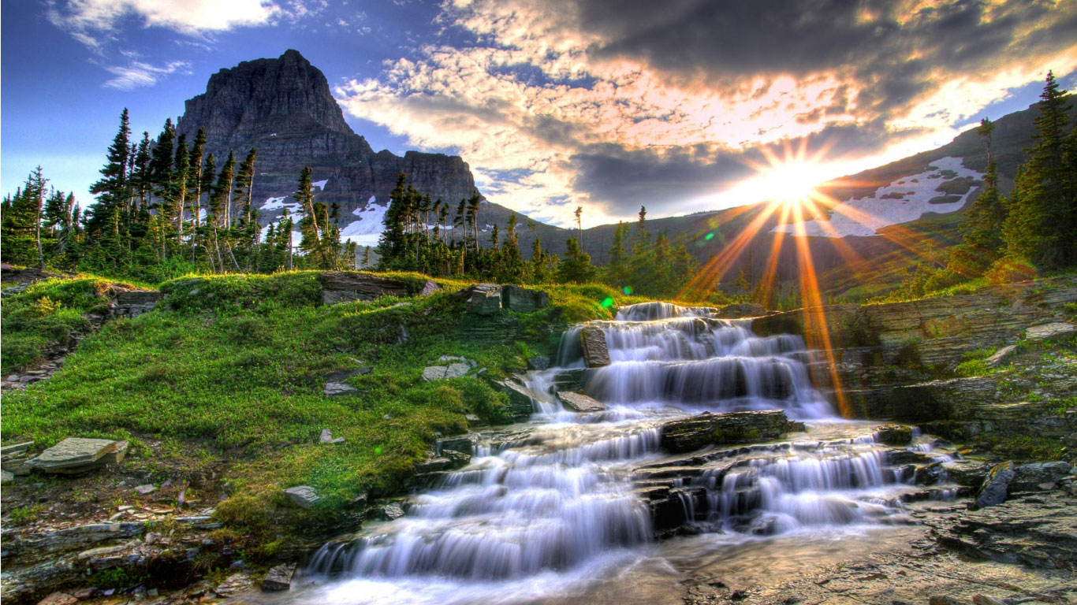

Slide 11
GREAT TURNING POINTS IN
God said, “Let us make mankind . . .”

Slide 13
Genesis 1:26-28 (ESV)
²⁶ Then God said, “Let us make man in our image, after our likeness. And let them have dominion over the fish of the sea and over the birds of the heavens and over the livestock and over all the earth and over every creeping thing that creeps on the earth.”
²⁷ So God created man in his own image, in the image of God he created him; male and female he created them.
²⁸ And God blessed them. And God said to them, “Be fruitful and multiply and fill the earth and subdue it, and have dominion over the fish of the sea and over the birds of the heavens and over every living thing that moves on the earth.”

Slide 14
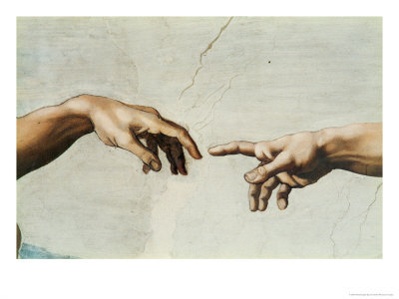

Slide 16
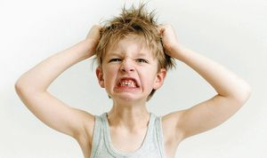
Spittin’ Image!

Slide 17
Genesis 1:26-28 (ESV)
²⁶ Then God said, “Let us make man in our image, after our likeness. And let them have dominion over the fish of the sea and over the birds of the heavens and over the livestock and over all the earth and over every creeping thing that creeps on the earth.”
²⁷ So God created man in his own image, in the image of God he created him; male and female he created them.
²⁸ And God blessed them. And God said to them, “Be fruitful and multiply and fill the earth and subdue it, and have dominion over the fish of the sea and over the birds of the heavens and over every living thing that moves on the earth.”

Slide 20
Genesis 2:5-8 (ESV)
⁵ When no bush of the field was yet in the land and no small plant of the field had yet sprung up—for the Lord God had not caused it to rain on the land, and there was no man to work the ground,
⁶ and a mist was going up from the land and was watering the whole face of the ground—
⁷ then the Lord God formed the man of dust from the ground and breathed into his nostrils the breath of life, and the man became a living creature.
⁸ And the Lord God planted a garden in Eden, in the east, and there he put the man whom he had formed.

Slide 21
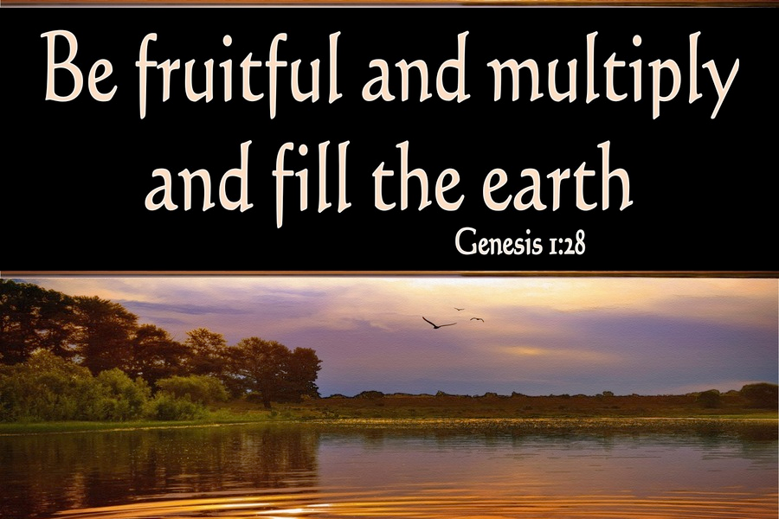

Slide 22
“ . . . and have put on the new self, which is being renewed in knowledge after the image of its creator.”

Slide 23
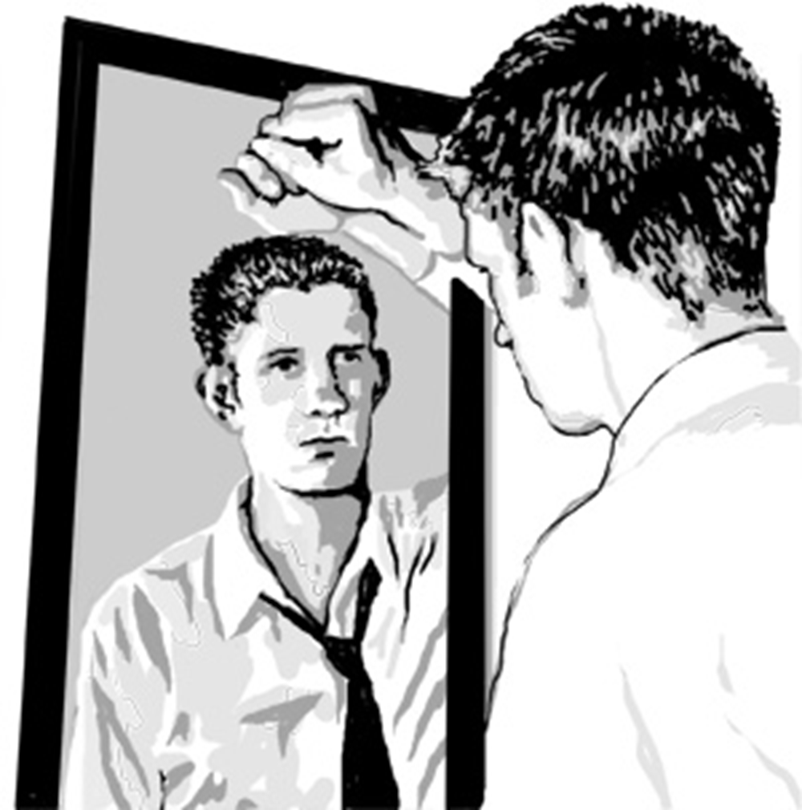
How’s
Your Image?

