Slide 3
Genesis 3:15

Slide 4
God created the heavens and the earth, AND IT WAS VERY GOOD!
God created MANKIND and endued him with HIS IMAGE!
The CREATION FELL into sin and rebellion, and was cast out from the presence of God.

Slide 5
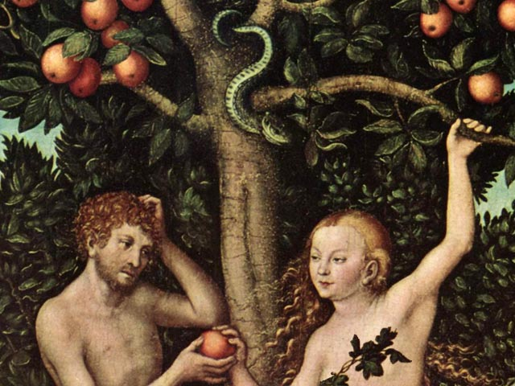

Slide 8
Genesis 3:15

Slide 11
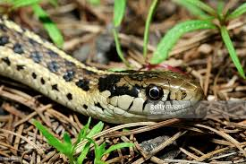

Slide 12
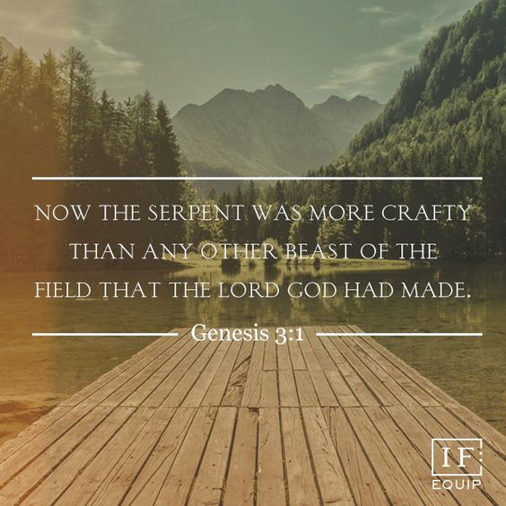

Slide 13
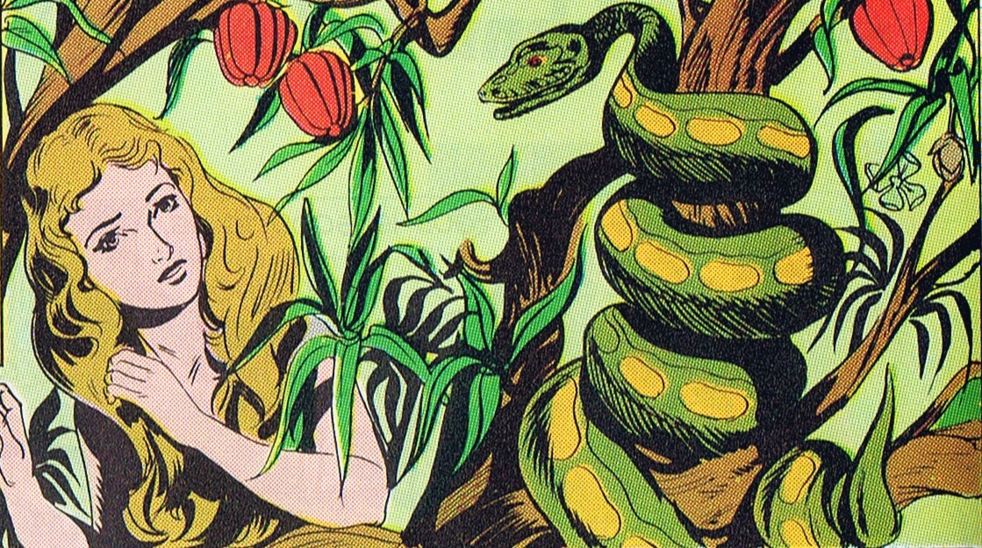

Slide 14
John 8:44 (ESV)
“You are of your father the devil, and your will is to do your father's desires. He was a murderer from the beginning, and does not stand in the truth, because there is no truth in him. When he lies, he speaks out of his own character, for he is a liar and the father of lies.”

Slide 15
2 Cor. 11:14 (ESV)
“And no wonder, for even Satan disguises himself as an angel of light.”

Slide 16
1 John 3:8 (ESV)
“Whoever makes a practice of sinning is of the devil, for the devil has been sinning from the beginning . . .”

Slide 18
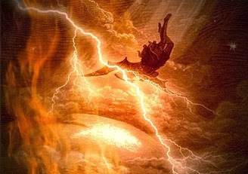
Revelation 12:9 (ESV)
⁹ And the great dragon was thrown down, that ancient serpent, who is called the devil and Satan, the deceiver of the whole world—he was thrown down to the earth, and his angels were thrown down with him.

Slide 20
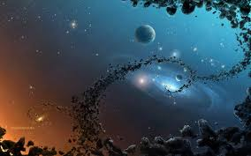
“I will put enmity between you and the woman, and between your offspring and her offspring; he shall bruise your head, and you shall bruise his heel.”
Genesis 3:15

Slide 21
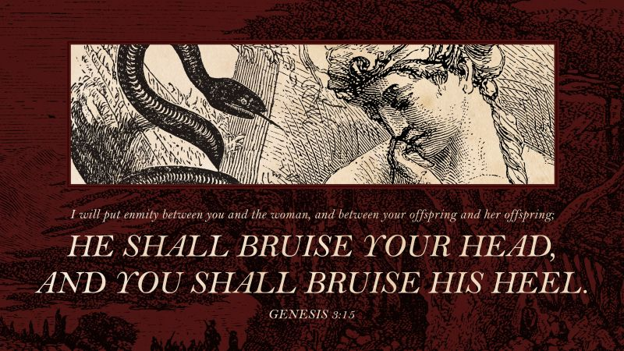
“THE FIRST GOSPEL”

Slide 22
“Seed of the
Woman”
“Seed of the
Serpent”

Slide 23
1 John 3:8 (ESV)
“Whoever makes a practice of sinning is of the devil, for the devil has been sinning from the beginning.
The reason the Son of God appeared was to destroy the works of the devil.”

Slide 24
And he said to them, “I saw Satan fall like lightning from heaven. (Luke 10:18)
Now is the judgment of this world; now will the ruler of this world be cast out. (John 12:31)
Since therefore the children share in flesh and blood, he himself likewise partook of the same things, that through death he might destroy the one who has the power of death, that is, the devil . . . (Hebrews 2:14)

Slide 25
“I will put enmity between you and the woman, and between your offspring and her offspring; he shall bruise your head, and you shall bruise his heel.”
Genesis 3:15
“The First Gospel”

Slide 26
Romans 16:19-20 (ESV)
¹⁹ For your obedience is known to all, so that I rejoice over you, but I want you to be wise as to what is good and innocent as to what is evil.
²⁰ The God of peace will soon crush Satan under your feet.

Slide 27
