Slide 2
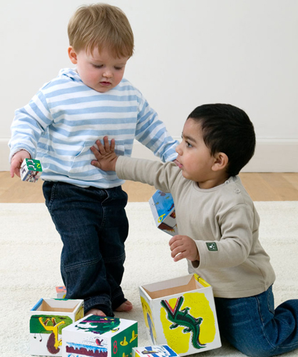
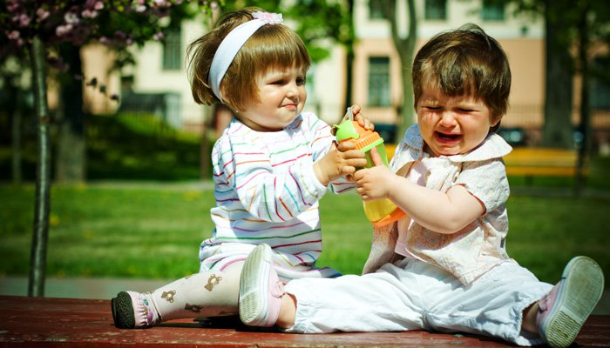
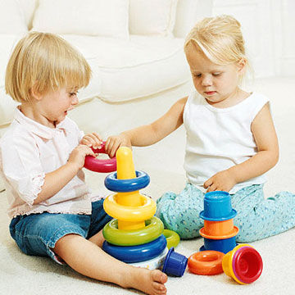

Slide 3
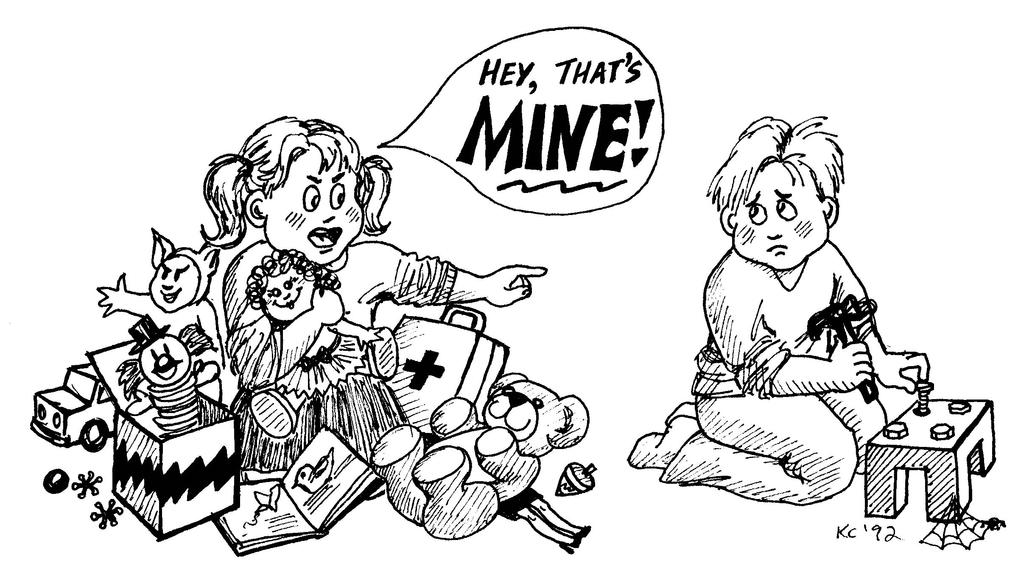

Slide 5
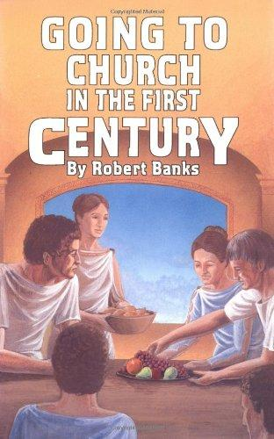

Slide 6
Sharing
Communion
Fellowship
Relationship
Participation
Taking Part
Being a Part
Giving
Partnership

Slide 7
KOINONIA
“fellowship”

Slide 8
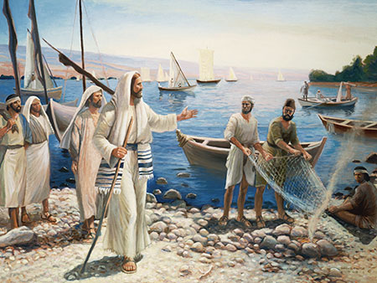

Slide 9
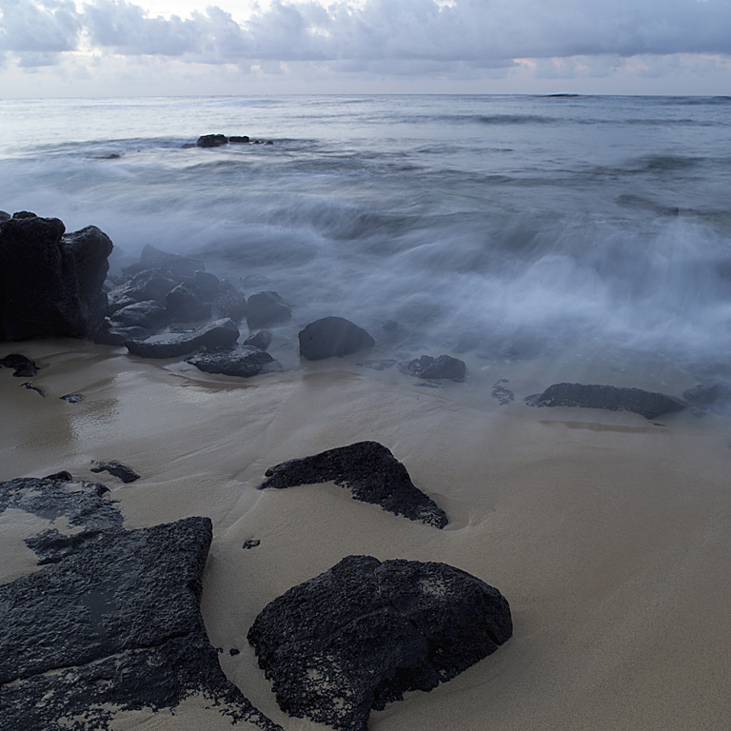
“I, John, your brother and partner in the tribulation and the kingdom and the patient endurance that are in Jesus, was on the island called Patmos on account of the word of God and the testimony of Jesus . . .”

Slide 10
“I, John, your brother and partner in the tribulation and the kingdom and the patient endurance that are in Jesus, was on the island called Patmos on account of the word of God and the testimony of Jesus . . .”

Slide 11
“I, John, your brother and partner in the tribulation and the kingdom and the patient endurance that are in Jesus, was on the island called Patmos on account of the word of God and the testimony of Jesus . . .”

Slide 12
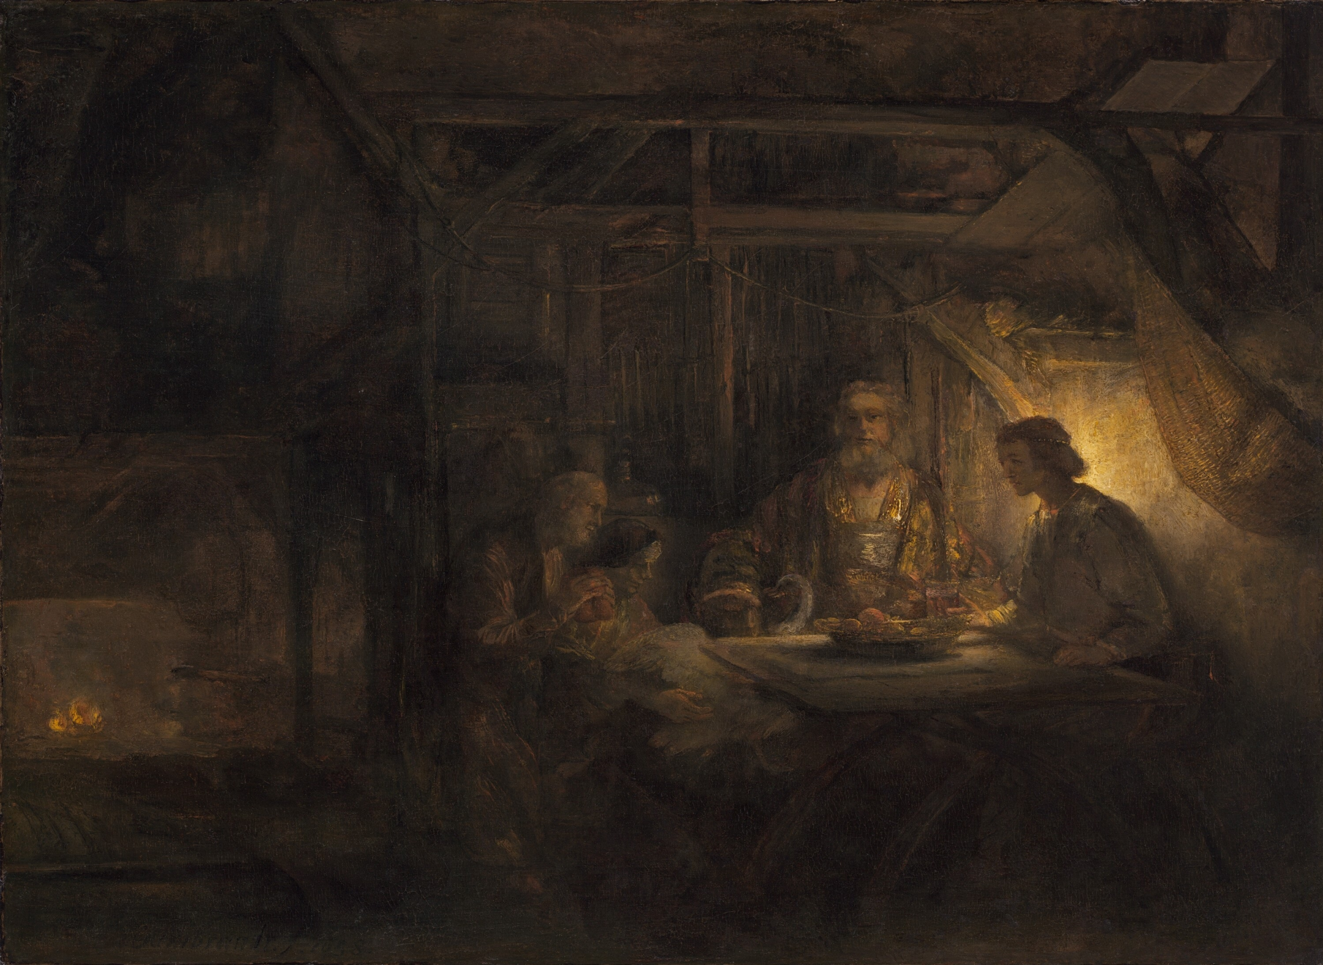
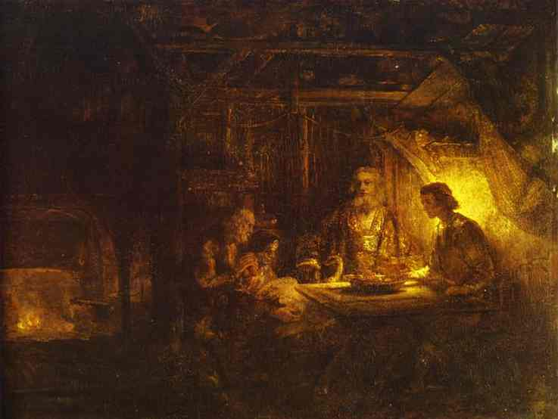
“So if you consider me your partner, receive him as you would receive me.”
Philemon 17

Slide 13
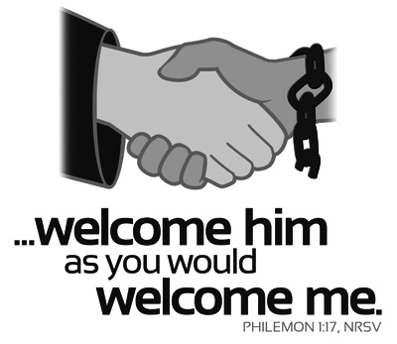
“So if you consider me your partner, receive him as you would receive me.”
Philemon 17
KOINONIA
WHAT COULD IT DO FOR ME, THIS WORD?

Slide 14
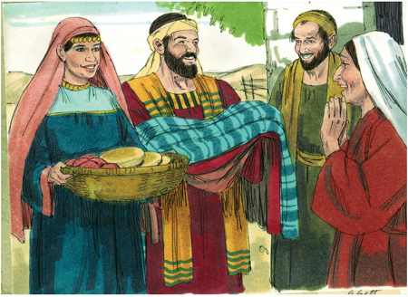
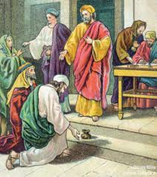
“Now the full number of those who believed were of one heart and soul, and no one said that any of the things that belonged to him was his own, but they had everything in common.” Acts 4:32
“There was not a needy person among them, for as many as were owners of lands or houses sold them and brought the proceeds of what was sold and laid it at the apostles' feet, and it was distributed to each as any had need. Acts 4:34-35

Slide 15
The church of Christ, in the mind of God, at the heart of the New Testament, is a group of incredible sharers.

Slide 16
1 John 1
“¹That which was from the beginning, which we have heard, which we have seen with our eyes, which we looked upon and have touched with our hands, concerning the word of life—”

Slide 17
1 John 1
³ that which we have seen and heard we proclaim also to you, so that you too may have fellowship with us; and indeed our fellowship is with the Father and with his Son Jesus Christ. ⁴ And we are writing these things so that our joy may be complete.

Slide 18
1 John 1
⁵ This is the message we have heard from him and proclaim to you, that God is light, and in him is no darkness at all. ⁶ If we say we have fellowship with him while we walk in darkness, we lie and do not practice the truth. ⁷ But if we walk in the light, as he is in the light, we have fellowship with one another, and the blood of Jesus his Son cleanses us from all sin.

Slide 19
FELLOWSHIP
KOINONIA
SHARING

Slide 20
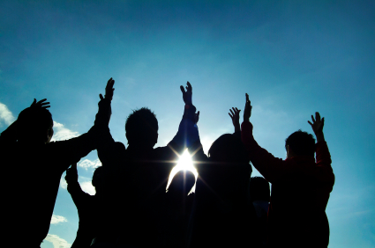
Share Groups

