Slide 2
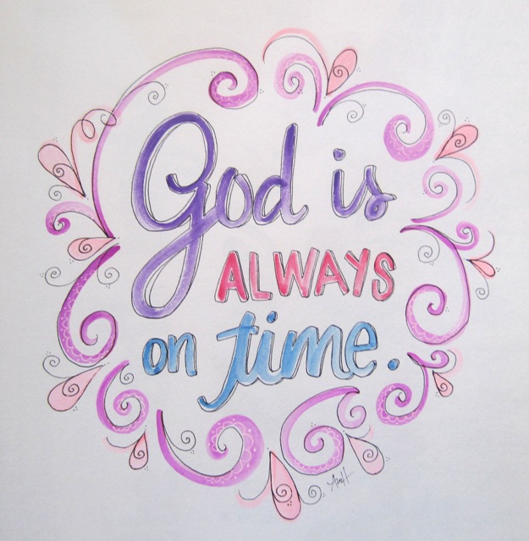

Slide 3
TURNING POINTS IN
Creation of the World
Creation of Man in God’s Image
Fall into Sin
First Gospel
Call of Abram
First Passover
Promise of Resurrection
GOD’S GRAND PLAN!

Slide 5
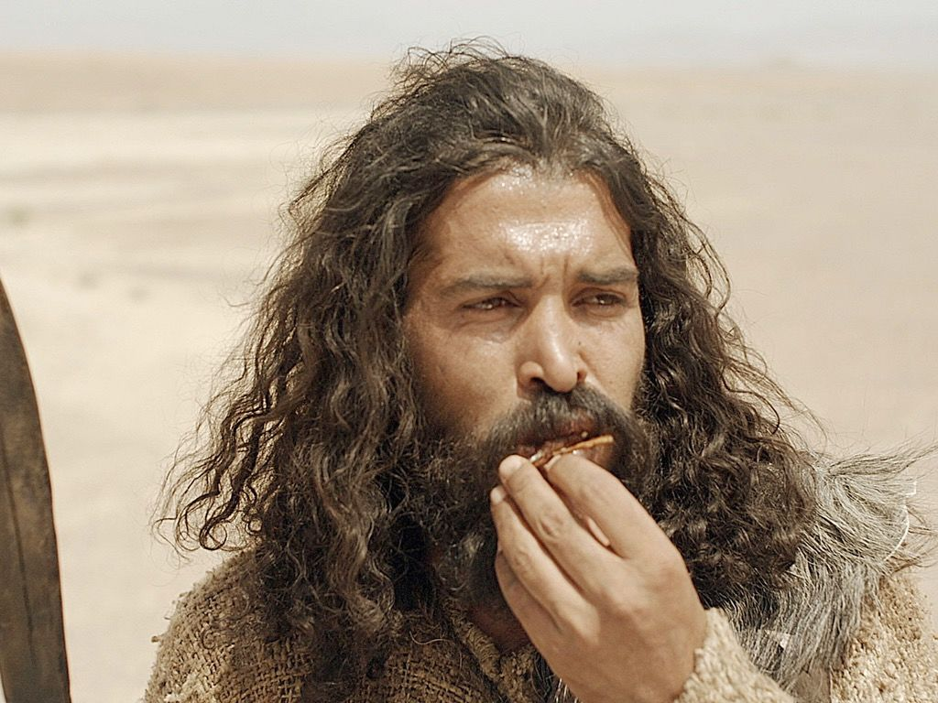

Slide 7
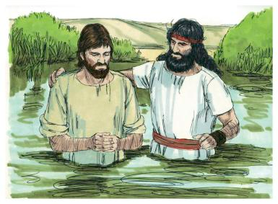

Slide 9
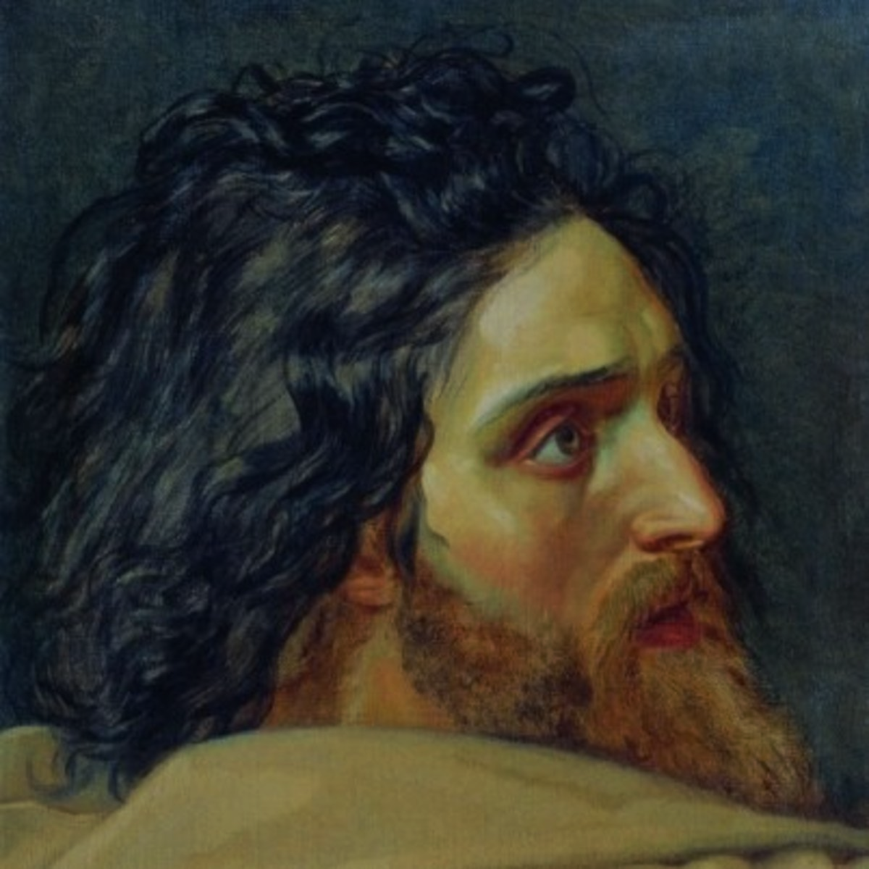
“he was delivered up”

Slide 10
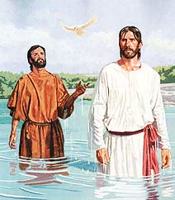
“FROM THE MESSENGER TO THE MESSAGE”

Slide 11
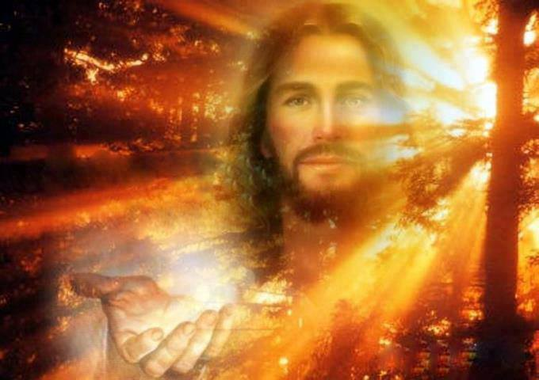
THE GOOD NEWS HAS ARRIVED!

Slide 13
THE TIME IS FULFILLED!
“KAIROS”
“THE SILENT YEARS”
“THE TIME BETWEEN THE TESTAMENTS”

Slide 14
HOW LONG HAVE YOU BEEN WAITING ON GOD?

Slide 15
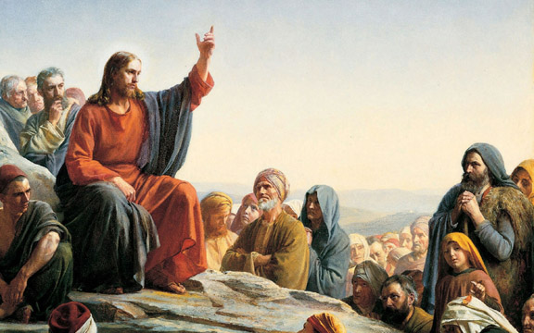
“The time is fulfilled.”
“The Kingdom of God is at hand.”

Slide 16
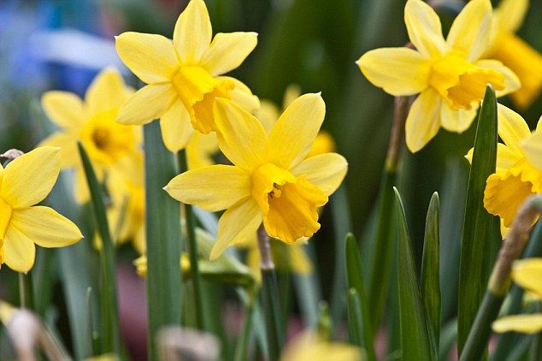

Slide 17
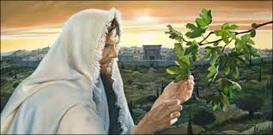
“From the fig tree learn its lesson: as soon as its branch becomes tender and puts out its leaves, you know that summer is near.” -Mark 13:28

Slide 18
“The time is fulfilled.”
“The Kingdom of God is at hand.”

Slide 19
“The time is fulfilled.”
“The Kingdom of God is at hand.”
“Repent and believe in the Gospel.”

Slide 21
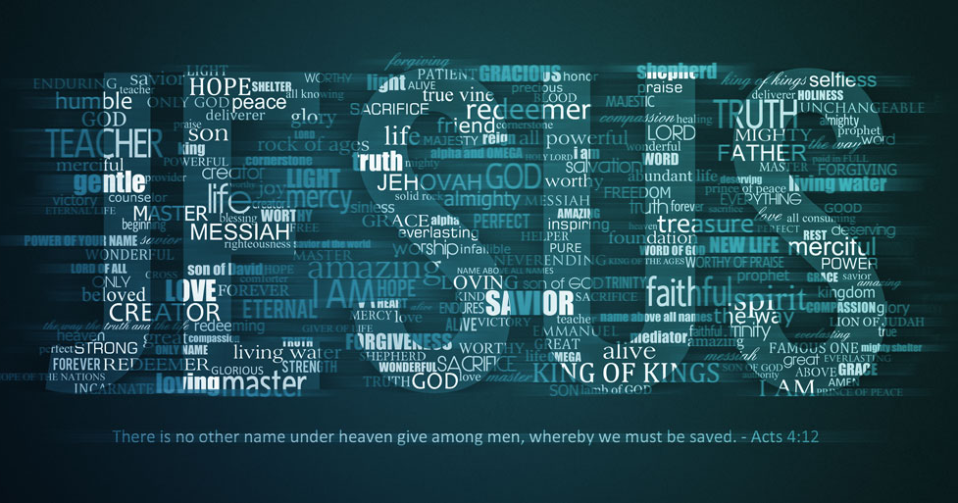

Slide 22
“The time is fulfilled.”
“The Kingdom of God is at hand.”
“Repent and believe in the Gospel.”

Slide 23
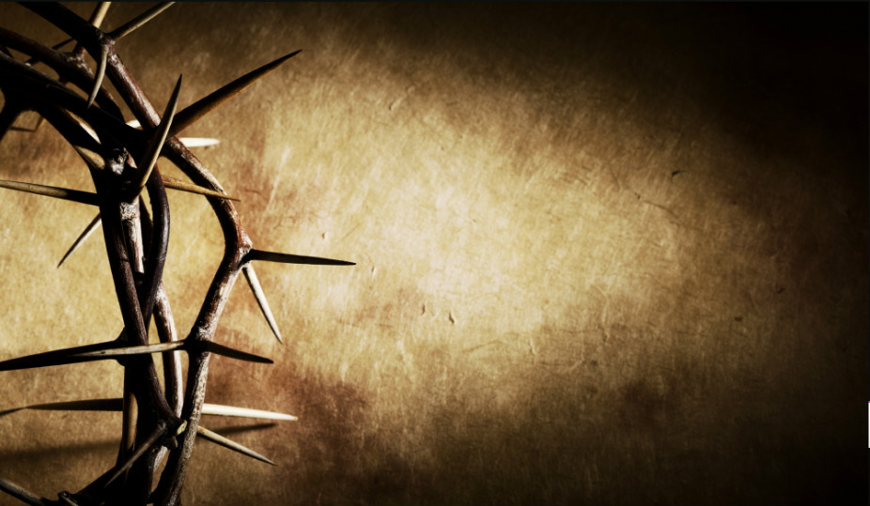
“Keep on REPENTING and BELIEVING in the Gospel.”

Slide 24
The time is right.
God’s Kingdom is here.
Repent and believe in then GOOD NEWS of Jesus Christ!

