Slide 2
History is

Slide 5
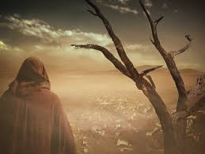
“You Shall Live!”

Slide 6
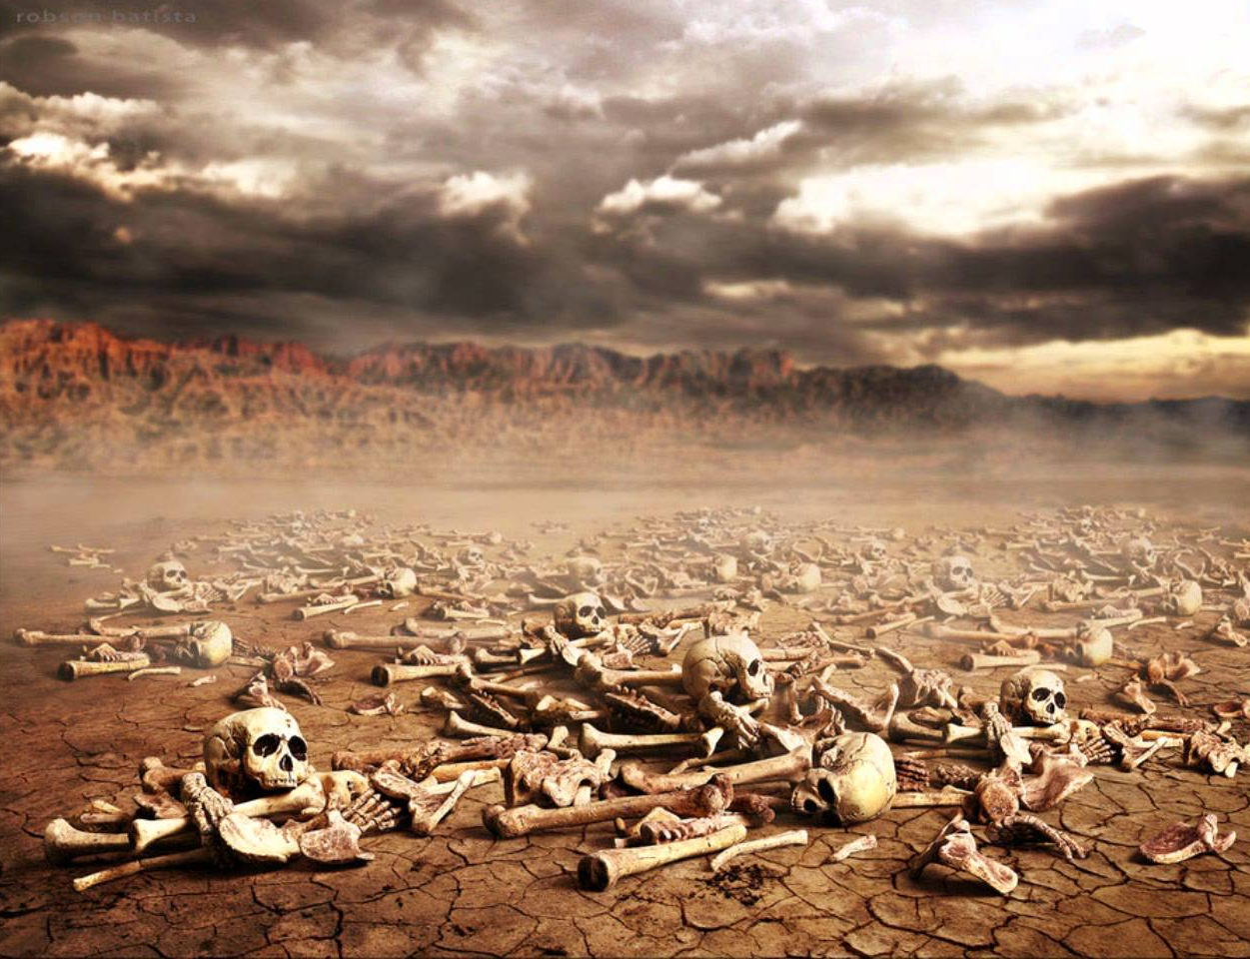
“You Shall Live!”

Slide 7
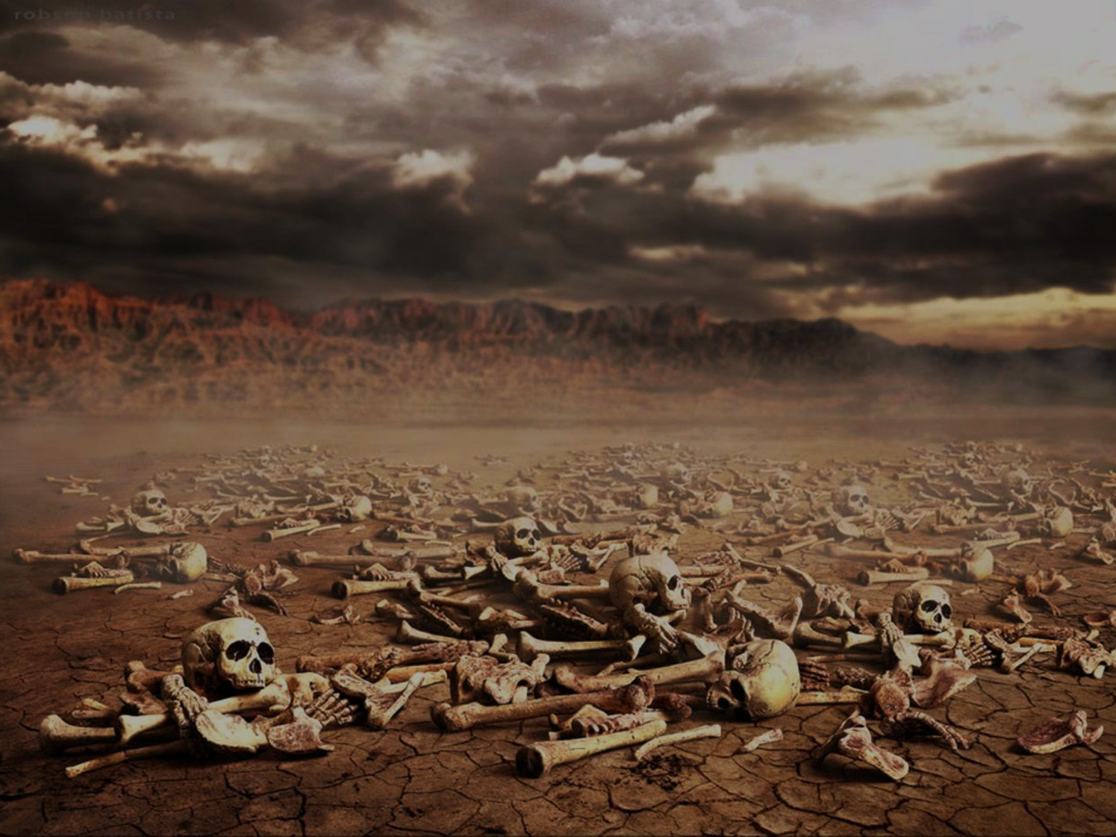
¹The hand of the Lord was upon me, and he brought me out in the Spirit of the Lord and set me down in the middle of the valley; it was full of bones. ² And he led me around among them, and behold, there were very many on the surface of the valley, and behold, they were very dry.³ And he said to me, “Son of man, can these bones live?” And I answered, “O Lord God, you know.” ⁴ Then he said to me, “Prophesy over these bones, and say to them, O dry bones, hear the word of the Lord.⁵ Thus says the Lord God to these bones: Behold, I will cause breath to enter you, and you shall live. ⁶ And I will lay sinews upon you, and will cause flesh to come upon you, and cover you with skin, and put breath in you, and you shall live, and you shall know that I am the Lord.”
Ezekiel 37:1-14

Slide 8
⁷ So I prophesied as I was commanded. And as I prophesied, there was a sound, and behold, a rattling, and the bones came together, bone to its bone. ⁸ And I looked, and behold, there were sinews on them, and flesh had come upon them, and skin had covered them. But there was no breath in them. ⁹ Then he said to me, “Prophesy to the breath; prophesy, son of man, and say to the breath, Thus says the Lord God: Come from the four winds, O breath, and breathe on these slain, that they may live.” ¹⁰ So I prophesied as he commanded me, and the breath came into them, and they lived and stood on their feet, an exceedingly great army.
Ezekiel 37:1-14

Slide 9
¹¹ Then he said to me, “Son of man, these bones are the whole house of Israel. Behold, they say, ‘Our bones are dried up, and our hope is lost; we are indeed cut off.’ ¹² Therefore prophesy, and say to them, Thus says the Lord God: Behold, I will open your graves and raise you from your graves, O my people. And I will bring you into the land of Israel.¹³ And you shall know that I am the Lord, when I open your graves, and raise you from your graves, O my people. ¹⁴ And I will put my Spirit within you, and you shall live, and I will place you in your own land. Then you shall know that I am the Lord; I have spoken, and I will do it, declares the Lord.”
Ezekiel 37:1-14

Slide 10
“You Shall Live!”

Slide 11
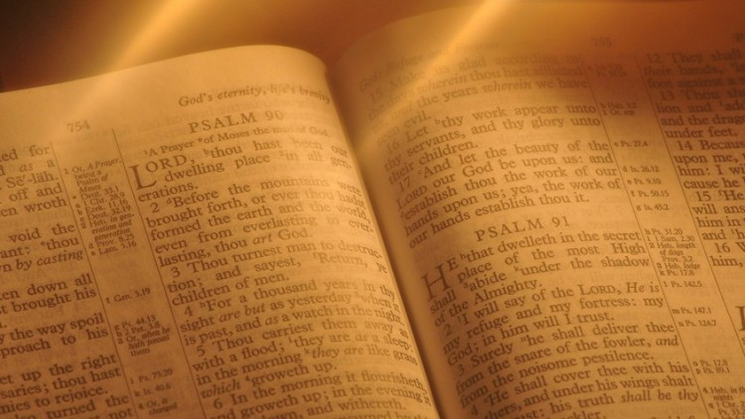
OLD TESTAMENT

Slide 12
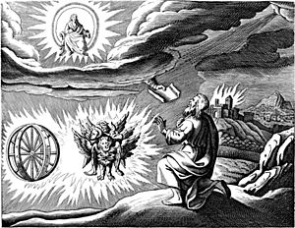

Slide 13
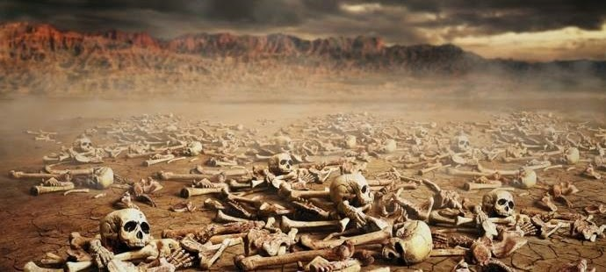
“Son of man, can these bones live?”

Slide 14
“O Yahweh God – you know!”

Slide 15
“Can these bones live?”
They shall live! You shall live!

Slide 16
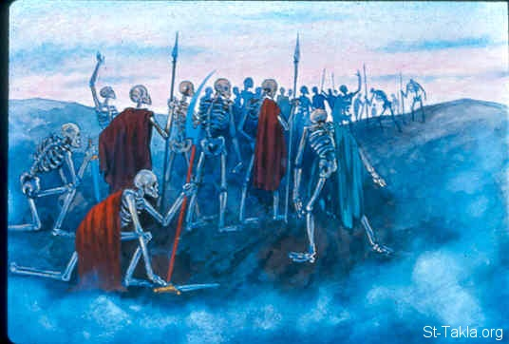

Slide 17
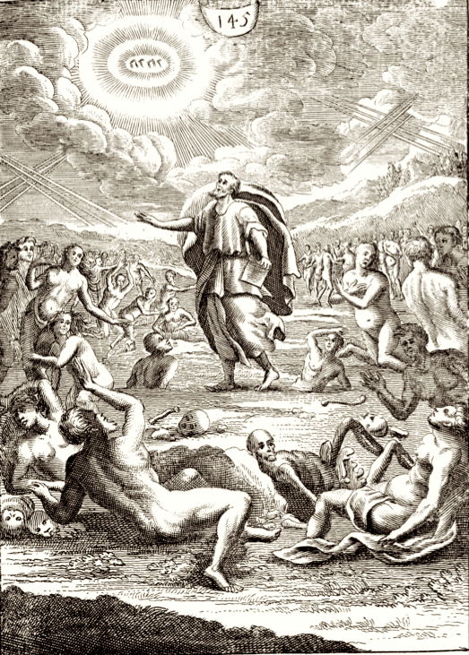

Slide 18
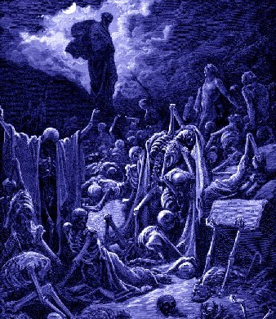

Slide 19
¹¹ Then he said to me, “Son of man, these bones are the whole house of Israel. Behold, they say, ‘Our bones are dried up, and our hope is lost; we are indeed cut off.’ ¹² Therefore prophesy, and say to them, Thus says the Lord God: Behold, I will open your graves and raise you from your graves, O my people. And I will bring you into the land of Israel.¹³ And you shall know that I am the Lord, when I open your graves, and raise you from your graves, O my people. ¹⁴ And I will put my Spirit within you, and you shall live, and I will place you in your own land. Then you shall know that I am the Lord; I have spoken, and I will do it, declares the Lord.”

Slide 20
You Shall Live!

Slide 21
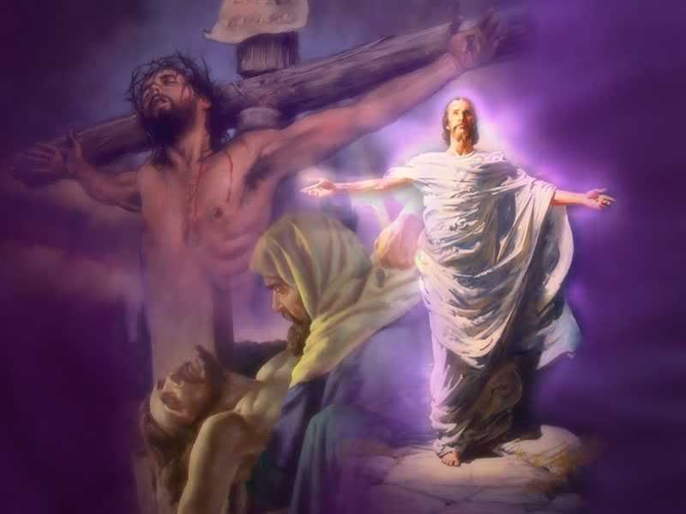
WE SHALL LIVE!

Slide 22
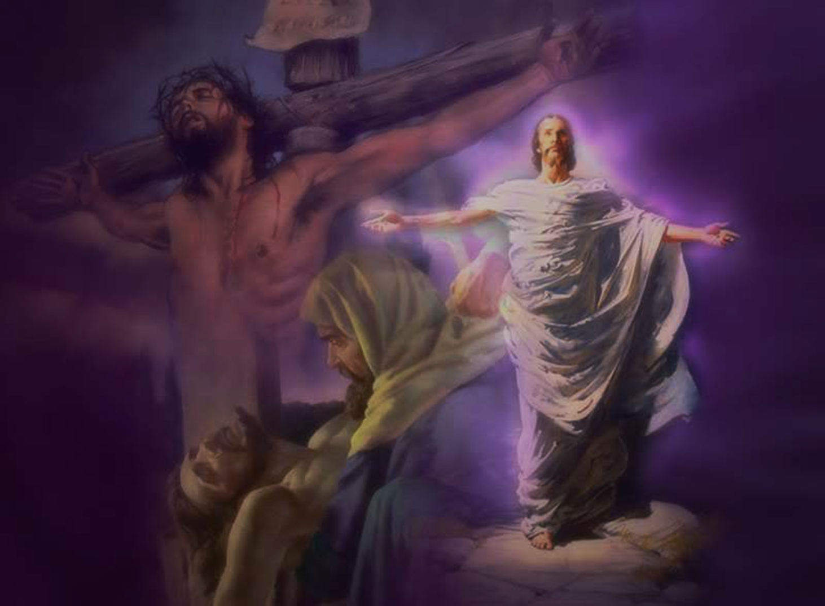
“But if Christ is in you, although the body is dead because of sin, the Spirit is life because of righteousness . . .
Romans 8:10-11

Slide 23
. . . if the Spirit of him who raised Jesus from the dead dwells in you, he who raised Christ Jesus from the dead will also give life to your mortal bodies through his Spirit who dwells in you.”
Romans 8:10-11

Slide 24
God Knows . . .

