Slide 2
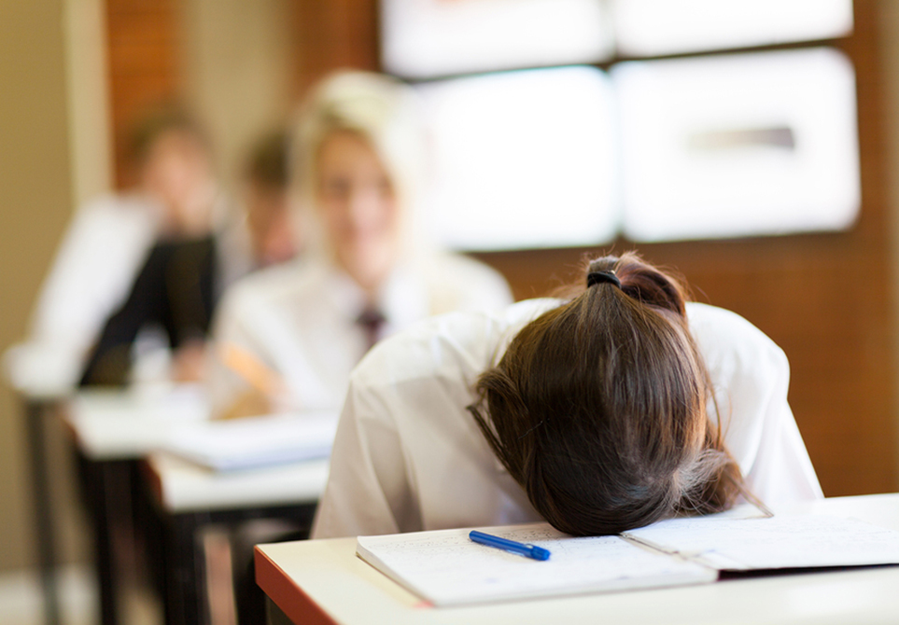

Slide 3
Sometimes you can get the right answer by accident!

Slide 4
Sometimes you can be literally right – but practically wrong!

Slide 7
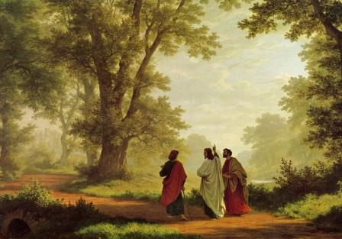

Slide 8
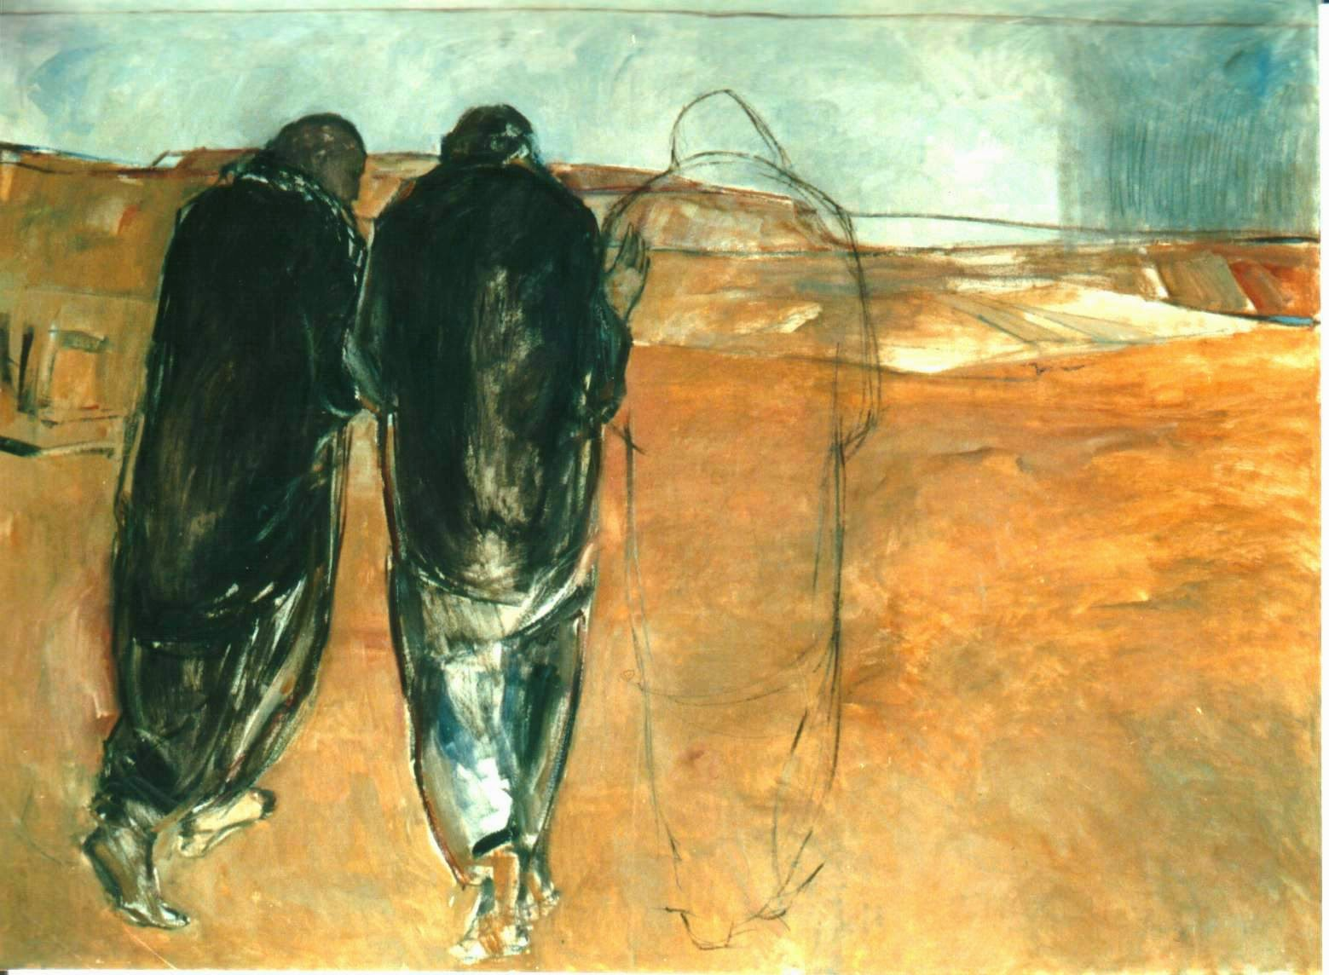
“Sometimes you can be literally right – but practically wrong.”

Slide 9
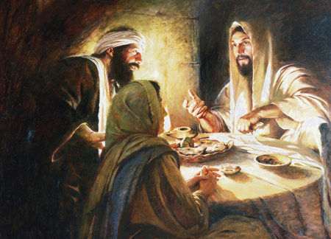

Slide 11
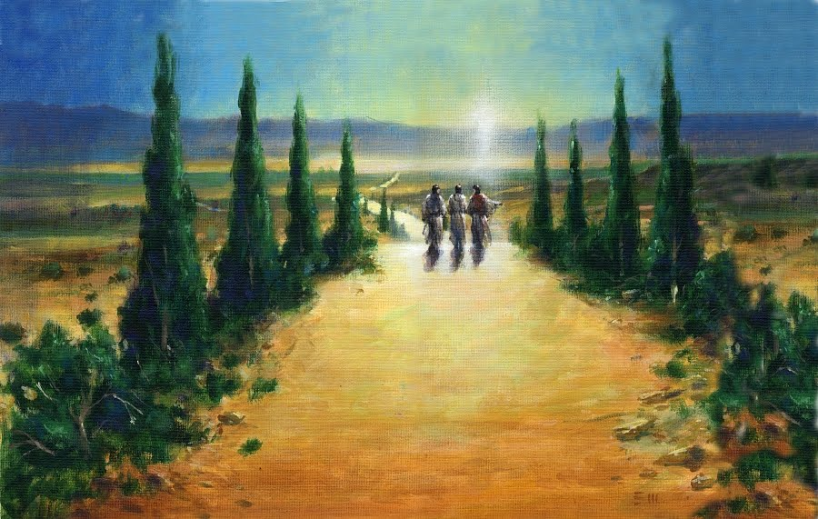
“Sometimes you can get the right answer by accident.”

Slide 13
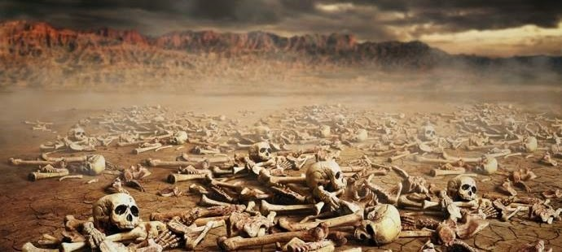
“Son of man, can these bones live?”

Slide 14
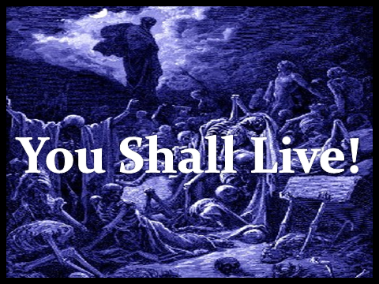

Slide 15
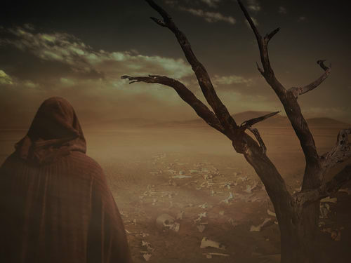
“Behold, I will open your graves and raise you from your graves, O my people . . . and you shall know that I am the LORD, when I open your graves, and raise you from your graves . . . and I will put my Spirit within you, and you shall live . . . then you shall know that I am the LORD.”
Ezekiel 37

Slide 16
Resurrection Power!

Slide 17
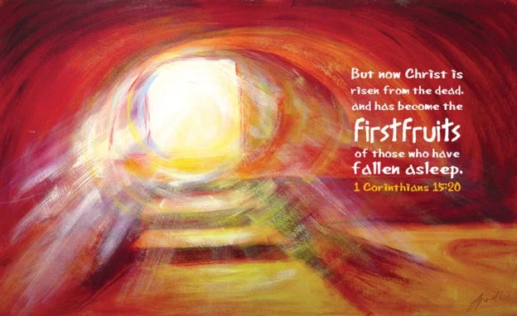
1 Corinthians 15:20-23
“But in fact Christ has been raised from the dead, the firstfruits of those who have fallen asleep. For as by a man came death, by a man has come also the resurrection of the dead. For as in Adam all die, so also in Christ shall all be made alive. But each in his own order: Christ the firstfruits, then at his coming those who belong to Christ.”

Slide 18
The Lord Has Risen Indeed!

Slide 19
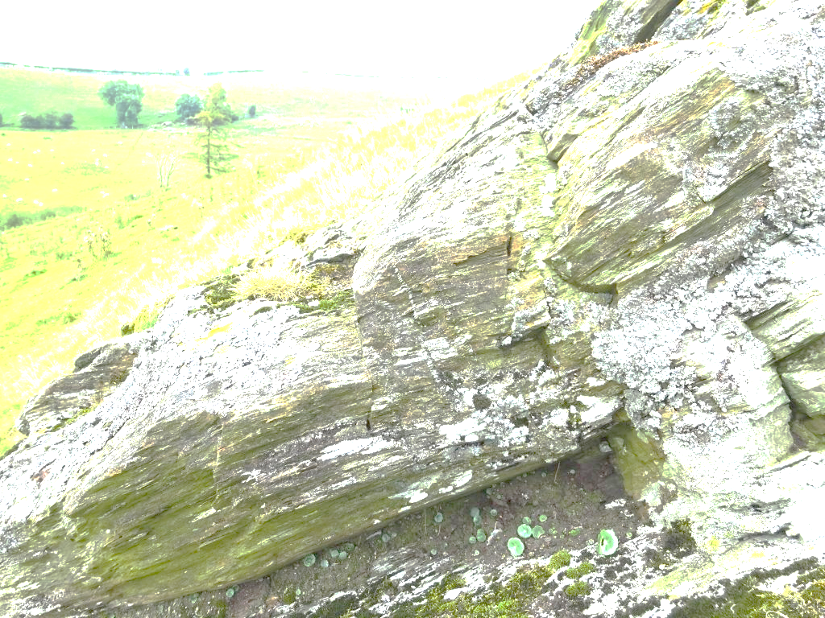
If we belong to Christ – we shall also be raised!

Slide 21
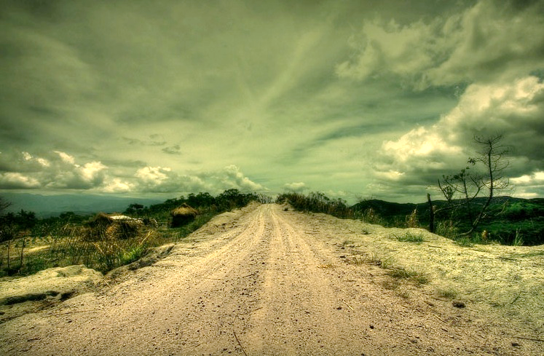
“ . . . He interpreted to them in all the Scriptures the things concerning Himself.”

Slide 23
“Blessed be the God and Father of our Lord Jesus Christ! According to his great mercy, he has caused us to be born again to a living hope through the resurrection of Jesus Christ from the dead, to an inheritance that is imperishable, undefiled, and unfading, kept in heaven for you, who by God's power are being guarded through faith for a salvation ready to be revealed in the last time.”

