Slide 2
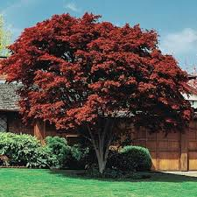
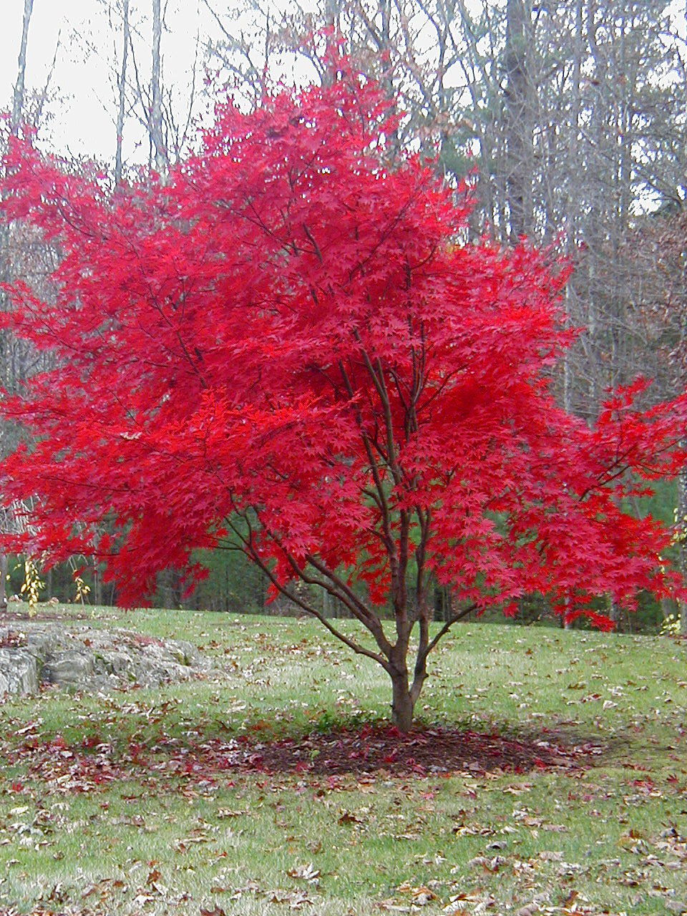
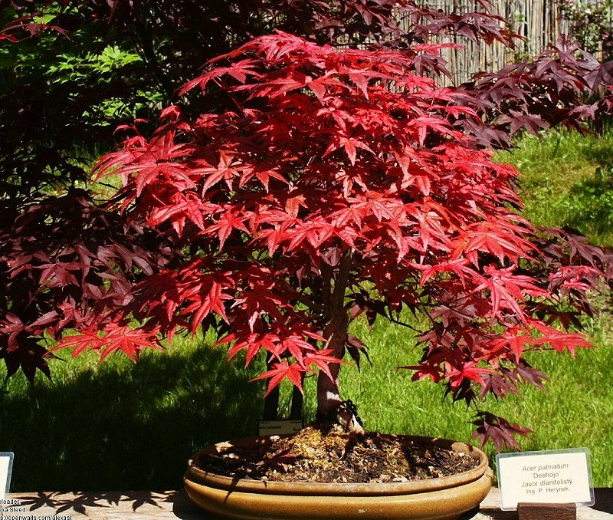

Slide 3
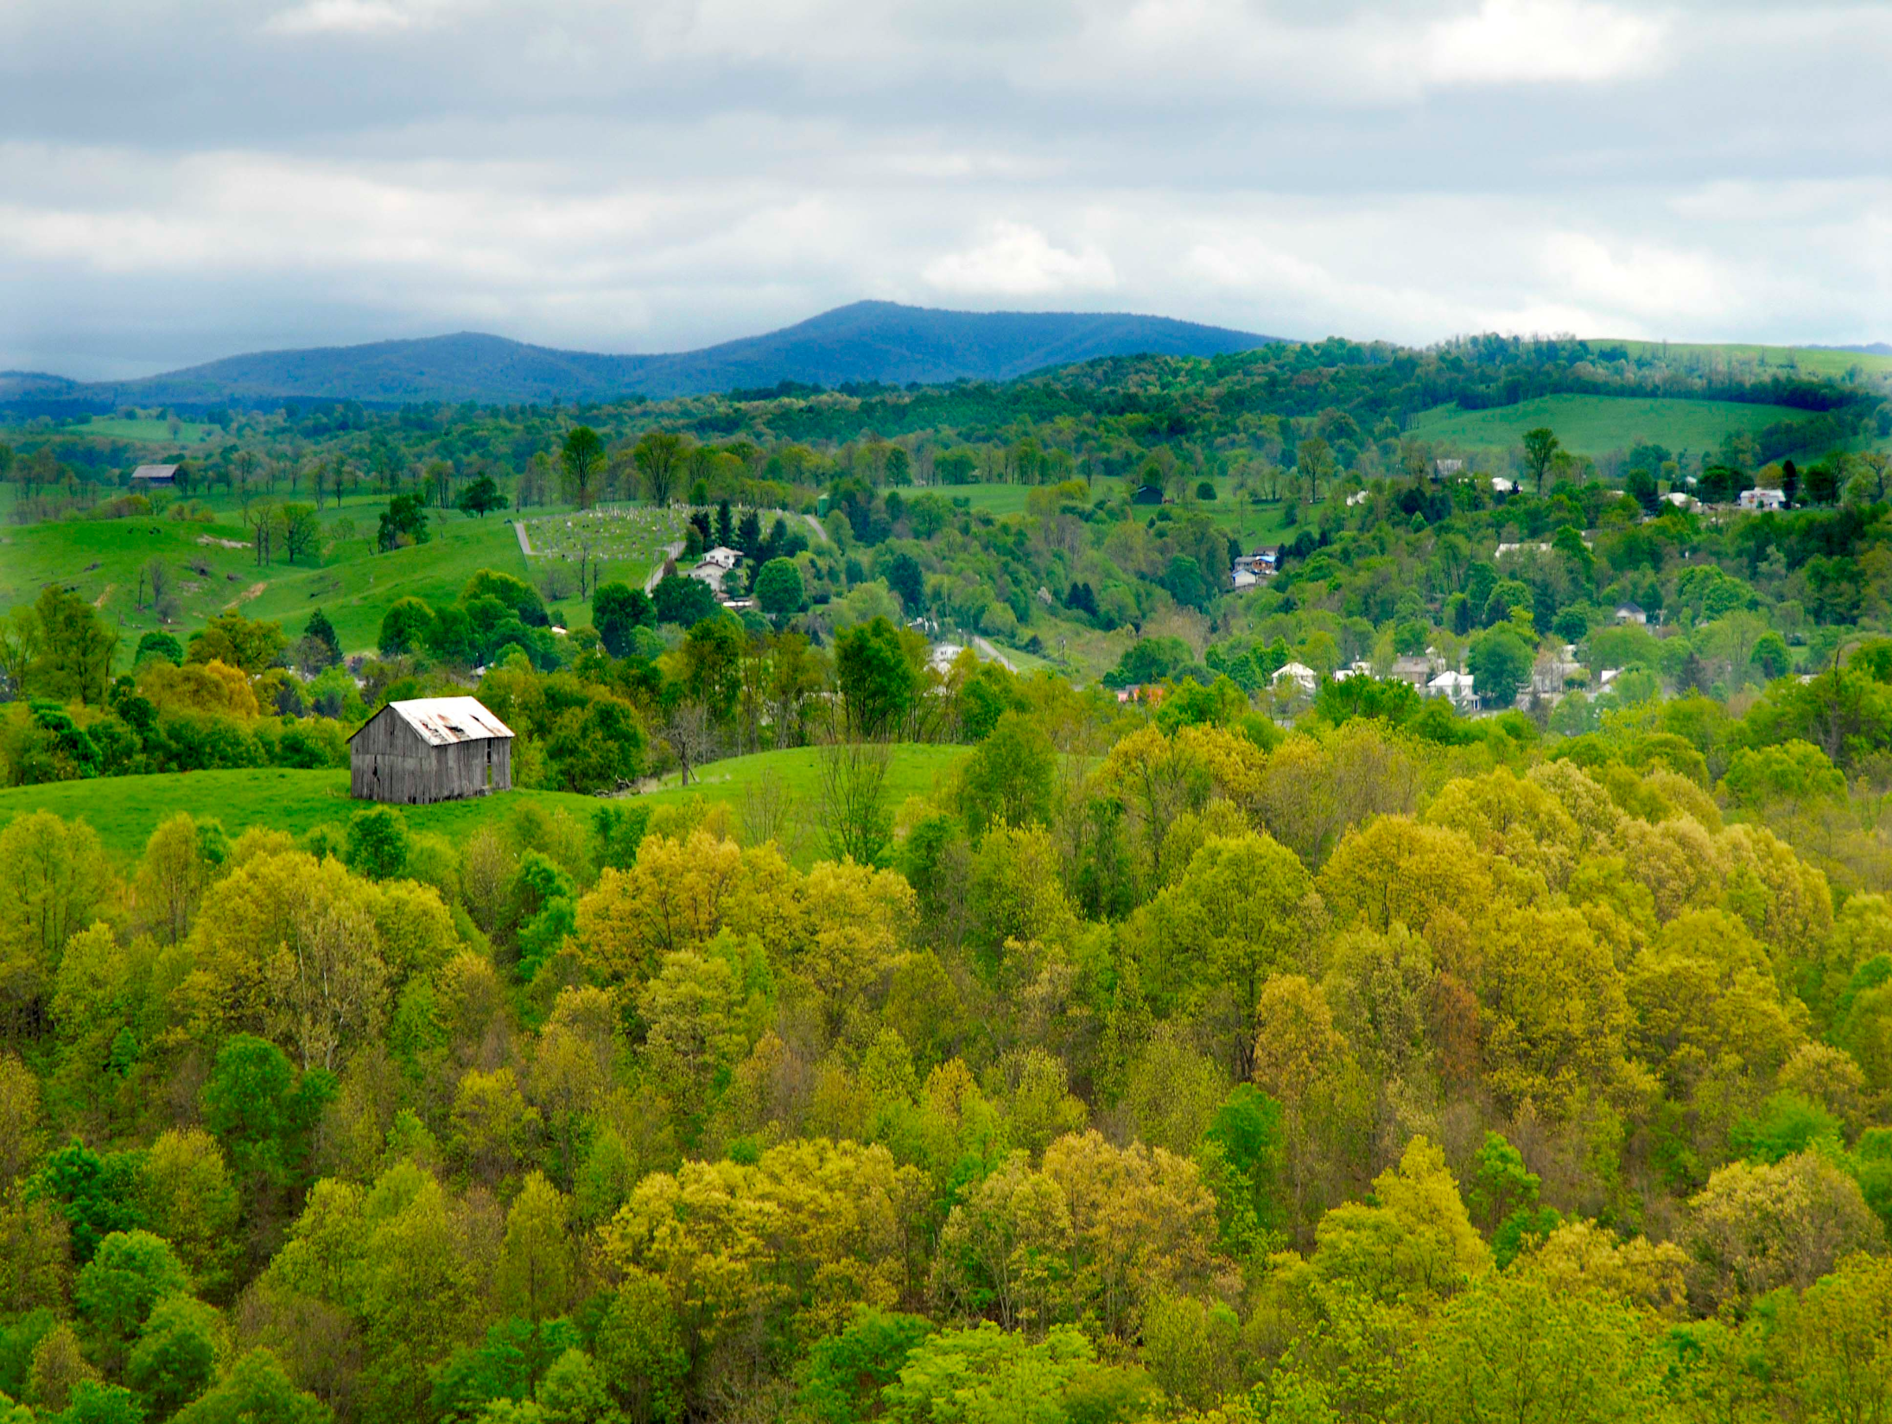

Slide 4
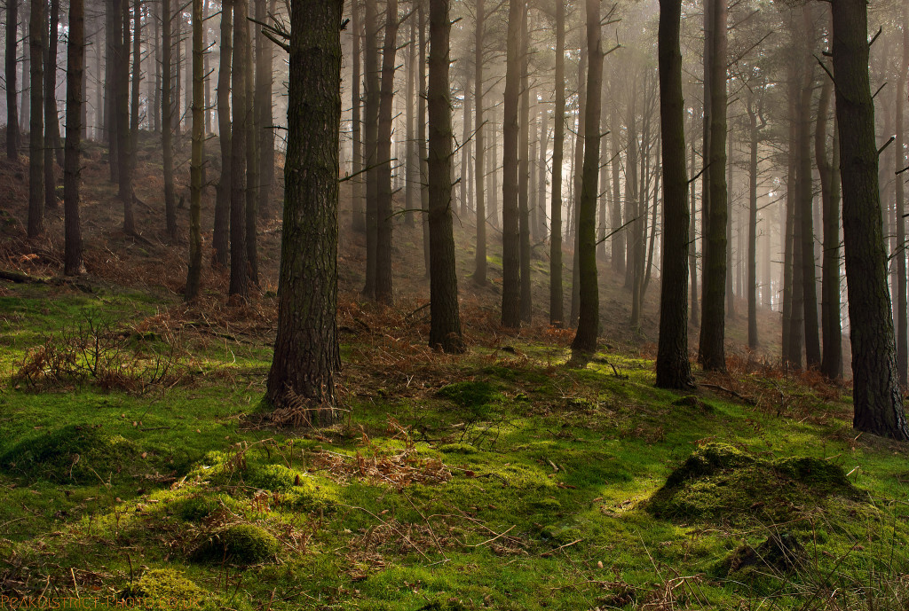

Slide 5
TURNING POINTS IN
“TWO TREES THAT TELL THE TALE”

Slide 6
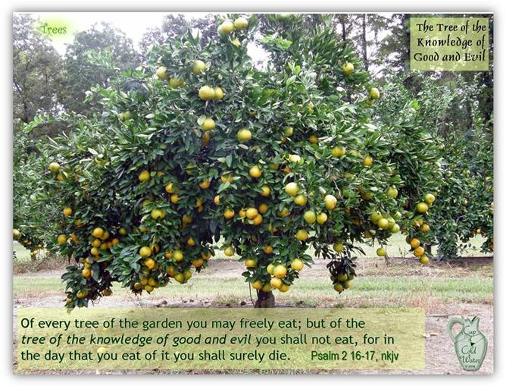

Slide 7
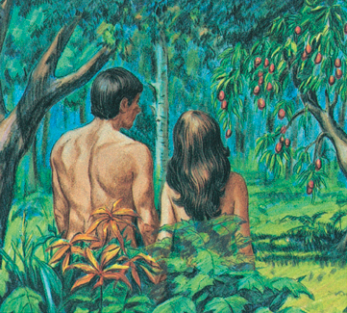

Slide 8
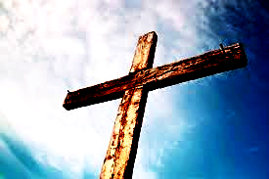

Slide 9
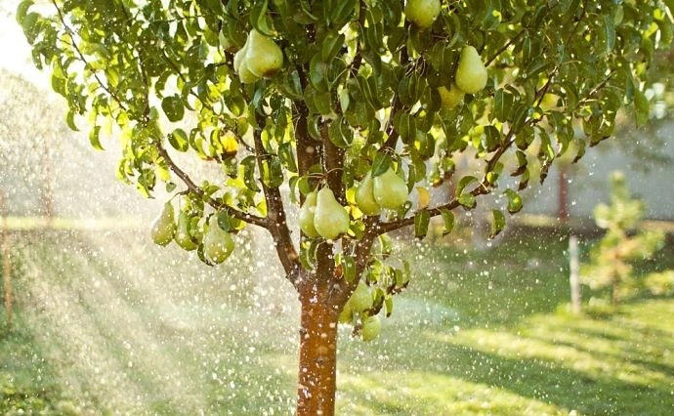
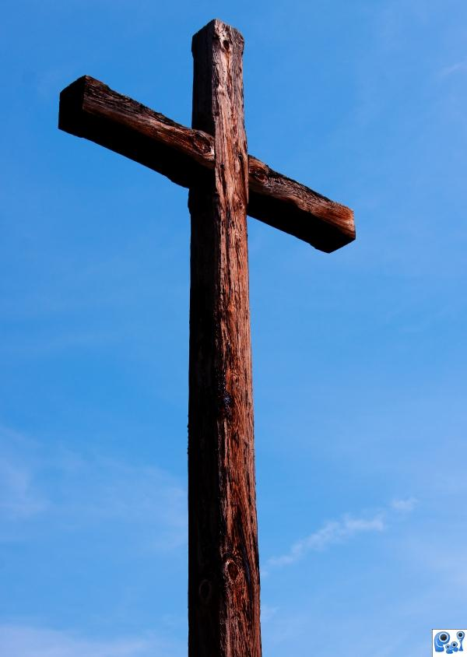
“XULON”
“DENDRON”

Slide 10
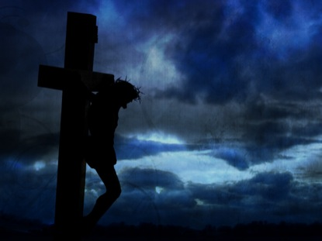
²¹ For to this you have been called, because Christ also suffered for you, leaving you an example, so that you might follow in his steps.
²² He committed no sin, neither was deceit found in his mouth.
²³ When he was reviled, he did not revile in return; when he suffered, he did not threaten, but continued entrusting himself to him who judges justly.
²⁴ He himself bore our sins in his body on the tree, that we might die to sin and live to righteousness. By his wounds you have been healed.
1 Peter 2:21-24

Slide 11
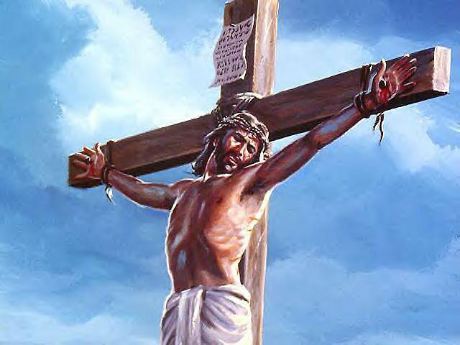
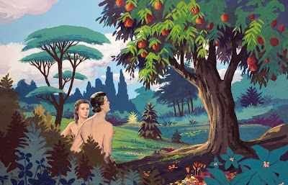

Slide 12
“Anybody that is hung upon a tree is cursed”
- Deuteronomy 21:22-23
“Christ redeemed us . . . by becoming a curse for us – for it is written. ‘Cursed is everyone who is hanged upon a tree.’”
- Galatians 3:13

Slide 13
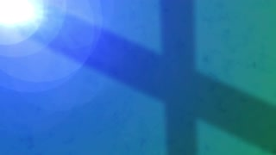
Acts 5:30 – “The God of our fathers raised Jesus, whom you killed by hanging Him on a tree.”
Acts 10:39 – “And we are witnesses of all that He did both in the country of the Jews and in Jerusalem. They put Him to death by hanging Him on a tree.”
Acts 13:29 – “And when they had carried out all that was written of Him, they took Him down from the tree and laid Him in a tomb.”

Slide 14
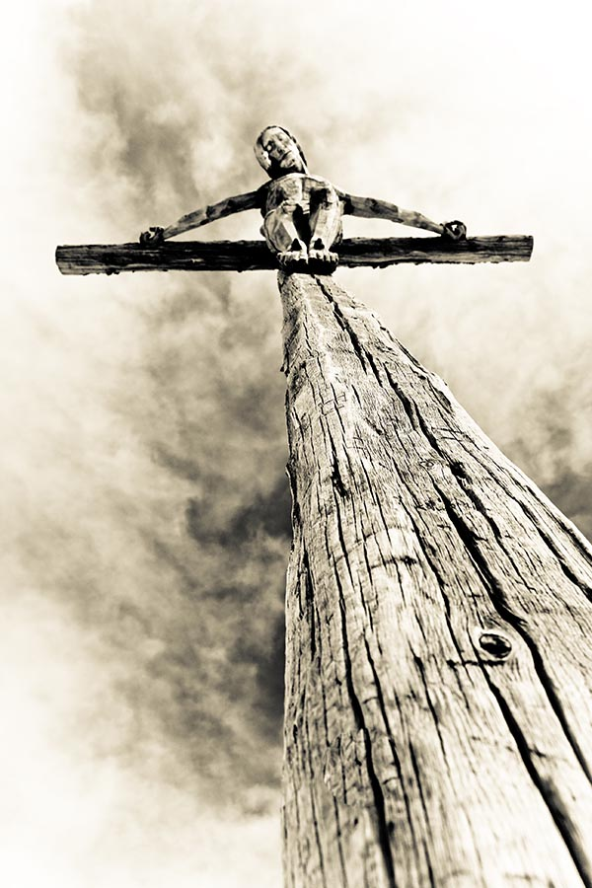
God chose this tree to be the hinge-point of HIS Story – THE great turning point.
On this tree, God did His greatest and most important work.
Sin is dealt with at this tree.
Grace is generated by this tree.
Healing comes from this tree.

Slide 15
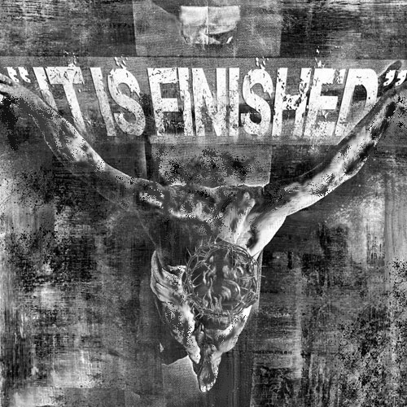
”“For Christ also suffered once for sins, the righteous for the unrighteous, that he might bring us to God, being put to death in the flesh but made alive in the spirit . . .”

Slide 16
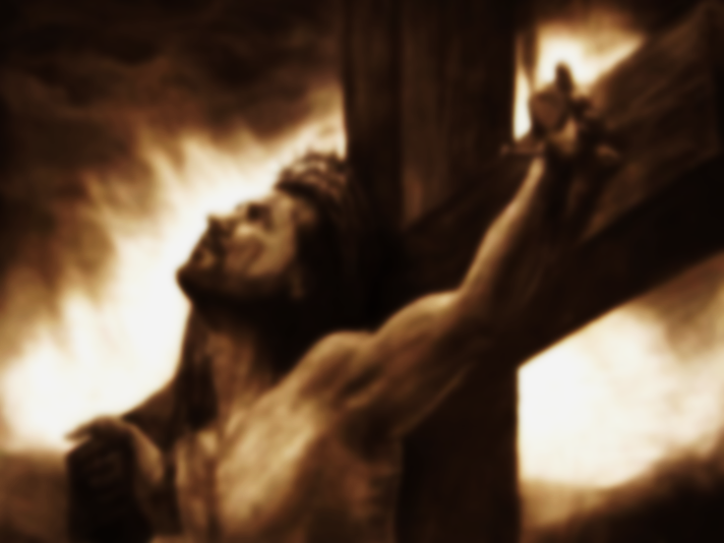
“But far be it from me to boast except in the cross of our Lord Jesus Christ, by which the world has been crucified to me, and I to the world.”

