Slide 2
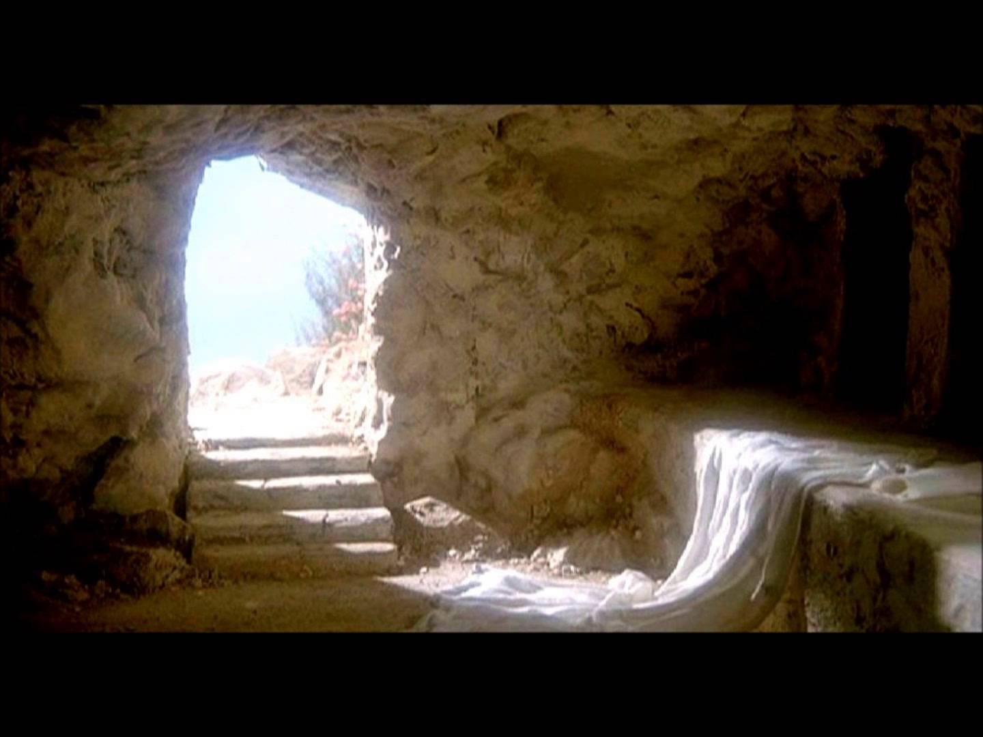
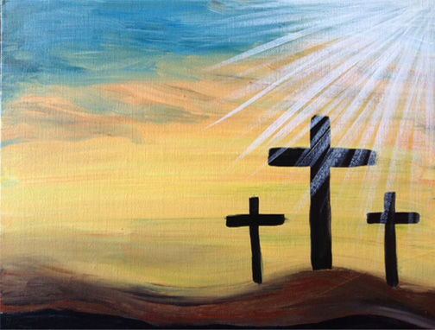
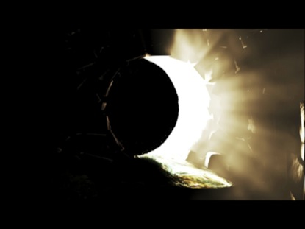

Slide 3
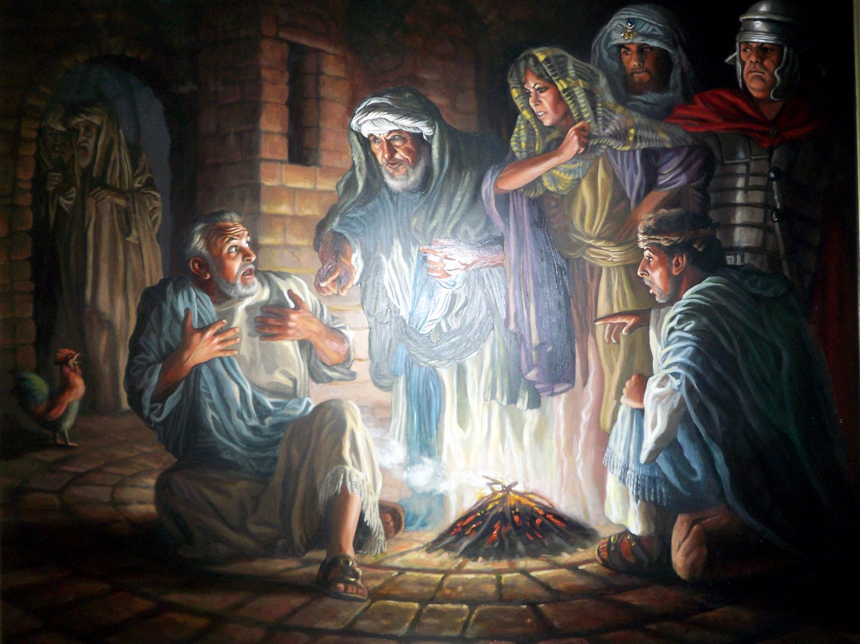
Peter failed Jesus in a miserable way!

Slide 5
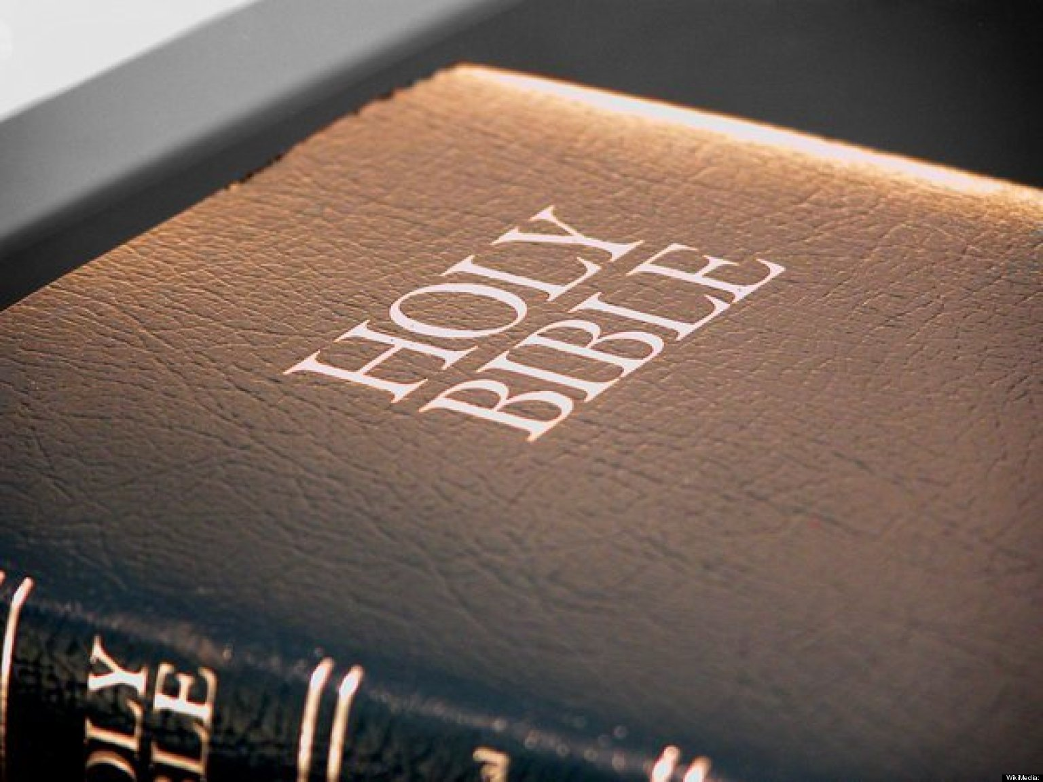

Slide 6
“CAN FAITH BE RAISED?”

Slide 7
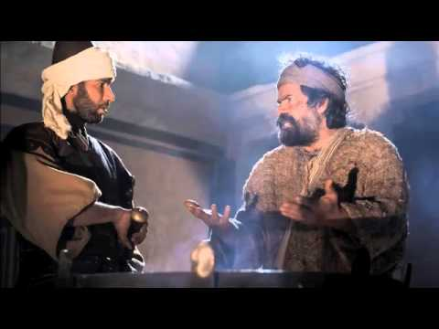
“I do not know the man!”

Slide 8
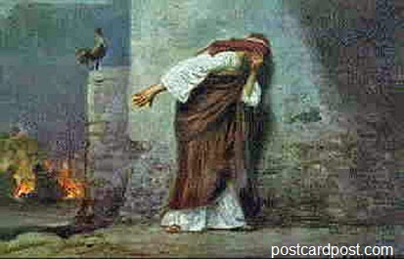
“CAN PETER’S FAITH
BE RAISED?”

Slide 9
John 21:15-19
¹⁵When they had finished breakfast, Jesus said to Simon Peter, “Simon, son of John, do you love me more than these?” He said to him, “Yes, Lord; you know that I love you.” He said to him, “Feed my lambs.”
¹⁶He said to him a second time, “Simon, son of John, do you love me?” He said to him, “Yes, Lord; you know that I love you.” He said to him, “Tend my sheep.”
¹⁷He said to him the third time, “Simon, son of John, do you love me?” Peter was grieved because he said to him the third time, “Do you love me?” and he said to him, “Lord, you know everything; you know that I love you.” Jesus said to him, “Feed my sheep.
¹⁸Truly, truly, I say to you, when you were young, you used to dress yourself and walk wherever you wanted, but when you are old, you will stretch out your hands, and another will dress you and carry you where you do not want to go.”
¹⁹(This he said to show by what kind of death he was to glorify God.) And after saying this he said to him, “Follow me.”

Slide 10
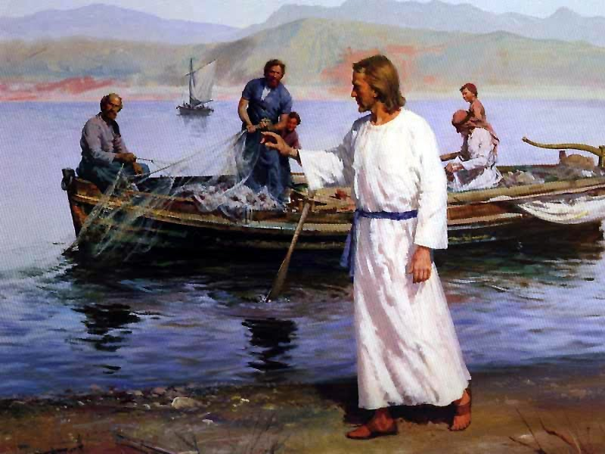

Slide 11
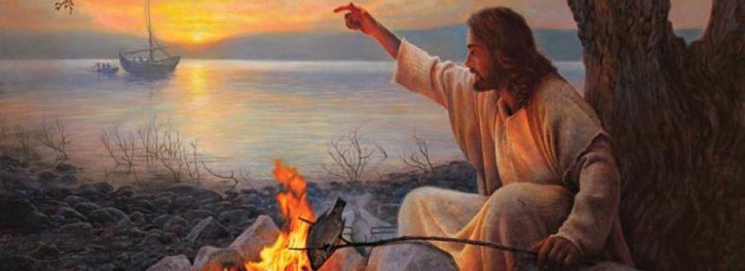

Slide 12
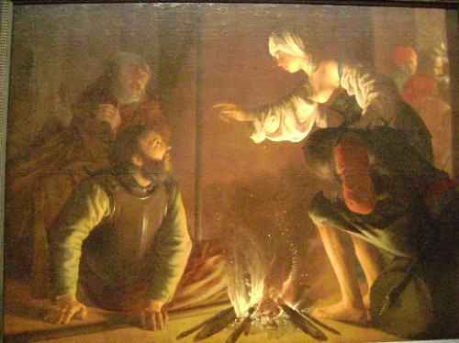
John 18:8
John 21:9
“A CHARCOAL FIRE”

Slide 14
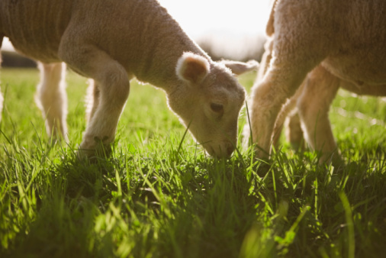
FEED MY LAMBS

Slide 15
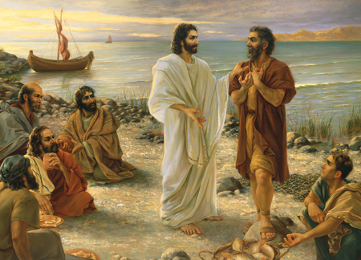
“Yes, Lord, you know that I love you”

Slide 16
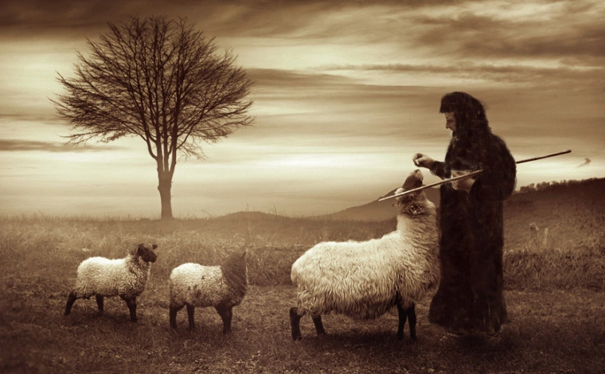
“Take care of my sheep!”

Slide 17
John 21:17

Slide 18
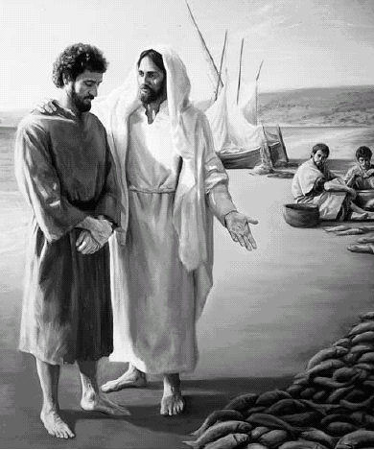
“ . . . when you were younger, you dressed yourself, went where you wanted; but when you are old, you will stretch out your hands, and someone else will fasten a belt around you and take you where you do not wish to go.”
John 21:18

Slide 19
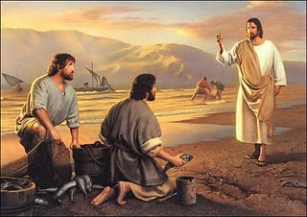
Follow Me!

Slide 20
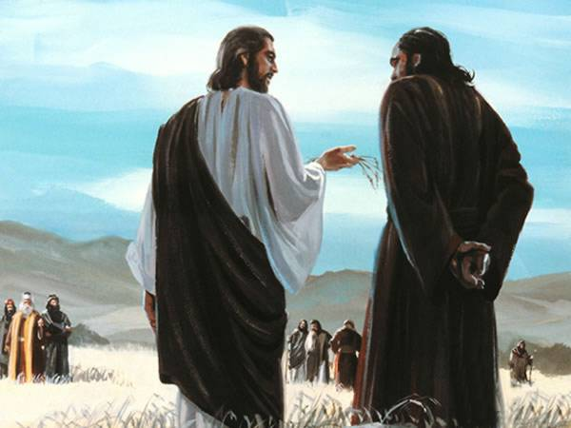

Slide 21
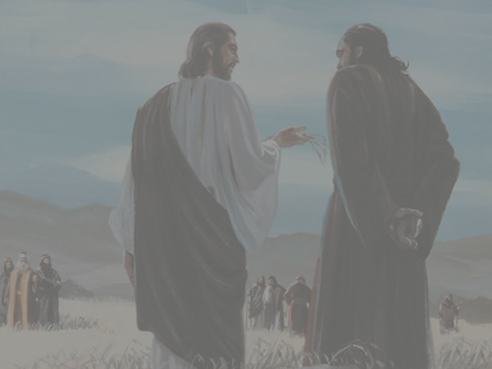
Can the man who raised from the dead, raise up someone’s dead faith?
Can Peter’s faith be revived and restored?
CAN FAITH BE RAISED?

Slide 22
Jesus answer is “Yes”.
But, for faith to be raised, three things have to happen:
one has to
Love God
Serve People
Die Well

Slide 24
#1 - Love God
#2 - Serve People
#3 - Die Well

Slide 25
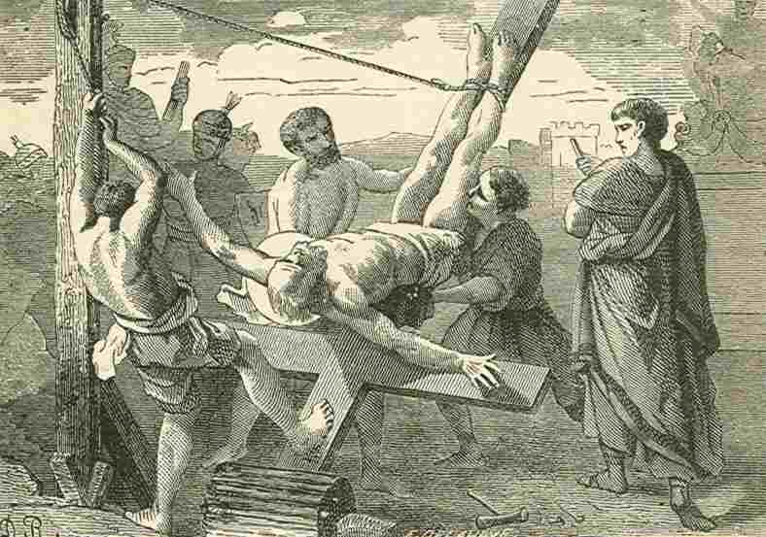

Slide 26
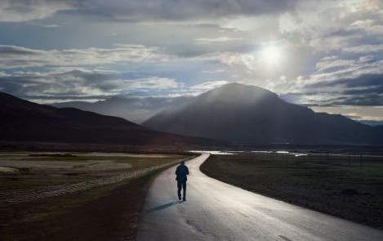
GOD IS MORE INTERESTED IN WHERE WE ARE GOING THAN IN WHERE WE HAVE BEEN.
LOVE GOD, SERVE PEOPLE, DIE WELL

