Slide 2
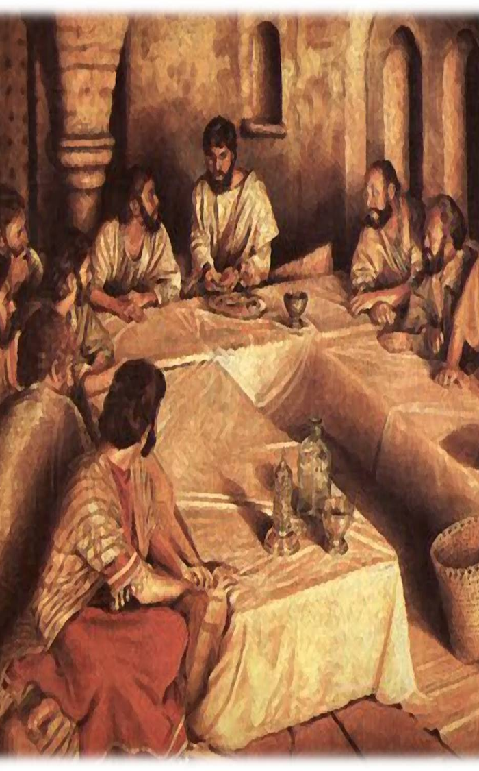
John 13:1-10
¹Now before the Feast of the Passover, when Jesus knew that his hour had come to depart out of this world to the Father, having loved his own who were in the world, he loved them to the end. ² During supper, when the devil had already put it into the heart of Judas Iscariot, Simon's son, to betray him, ³ Jesus, knowing that the Father had given all things into his hands, and that he had come from God and was going back to God, ⁴ rose from supper. He laid aside his outer garments, and taking a towel, tied it around his waist.

Slide 3
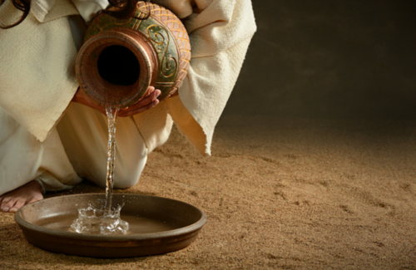
John 13:1-10
⁵ Then he poured water into a basin and began to wash the disciples' feet and to wipe them with the towel that was wrapped around him. ⁶ He came to Simon Peter, who said to him, “Lord, do you wash my feet?” ⁷ Jesus answered him, “What I am doing you do not understand now, but afterward you will understand.”⁸ Peter said to him, “You shall never wash my feet.” Jesus answered him, “If I do not wash you, you have no share with me.” ⁹ Simon Peter said to him, “Lord, not my feet only but also my hands and my head!”

Slide 4
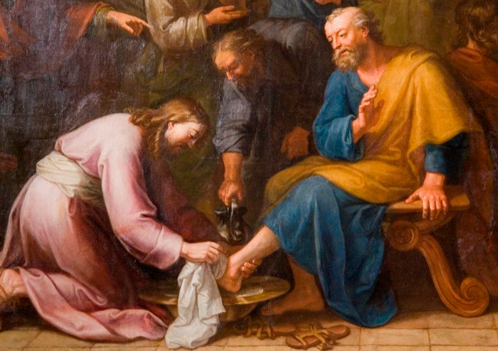
John 13:1-10
¹⁰ Jesus said to him, “The one who has bathed does not need to wash, except for his feet, but is completely clean. And you are clean, but not every one of you.”

Slide 5
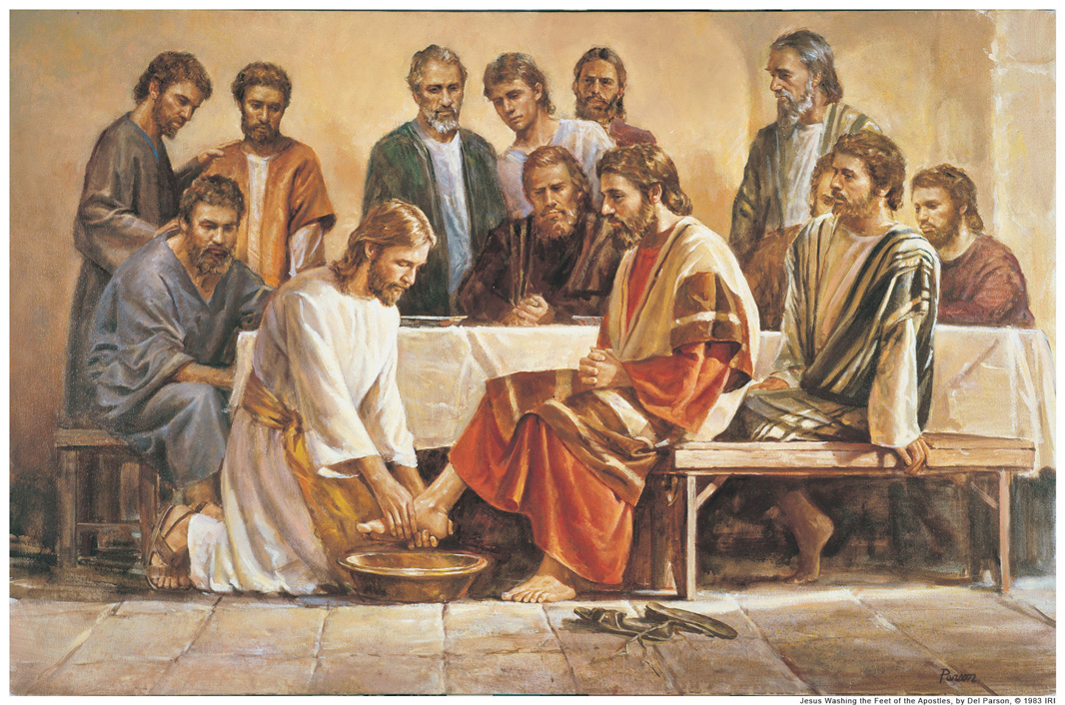
John 13:1-10 (ESV)
Jesus Washes the Disciples' Feet

Slide 6
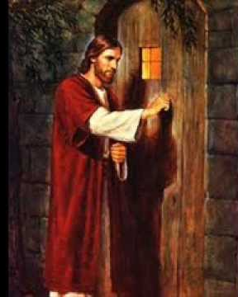
WHAT IF JESUS CAME TO YOUR HOUSE?

Slide 7
John 13:1-10 (ESV)
Jesus Washes the Disciples' Feet

Slide 8
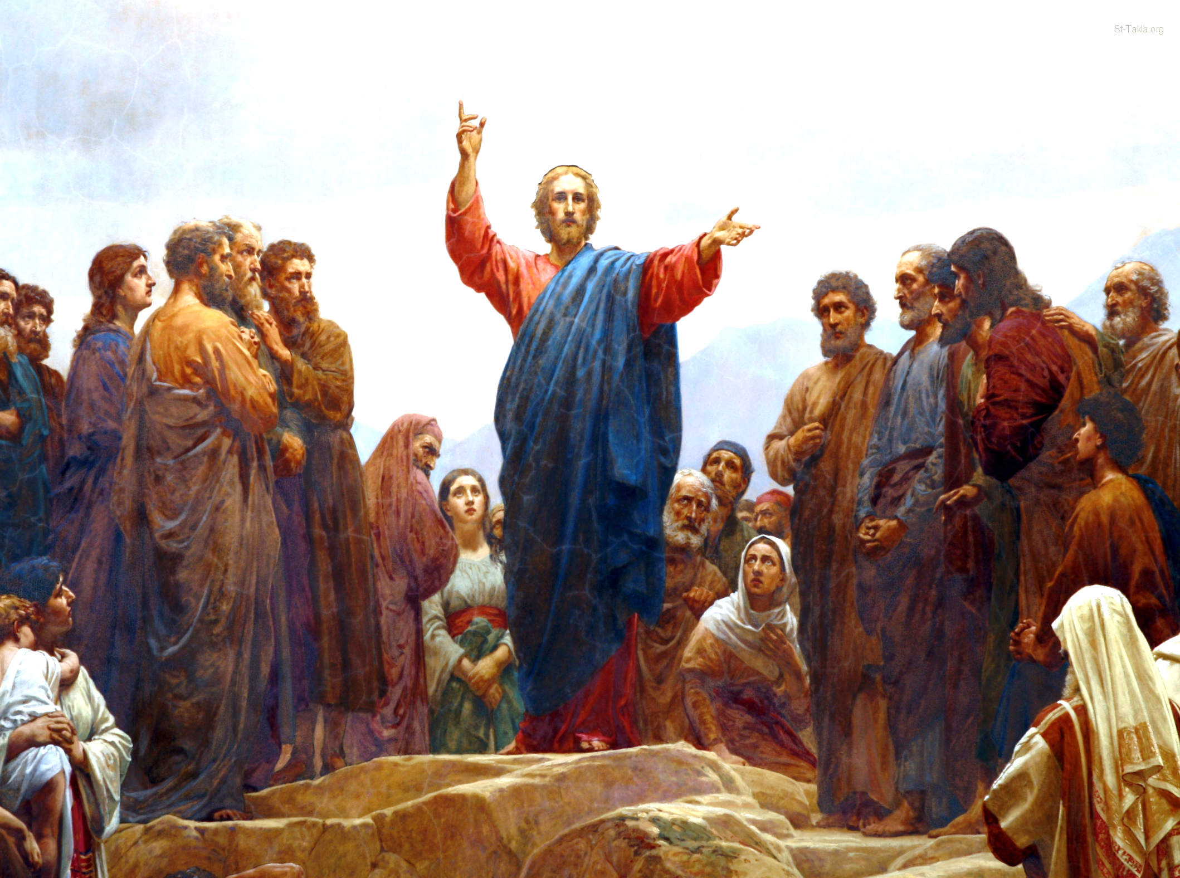

Slide 9
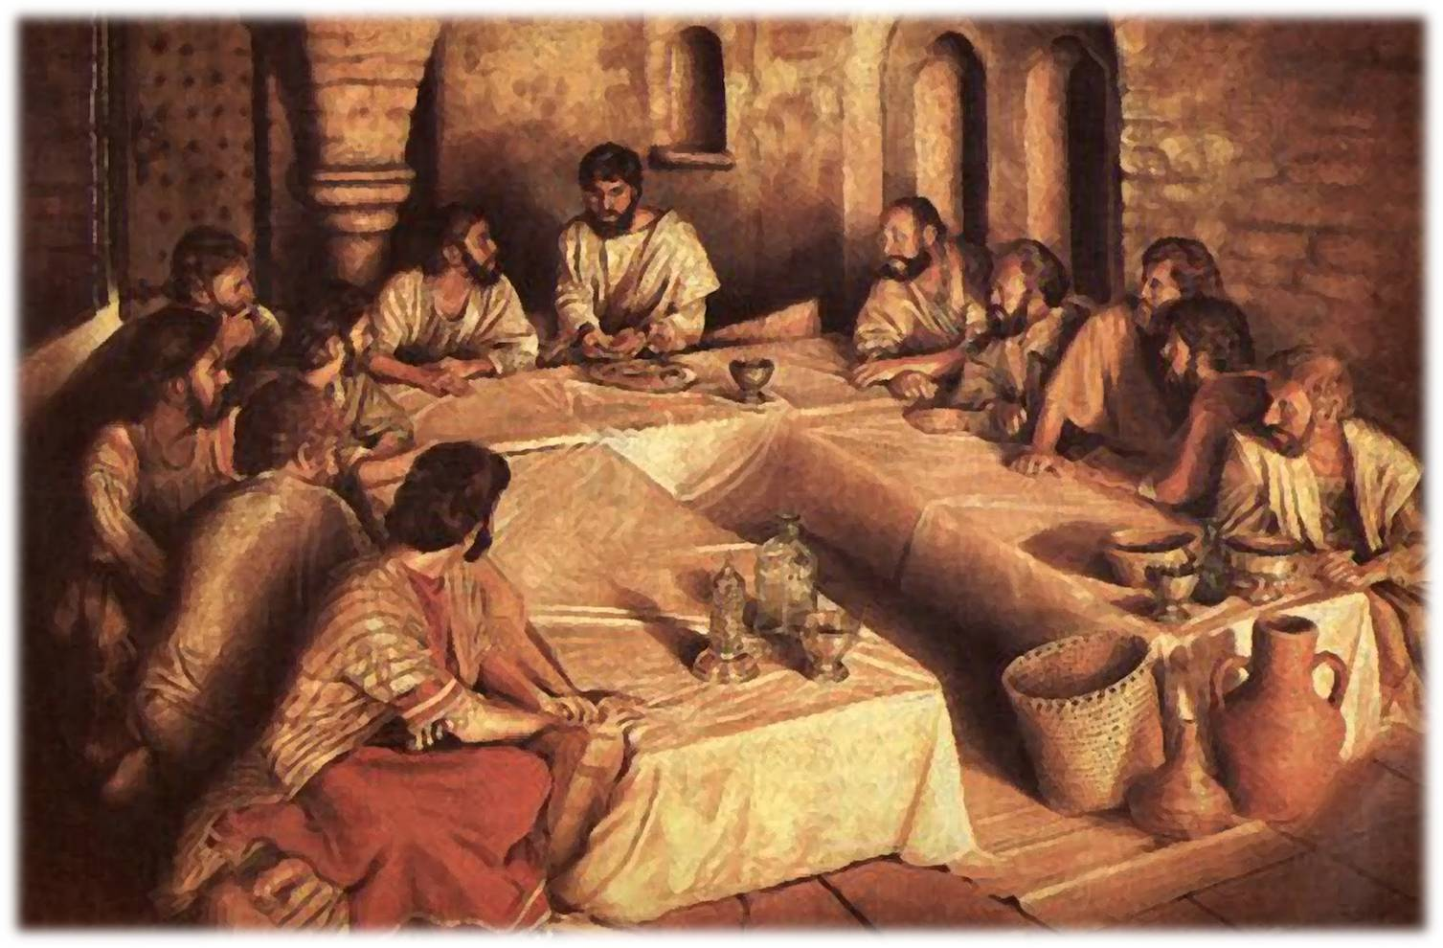

Slide 10
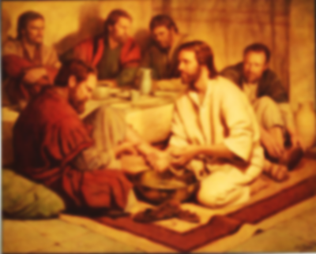

Slide 11
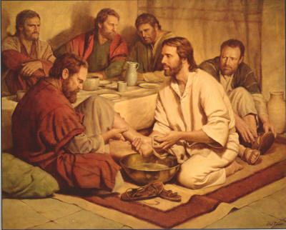

Slide 12
“Have this mind among yourselves, which is yours in Christ Jesus, who, though he was in the form of God, did not count equality with God a thing to be grasped, but emptied himself, by taking the form of a servant, being born in the likeness of men”.

Slide 13
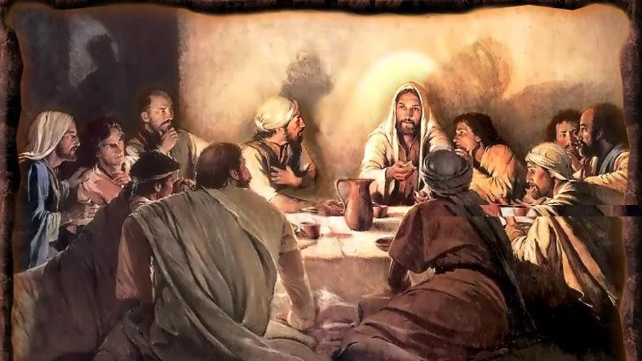

Slide 14
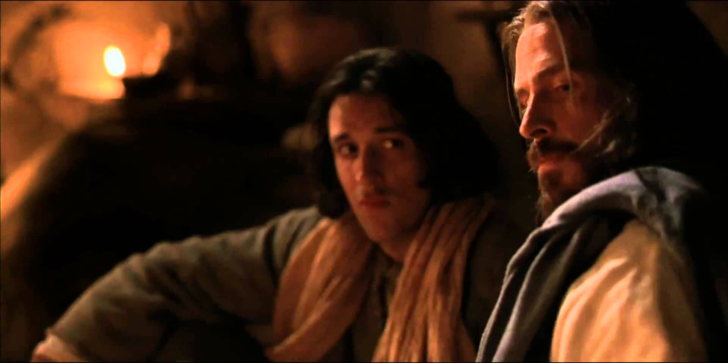
“Lord, Do YOU wash MY feet?”

Slide 15
“NO! You will NEVER wash my feet!”

Slide 16
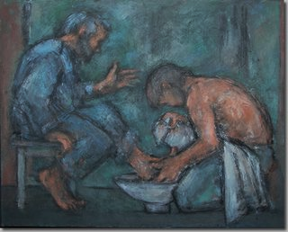
“If I do not wash you, you have no SHARE with me.”

Slide 17
When Jesus washed the feet of the disciples, it was about a lot more than just cleaning dirty feet.
It was a living illustration of the fact that the only way these guys – or any guys – could be cleansed was by the work of Jesus.
He had to clean them – He had to wash them.

Slide 18
“What If Jesus Came
To Your House?

Slide 20
HE WANTS TO WASH OUR FEET!

