Slide 2
Producer, Director & Writer |  | Art Clokey
Assistant to Executive Producer |  | Gloria Clokey
Animation Director |  | Ray Peck
Animation Director |  | Peter Kleinow
Art Director |  | Alfonso Eggleston
Art Director |  | Melvin Wood
Editor |  | Don McIntosh
 |  | Woodword Smith
 |  | Colin Young
Music Composition |  | Jerry Gerber
Music Editor |  | Larry Oppenheimer
Audio Supervision |  | Focused Audio
Audio Production |  | Jeff Roth
Sound Effects Designer |  | James Allen
Production Coordinator |  | Ruth Gooddell
Vocal Coach |  | Dallas McKinnon
Lighting Director |  | Wady Woodaver
Special Effects |  | David Allen
Post Production Coordinator |  | Jay Weinman
Audio Transfers |  | Sprocket Systenms
 |  | Saul Zaentz Co.
Film Laboratory |  | Hollywood Film & Video
Video Transfers |  | Russian Hill Recording
Credit Titles |  | Cinermatte, Inc.

Slide 5
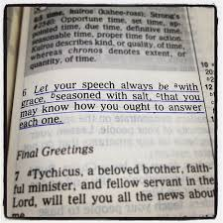
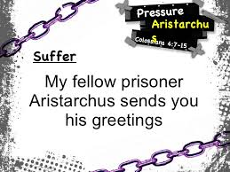
“THE GREETINGS”

Slide 7
Colossians 4:7-18
⁷ Tychicus will tell you all about my activities. He is a beloved brother and faithful minister and fellow servant in the Lord.
⁸ I have sent him to you for this very purpose, that you may know how we are and that he may encourage your hearts,
⁹ and with him Onesimus, our faithful and beloved brother, who is one of you. They will tell you of everything that has taken place here.
¹⁰ Aristarchus my fellow prisoner greets you, and Mark the cousin of Barnabas (concerning whom you have received instructions—if he comes to you, welcome him),
¹¹ and Jesus who is called Justus. These are the only men of the circumcision among my fellow workers for the kingdom of God, and they have been a comfort to me.
¹² Epaphras, who is one of you, a servant of Christ Jesus, greets you, always struggling on your behalf in his prayers, that you may stand mature and fully assured in all the will of God.

Slide 8
Colossians 4:7-18
¹³ For I bear him witness that he has worked hard for you and for those in Laodicea and in Hierapolis.
¹⁴ Luke the beloved physician greets you, as does Demas.
¹⁵ Give my greetings to the brothers at Laodicea, and to Nympha and the church in her house.
¹⁶ And when this letter has been read among you, have it also read in the church of the Laodiceans; and see that you also read the letter from Laodicea.
¹⁷ And say to Archippus, “See that you fulfill the ministry that you have received in the Lord.”
¹⁸ I, Paul, write this greeting with my own hand. Remember my chains. Grace be with you.

Slide 9
Tychicus
MESSENGER
CO-WORKER
“beloved brother, faithful minister, and fellow servant in the Lord.”

Slide 10
Onesimus
FELLOW TRAVELER WITH TYCHICUS
FROM COLOSSAE
“Onesimus’ thrilling story in the book of Philemon”

Slide 11
Colossians 4:10
“Aristarchus my fellow prisoner greets you, and Mark the cousin of Barnabas (concerning whom you have received instructions—if he comes to you, welcome him), and Jesus who is called Justus.”
GREAT ENCOURAGERS, (OR COMFORTERS)
FELLOW JEWS
ALL WERE A GREAT HELP TO PAUL

Slide 12
Epaphras
A COLOSSIAN
A CO-WORKER WITH PAUL
“He was a prayer-warrior on behalf of the Colossians”

Slide 13
Luke
CO-MISSIONARY WITH PAUL
WRITER OF THE GOSPEL OF LUKE AND BOOK OF ACTS.
“the beloved physician”

Slide 14
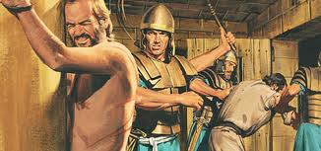
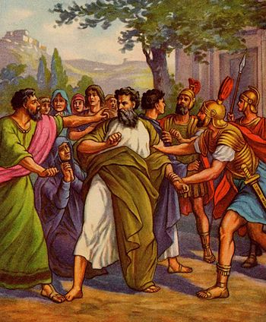
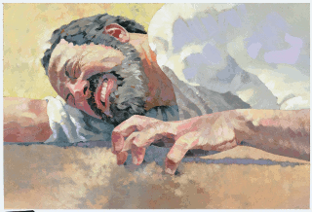
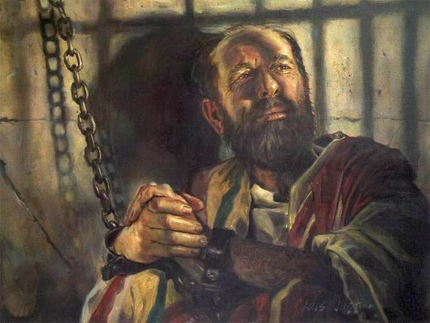

Slide 15
Tychicus Onesimus Aristarchus Mark Justus Epaphras Luke
DEMAS
NYMPHA

Slide 16
Colossians 4:16
“And when this letter has been read among you, have it also read in the church of the Laodiceans; and see that you also read the letter from Laodicea.”
“READ THE BIBLE, AN MAKE SURE YOU SHARE IT WITH OTHERS.”

Slide 17
Archippus
Verse 17 – “And say to Archippus, ‘see that you fulfill the ministry that you have received in the Lord.’”
Archippus = a fellow soldier with Paul.

Slide 18
Fulfill the Ministry YOU have received in the Lord!

Slide 19
Tychicus Onesimus Aristarchus Mark Justus Epaphras Luke Demas Nympha Archippus PAUL PETER

Slide 20
Fulfill the Ministry YOU have received in the Lord!

